Slide 1
Cystic like intramedullary lesions
15 yr boy referred for possible right distal hamstring sprain.
The muscles are normal – no strain
Multiple cystic like lesions both femurs - ?angiomatosis
What other differentials? Langerhans cell histiocytosis?
Please advise.

Slide 2
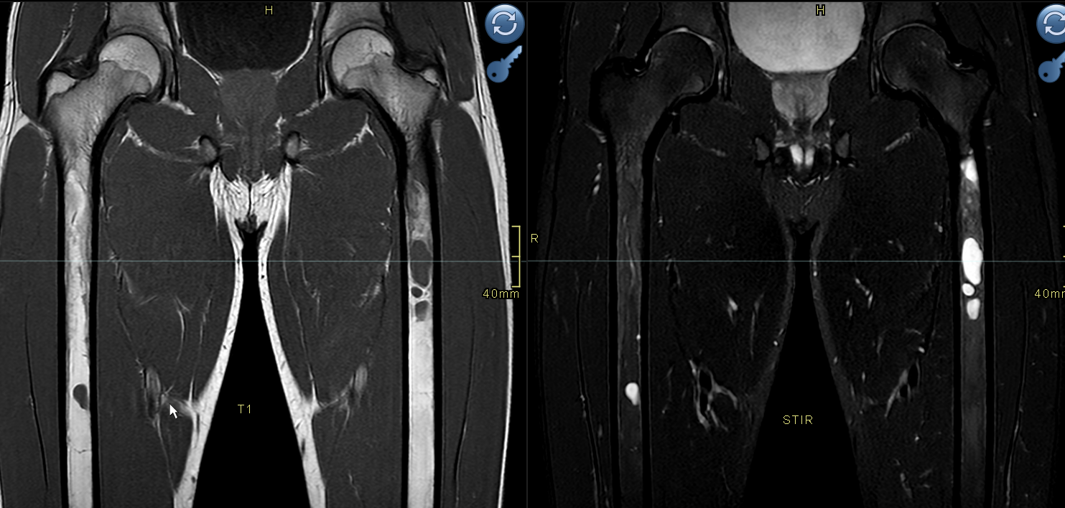

Slide 3
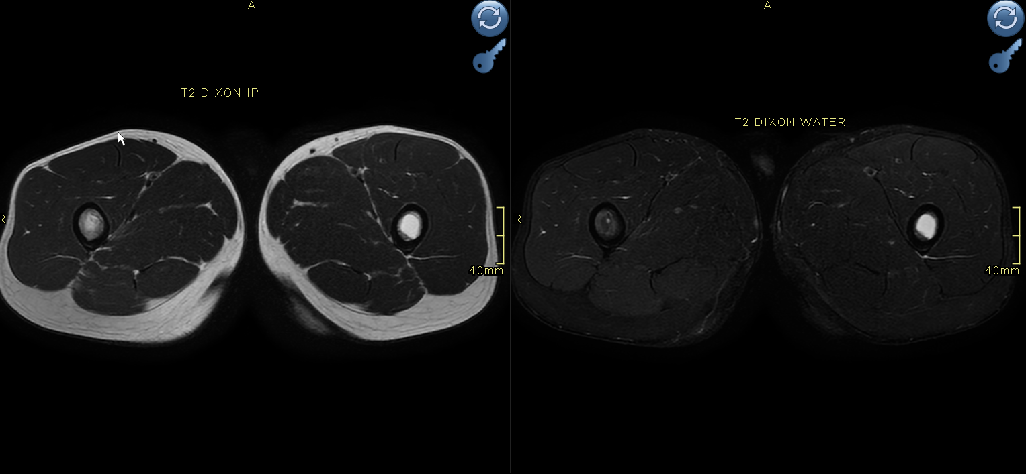

Slide 4
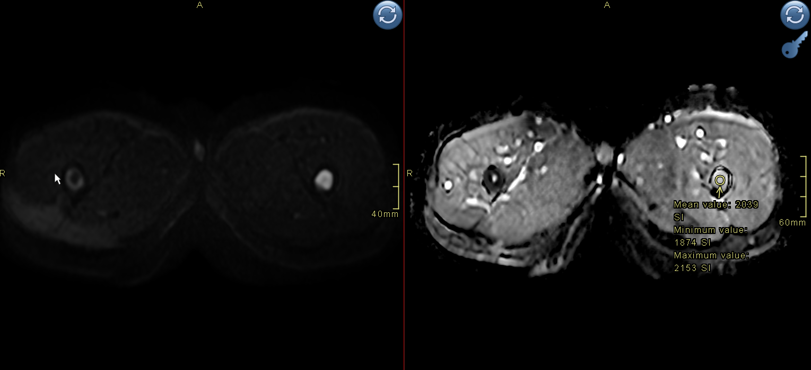

Slide 5
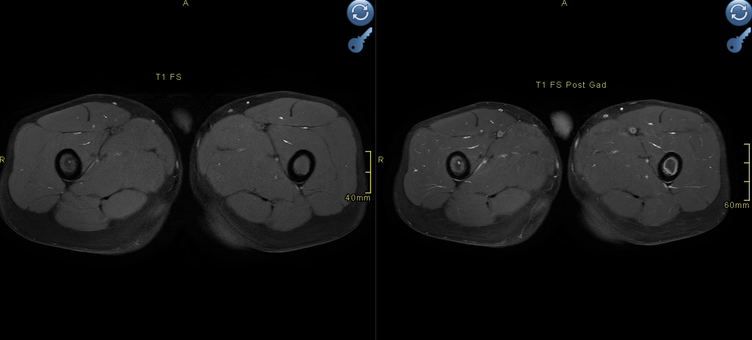

Slide 6
