Slide 1
42M with several month history of R shoulder pain, felt to be related to subscapularis or biceps pathology, no trauma

Slide 3
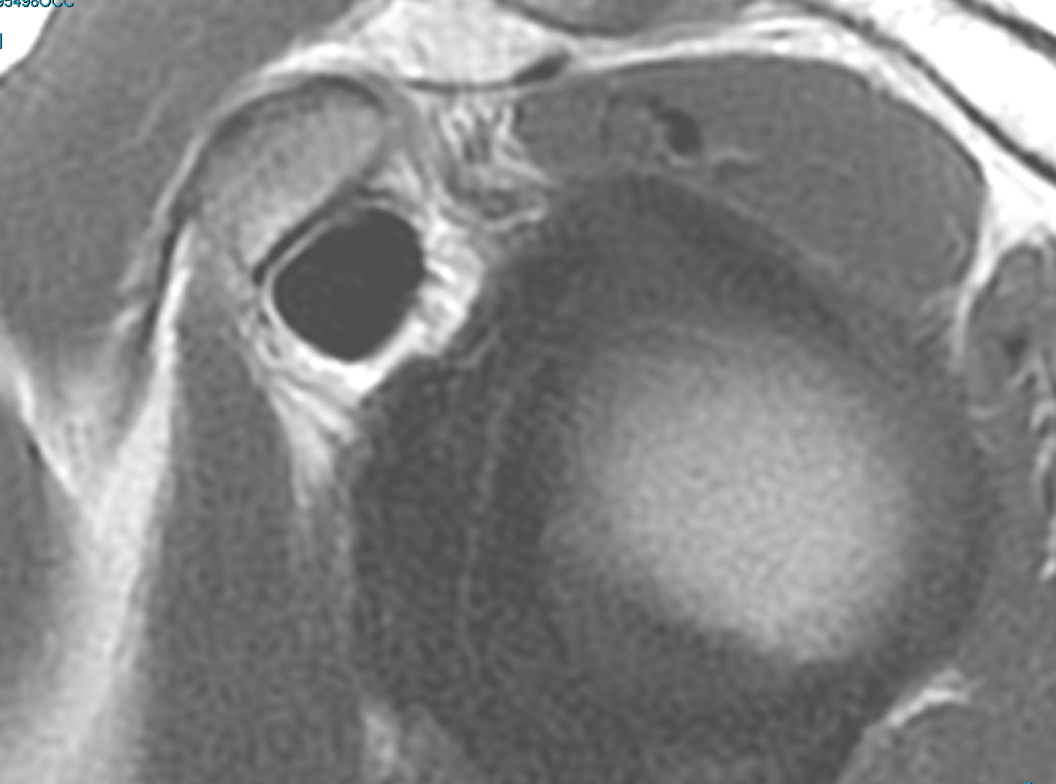
Sagittal PD
Coronal

Slide 4
Coronal
Axial

