Slide 1
Male, 49 years old, presenting with a tumor on the lower border of the right scapula for 4 years. Reports discomfort in the region. I assumeit is a osteochondroma with associated parosteal lipoma. Any other possibilities? Thank you in advance.

Slide 2
T1 FAT SAT CONTRAST
DP FAT SAT
T1
T2 *

Slide 6
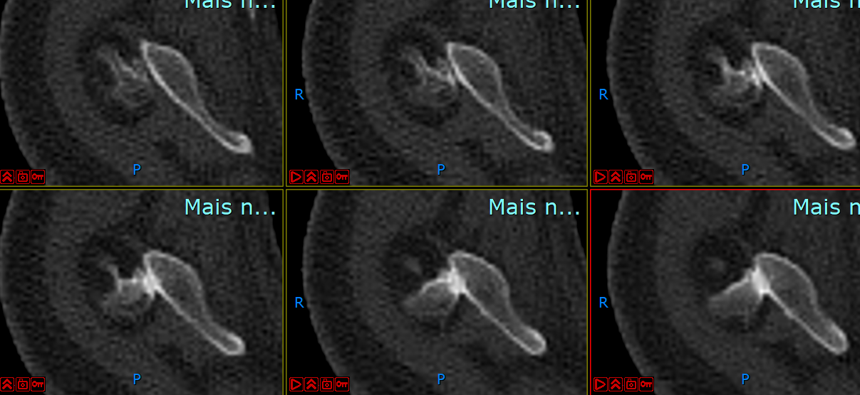

Slide 7
