Slide 1
64F status post L THA revision
Currently metal and ceramic, previously metal-on-metal

Slide 3
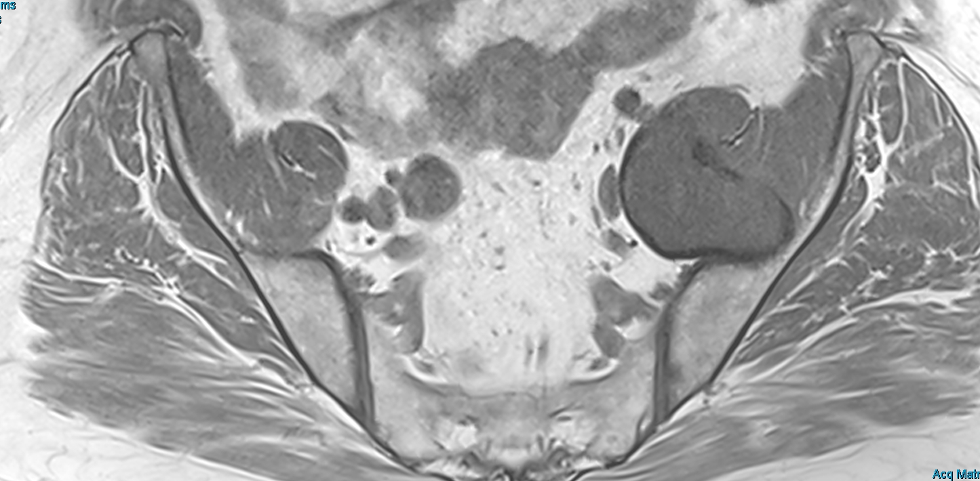
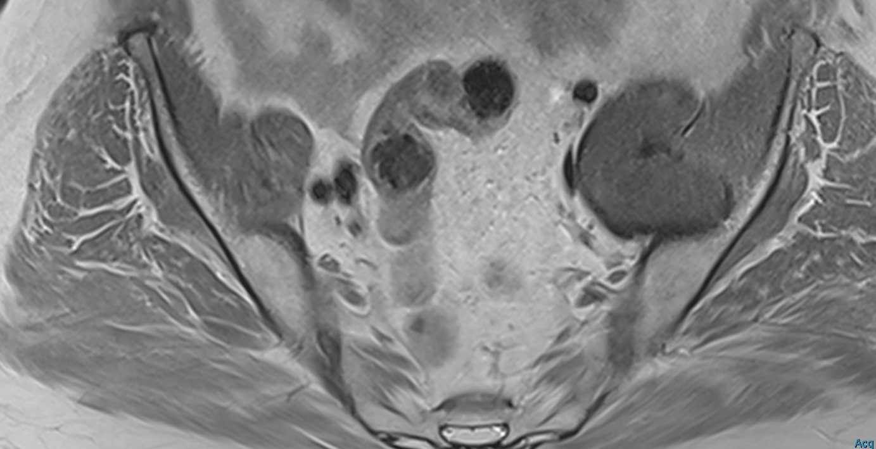
Axial T1 WARP
Axial T1 WARP post Gad

Slide 4
Axial STIR
Axial T1 WARP post Gad

Slide 5
Coronal T1 WARP post Gad
Coronal STIR

Slide 6
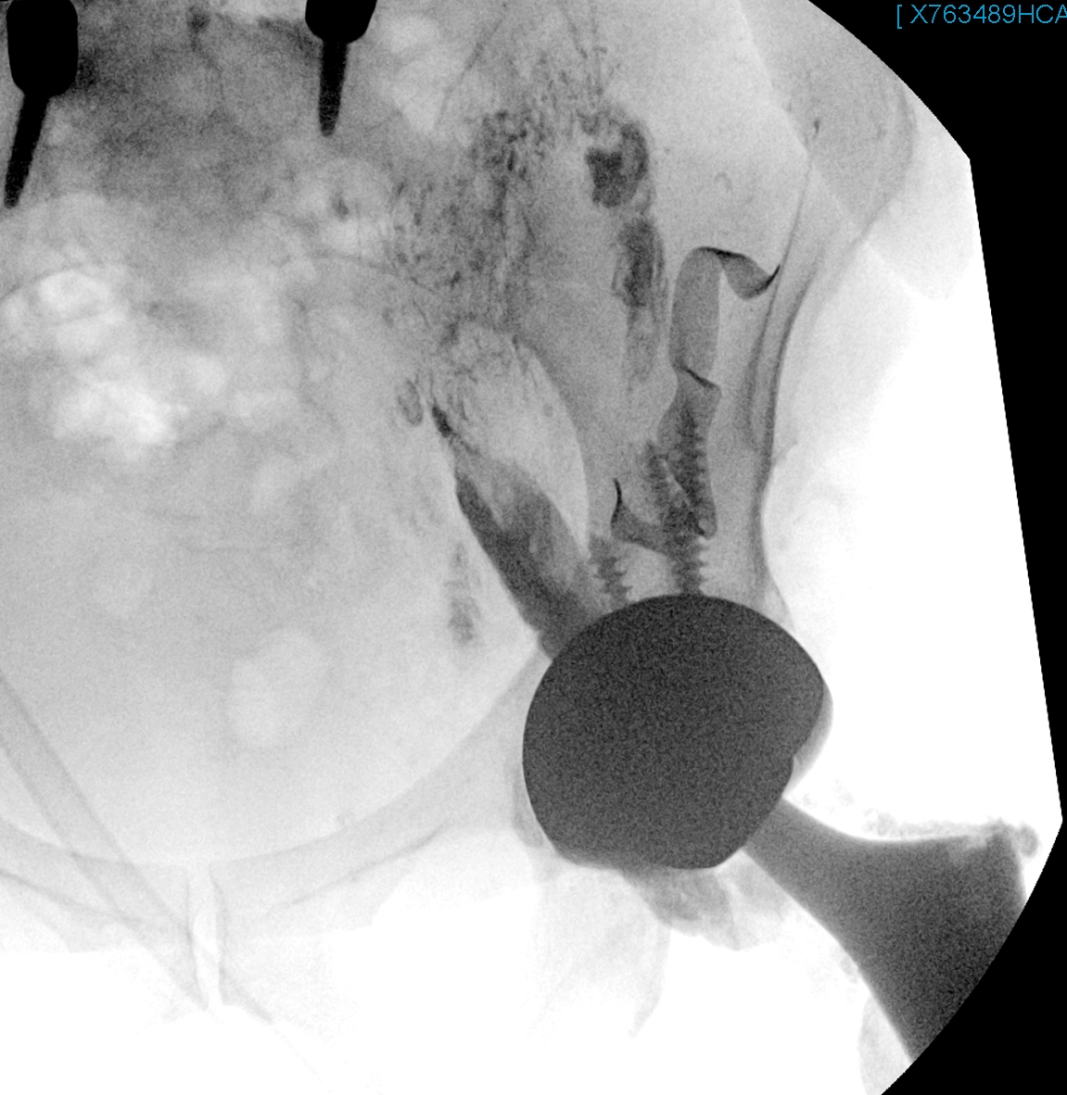

Slide 8
