Slide 1
46 yr male known HIV Biopsy of focal lesion showed anaplastic large cell non Hodgkin’s lymphoma
The background marrow signal is low on all sequences but does show some drop in signal on OP images and does not show diffusion restriction. Is this background marrow signal change due to siderosis due to chronic illness/anaemia?

Slide 2
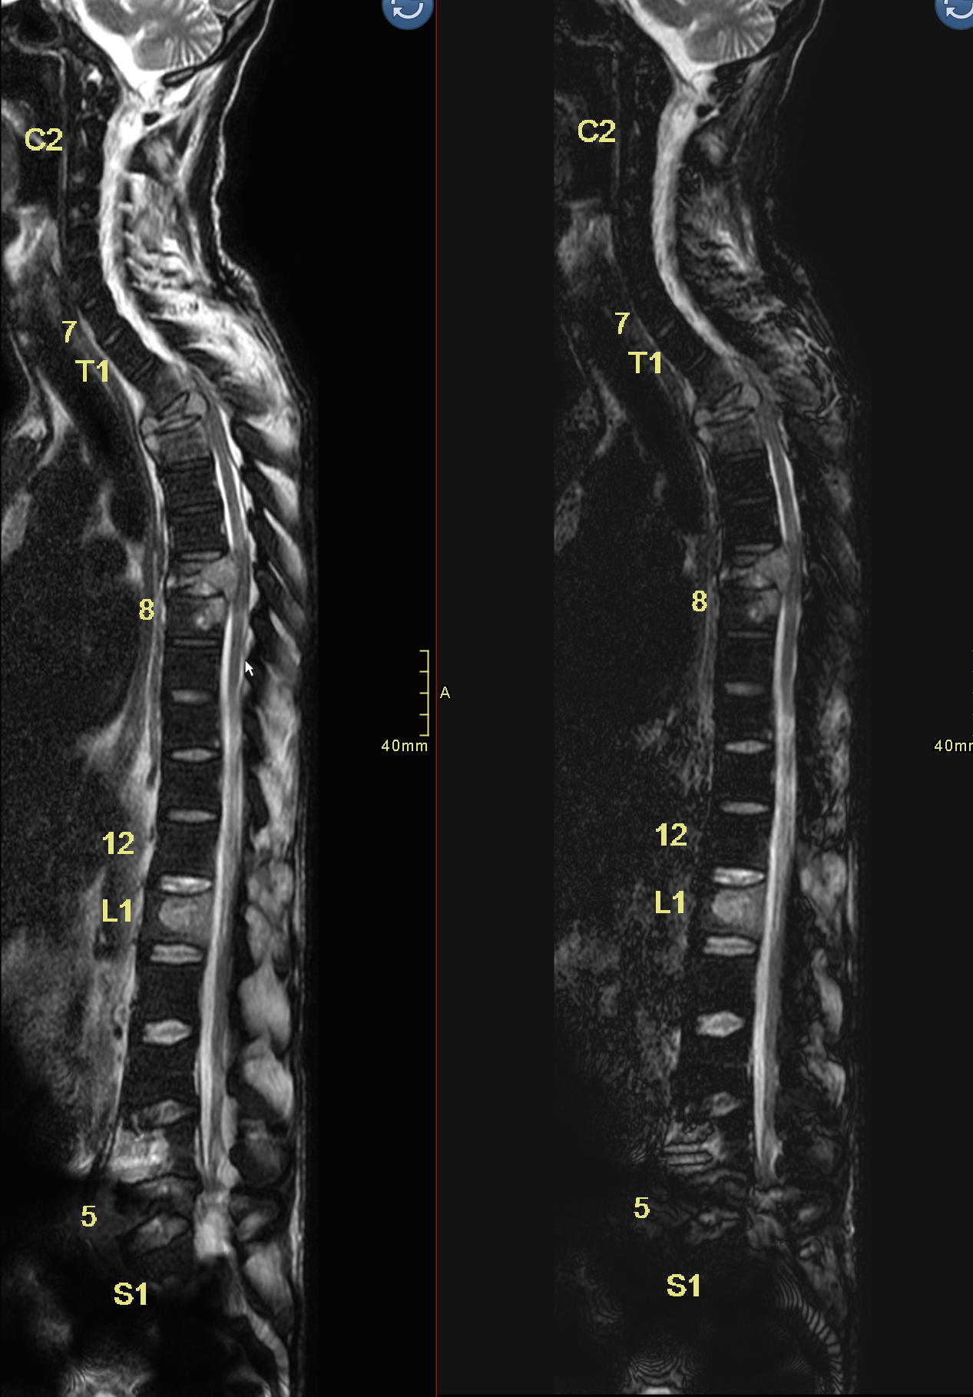
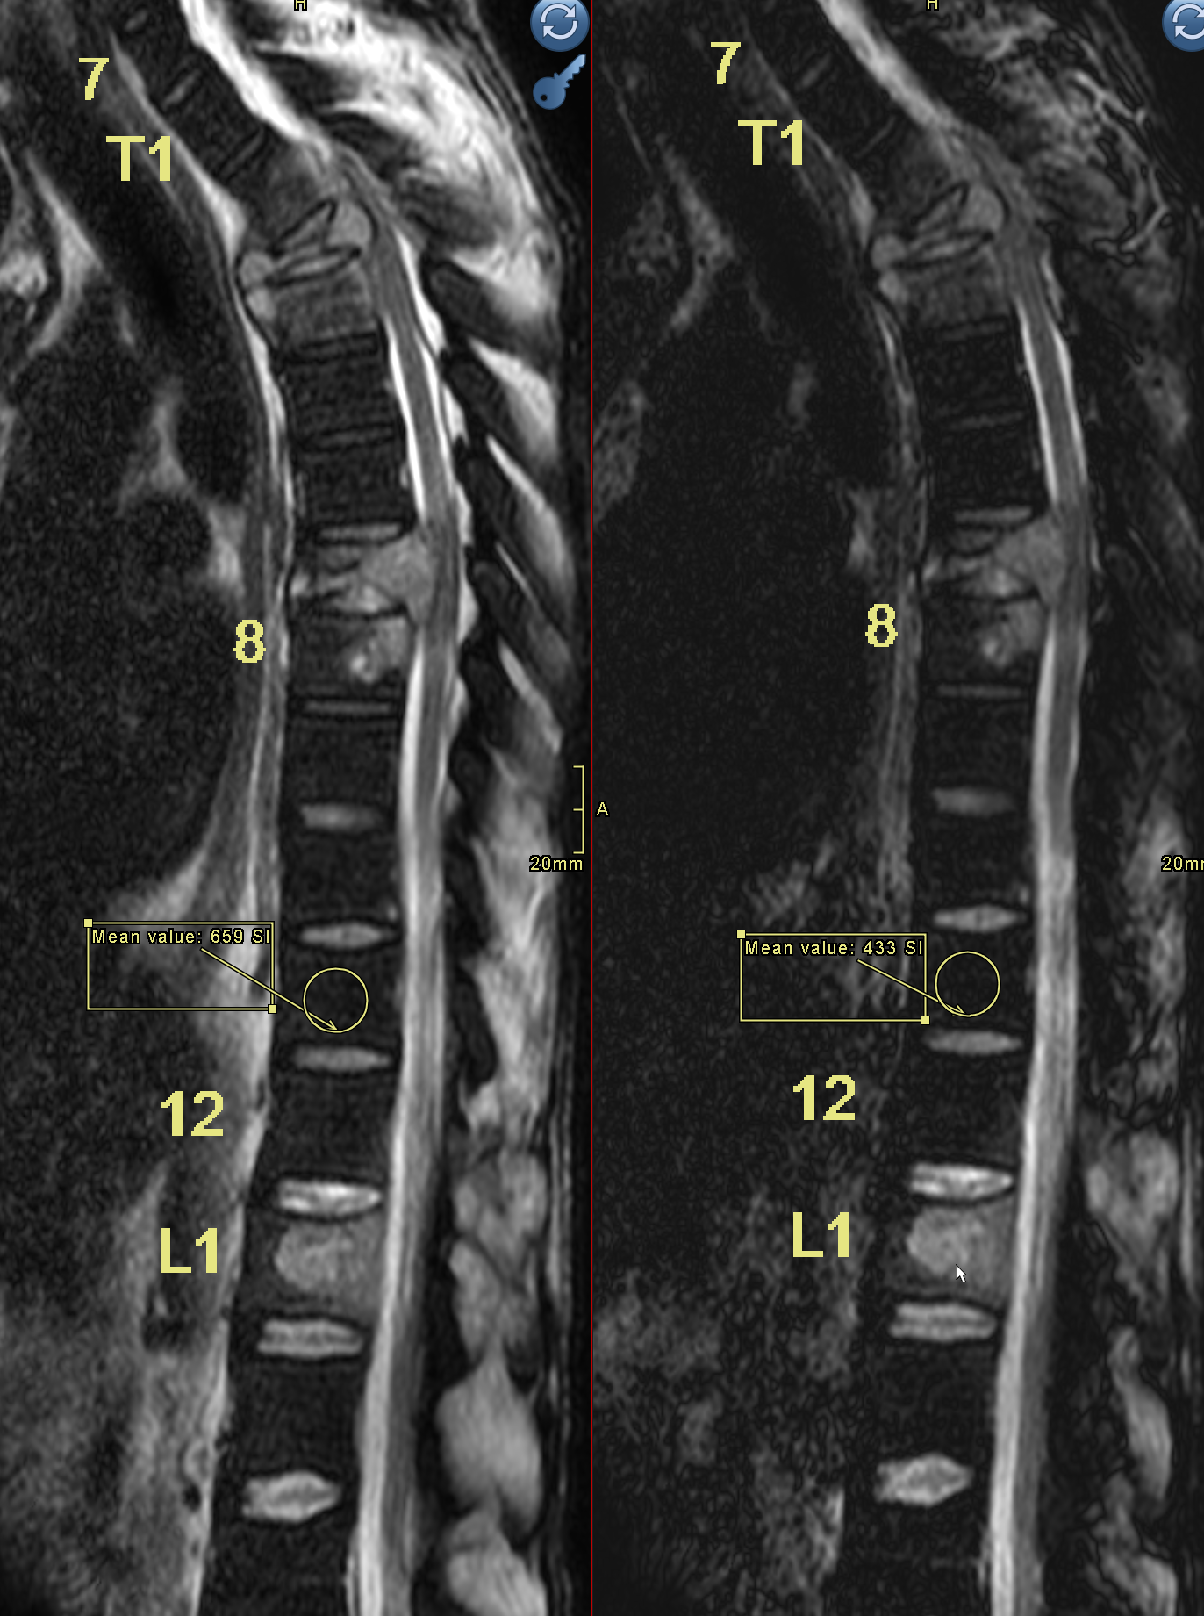
T2 Dixon
OP
T2 DIXON
IP
T2 DIXON
IP
T2 DIXON
OP

Slide 3
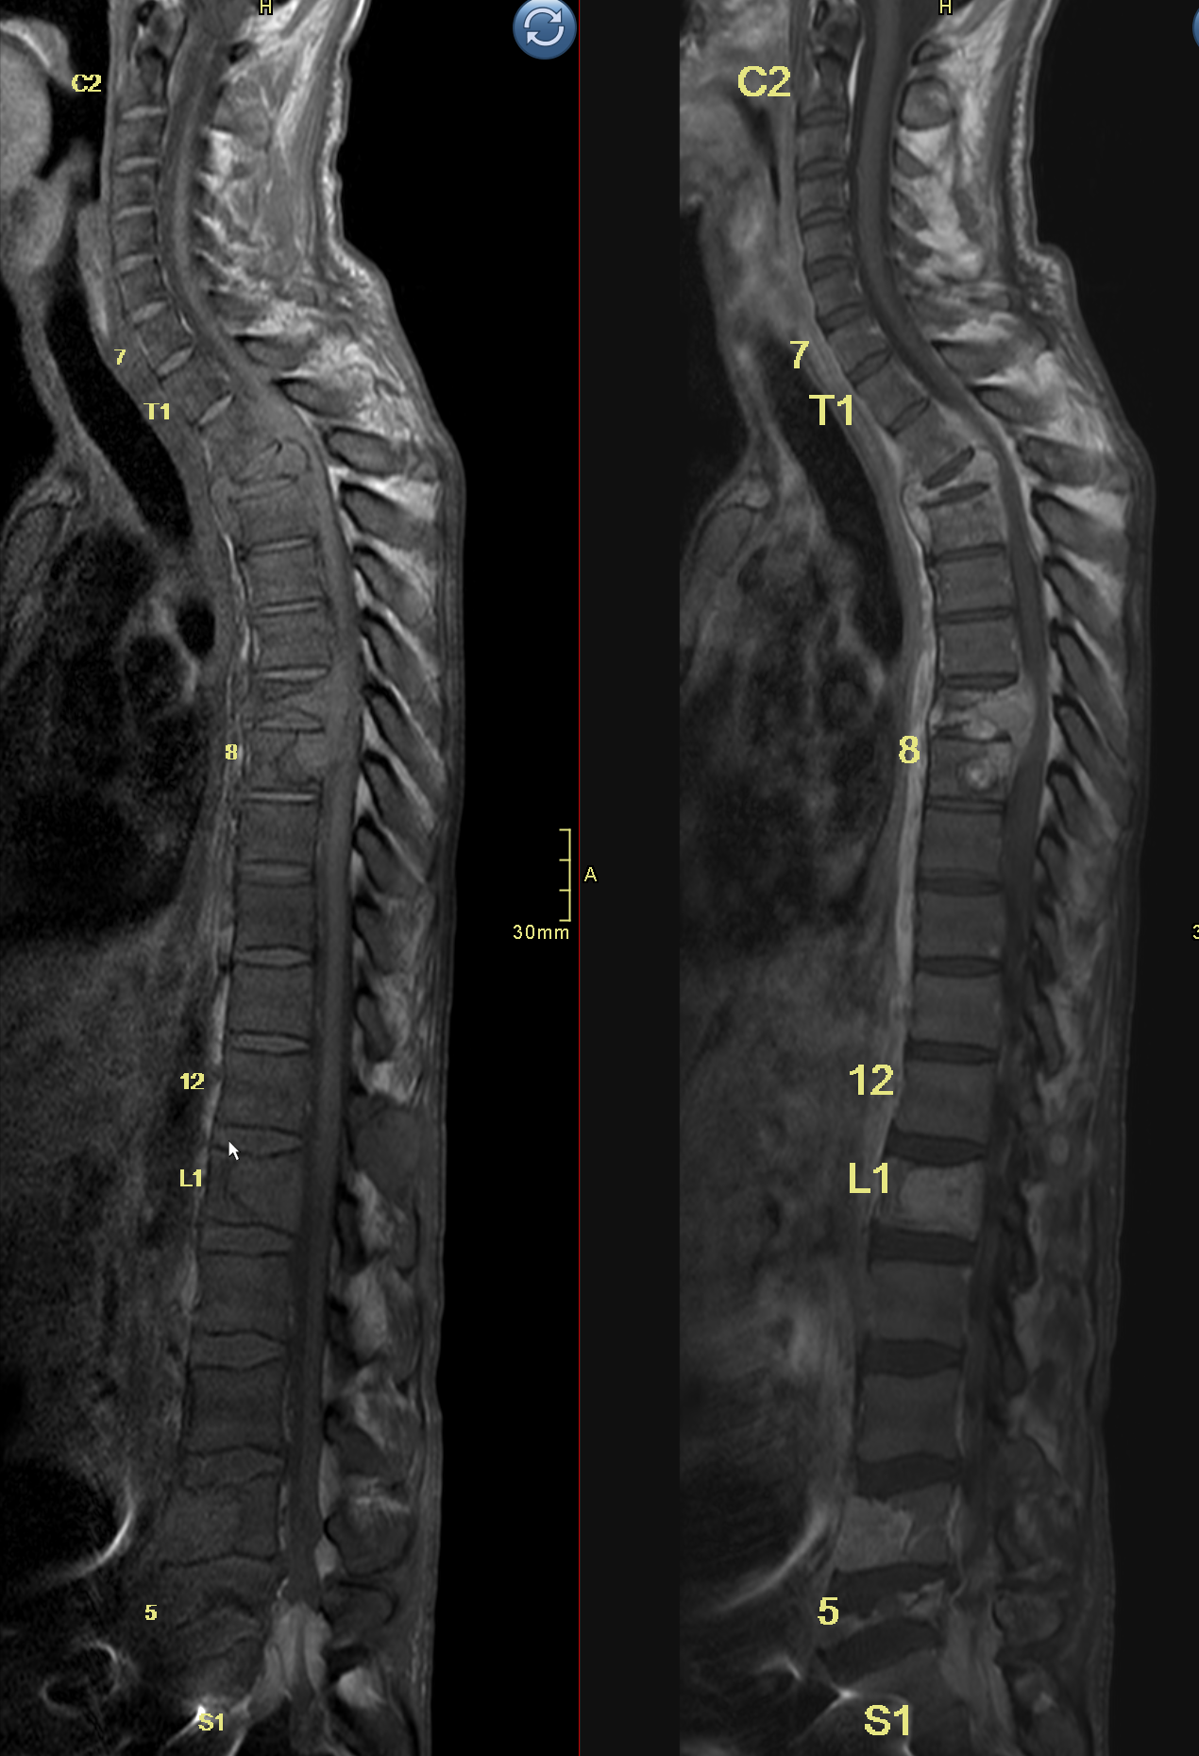
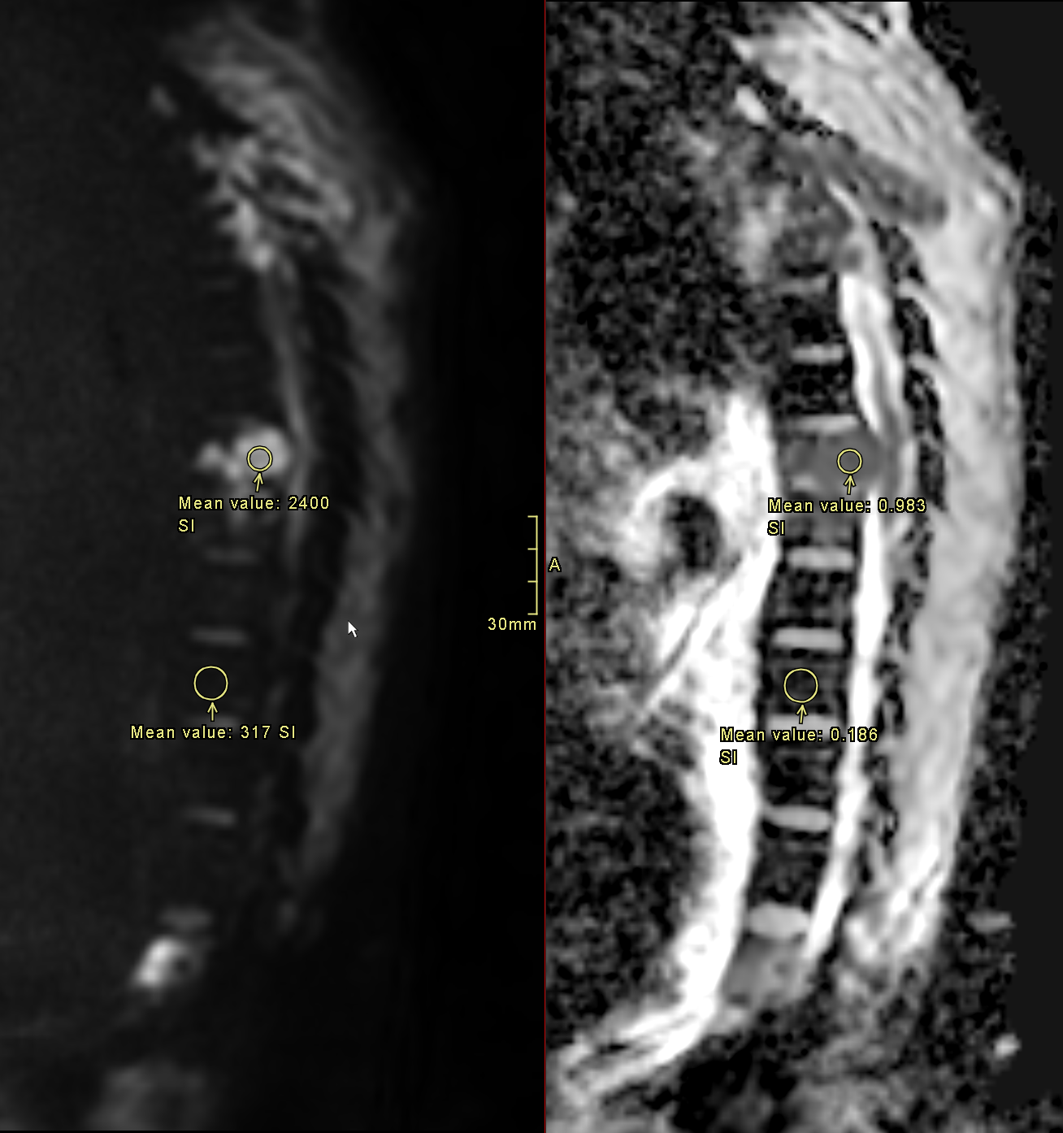
T1 Gad
T1

