Slide 1
Ocad case

Slide 2
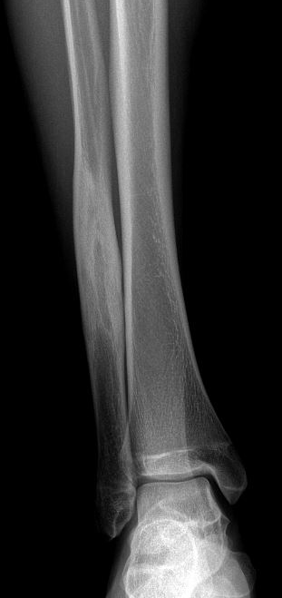
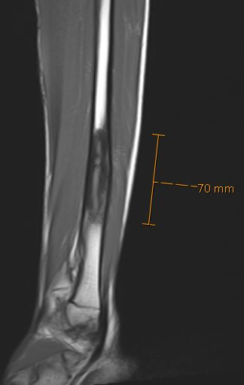
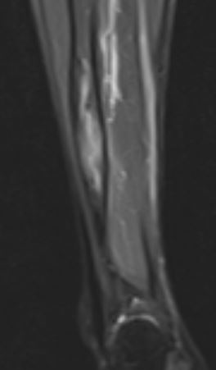
2015 (15 yo): RX, T1 (sagital) and STIR (coronal)

Slide 3
2015 (15 yo): T1, DP fat sat and T2

Slide 4
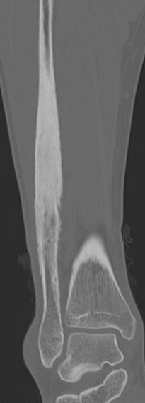
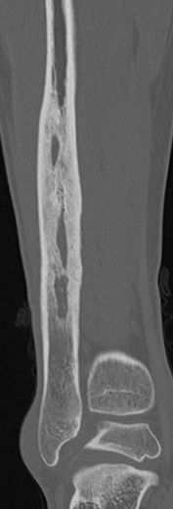
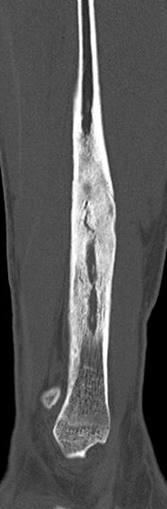
2024 (25 y.o.): CT

Slide 5
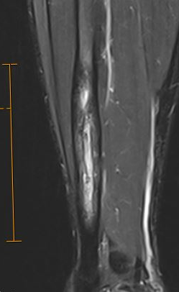
2024 ( 25 y.o.) Coronal STIR (8,0 cm) and DP fs

Slide 6
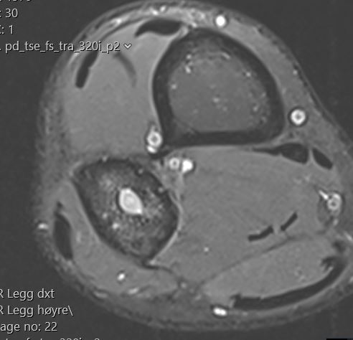
2024 (25 y.o.): T1 , T2 and DP fat sat

Slide 7
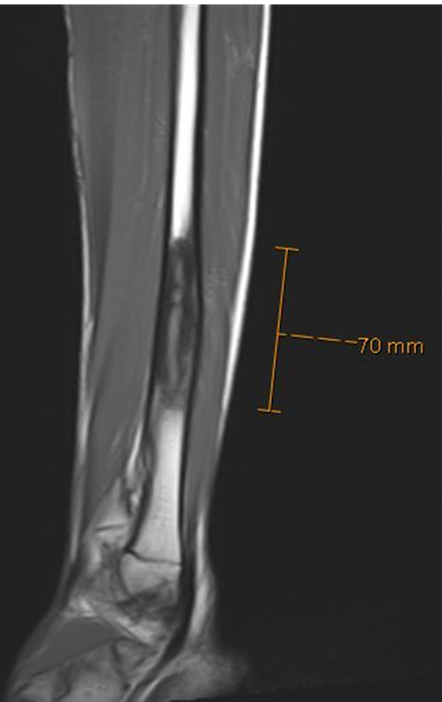
2015 (7,0 cm) x 2024 (8,0 cm)

