Slide 1
11 year Girl Knee pain since 2 weeks no trauma healthy kid
Xray: no finding
MRI: subcortical Edema with enhancement metaphysis dorsal femur and discrete in surrounding soft tissue
Any idea?
What to do next?

Slide 2
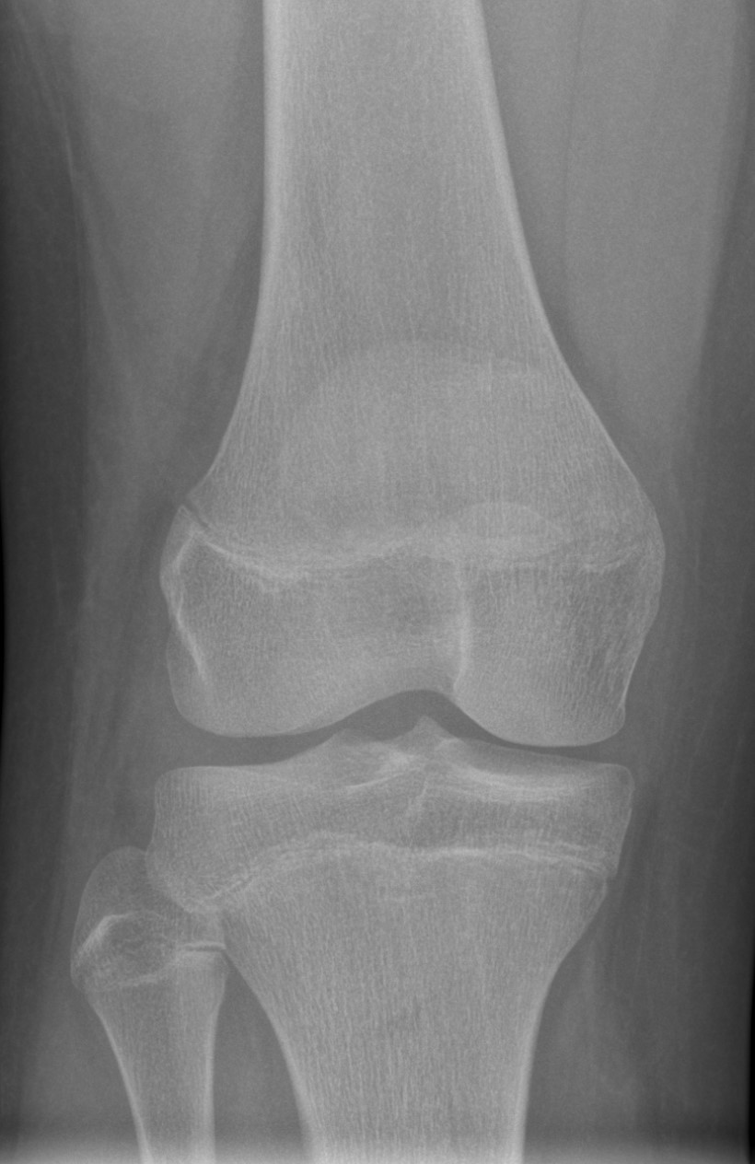
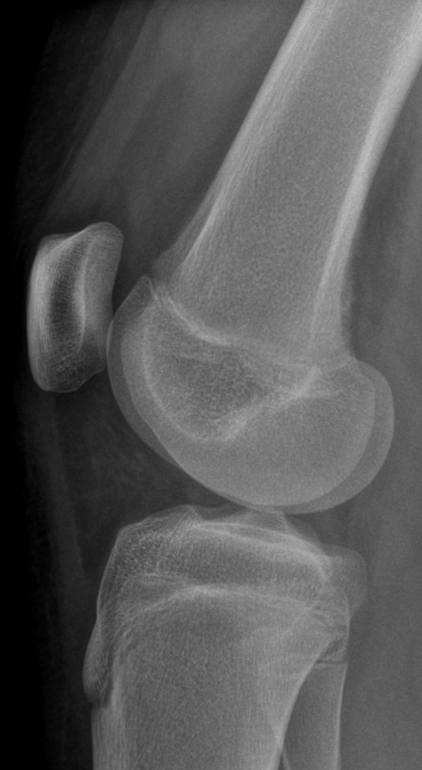

Slide 3
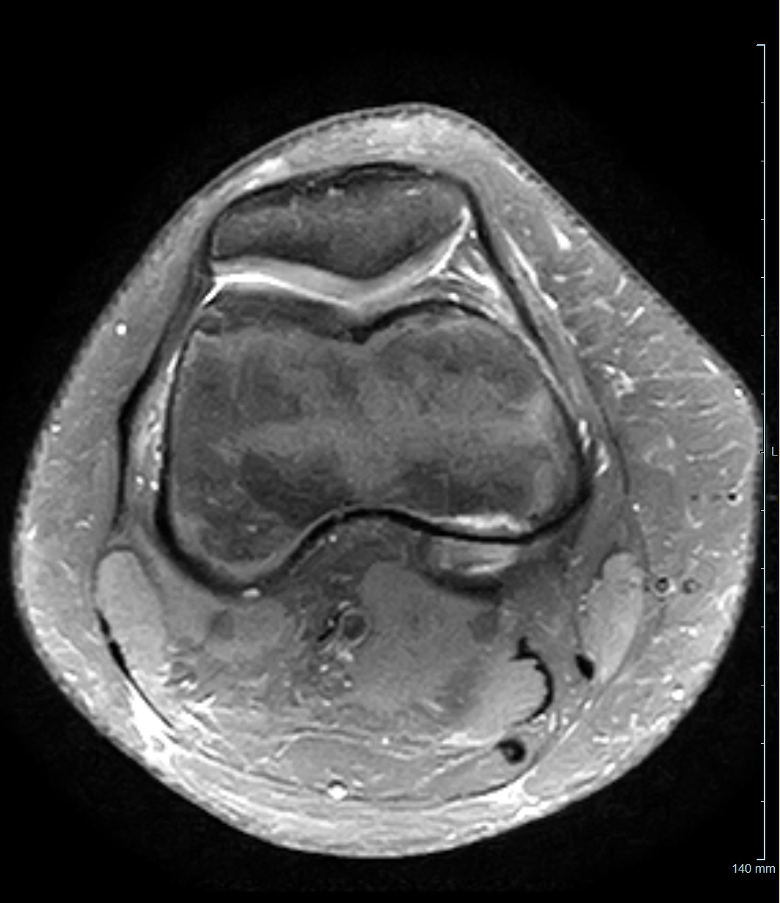
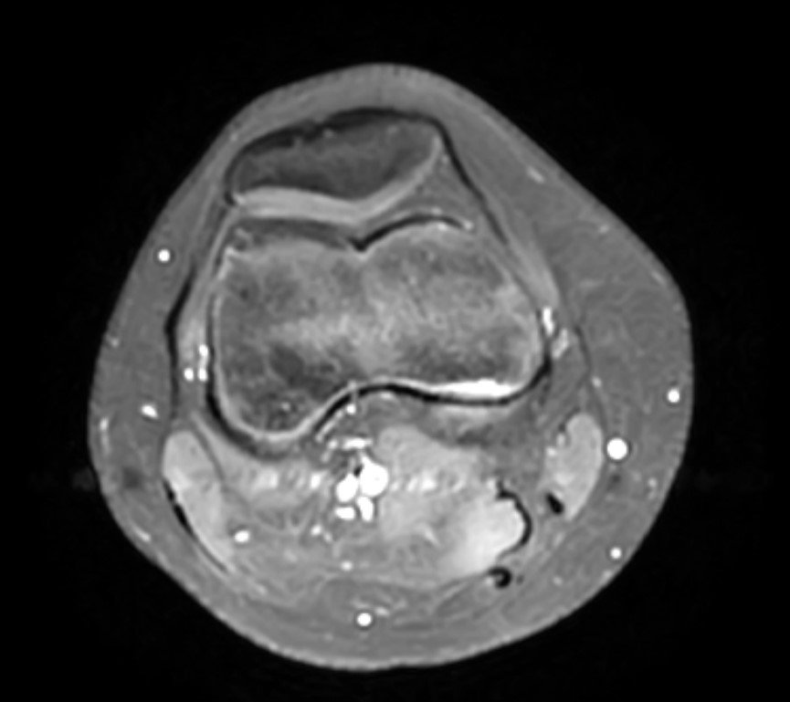
Axial PDfs
Axial T1fs post gad

Slide 4
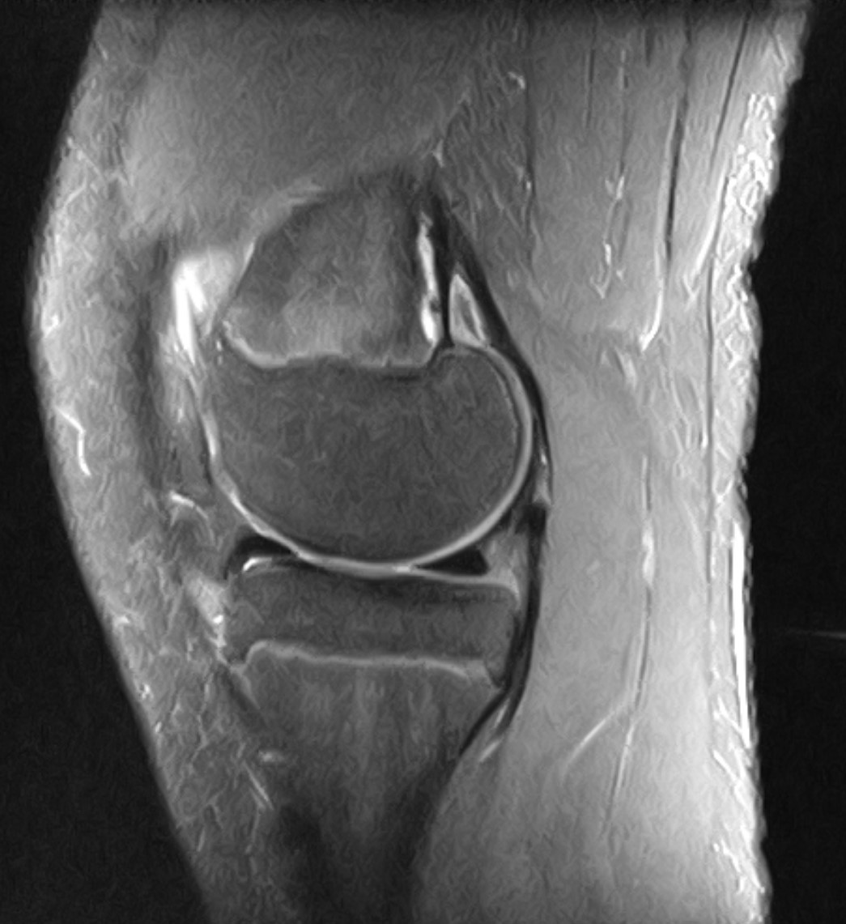
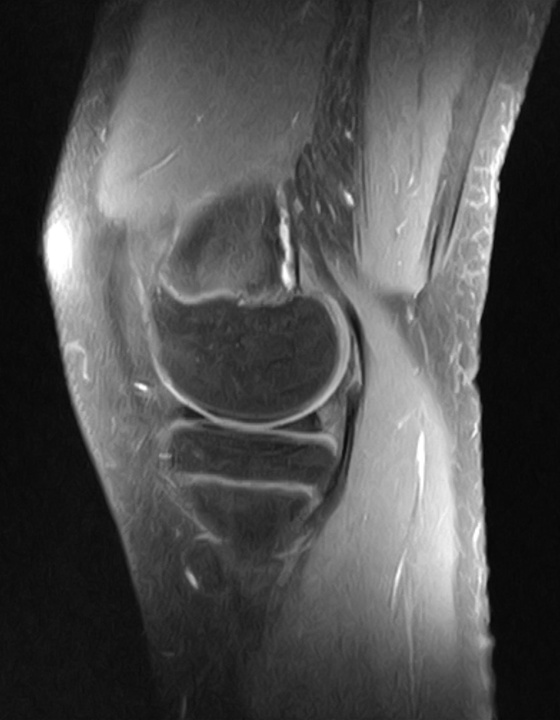
Sag PDfs
Sag T1fs post gad

Slide 5
Cor T1
Cor PDfs

