Slide 1
OCAD CASE
Male, 42 years old, chronic knee pain
used to practice soccer
no history of significant trauma;
no previous history of diseases;
Carlos Henrique Alencar, MD
Cláudio Régis Silveira, MD
São Carlos Hospital, Fortaleza, CE, Brazil

Slide 2
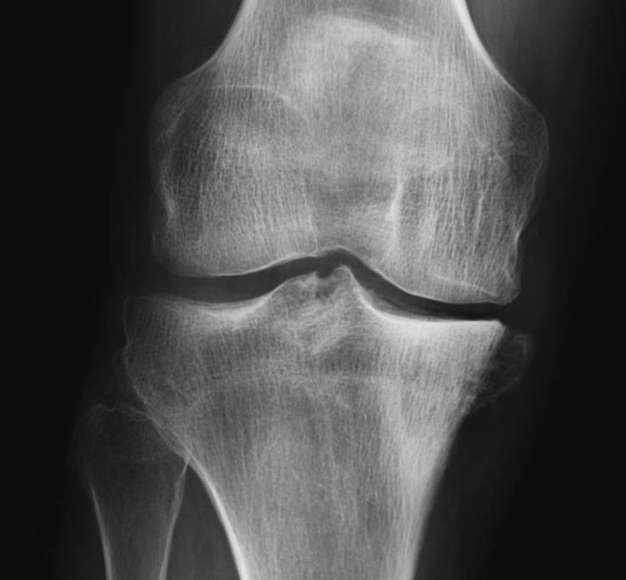
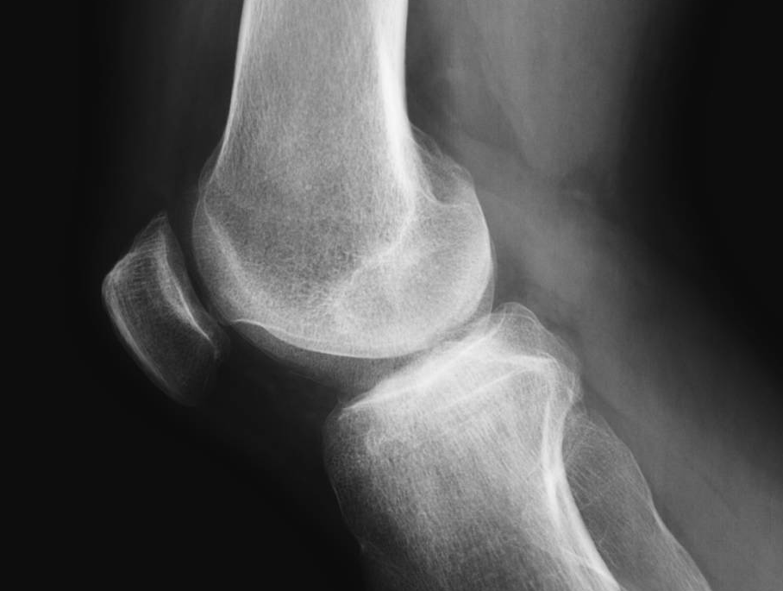
07/Feb/2024

Slide 3
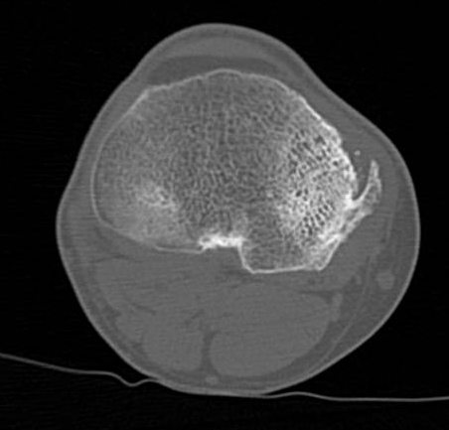
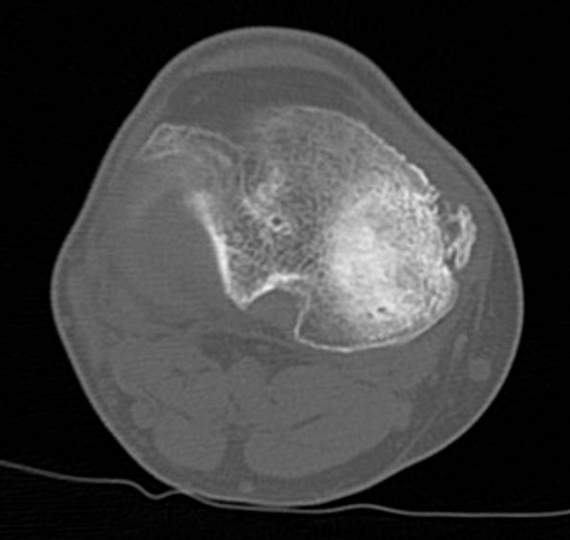
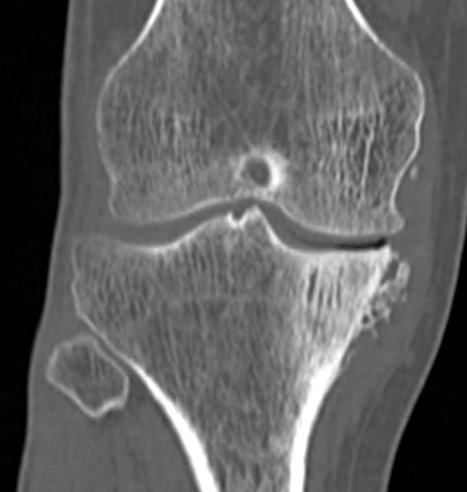
07/Feb/2024

Slide 4
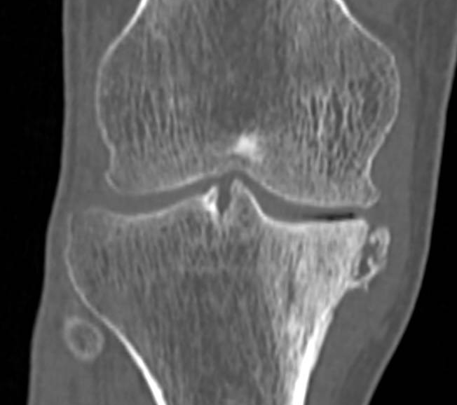
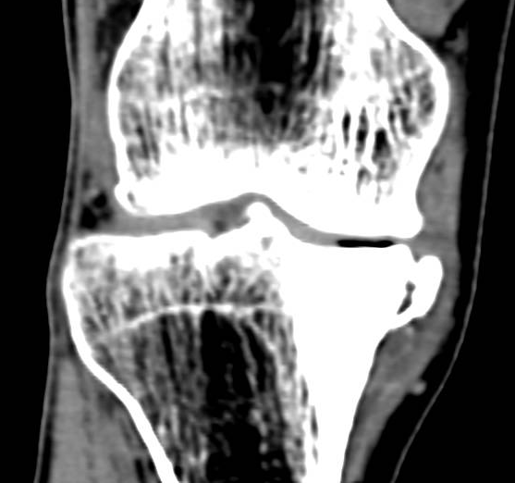
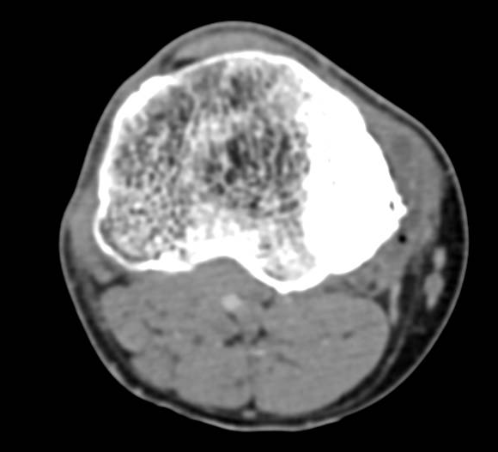
07/Feb/2024

Slide 5
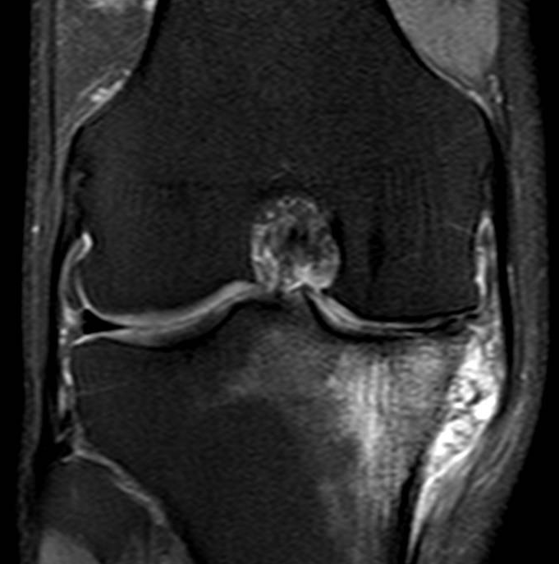
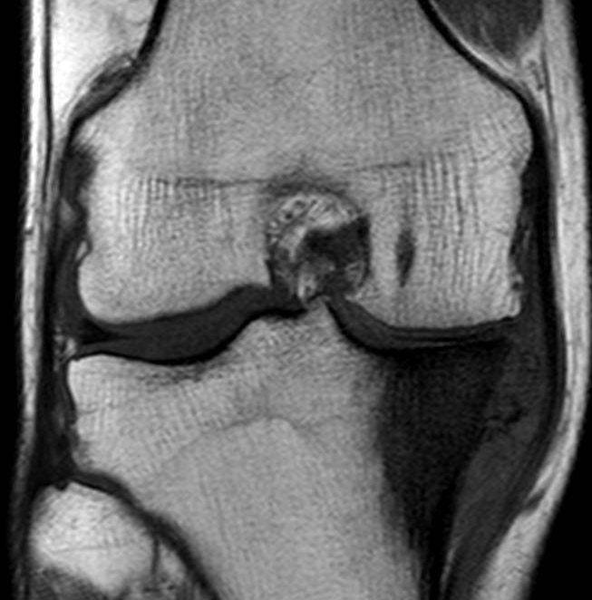
30/01/2024

Slide 6
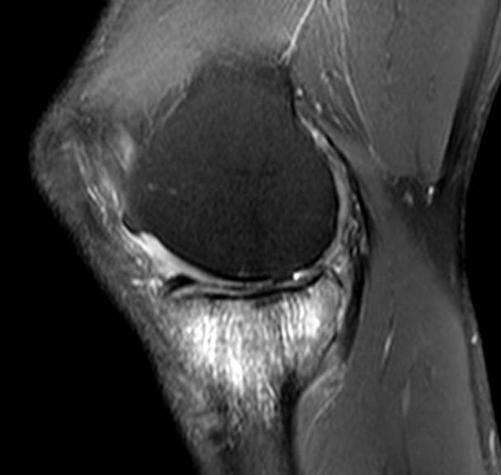
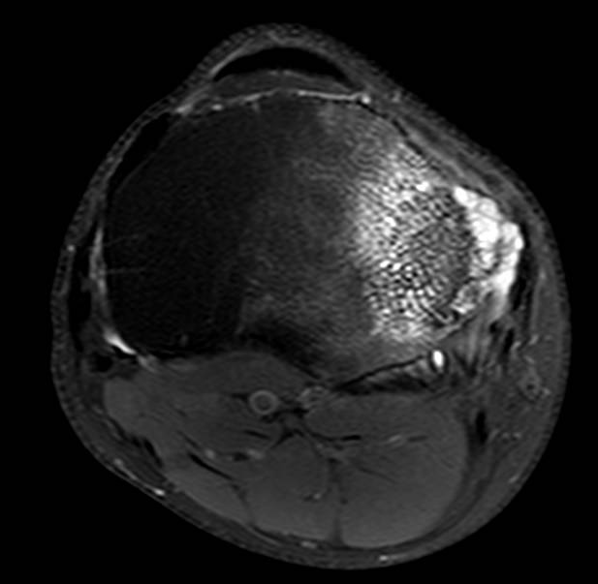

Slide 7
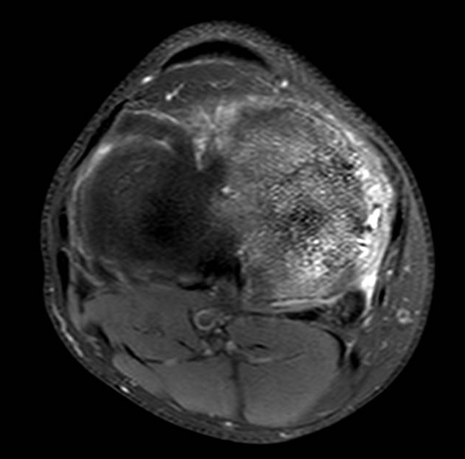
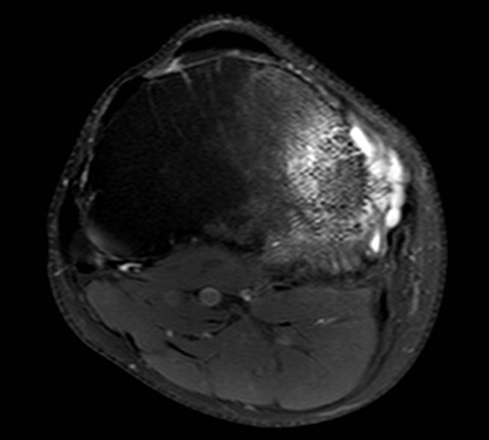

Slide 8
What are your hypothesis for the finding?
Chronic changes related to overload/overuse?
Osteohypertrophic reactions due to stretching of the medial collateral ligament?
Reactive sclerosis of the medial tibial plateau?
Cystic formation related to complex meniscal injury?
More suggestions?
What to do? Follow-up or biopsy?

