Slide 1
58/M
Paravertebral mass
2022-05-24
Case Courtesy of Yong Whan Lee

Slide 2
1 year later

Slide 4
T1
T2
Gd

Slide 5
T1
T2
FS T2
Gd

Slide 6
T2
Gd

Slide 7
IgG4-related disease
paravertebral
Lower thoracic
Right paravertebral
Band-like soft tissue mass
Patent small vessels

Slide 8
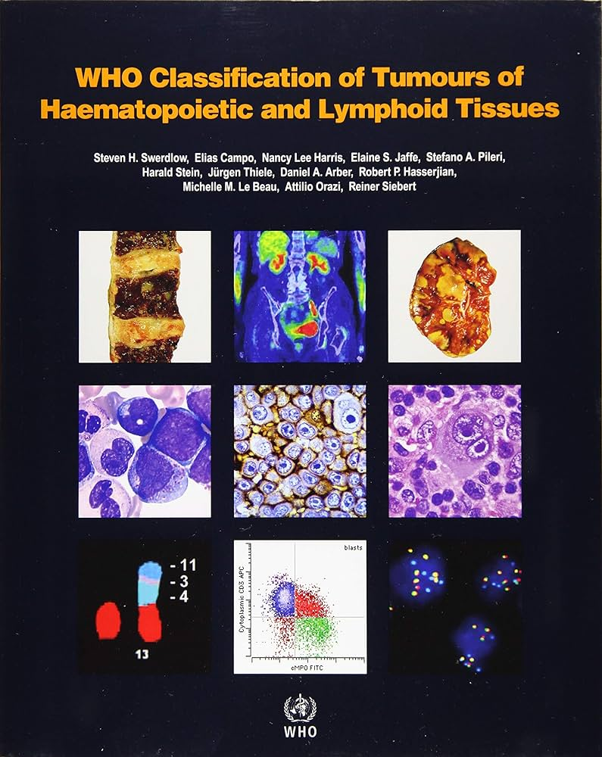
Lymphoid Neoplasms: The 5thed of WHO Classification of Haematolymphoid Tumours (2022)
Major Changes in 2022 Lymphoid Classification
Reorganization of entities by a hierarchical system
Modification of nomenclature for some entities
Revision of diagnostic criteria and subtypes
Deletion of certain entities
Introduction of new entities
Inclusion of tumor-like lesions, mesenchymal lesions
specific to lymph node and spleen
Inclusion of germline predisposition syndromes
associated with the lymphoid neoplasms
Summary Kyung Jin Suh

Slide 9
Lymphoid Neoplasms: The 5thed of WHO Classification of Haematolymphoid Tumours (2022)
Newly Induced Tumor-Like Lesions
Tumor-Like Lesions with B-cell Predominance
Tumor-Like Lesions with T-cell Predominance
Stroma-Derived Neoplasms of Spleen and Lymphoid Tissues
IgG4-Related Disease
Castleman Disease
Reactive B-cell-rich
lymphoid proliferations
Kikuchi-Fujimoto Disease
Autoimmune
lymphoproliferative syndrome
Follicular Dendritic Cell Sarcoma
Intranodal Myofiboblastoma
Splenic Vascular-stromal Tumors
Littoral Cell Angioma
Splenid Hamartoma
Sclerosing Angiomatoid Nodular Transformation of Spleen
IgG4-Related Disease

Slide 10
Lymphoid Neoplasms: The 5thed of WHO Classification of Haematolymphoid Tumours (2022)
B-cell Lymphoma
T-cell and NK-cell Lymphoma
Hodgkin Lymphoma
Follicular Lymphoma
Large B-cell Lymphoma
Mantle cell Lymphoma
Marginal Zone Lymphoma
Burkitt Lymphoma
Splenic B-cell Lymphomas and leukemias
Lymphoplasmacytic Lymphoma
HHV8-associated B-cell Lymphoma
Lymphomas associated with immune deficiency, including post-transplant lymphoproliferative disorders
Primary cutaneous T-cell Lymphoma
Interstitial T-cell and NK-cell lymphoid proliferations and Lymphomas
Anaplastic Large cell Lymphoma
Hepatosplenic T-cell Lymphoma
EVB-positive NK/T-cell Lymphoma
T-cell Lymphoblastic leukemias/Lymphomas

Slide 11
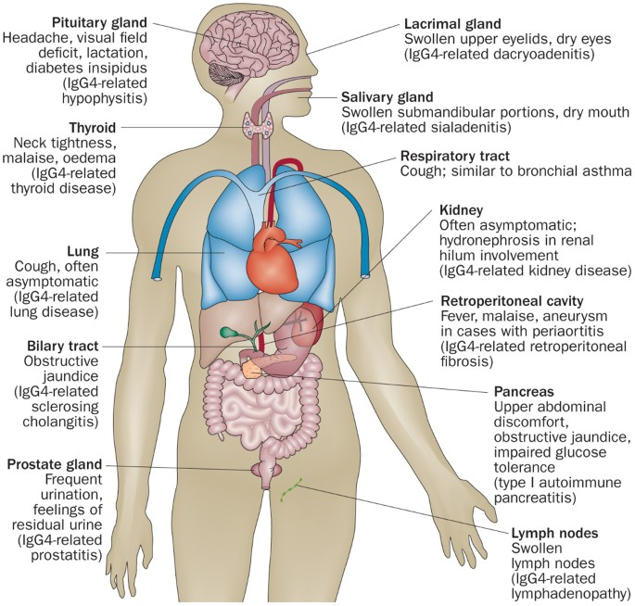
IgG4-Related Disease
A novel, immune-mediated, multisystem disease with development of tumefactive lesions in multiple organs
Characteristic clinical (multifocal tumefactive lesions), serological (serum IgG4 ↑) and pathological (lymphoplasmacytic infiltration rich in IgG4 plasma cells, obliterative phlebitis, and storiform fibrosis) findings.
Manifestations: Autoimmune pancreatitis, cholangitis, kidneys lesions, liver masses, retroperitoneal fibrosis, fibrosing mediastinitis, thoracic paravertebral disease, aortitis/periaortitis, inflammatory aortic aneurysms, hytrotrophic pachymeningitis, orbital inflammatory disease, sialadenitis, lymphadenopathy and lung disease/hilar soft tissue thickening
Glucocorticoids and rituximab are frequently used for treatment
Nat Rev Rheumatol 2014:10:148

