Slide 1
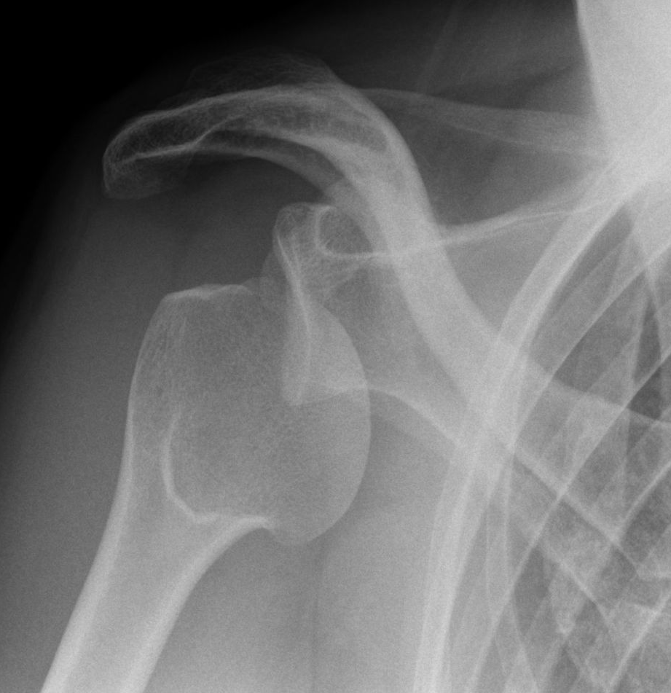
Shoulder Instability
Bipolar Lesions
Back to Basic
Kyugn Jin Suh
kyungjin.suh@gmail.com

Slide 2
Shoulder Dislocation
321 dislocations
42% overall redislocation rate
<10 yo 100% (4/4)
11-20 94% (46/49)
21-30 79% (51/64)
31-49 50% (8/16)
41-50 24% (8/33)
51-60 14% (9/63)
First 2 years redislocation
252 patients
15-35 yo at first dislocation
Male Female
15 yo 86% 54
20 72 40
25 56 28
30 41 19
35 29 13
Rowe et al. Orth Clin NA 1980
JBJS 2006;88A:2326
Critical risk factors: Age, gender
Greatest risk if instability in first 2 years

Slide 3
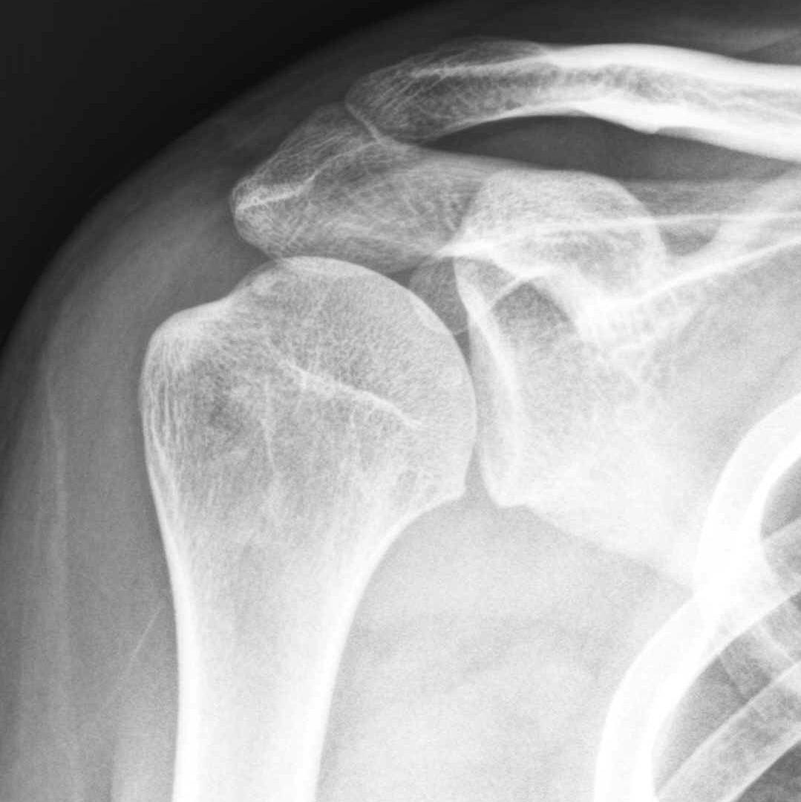
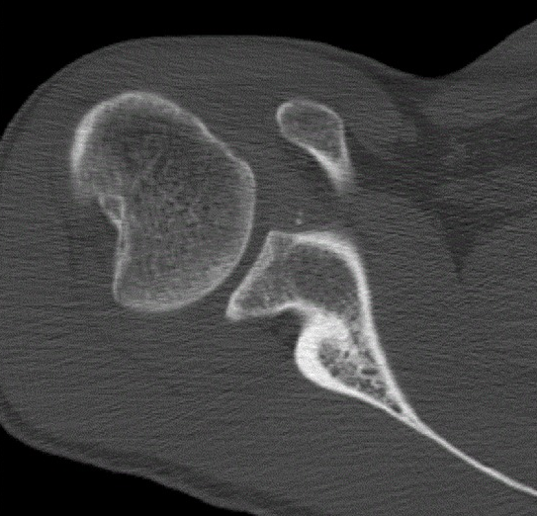
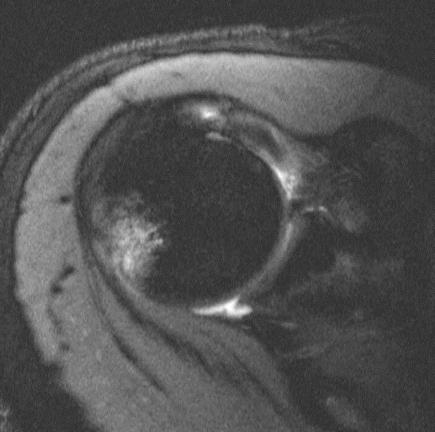
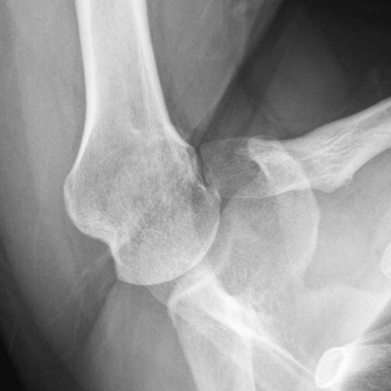
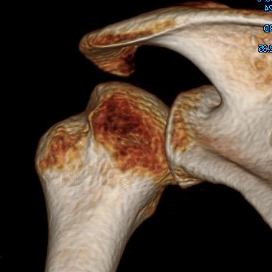
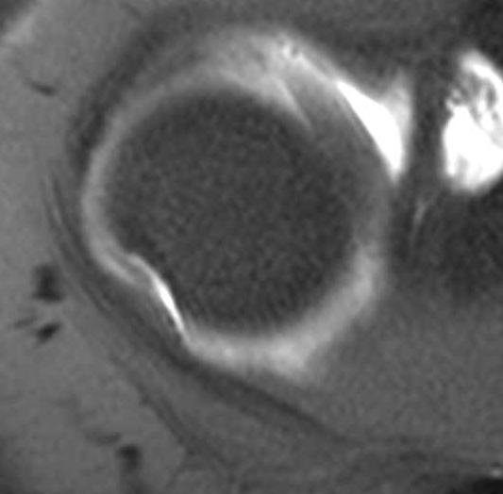
Shoulder Dislocation
Engaged vs non-engaged lesion (Burkhart S. 2000)
On-tract vs off-tract lesion (Itoi E. 2007)

Slide 4
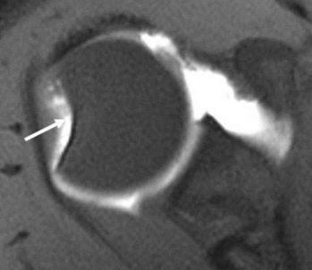
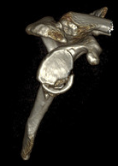
Hill-Sachs Lesion
Posterior superior location
2.5 cm from superior aspect
Above coracoid process
Articular surface involve
<20% Small (stable)
20-40% Intermediate
>40% Large (likely to engaged)
Bankart Lesion
> 20-25% Surgical repair/reconstruction

Slide 5
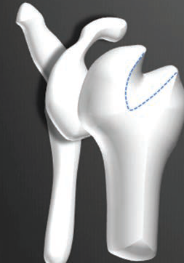
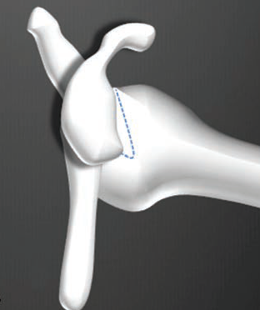
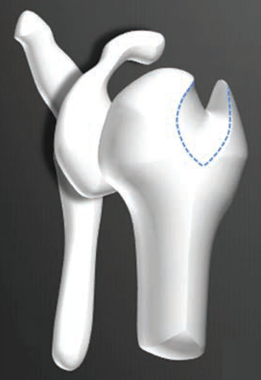
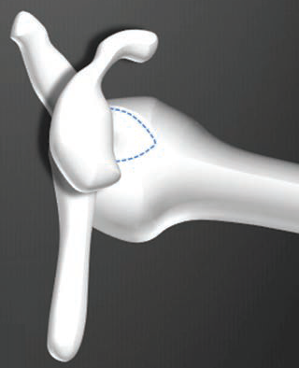
Hill-Sachs Lesion
Engaging
Predisposes to failure of arthroscopic repair
Nonengaging
Misleading term
Any Hill-Sachs lesion resulted from engagement of the anterior glenoid with humeral head
Neutral
ABER
Neutral
ABER
Hill-Sachs lesion obliquely oriented
HS margin and anterior glenoid: parallel
Hill-Sachs lesion vertical
HS margin and anterior glenoid: diagonal
AJR 2013;201:W633
Notes:
Burkhart and De Beer [3] originally described
the term “engaging Hill-Sachs lesion”
as an osseous injury that occurs in the
setting of anterior shoulder dislocation and
predisposes to failure of arthroscopic repair.
Engaging Hill Sachs lesion.
A, Hill-Sachs lesion (blue) is obliquely oriented on neutral view.
B, When shoulder is in abducted and externally rotated position, margins of Hill-Sachs lesion (blue) and
anterior glenoid are parallel, which predisposes to engagement.
Nonengaging Hill Sachs lesion.
A, Hill-Sachs lesion (blue) is vertically oriented on neutral view.
B, When shoulder is in abducted and externally rotated position, margins of Hill-Sachs lesion (blue) are
diagonal to anterior glenoid, which decreases chance of engagement

Slide 6
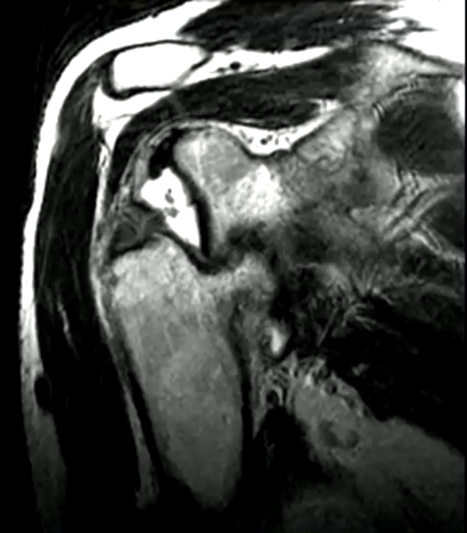
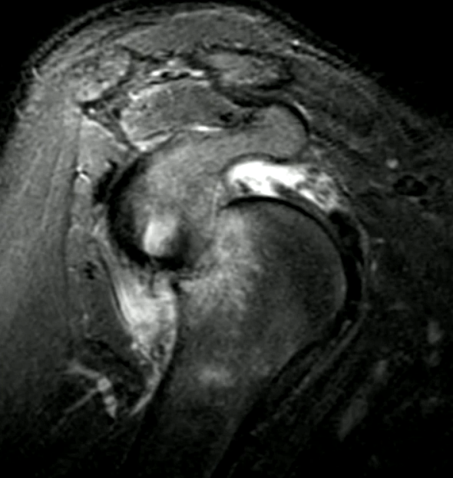
Engaging Hill-Sachs Lesion
During motion recurrent shoulder dislocation
Engaging Hill-Sachs lesion on physical examination and the degree of glenoid bone loss as well as a trend toward increased engagement with more medially oriented Hill-Sachs lesions
AJR 2013;201:W633
Notes:
Fig.22-year-old man with history of recurrent shoulder dislocation and engagement on physical
examination.
A and B, Axial fat-suppressed proton density–weighted (A) and sagittal T1-weighted (B) images show
anteroposterior (line “A,” blue line, A), depth (line “B,” green line, A), and craniocaudal (red line, B)
measurements of Hill-Sachs lesion. In A, dotted line shows humeral head.

Slide 7
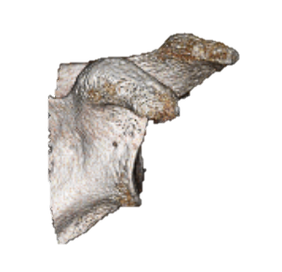
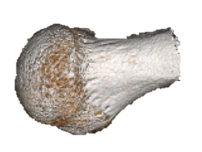
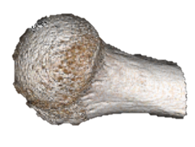
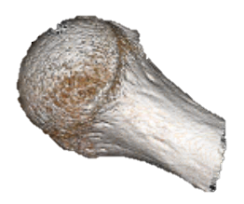
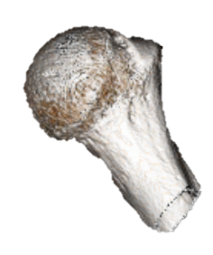
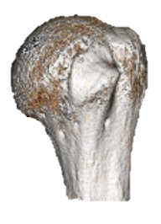
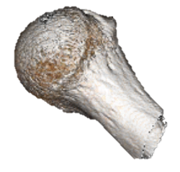
Glenoid Track
Definition
Zone of contact between the glenoid and humeral head during motion from neutral to ABER
Notes:
2007 Yamamoto, Itoi introduced the concept, shoulder dislocation에서 bipolar defect가 있을 때
Zone of contact 는 Posterior superior로
Trapezius 와 serratus anterior의 작용에 의해 upward rotation
Maximal elevation때 50도 이상

Slide 8
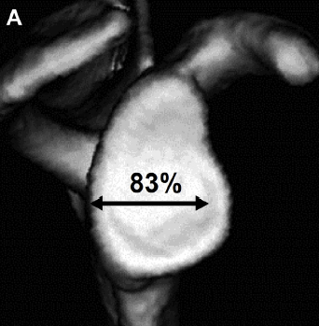
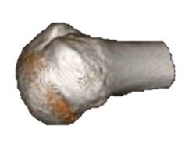
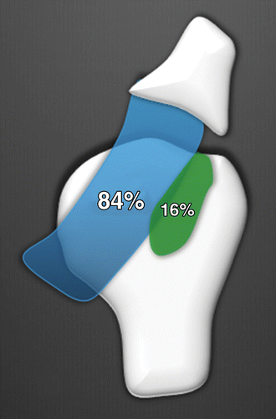
Glenoid Track
Definition
Zone of contact between the glenoid and humeral head during motion from neutral to ABER
Width of Glenoid Track Approximately 83% of
glenoid AP diameter
Glenoid bone loss results in
a smaller glenoid track
83%
17%
AJR 2013;201:W633

Slide 9
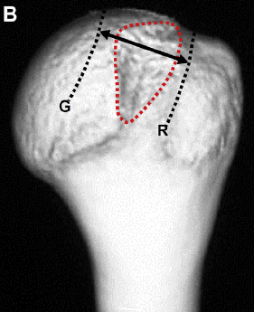
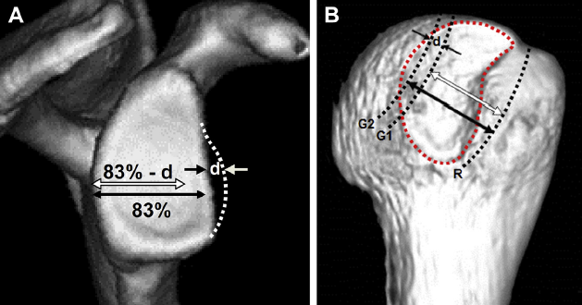
On track
Hill-Sachs lesion is located within glenoid track
Off-track
Hill-Sachs lesion extends medially over medial margin of glenoid track

Slide 10
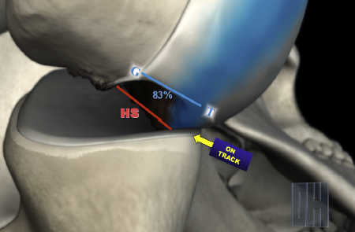
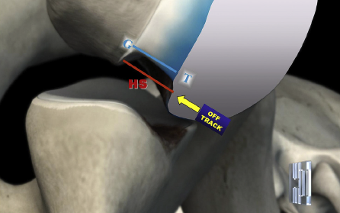



On-Track
Off-Track
Notes:
차의 폭이 glenoid track
구덩이가 hill-sachs lesion

Slide 11
How to Determine
On-Track vs Off-Track
1. Measure the diameter (D) of the inferior glenoid
2. Determine the width of the anterior glenoid bone loss (d)
3. Calculate the width of the glenoid track (GT) by the following formula
GT = 0.83 x D - d

Slide 12
How to Determine
On-Track vs Off-Track
Calculate the Hill-Sachs interval (HSI), which is the width of the Hill-Sachs lesion (HS) plus the width of the bone bridge (BB) between the rotator cuff attachments and the lateral aspect of the Hill-Sachs lesion
HSI =HS + BB
HSI > GT, the HS is off-track, or engaging
HSI < GT, the HS is on-track, or non-engaging
Notes:
Medial margin is the key!!!!!
Glenoid track 의 lateral margin은 rotator cuff foot print의 medial border

Slide 13
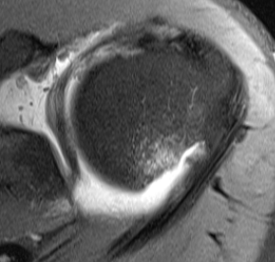
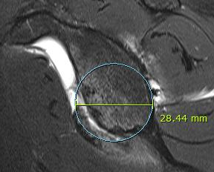
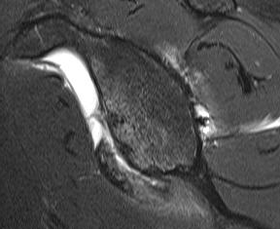
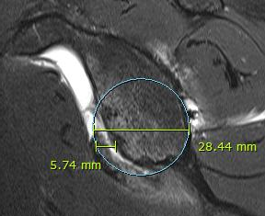
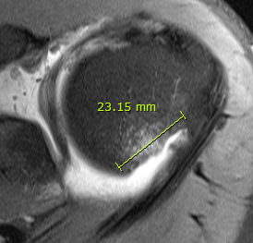
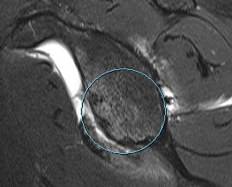
>
HSI = 23.15 cm
GT= (28.44 x 0.83) - 5.74 cm
= 20.71 cm
Off-track lesion

