Slide 1
36 yo Female
History: Soft tissue mass

Slide 3
Ax t2fs
Ax PD
Ax T1fs post

Slide 4
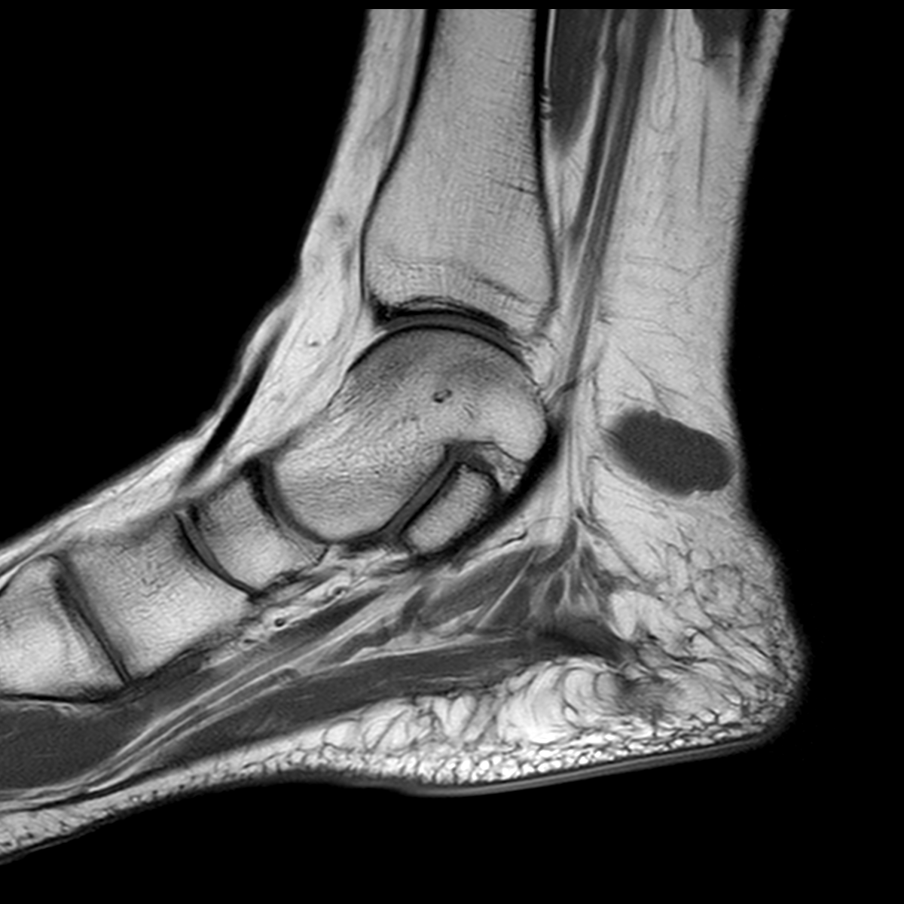
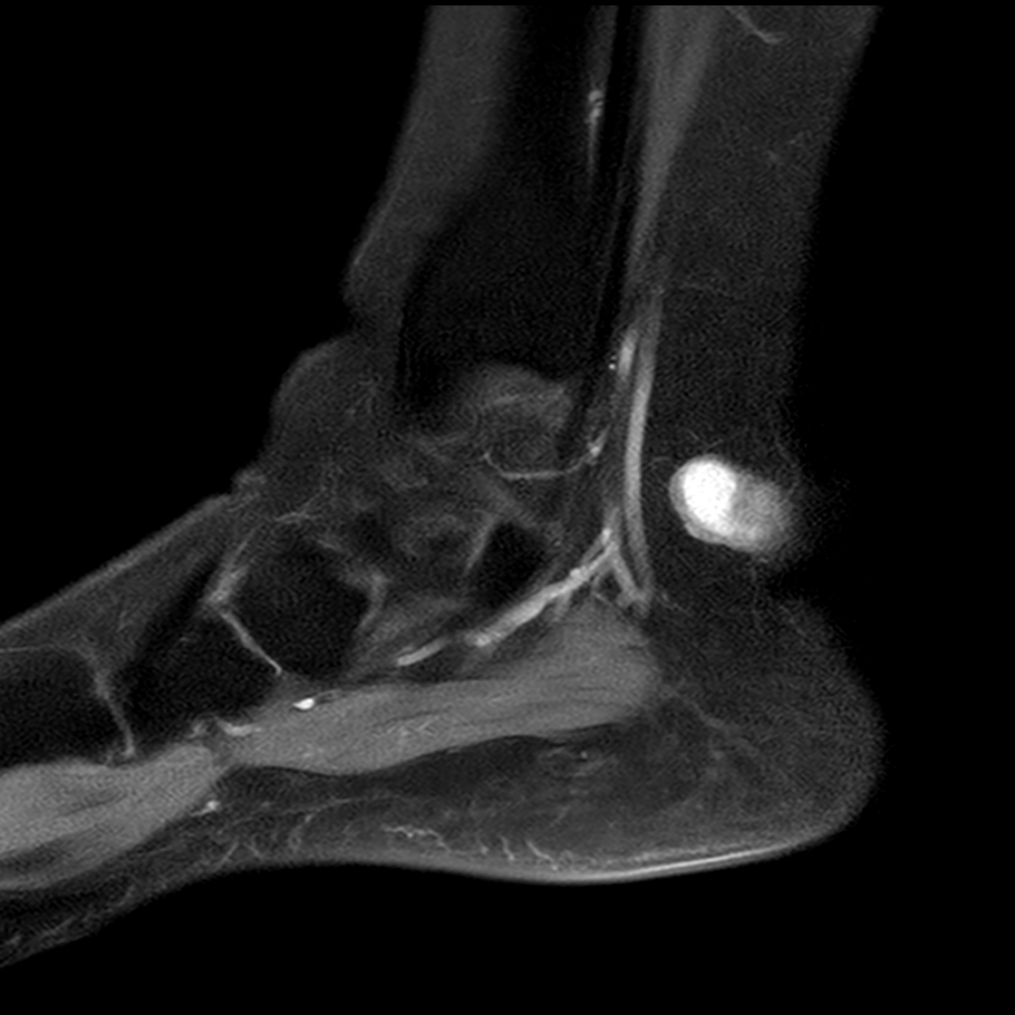
Sag T1
Sag T1fs post

Slide 5
Cor T2fs
Cor T1fs post
Cor T1

