Slide 1
54 year old male, c/o swelling in right calf region since 1 year. Now c/o increased pain at the region of swelling.
Past history- Similar complaints in past in 2019, USG in 2019- Localised collection in right popliteal fossa s/o infective/inflammatory etiology.
Histopath dated 19/12/2019- foreign body giant cell granulomatous reaction.
MRI dated 27/08/2021 - diffuse edematous thickening of gastrocnemius and soleus s/o strain with intermuscular hemorrhage .
Scan coming from peripheral town, Previous imaging not available.
Your thoughts please.
Showing MRI dated 17-10-2023

Slide 2
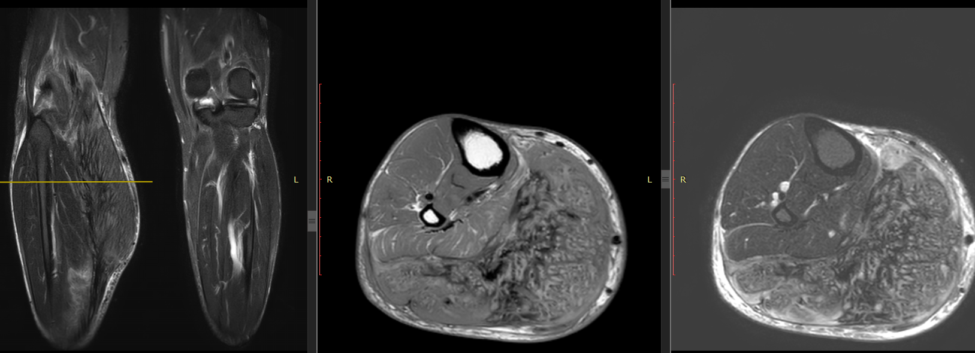
STIR cor, T1 and STIR axial

Slide 3
T2, DW, STIR

Slide 4
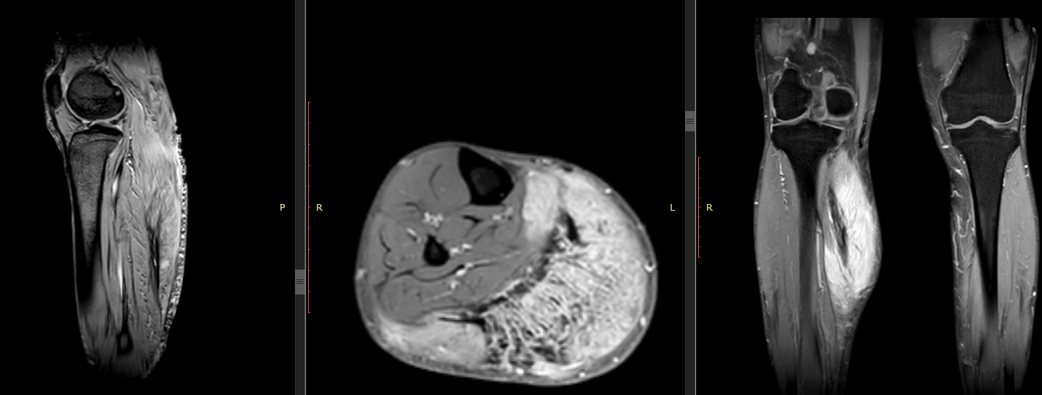
GRE, Gad axial and coronal

