Slide 1
8-yo male with pain of his left pinky. No trauma in his clinical record. Glomic tumor?: not the usual age; why sclerosis? Epidermoid inclusion cyst: no trauma history; why sclerosis GTC: rare; not the age ; sclerosis I would go with a OO: there is some sclerosis and subtle oedema of the nearby soft tissues after contrast agent injection. Am i overdiagnosing? Epidermoid inclusion cyst is a better hypotesis? I need OCADers help. It is a tumor/lesion I seldom encounter lately as a ped MSK radiologist . Any hints?I haven’t got the histology yet. Paolo Simoni, Bruxelles

Slide 2
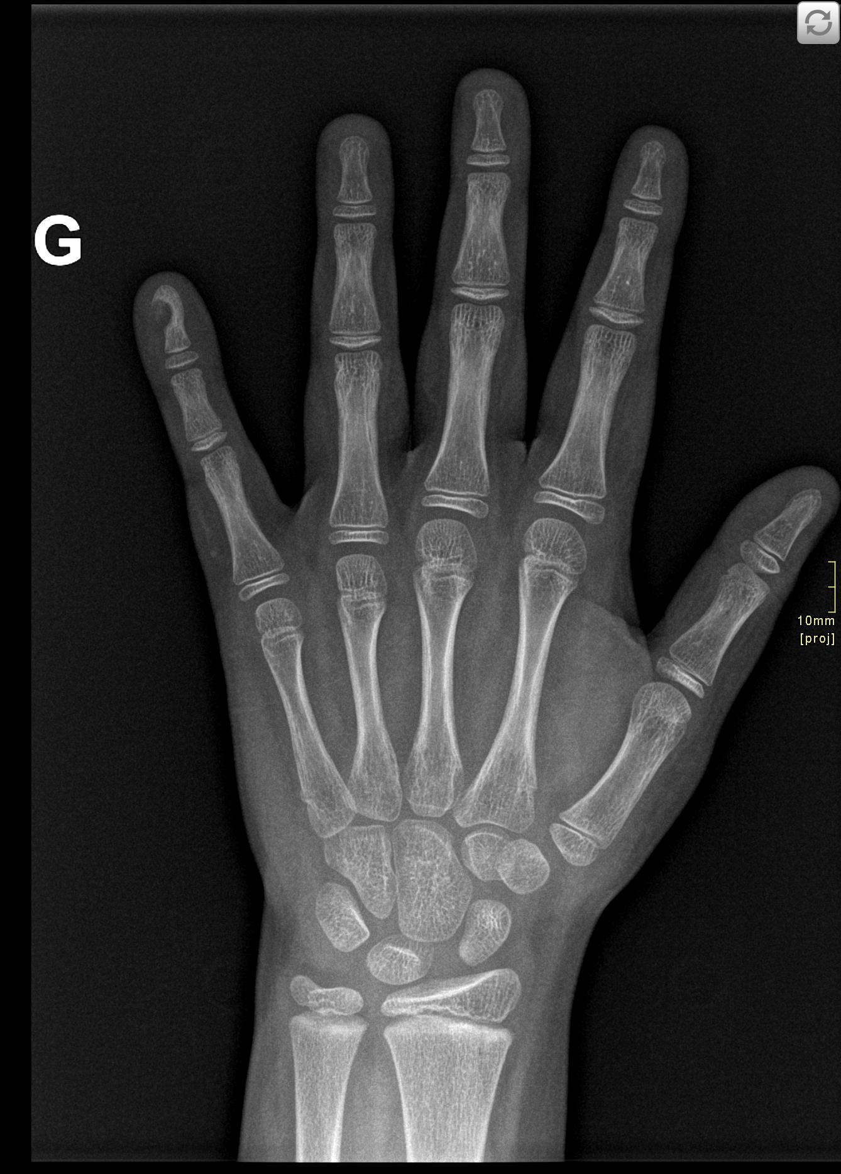
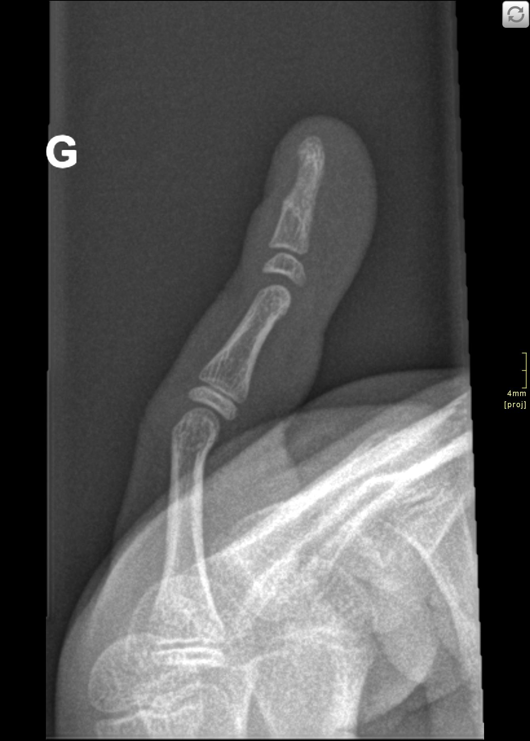
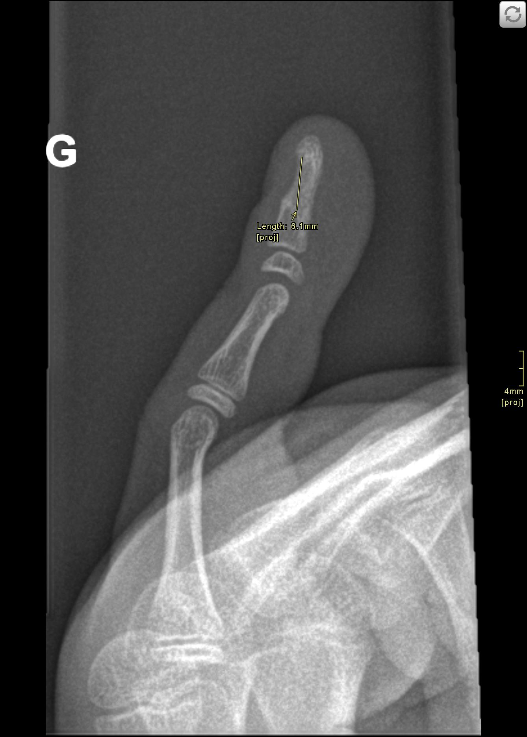

Slide 3
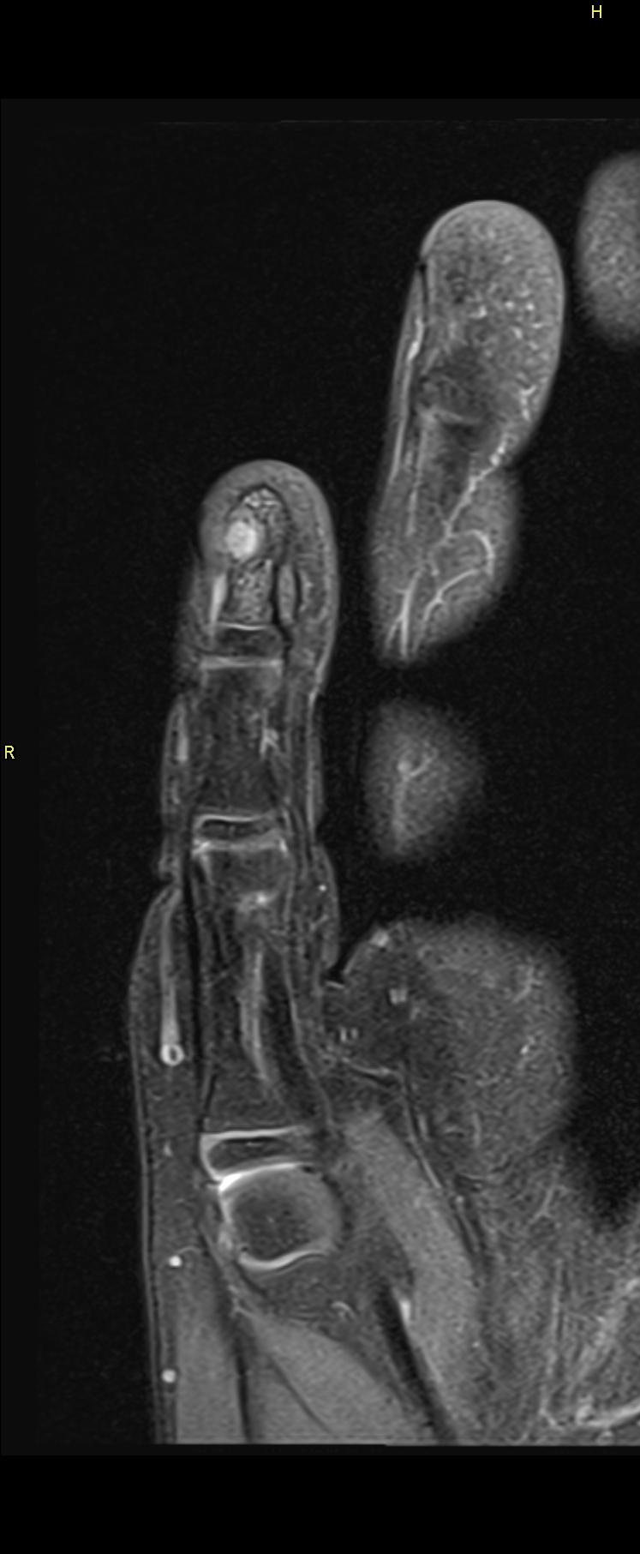
PDwFS
T2W STIR
T1w
PDwFS

Slide 4
T1 FS Gd+
T1w
PDwFS
T1 FS Gd+

