Slide 1
History
16 year 8 months old male
h/o Toe walking, inability to completely straighten the knees for several years. No knee pain or swelling.
Seen by outside Ortho in 2021 for bilateral knee pain from toe walking; recommended PT and neuro evaluation. PT helped straighten his legs but still having issues (2021). Did not follow through with neuro evaluation. No prior imaging.
When he straightens his foot, his knee goes to the side, no sports.

Slide 3
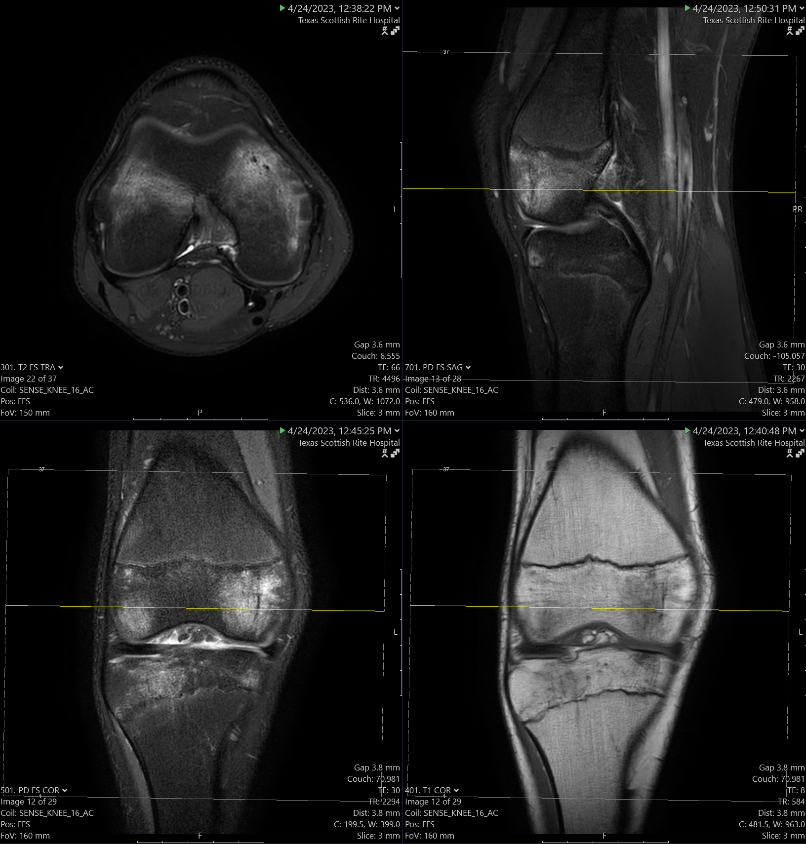
Right

Slide 4
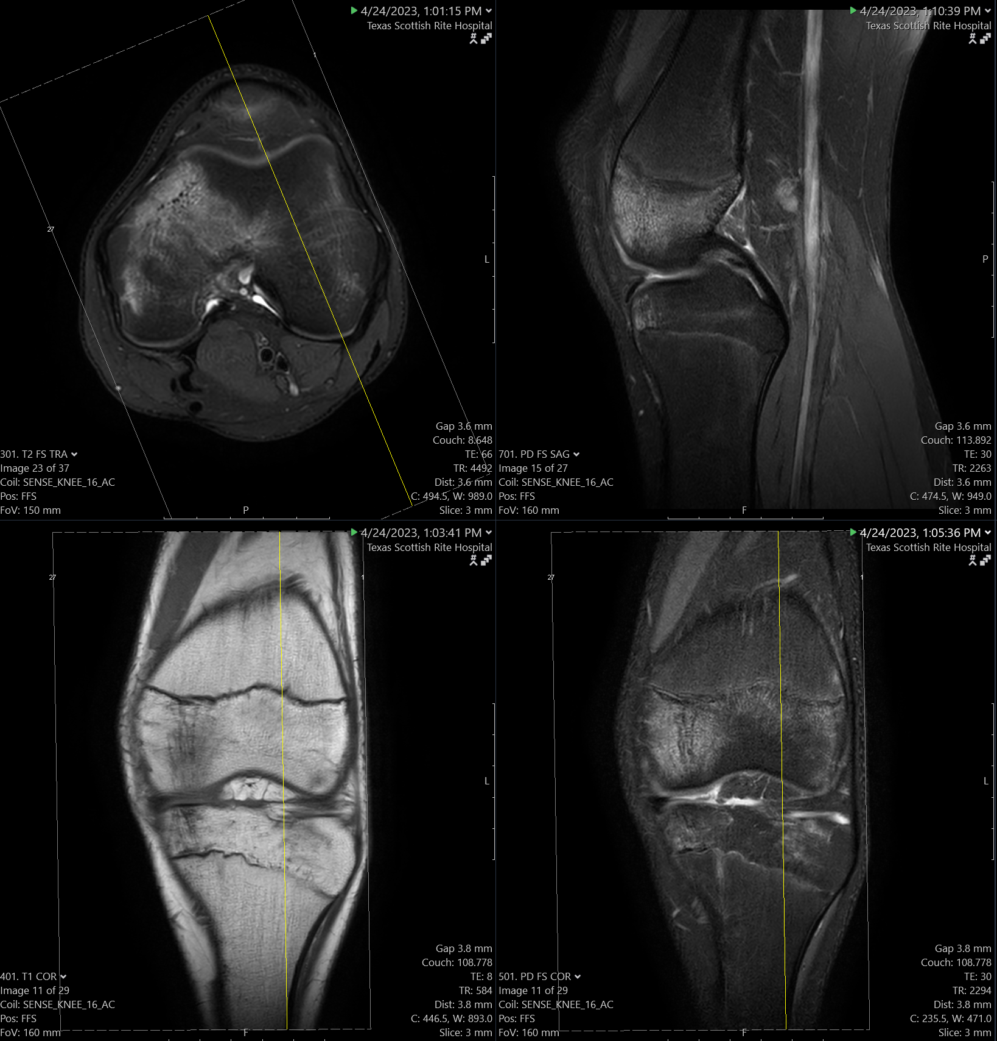
Left

Slide 5
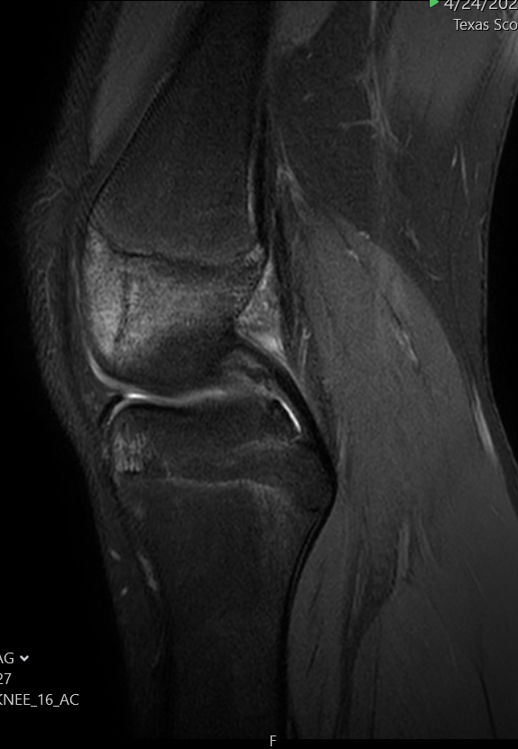
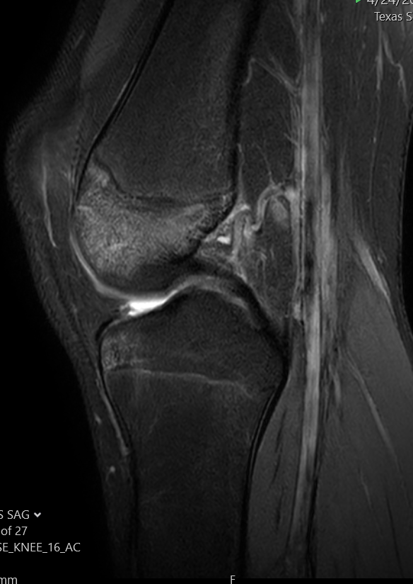
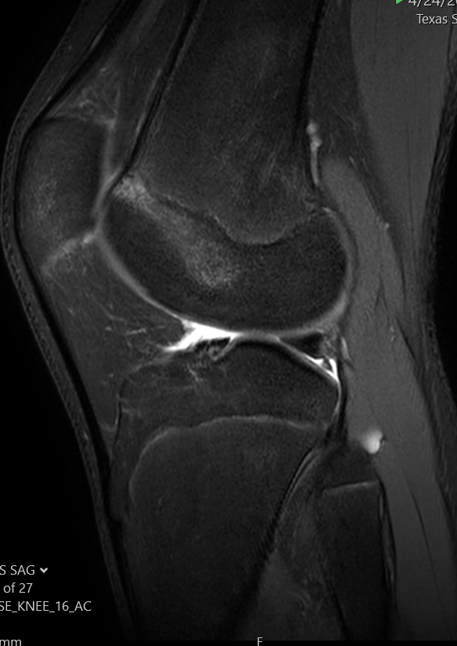
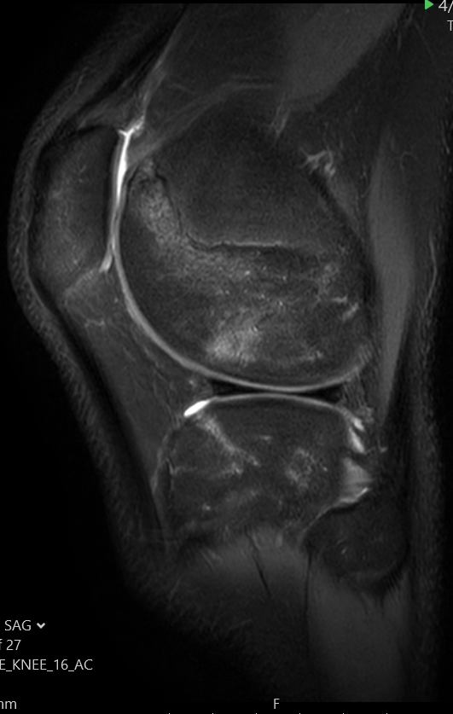
Left medial to lateral

Slide 6
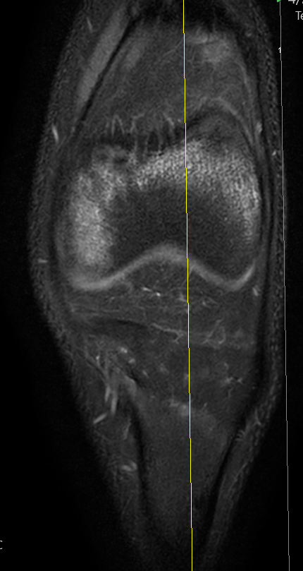
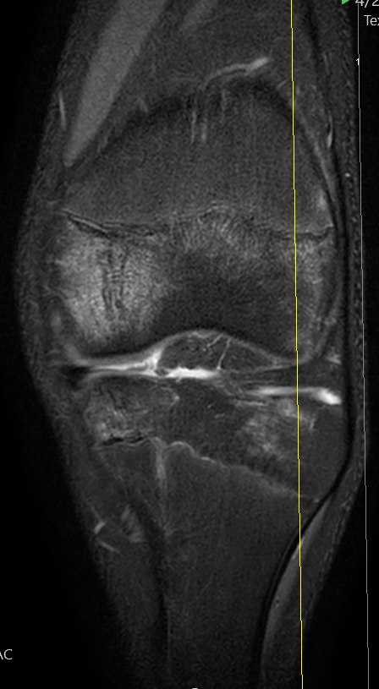
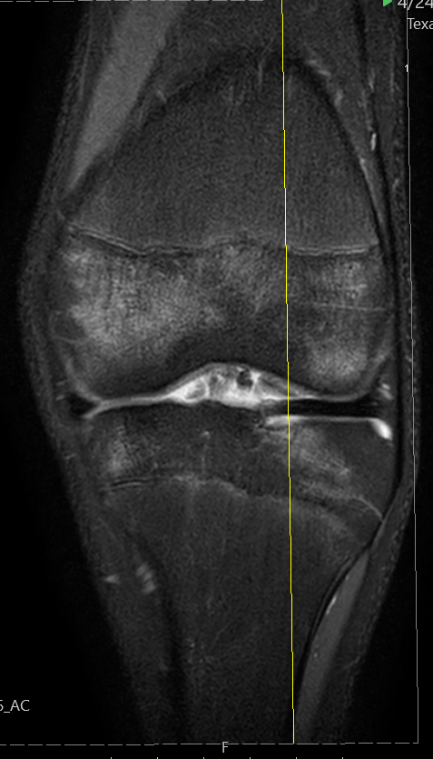
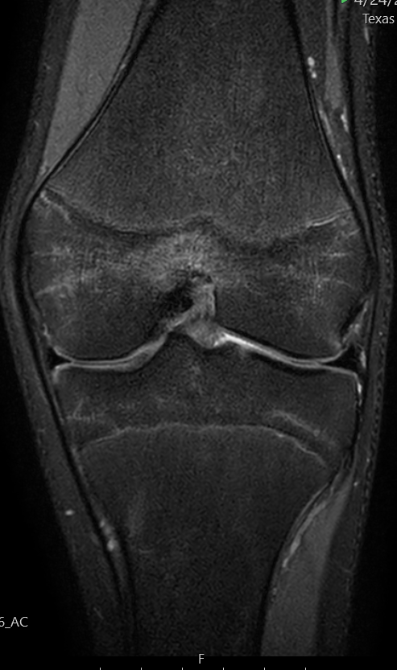
Left Anterior to Posterior

Slide 7
Questions
What are your thoughts/differential considerations for the bilateral knee marrow edema?
What is your top consideration (if there is one)?
Any other comments or pearls of wisdom for this case or cases like this?

