Slide 1
OCAD Wrist
Patient, 39 y.o., wrist pain with no history of trauma.

Slide 3
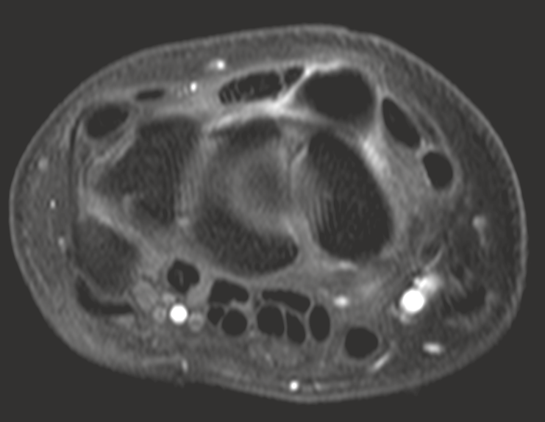
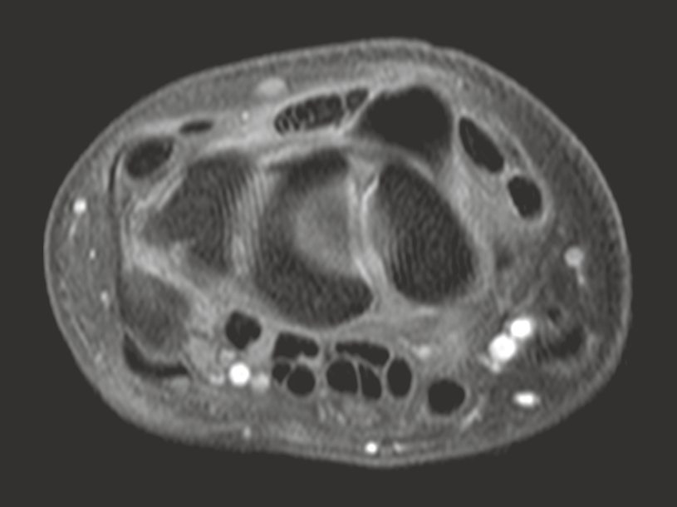

Slide 4
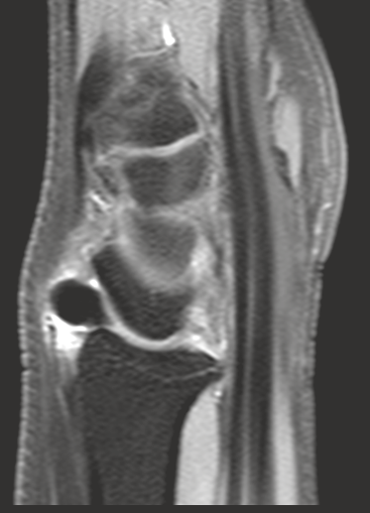
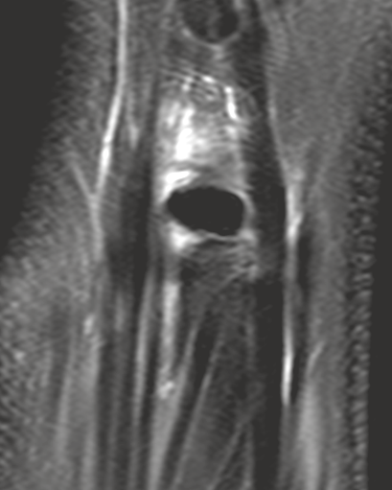

Slide 5
Hypothesis?
Hydroxyapatite deposition disease? Accessory Ossicle (os epilunatum? os hypolunatum?).

