Slide 1
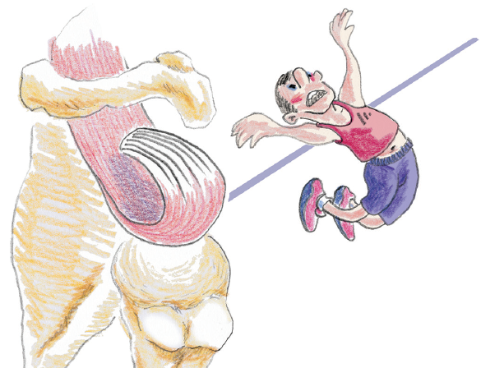
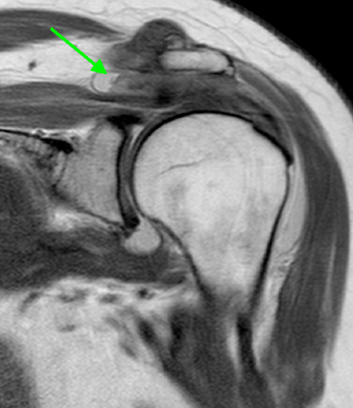
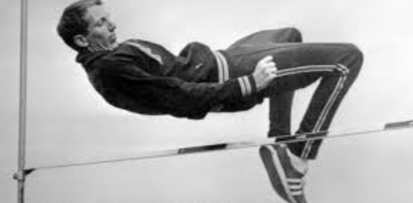
PATHOLOGIC CONSIDERATIONS
TENDON TEARS
TERMINOLOGY
FOSBURY FLOP TEAR | Full-thickness tear that involves the posterior cuff that inverts with adhesions between the torn inverted tendon and the wall of the subacromial bursa, leading to abnormal orientation of the torn fibers
Dick Fosbury, 1968 Olympic Games
Kolo FC, et al: Br J Radiol 90: 146, 2017

Slide 2
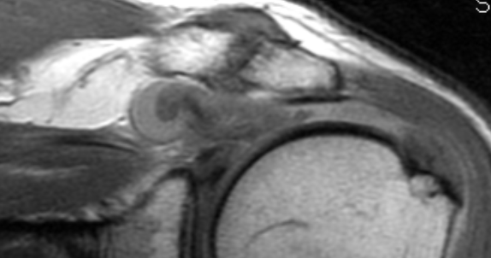
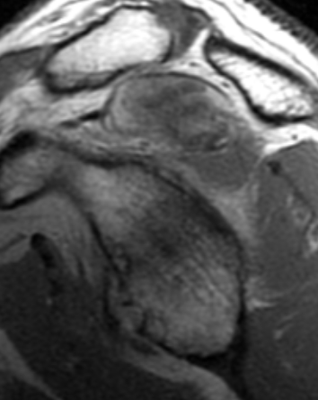
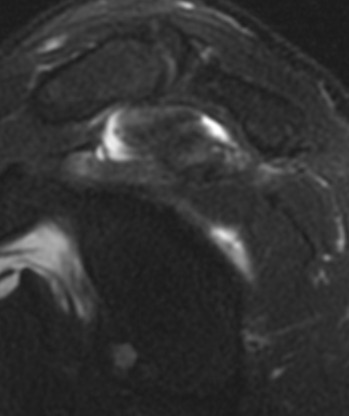
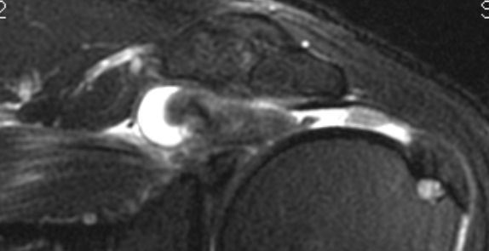
PATHOLOGIC CONSIDERATIONS
TENDON TEARS
TERMINOLOGY
FOSBURY FLOP TEAR | Full-thickness tear that involves the posterior cuff that inverts with adhesions between the torn inverted tendon and the wall of the subacromial bursa, leading to abnormal orientation of the torn fibers

