Slide 1
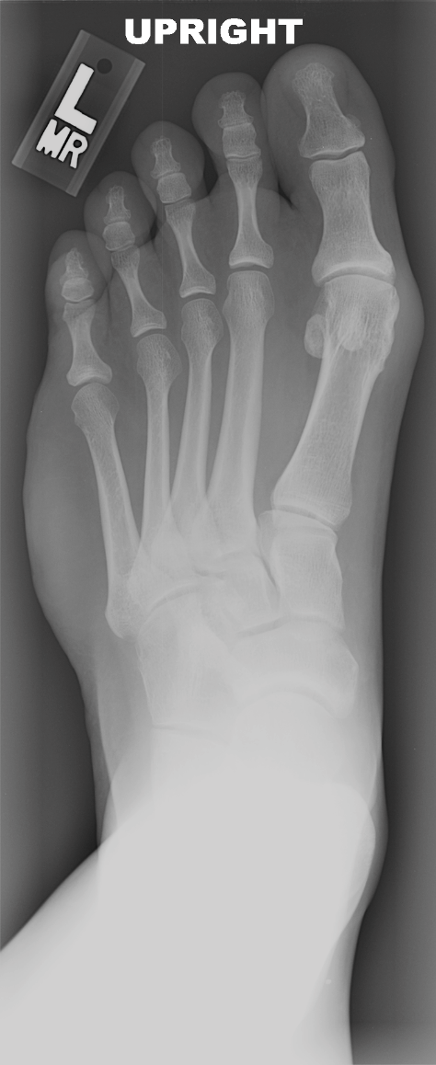
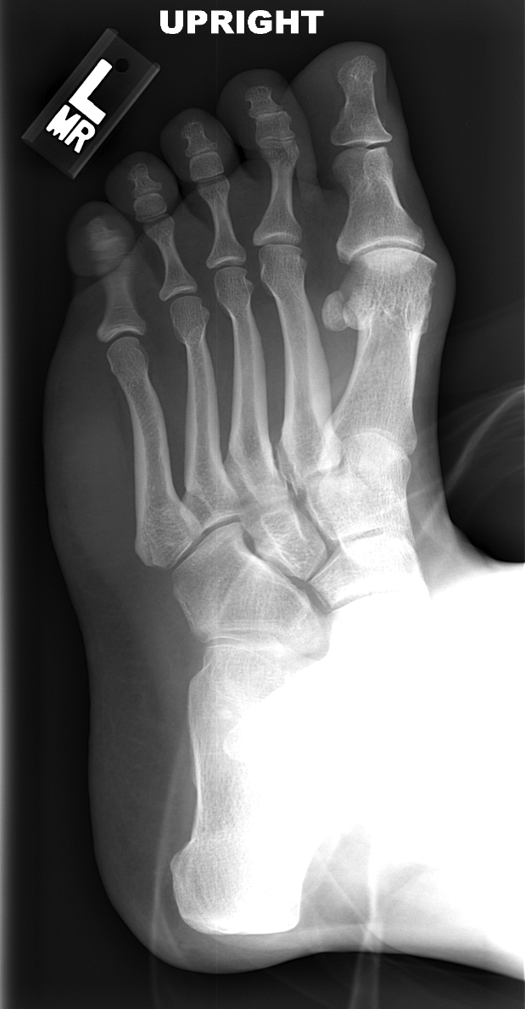
CASE 8
40 YEAR OLD WOMAN WITH MASS ON OUTSIDE OF LEFT FOOT AND SIMILAR BUT SMALLER MASS ON THE OPPOSITE SIDE

Slide 2
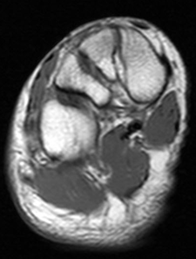
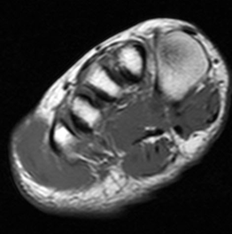
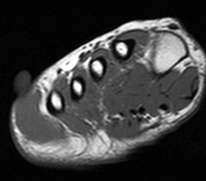
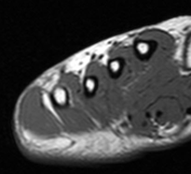
CASE 8
PROXIMAL DISTAL
T1 FSE

Slide 3
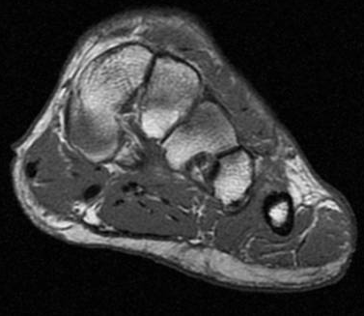
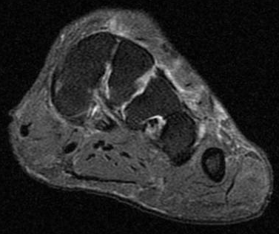
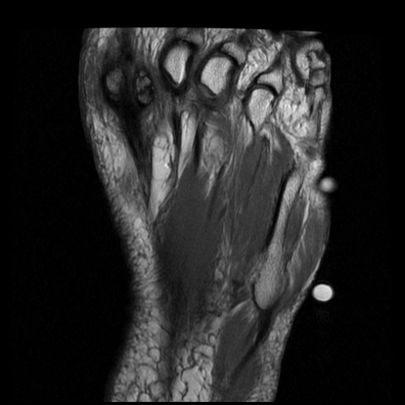
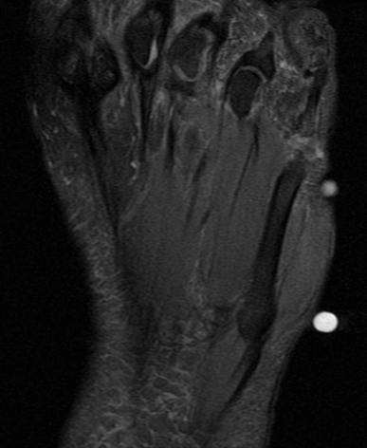
CASE 8
ANOTHER CASE WITH SAME DIAGNOSIS

Slide 4
CASE 8
HYPERTROPHY OF THE ABDUCTOR DIGITI MINIMI MUSCLE

Slide 5
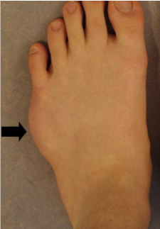
CASE 8
HYPERTROPHY OF THE ABDUCTOR DIGITI MINIMI MUSCLE
Reported to occur in athletic children
Ddx:
“Pseudohypertrophy” in muscular dystrophy
Hypertrophy in gigantism, but both bone and soft tissue involved
Raab P. Hypertrophy of the abductor digiti minimi. Foot Ankle Surg 2008. 14: 43-6.

Slide 6
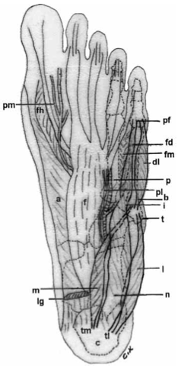
CASE 8
HYPERTROPHY OF THE ABDUCTOR DIGITI MINIMI MUSCLE
Abductor digiti minimi muscle
Origin: calcaneal tuberosity
Insertion: base of 5th proximal phalanx
Numerous variations exist
Kopuz C. A rare anomaly of the abductor digiti minimi. CTO 1999. 164:174-6.
Notes:
6

Slide 7
CASE 8
HYPERTROPHY OF THE ABDUCTOR DIGITI MINIMI MUSCLE
Proximally, anomalous fascicles have been described
Proximal lateral fascicle
Proximal medial fascicle
Distally, only one distal belly has been described
Kopuz C. A rare anomaly of the abductor digiti minimi. CTO 1999. 164:174-6.
Notes:
And therefore it is not an accessory muscle or fascicle, but a true hypertrophy of the muscle.
7

Slide 8
CASE 8
HYPERTROPHY OF THE ABDUCTOR DIGITI MINIMI MUSCLE
Hypertrophied muscle can minimally enhance, but with diffuse pattern without infiltration of surrounding soft tissue
On histology:
True muscle hypertrophy (increased thickness of muscle fibers)
Few areas of fibrosis and lymphocytic infiltration, similar to myositis
No malignant changes or evidence of denervation / reinnervation
Kopuz C. A rare anomaly of the abductor digiti minimi. CTO 1999. 164:174-6.

Slide 9
References
Raab P. Hypertrophy of the abductor digiti minimi. Foot Ankle Surg 2008. 14: 43-6.
Kopuz C. A rare anomly of the abductor digiti minimi. CTO 1999. 164:174-6.

