Slide 1
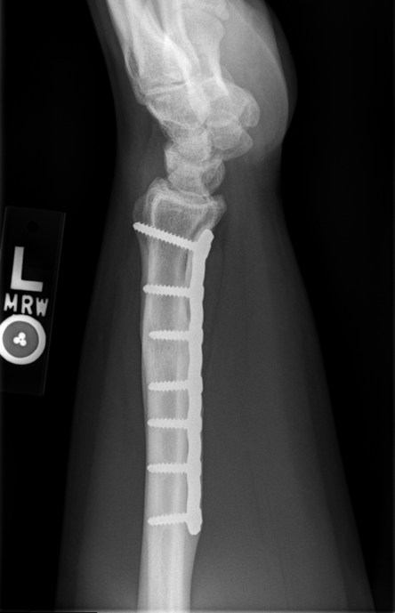

Slide 2
Cine of forearm. Proximal to distal.

Slide 3
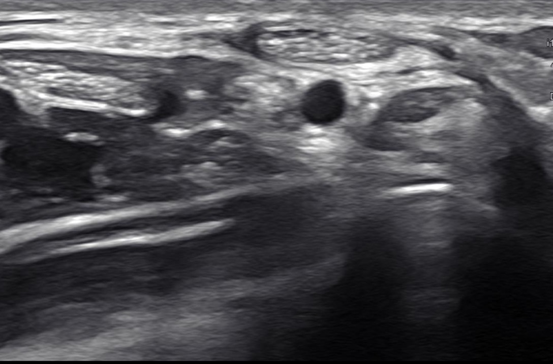
Palmaris longus
Persistent median artery
Median Nerve
Level of mid-distal forearm about volar scar

Slide 4
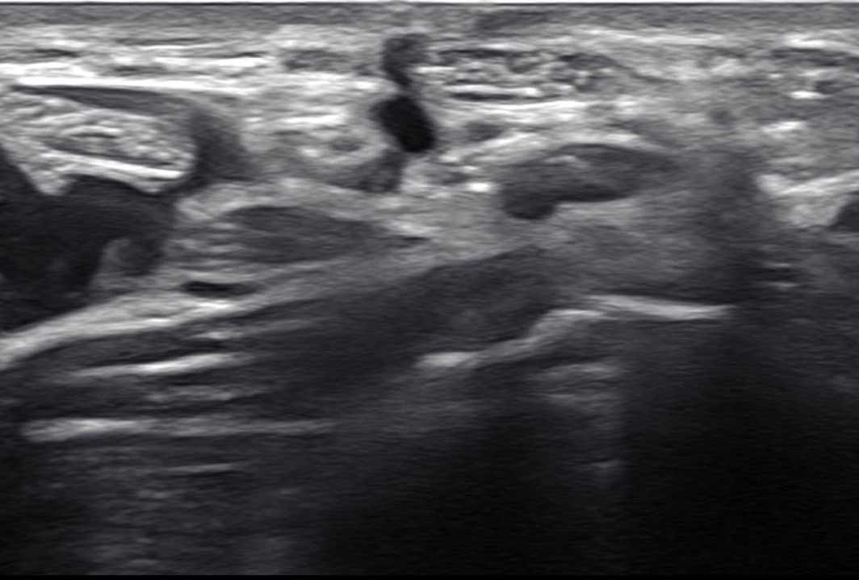
Palmaris longus
Persistent median artery
Median Nerve

Slide 5
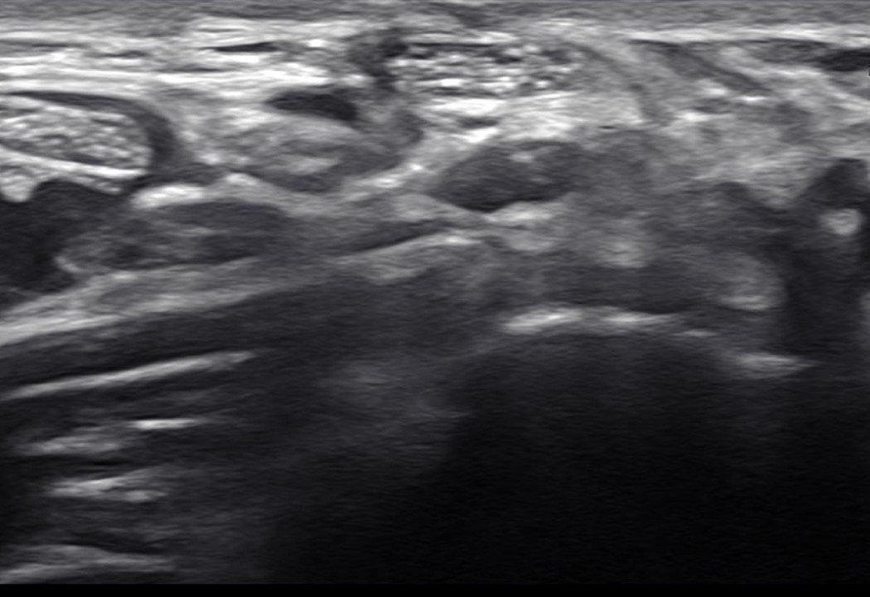
Palmaris longus
Persistent median artery
Median Nerve

Slide 6
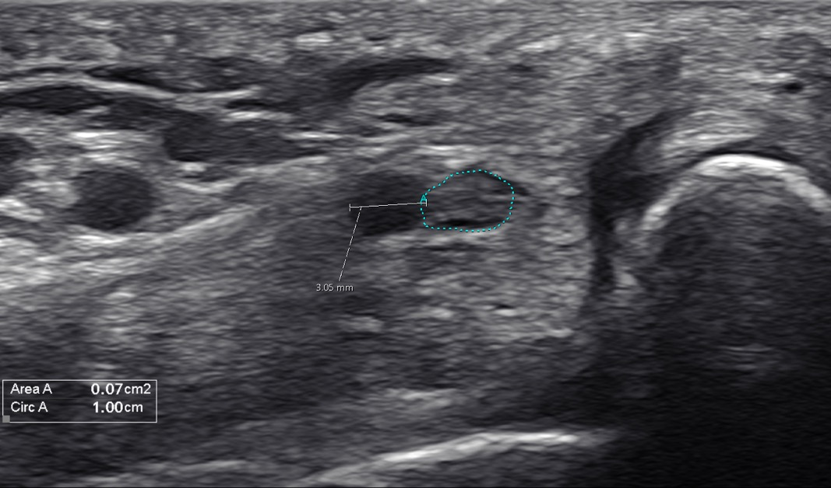
Median nerve
Radial artery
Persistent median artery
Level of pisiform at wrist

Slide 7
