Slide 1
Ken Schreibman, PhD/MD, FACR
Teleradiologist (ERs in OH)
Orlando, FL, USA

Slide 2
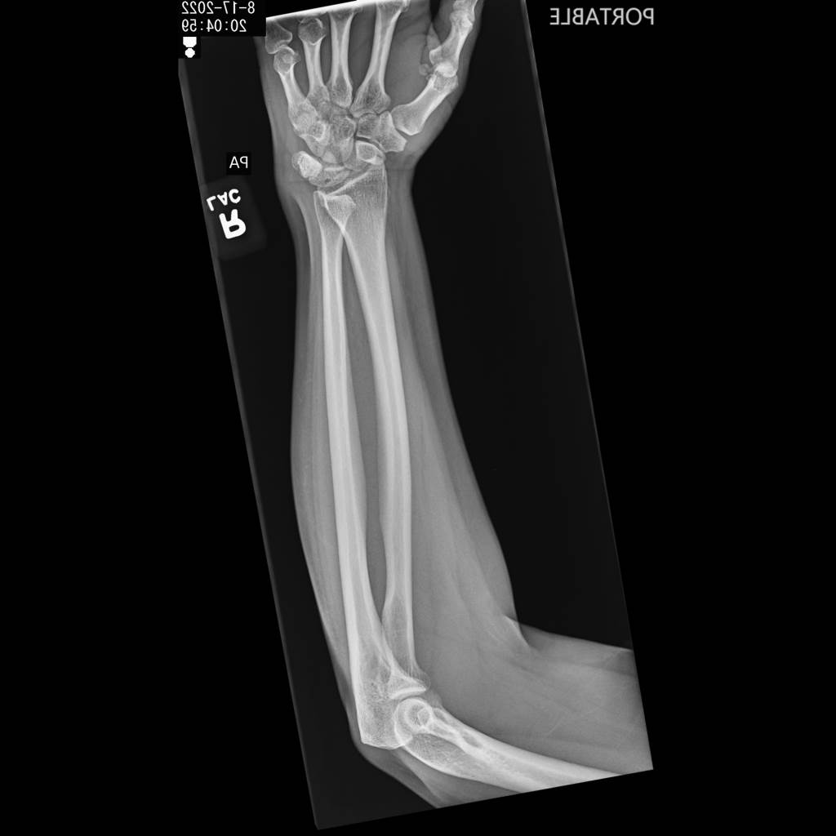
Clinical Information
From the technologist:
42yoF, fell on right arm today
Unable to turn wrist
1st image shot PA
2nd image shot “crossfire”
Best images possible
Report (MSK radiologist)
No acute osseous finding
Given clinical history, follow-up dedicated wrist series suggested, c/w priors
Do they use this term at your place?

Slide 3
IMAGING
5 years earlier:
Do they shoot wrists with the fingers flexed at your place?

Slide 4
further IMAGING
Isolated Traumatic Dislocation of the Distal Radio-Ulnar Joint
(DRUJ)
Wrist Series? ❌
Wrist CT? ✅
CT Scout
Axial CT

Slide 5
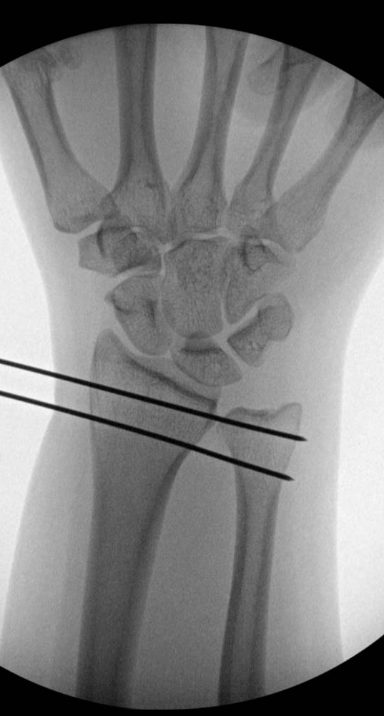
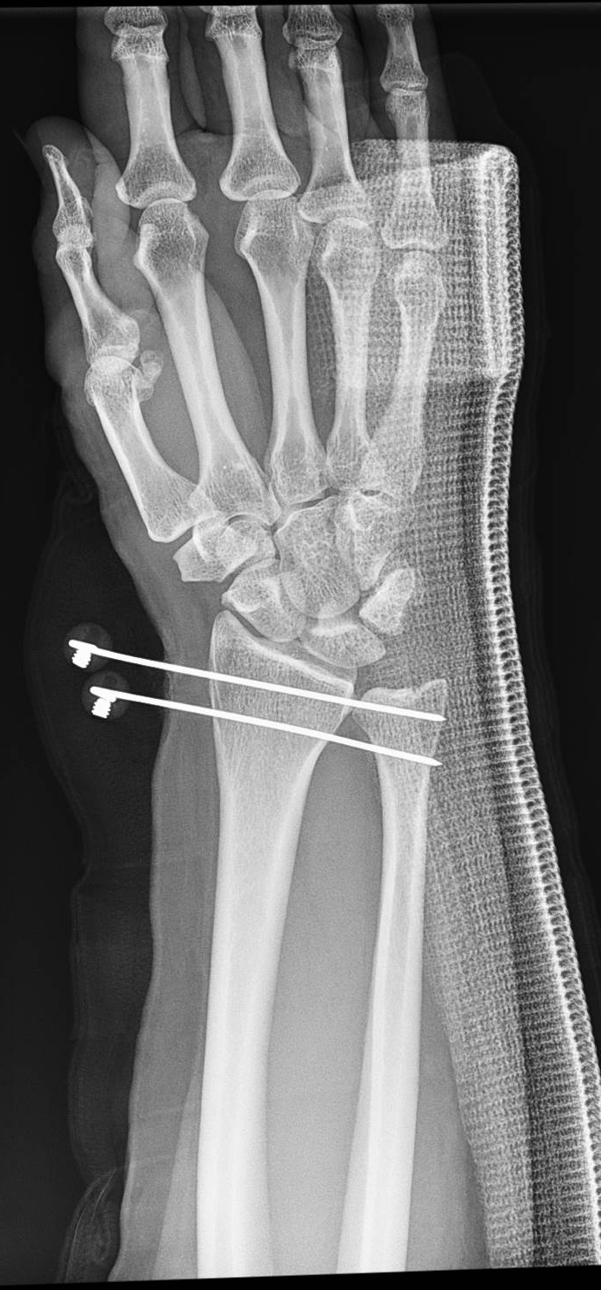
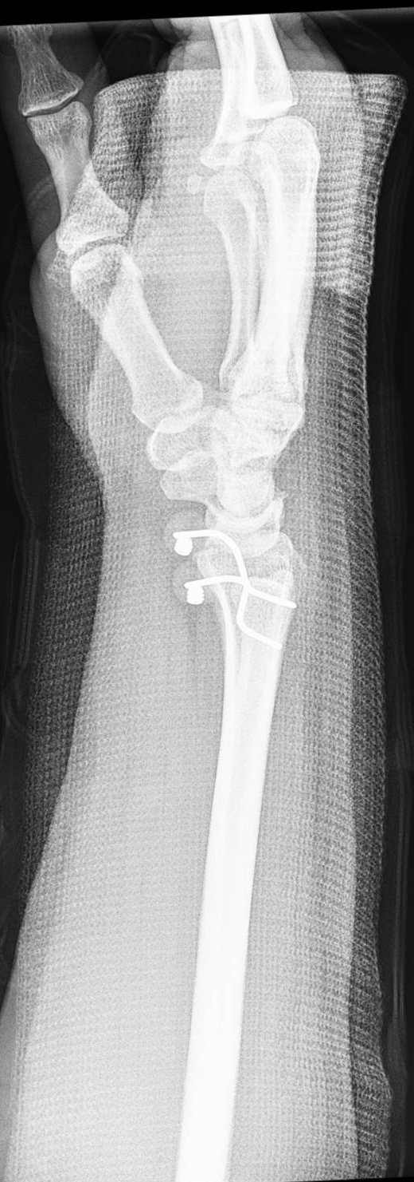
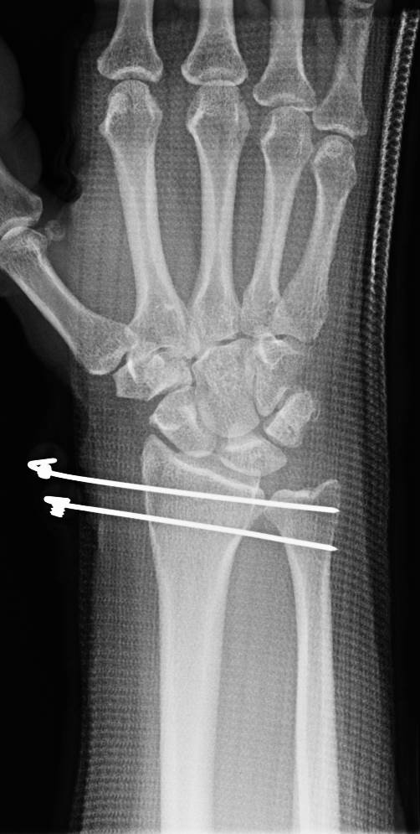
Treatment
@2 weeks:
@4 weeks:
@7 weeks:
Next Day:

Slide 6
Here’s what I was able to find out: Isolated dislocation of the DRUJ
1st identified by Desault 1777, in a cadaver Desault M. Extrait d’un memoire de M. Desault sur la luxation de Pextremite inferieure du cubitus.Chir.1791;1:78–87.
He clearly pointed out it is distal radius which dislocated on the ulna
Should be described as: “DRUJ dislocation – ulna dorsal” or “DRUJ dislocation – ulna volar”
Dameron 1972: ½ dorsal, ½ volar (10 patients) Clinical Orthopaedics and Related Research 83():p 55-63, March 1972.
All the articles say:
This is a rare phenomenon (“0.02% of all bony injuries”)
50% missed
That’s all I got 🤷🏽‍♂️

