Slide 1
13M soccer player and runner
Anterior knee pain of relatively sudden onset while running
Pain relatively severe

Slide 2
Clinic note

Slide 4
Sagittal T2

Slide 5
T2 FS

Slide 6
Sagittal PDFS

Slide 7
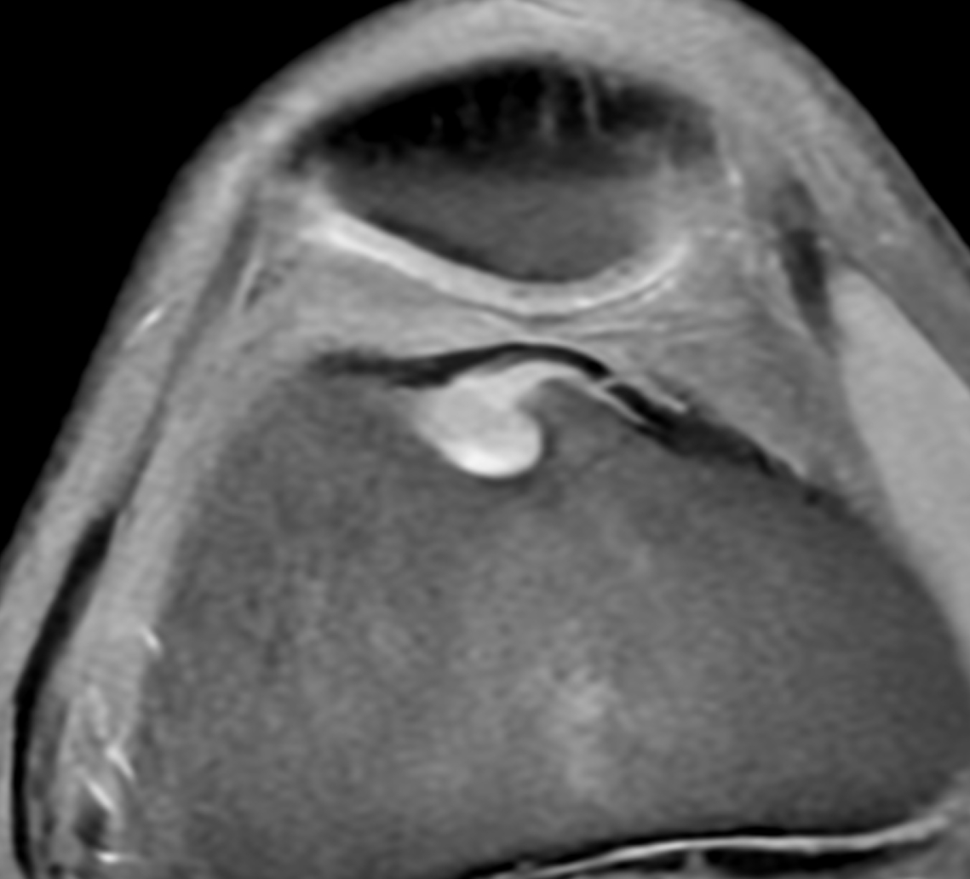
T1 FS pre-Gad
T1 FS post-Gad

Slide 8
T1 FS post-Gad

Slide 9
Cor T1
Cor T1 FS post-Gad

Slide 10
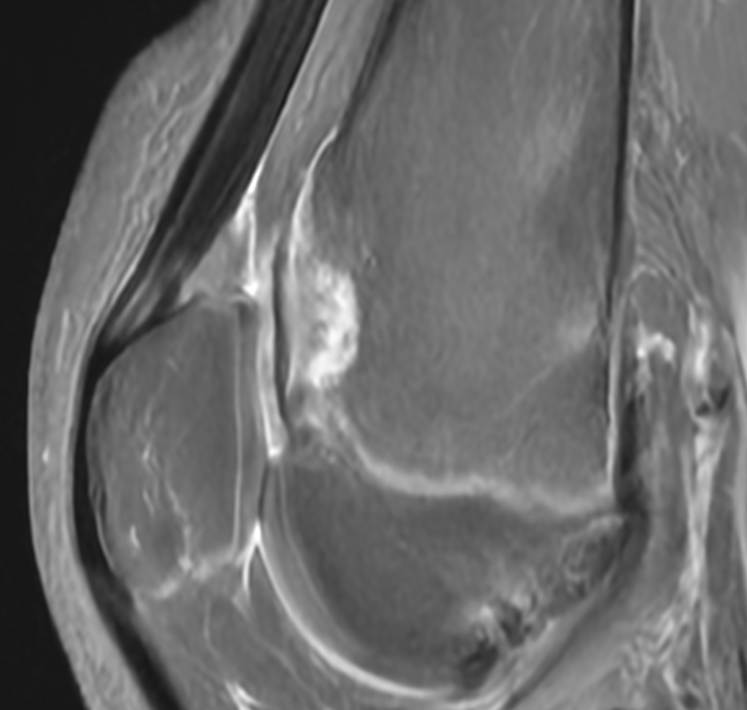
Sagittal T1 FS post-Gad

