Slide 1
26 year old with posterior ankle pain

Slide 2
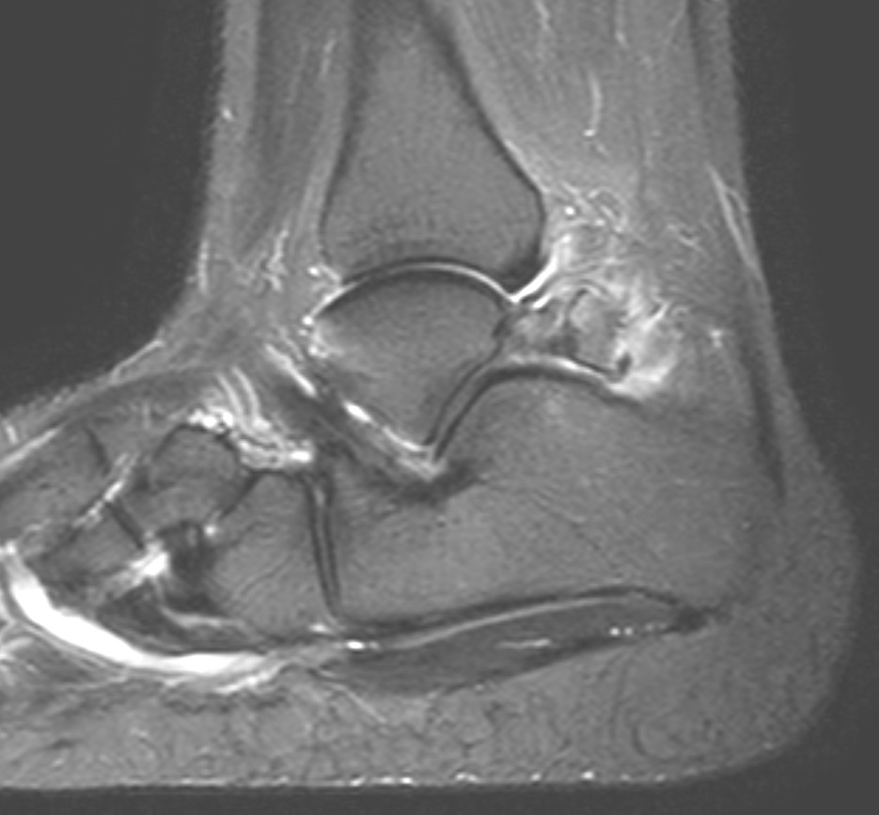
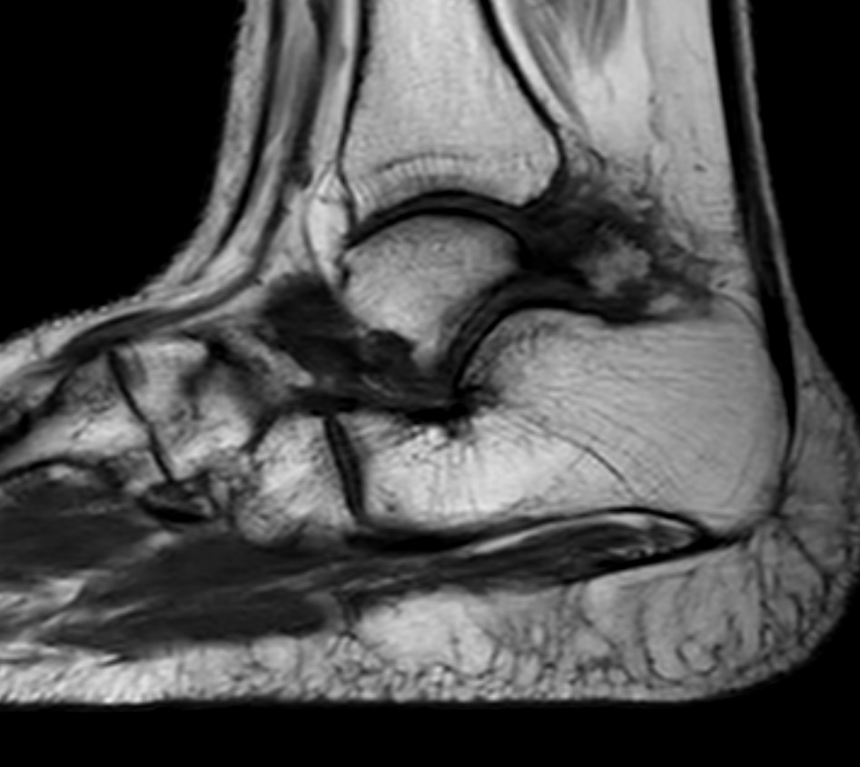
26 year old with posterior ankle pain

Slide 3
26 year old with posterior ankle pain

Slide 4
More proximal

