Slide 1
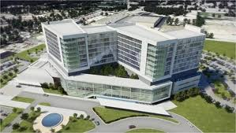
Enjoy Facial nerve case

Slide 2
Right facial weakness. Left facial weakness before- improving. H/o prior Basal cell carcinoma

Slide 3
What do you see?

Slide 4
What do you see?

Slide 12
ADC= 1.2

Slide 13
3D

Slide 15
Left facial and IAN

Slide 16
Right facial

Slide 17
Right facial- zygomatic

Slide 18
IAN right

Slide 19
Right IAN

Slide 20
Right IAN and b/l facial

Slide 21
V2- maxillary- Report enclosed

