Slide 1
Brachial plexus TOS protocol

Slide 2
3D spine
Cervical spine:. Disc desiccation at all levels Alignment: Grade 1 pseudolisthesis at C2-C3 level Spinal Canal: Developmental stenosis absent. Atlantoaxial (C1-2) articulations: Mild degenerative changes C2-C3: Central canal: Patent Neural foramina: Right Normal Left Normal C3-4: Central canal: Patent Neural foramina: Right Normal Left Normal C4-5: Central canal: Patent. Perineural cyst on the right Neural foramina: Right Normal Left Normal C5-6: Central canal: Patent.. Mild disc bulge. Small perineural cysts bilaterally. Mild bilateral facet arthropathy Neural foramina: Right mild narrowing Left Normal C6-7: Central canal: Disc desiccation with diffuse bulge and effacement of the anterior and posterior CSF. Mild ligamentum flavum hypertrophy. Mild canal narrowing. Perineural cysts and bilaterally left facet arthropathy. Neural foramina: Right Normal Left moderate narrowing C7-T1: Central canal: Patent. Perineural cysts bilaterally Neural foramina: Right Normal Left Normal

Slide 3
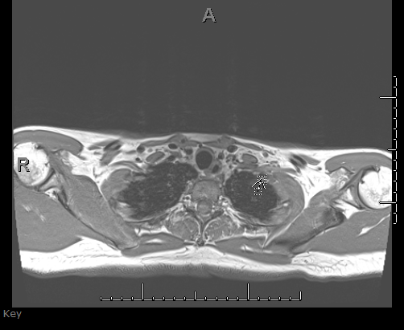
Axial T1W
Muscles/Tendons Scalenes: Normal Pectoral muscles: Mildly small on the left Bones Cervical ribs: Absent. Droopy neck morphology C7 transverse processes: Normal Marrow signal: Normal
Spaces Interscalene triangle: Mild curvature of the C8 nerve roots as they course of the distal scalene triangle into the costoclavicular space suggesting possible fibrous bands. Costoclavicular space: Effaced on the left Retropectoralis minor space: Normal in size

Slide 4
2D STIRs for segmental analysis

Slide 5
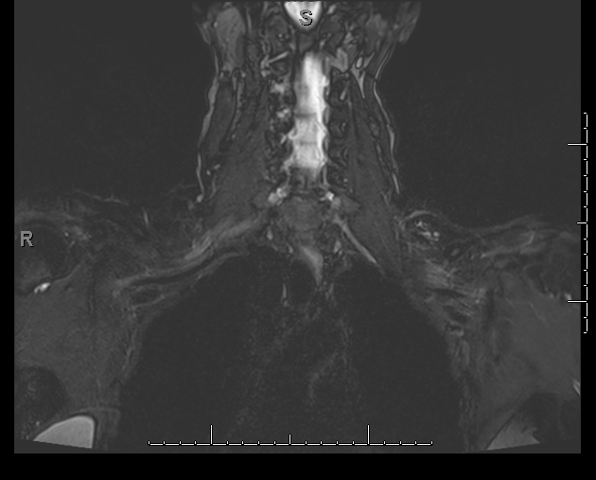
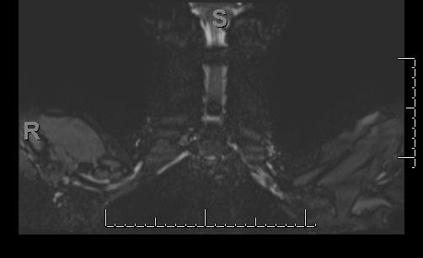
3D STIR- arms up and down

Slide 6
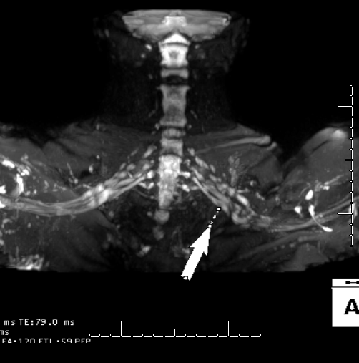
MIPS

Slide 7
Heat map
Nerves Spinal cord: Normal in signal and appearance Brachial plexus: Increased signal of the left C8 and T1 nerve roots at the costoclavicular space. Increased signal of the lower trunks bilaterally, left greater than right

Slide 8
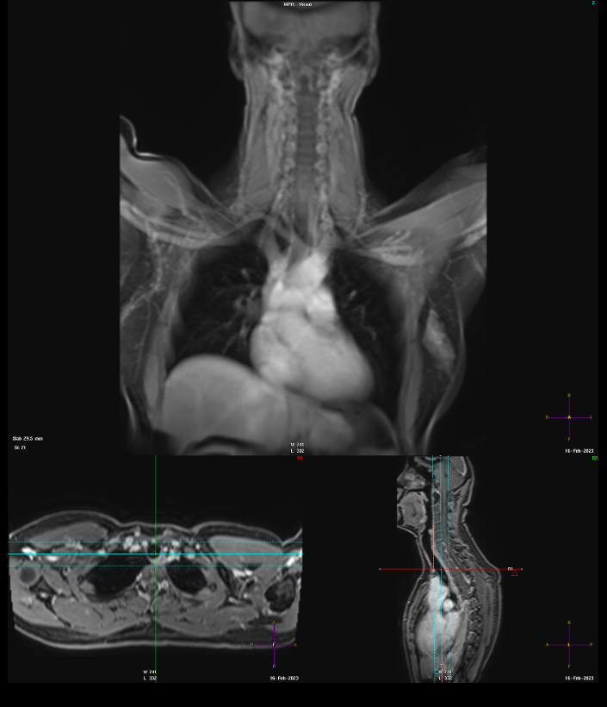
3D MRA_ Vessels: Mild venous compression of bilateral subclavian veins and mild kinking of the left subclavian artery at the level of the costoclavicular space without internal thrombus.

Slide 9
IMPRESSION: Findings of neurogenic and vasculogenic thoracic outlet syndrome, left greater than right. Droopy neck morphology, which can be confirmed on radiographs of the cervical spine NS-RADS: Nerve: E2 - Moderate entrapment, Muscle: M0 - Normal

