Slide 1
Middle aged patient, anterior knee pain

Slide 2
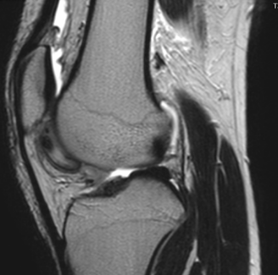
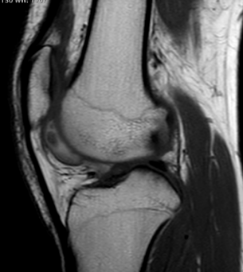
T2
T1

Slide 3
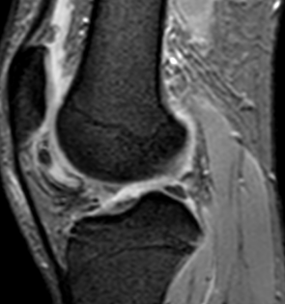
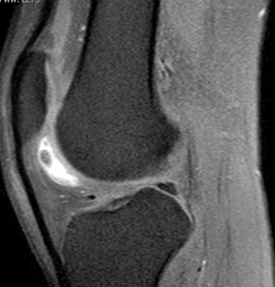
Pre gad
T1 FS Mostly pseudohyperintensity
GRE

Slide 4
CT negative for fat or calcification

Slide 5
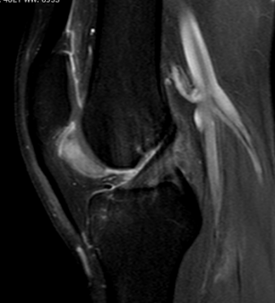
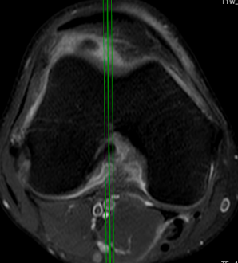
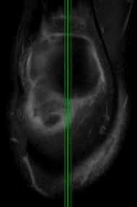
POST GAD

Slide 6
Thoughts?

