Slide 1
CLINICAL DETAILS
40/F
Lower back pain with right radiculopathy x 3 months.
No h/o trauma/fever

Slide 2
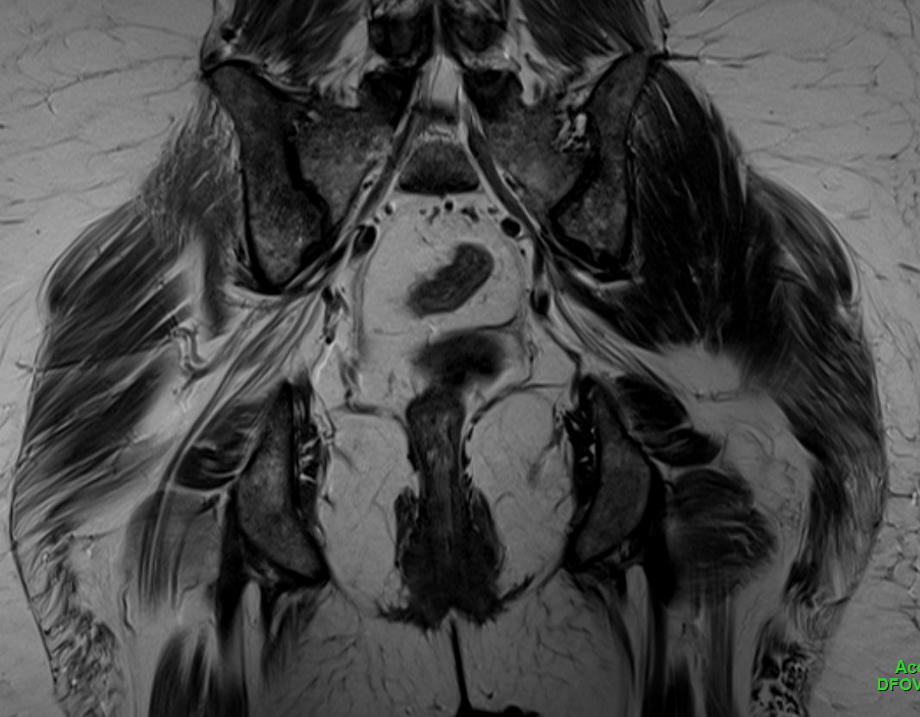
T2WI Coronal

Slide 3
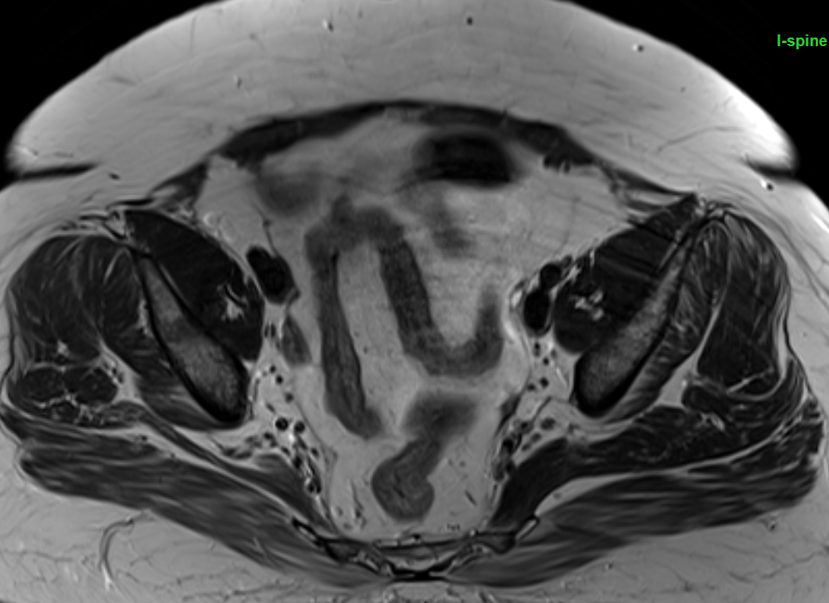
T2WI Axial

Slide 4
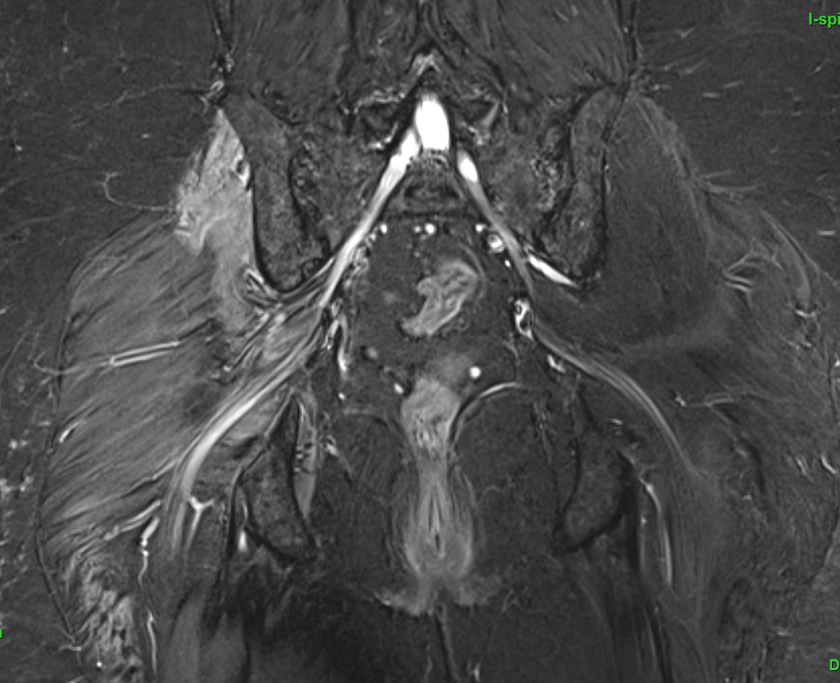
STIR CORONAL

Slide 5
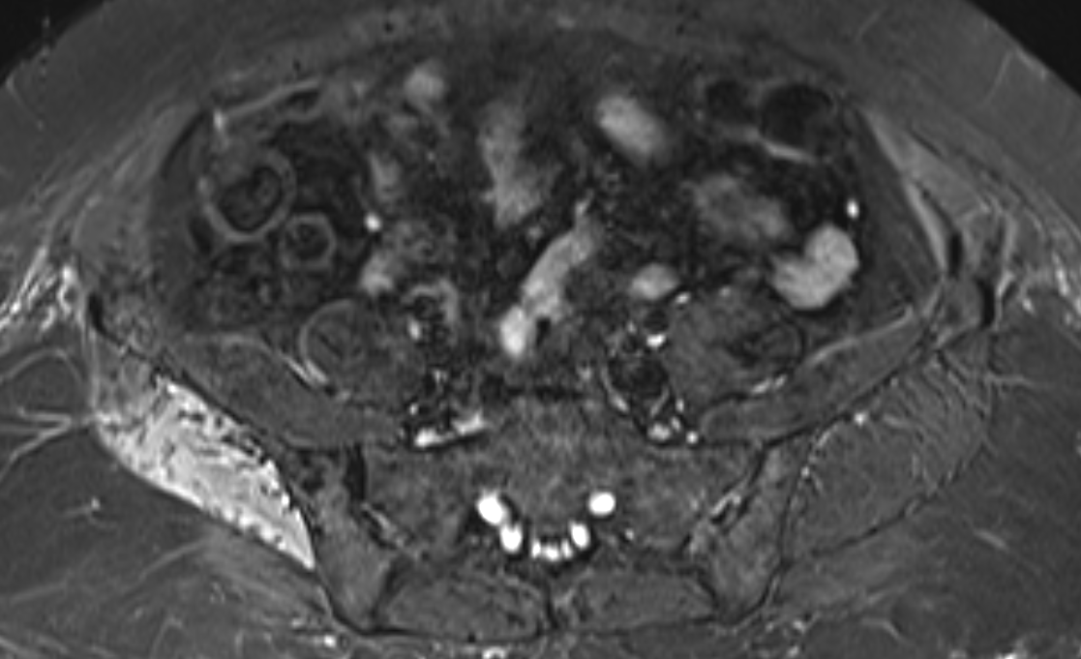
STIR Axial

Slide 6
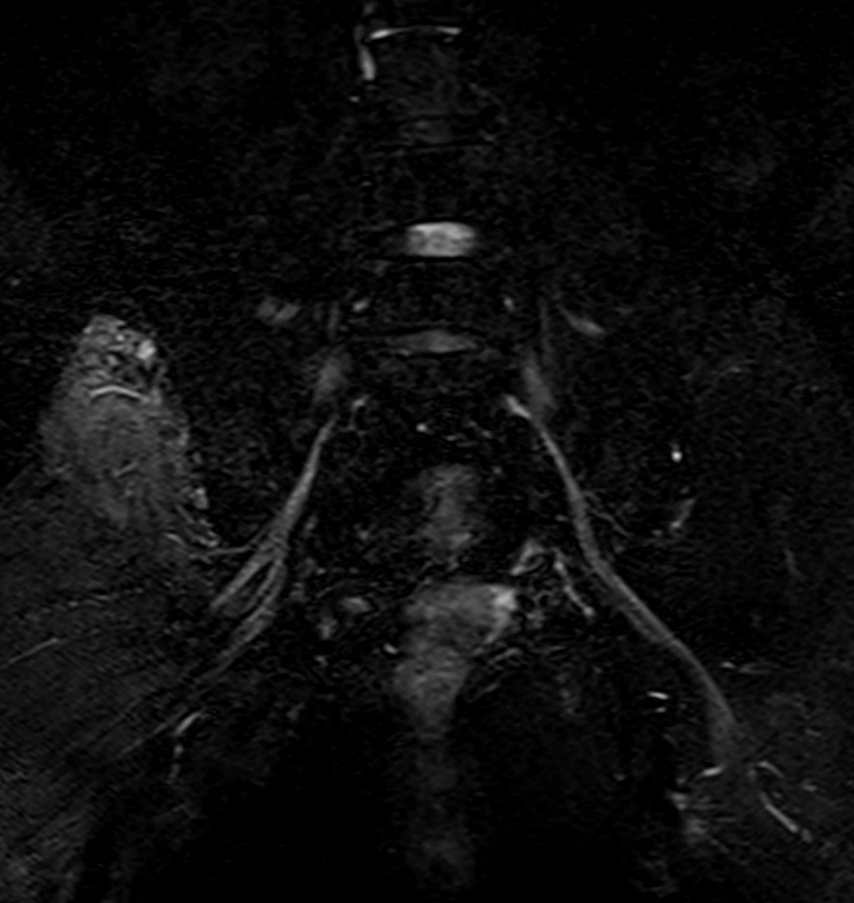
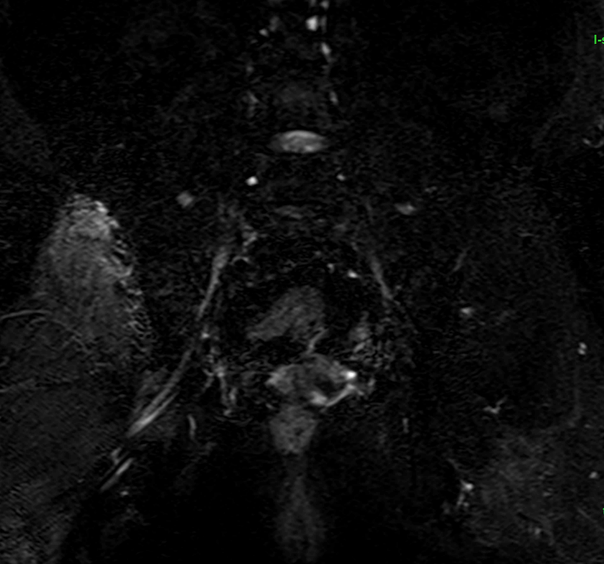
MIP

