Slide 1
74M with sudden onset of nontraumatic leg pain and swelling
Remote history of knee replacement and prostate cancer

Slide 2
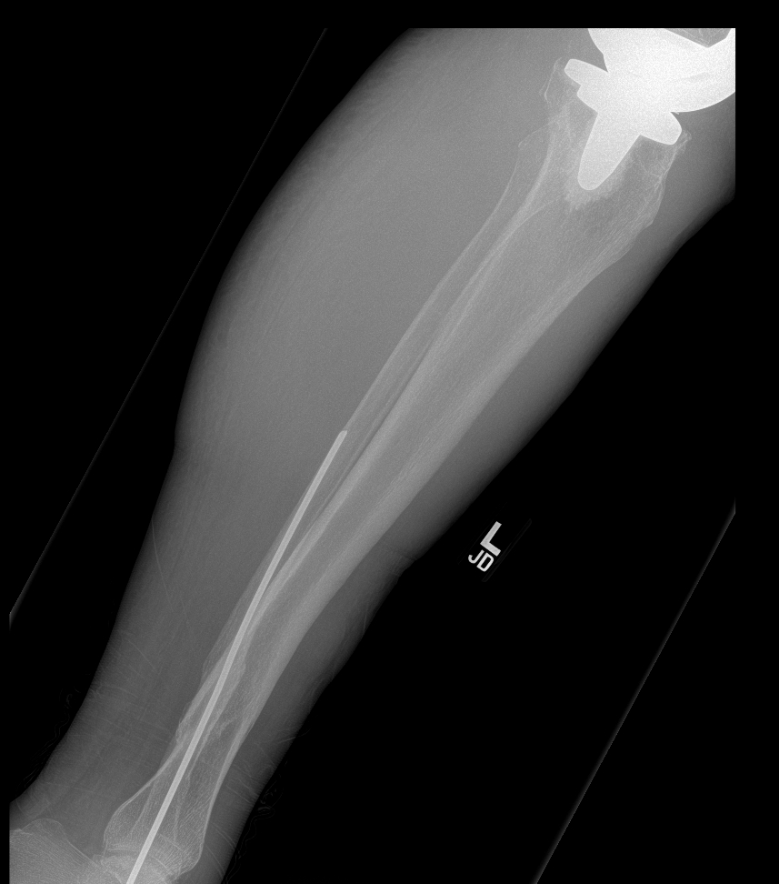
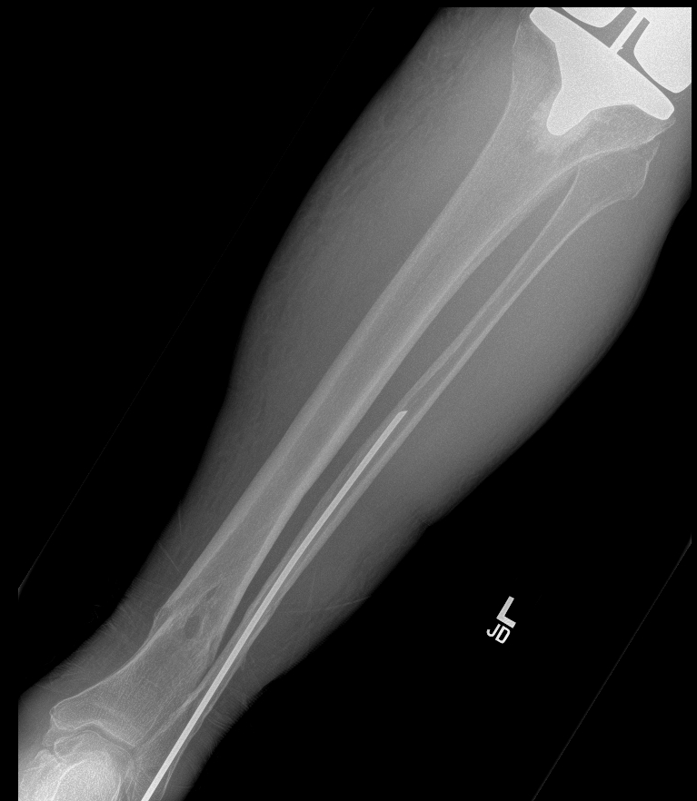
Radiographs “now”

Slide 3
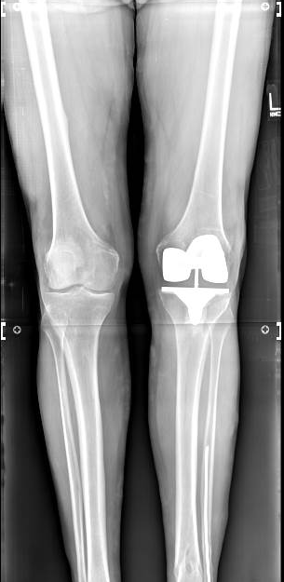
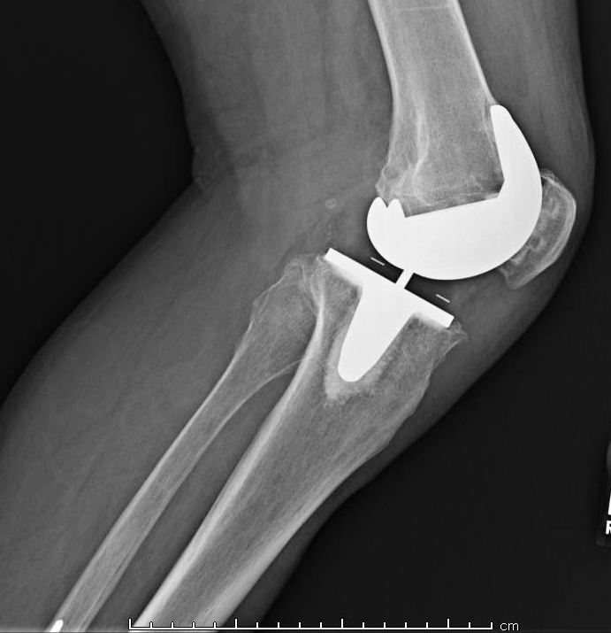
Radiographs 2months earlier

Slide 4
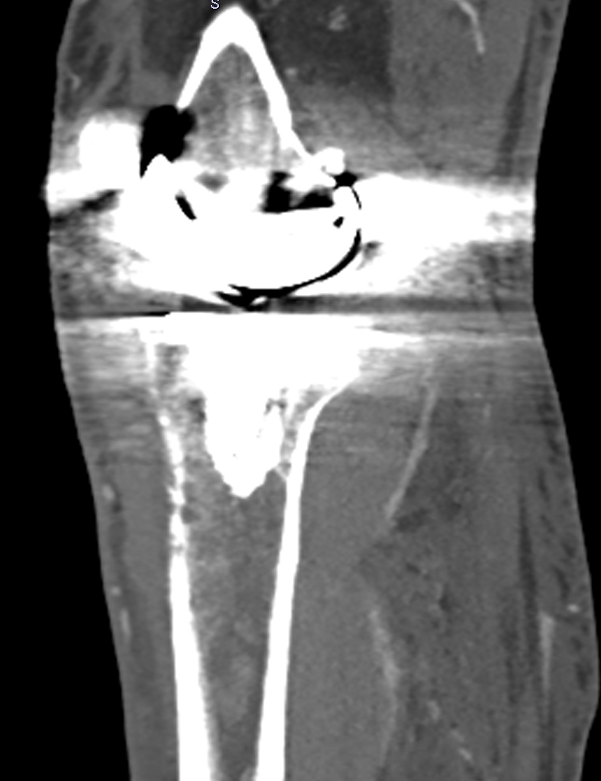
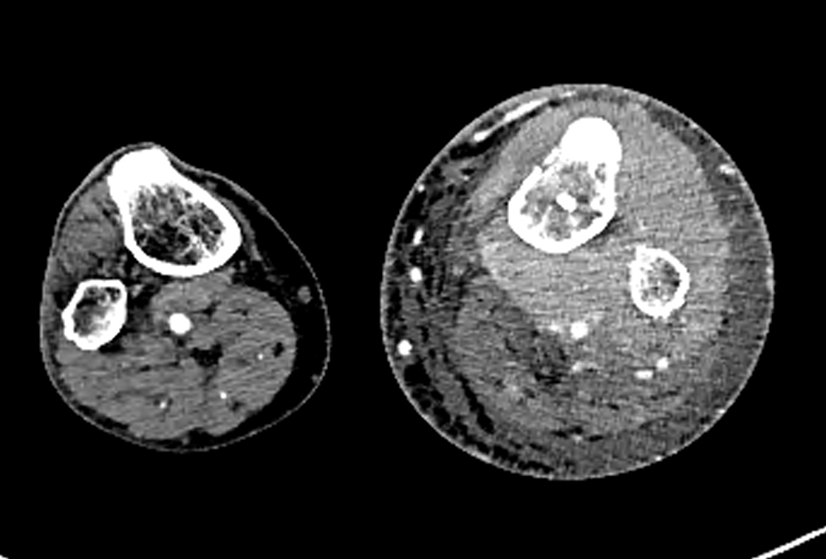
Symptoms were thought to be vascular; CT angio performed
Cortical breakthrough

Slide 5
At this point, someone showed me the case. Given the extensive infiltrative nature and increased CT density of the process without much architectural distortion, we were fairly confident this would be lymphoma.

Slide 6
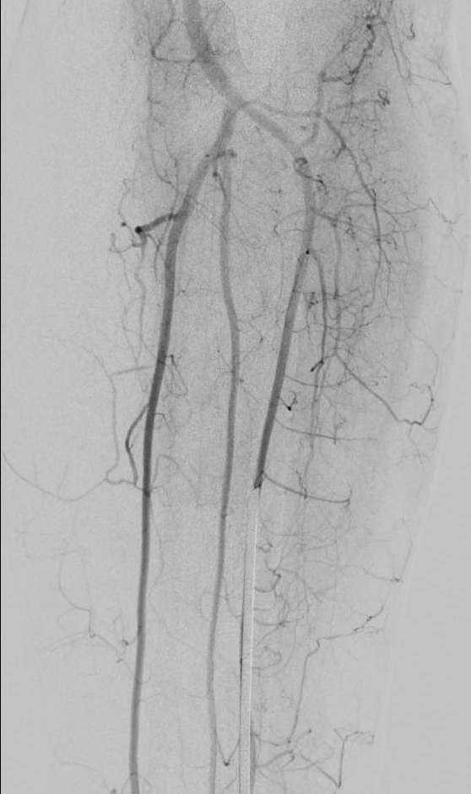
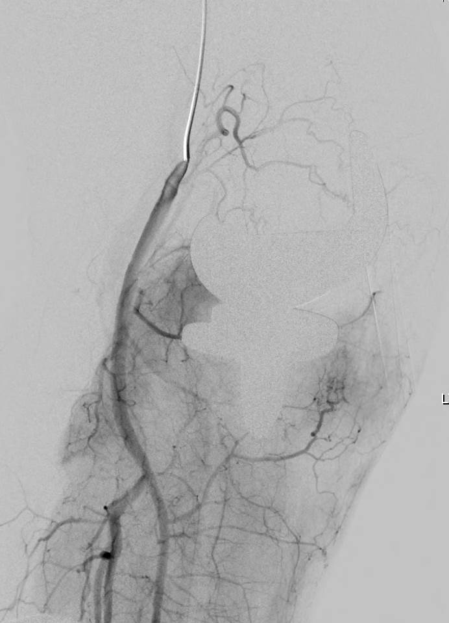
Which for some reason led to catheter angiography

Slide 7
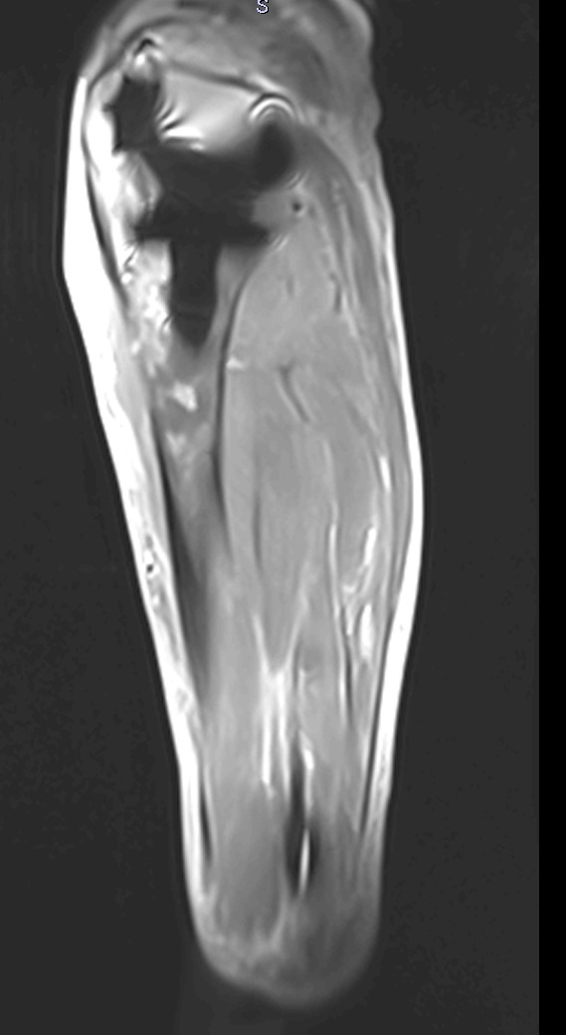
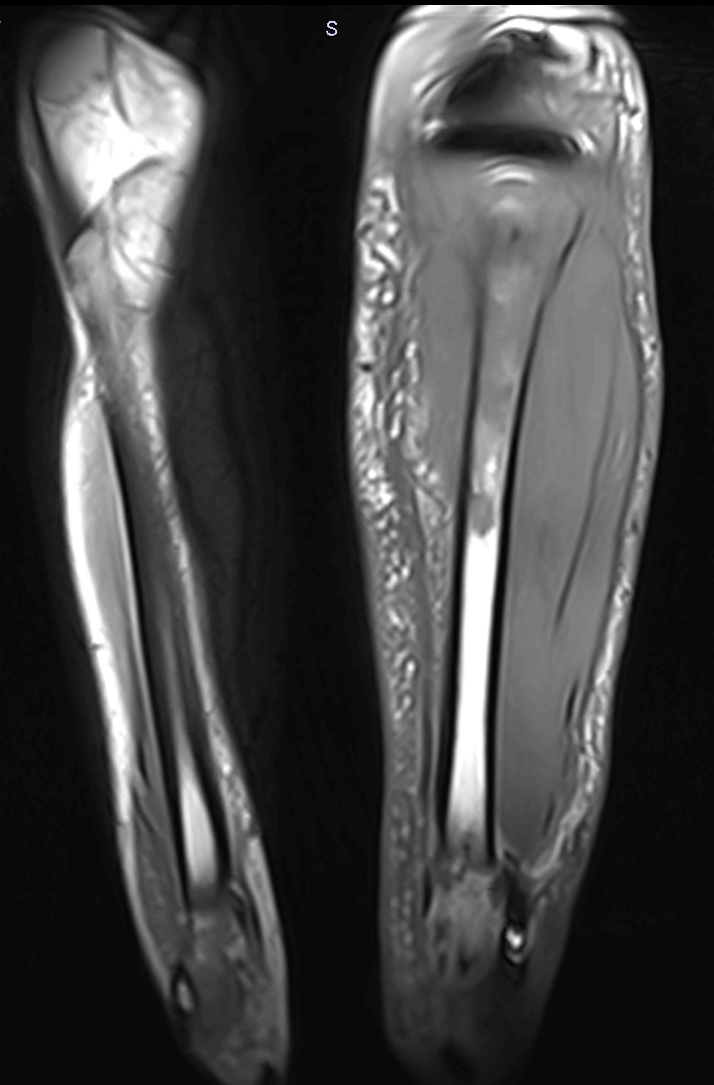
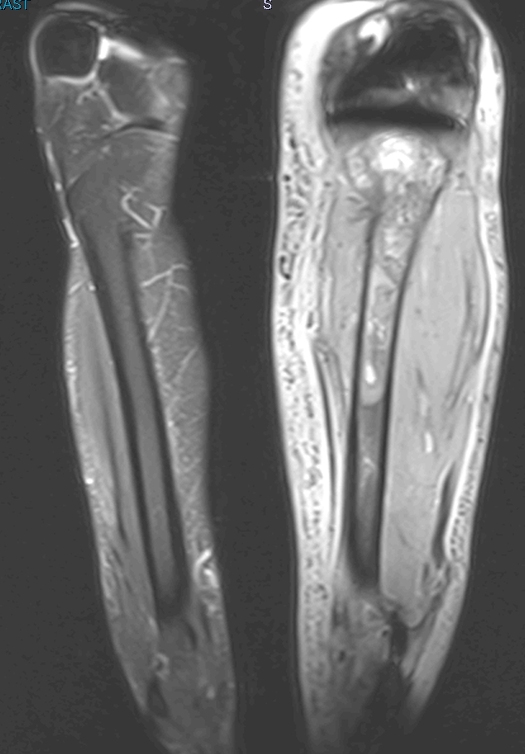
And finally, a “definitive” study
Cortical breakthrough
Coronal T1
Coronal STIR
Sagittal STIR

Slide 8
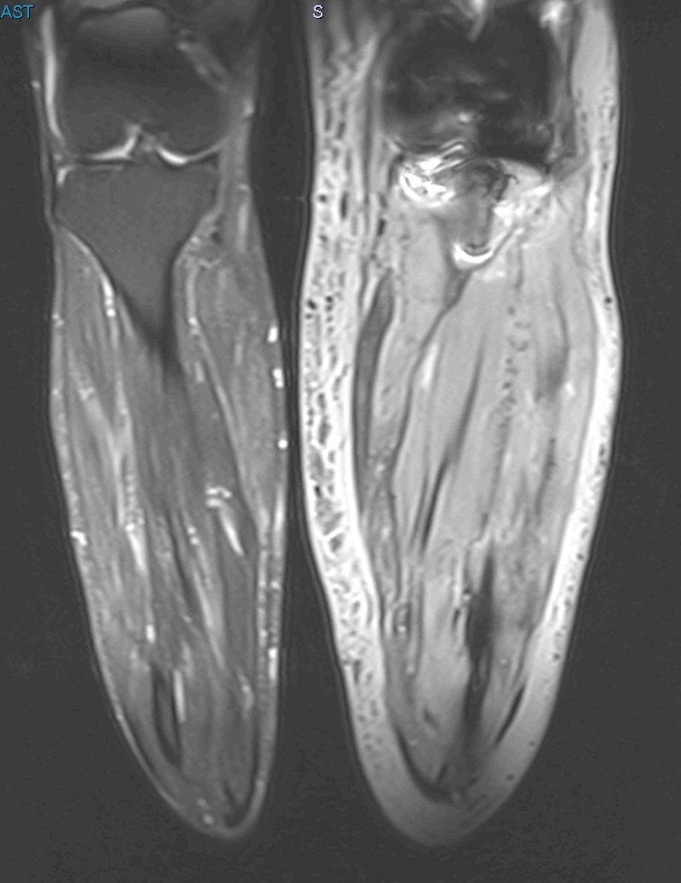
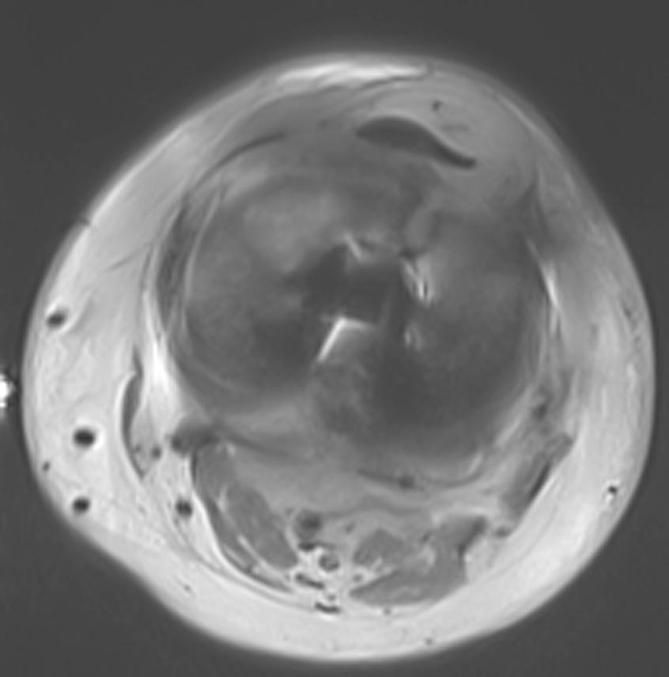
Coronal STIR
Axial T2

Slide 9
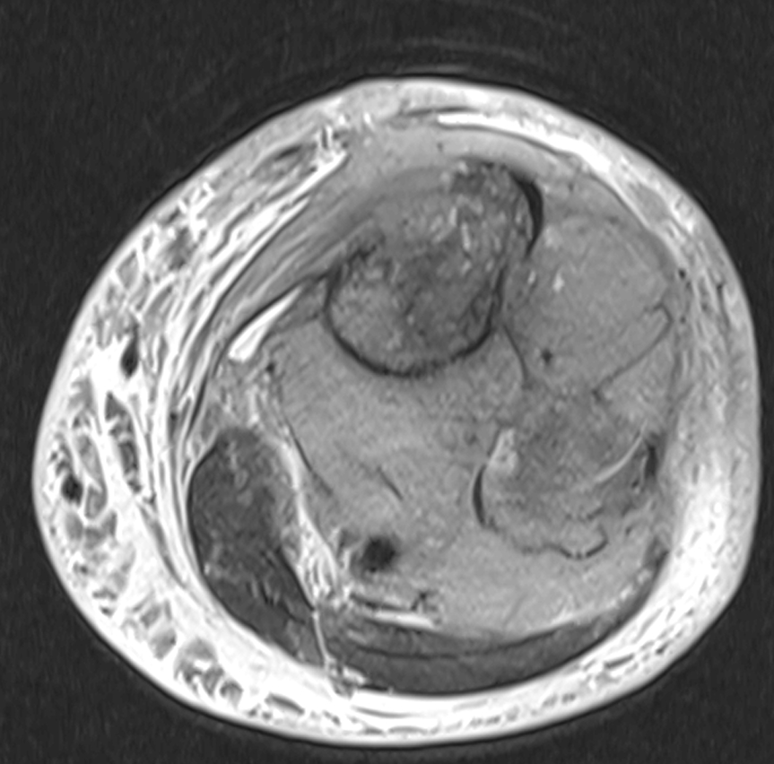
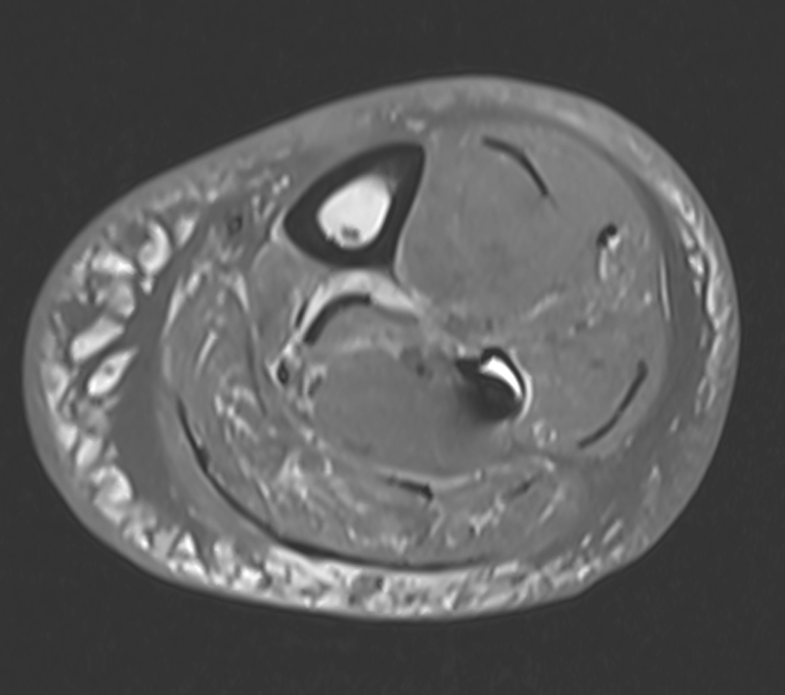
Cortical breakthrough
Axial T1
Axial STIR

Slide 10
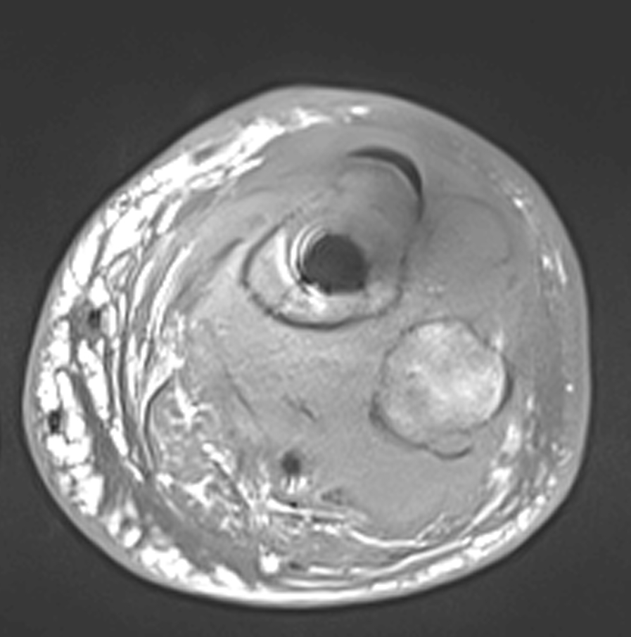
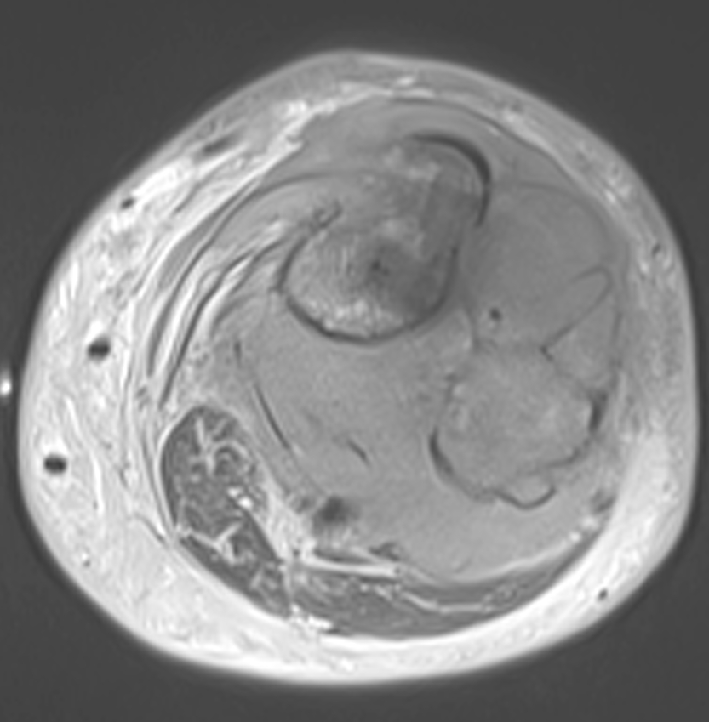
Axial T2

Slide 11
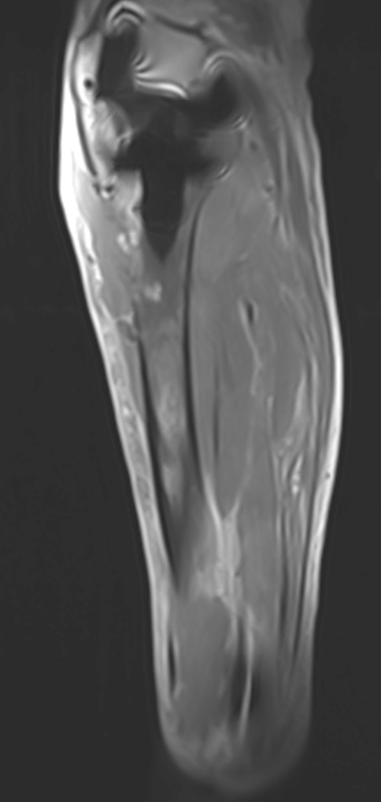
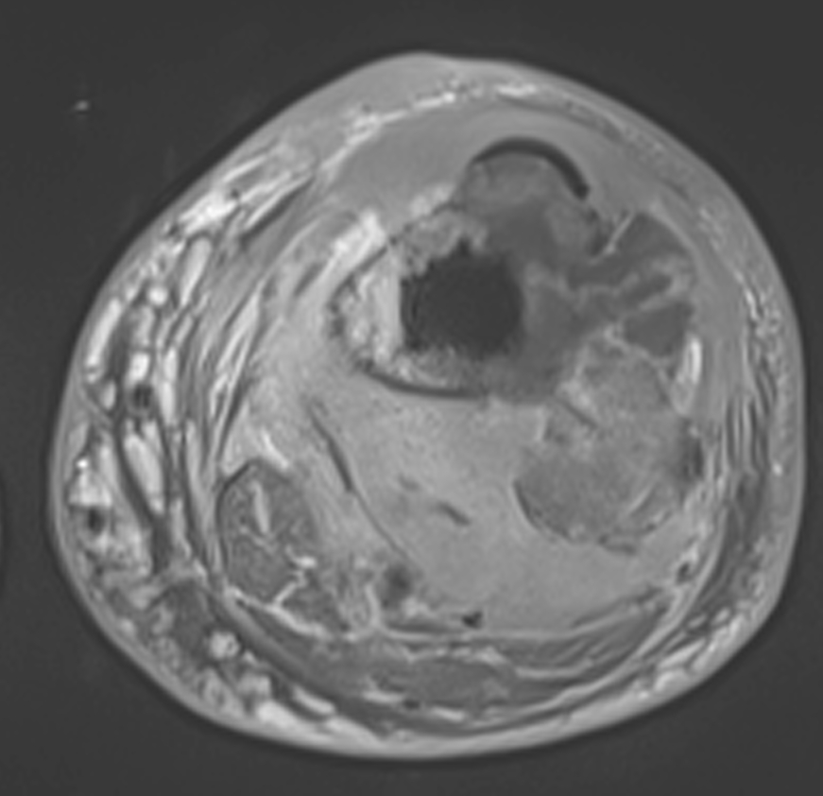
Sagittal T1 FS post Gad
Axial T1 FS post Gad

Slide 12
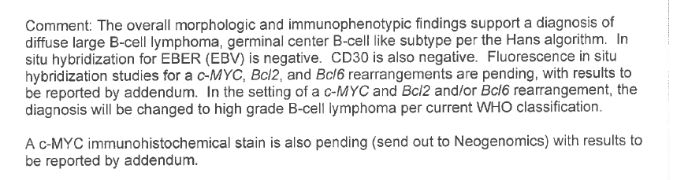
Biopsy Diagnosis
Diffuse large B-cell lymphoma

Slide 13
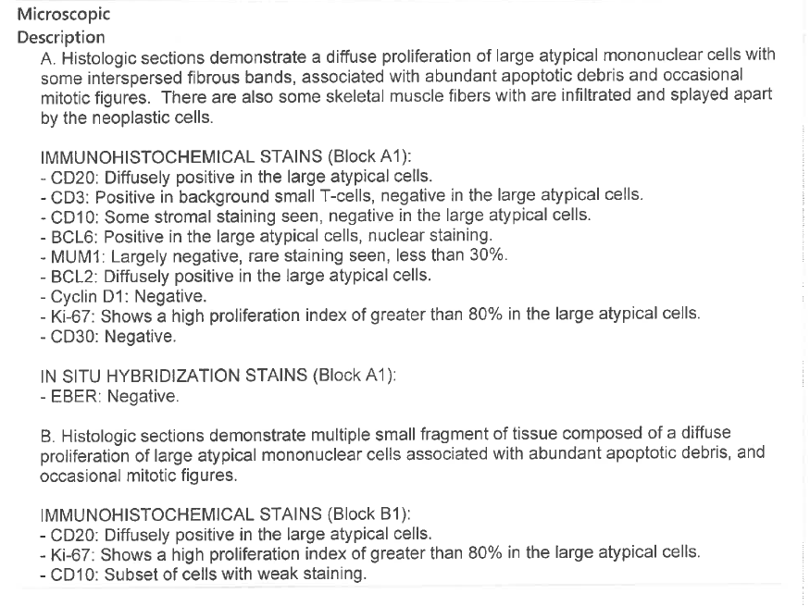

Slide 14
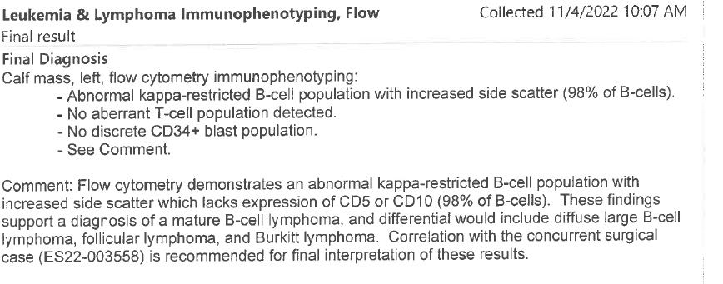

Slide 15
Sorry Mark Murphey, I don’t have the gross and histo slides yet

