Slide 1
15 years old teenager Healthy, No trauma, not a sport girl 6 months pain on the knee that has increase, now limping

Slide 2
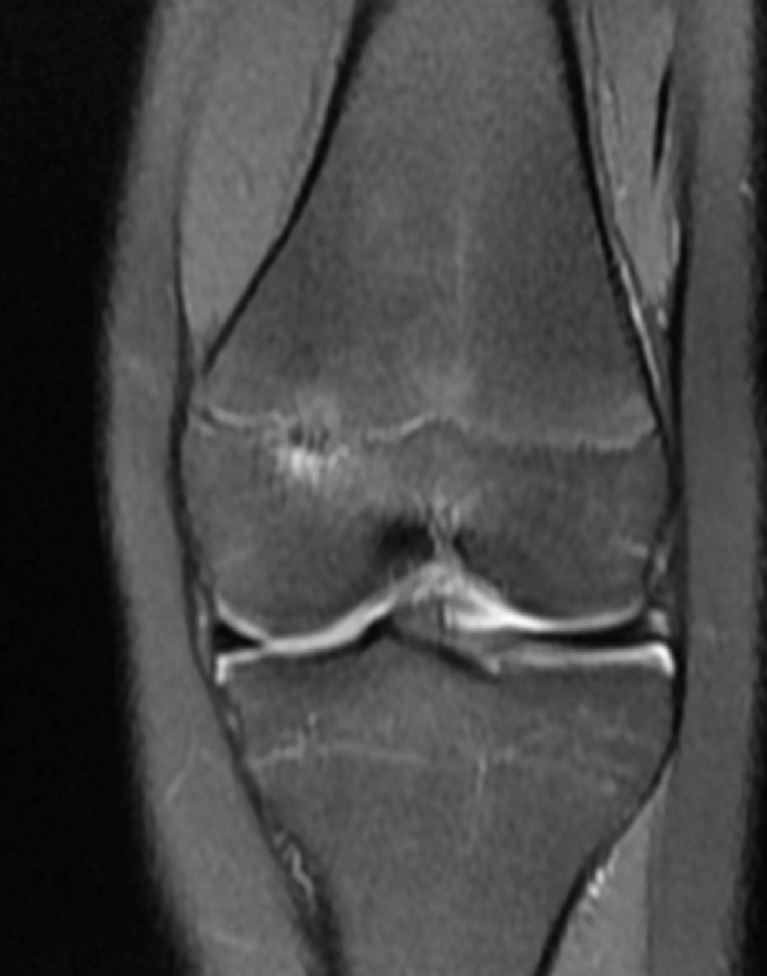
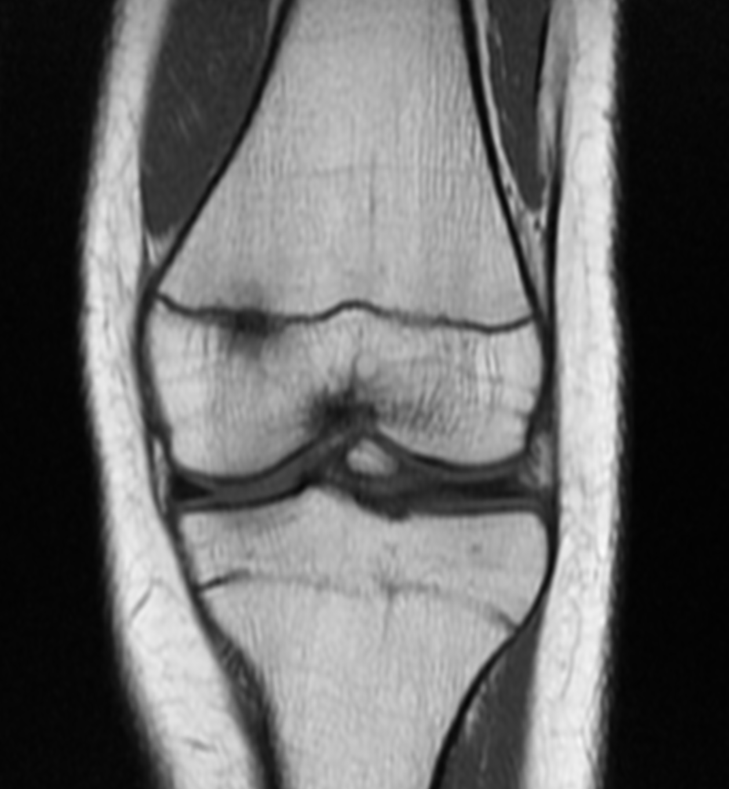
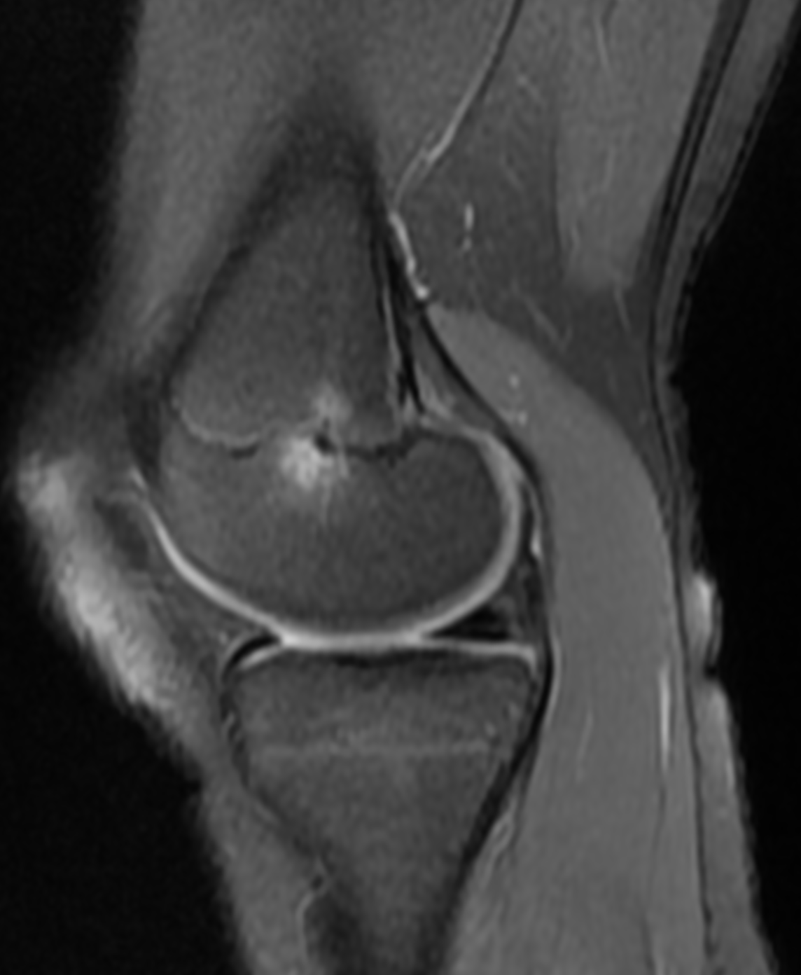
First MRI: date 5-4-2022

Slide 3
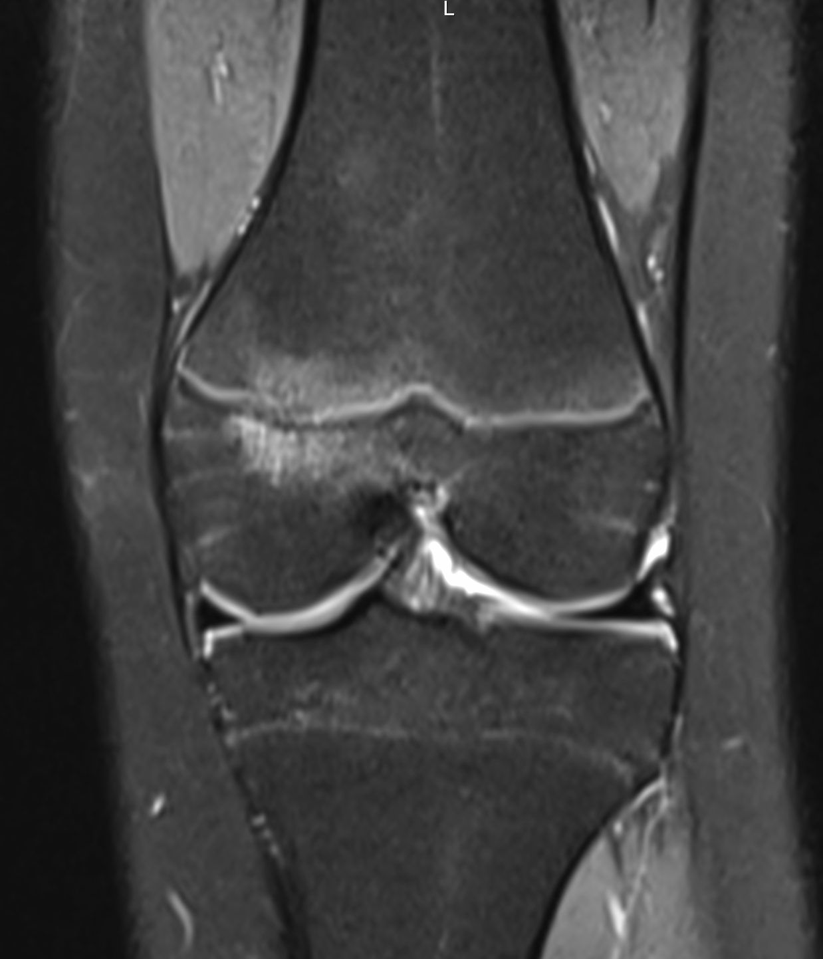
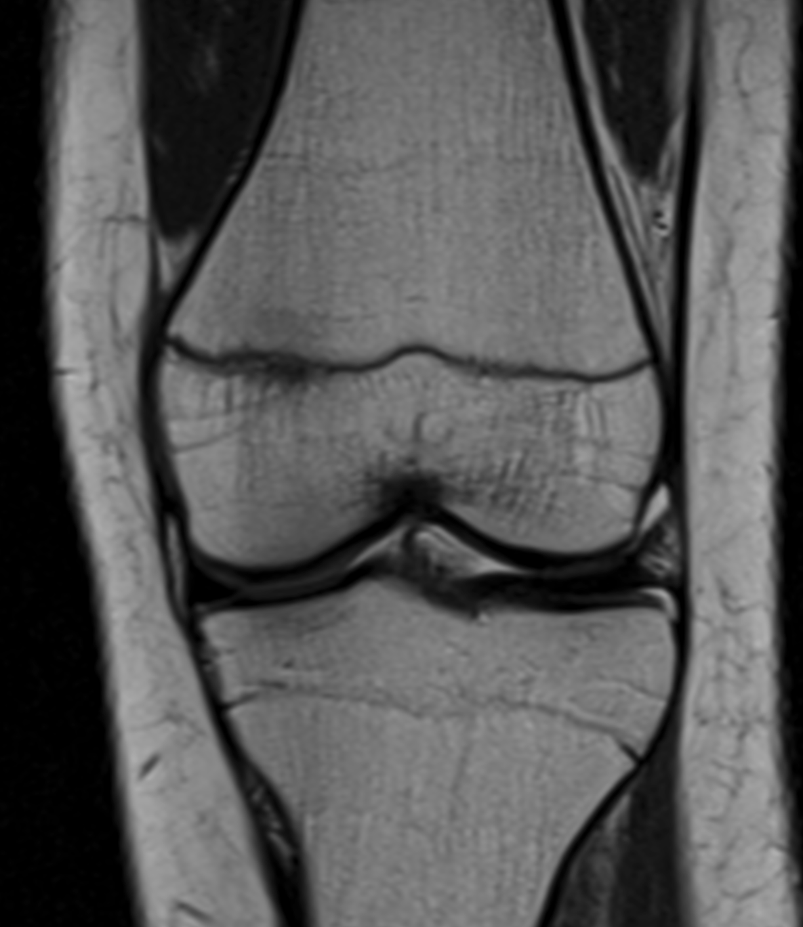
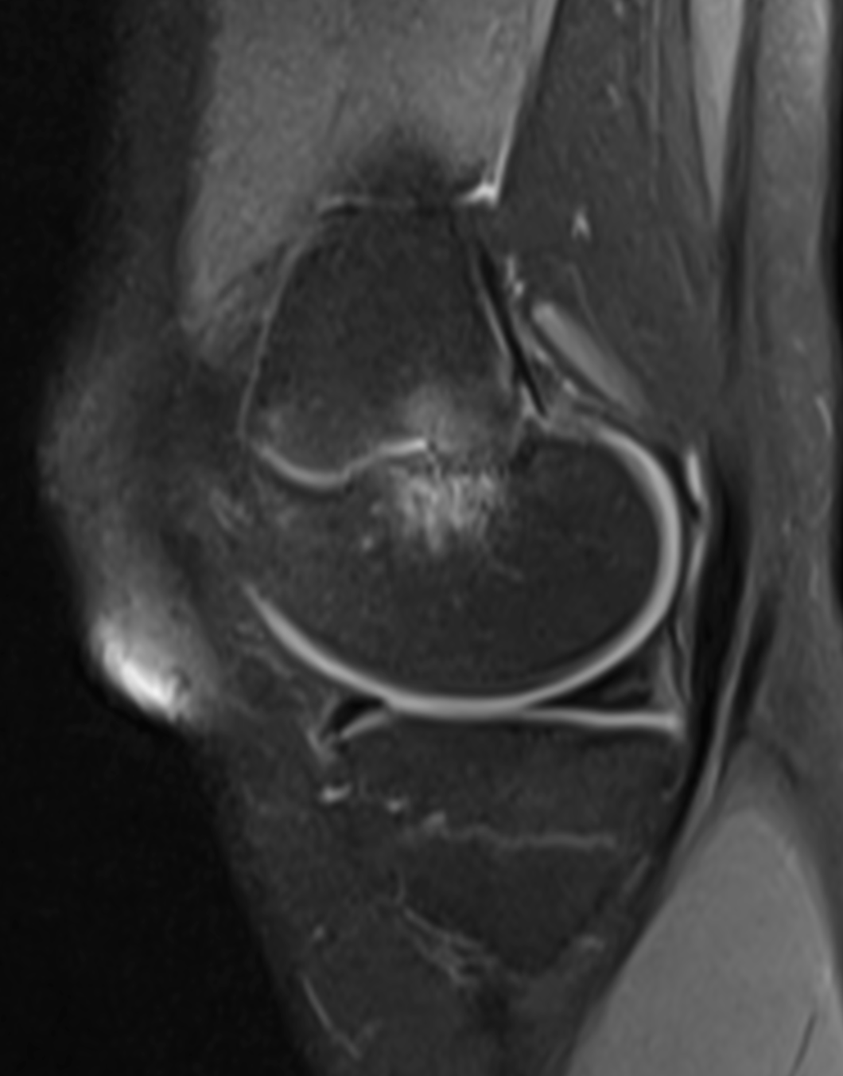
Following MRI: 10-31-2022

Slide 4
5-4-2022
10-31-2022

