Slide 1
64yr male，no primary tumor history. multiple bone destruction in cortex and medullary cavity of L4,L5,Pelvic and lower extremity. And high density can be found in the destructed area in cortex. Biopsy result of right femoral medial condyle revealed fribroblast cell and multinuclear giant cell. Bone scan is multiple foci with high-intake. At first I think brown tumor should be suspected. But normal blood calcium,phosphorus and parathyroid hormone and parathyroid ultrasound.No M-protein. Serum erythrocyte sedimentation rate and C-reactive protein abnormally increased. Please help! Thank you！

Slide 2
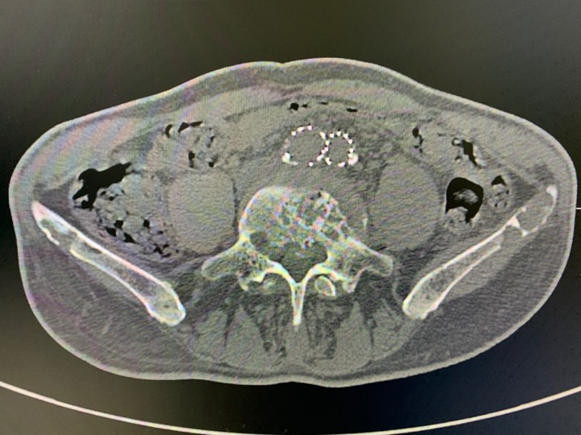

Slide 3
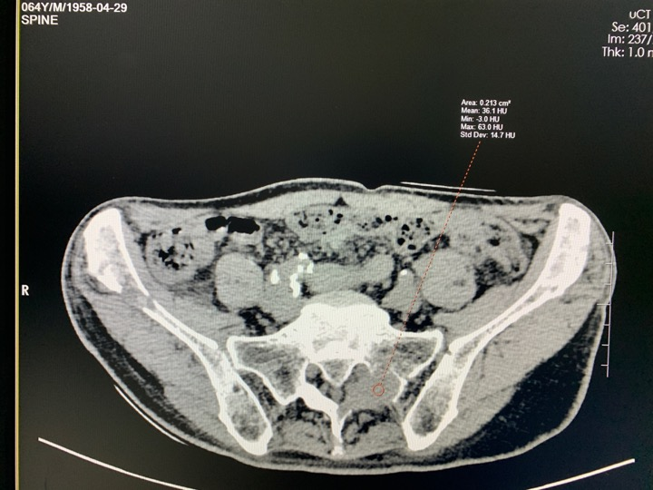

Slide 4
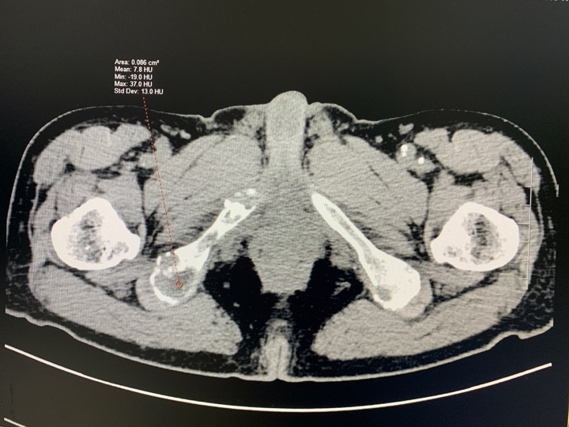

Slide 5
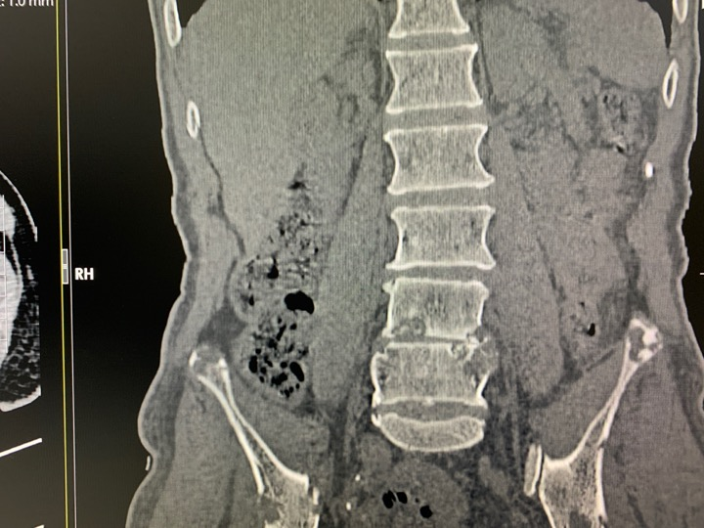

Slide 6
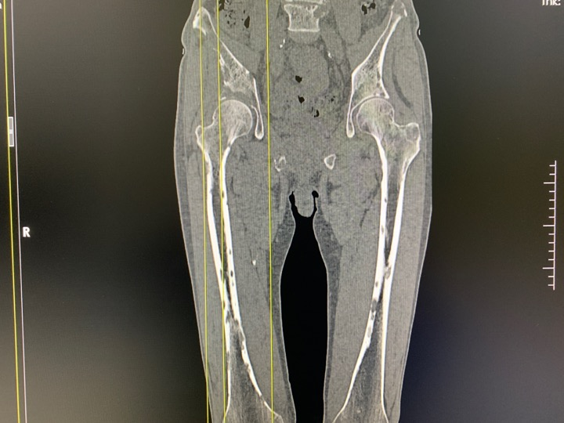

Slide 7
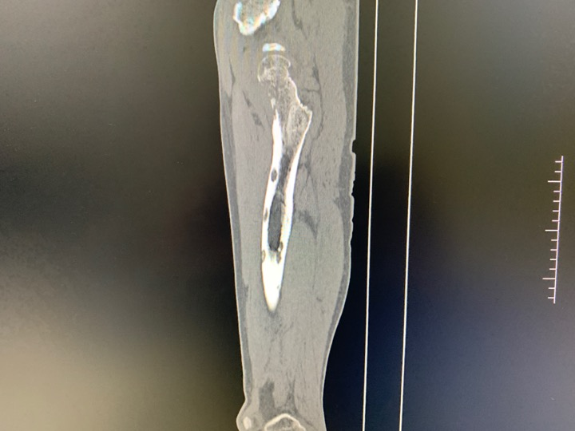

Slide 8
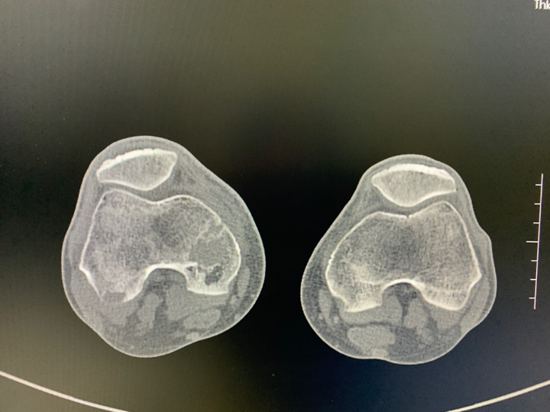

Slide 9
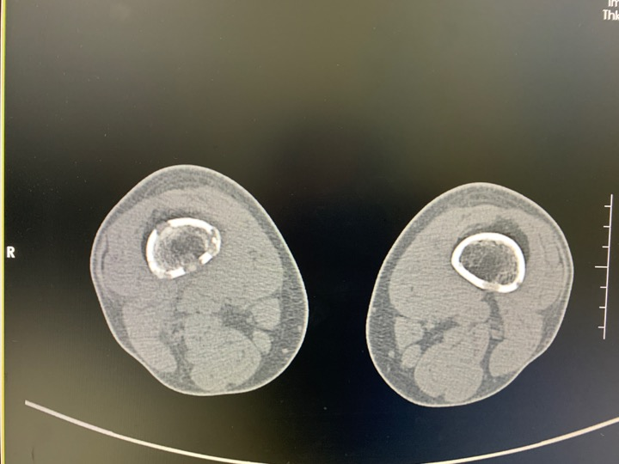

Slide 10
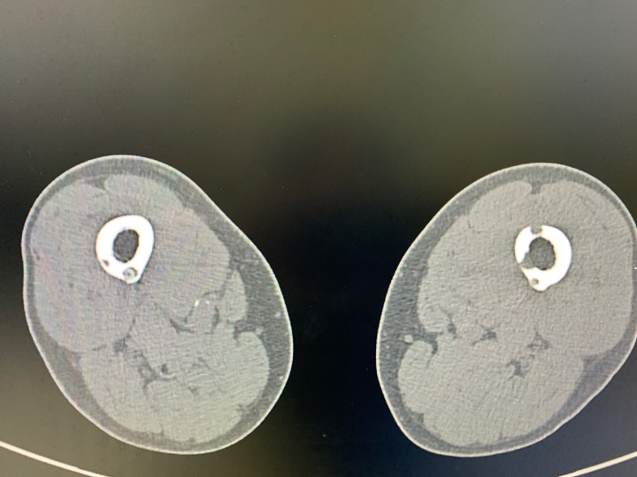

Slide 11
