Slide 1
Glenoid anchors usually around 11-1:00 best seen on Sag
Graft covers humeral head + apex, suture hole can be normal

Slide 2
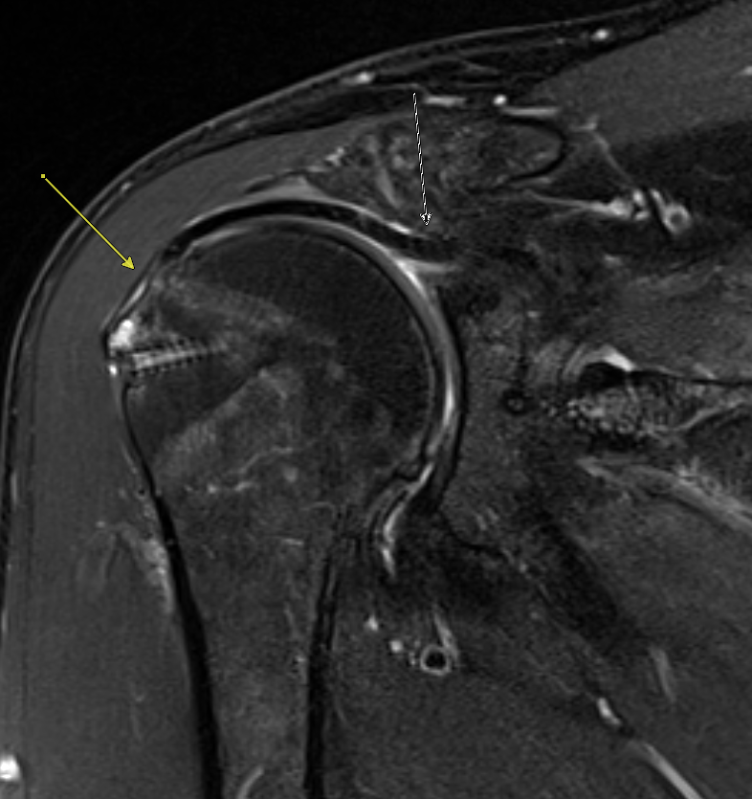
Intact humeral + glenoid attachment

Slide 3
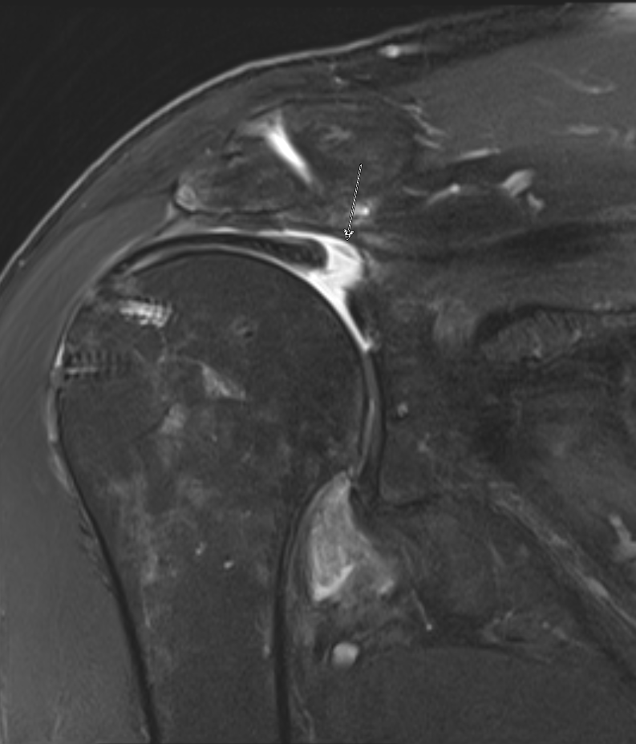
Graft failure at Glenoid attachment

Slide 4
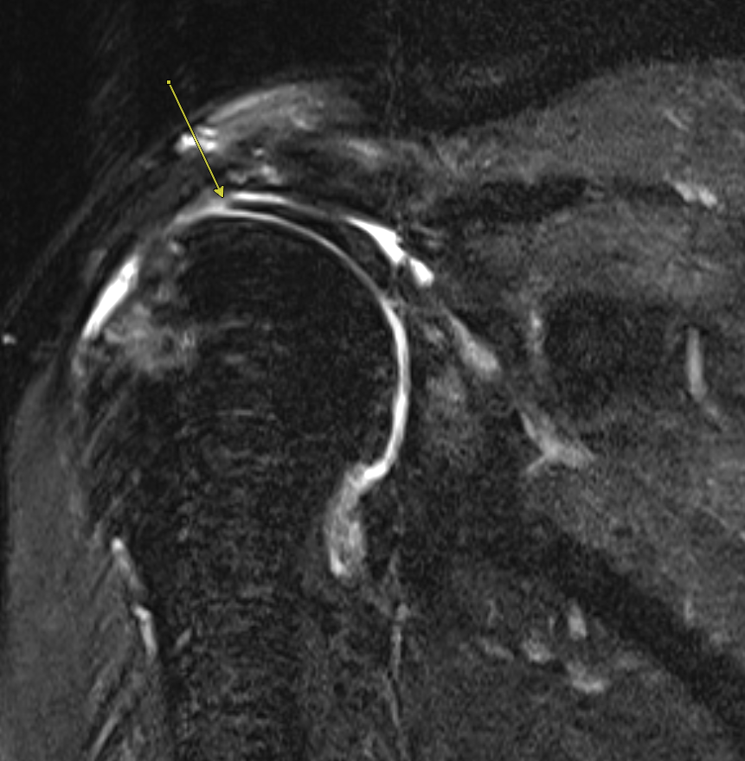
Graft failure at Humeral attachment

