Slide 1
Fem, 64y
Both knee MRI

Slide 2
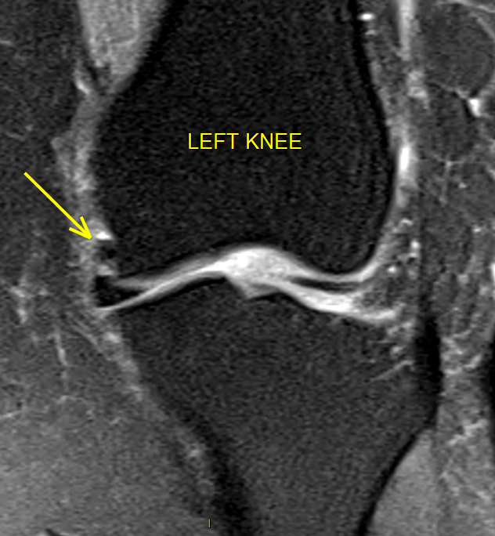

Slide 4
