Slide 1
58M status post fall

Slide 2
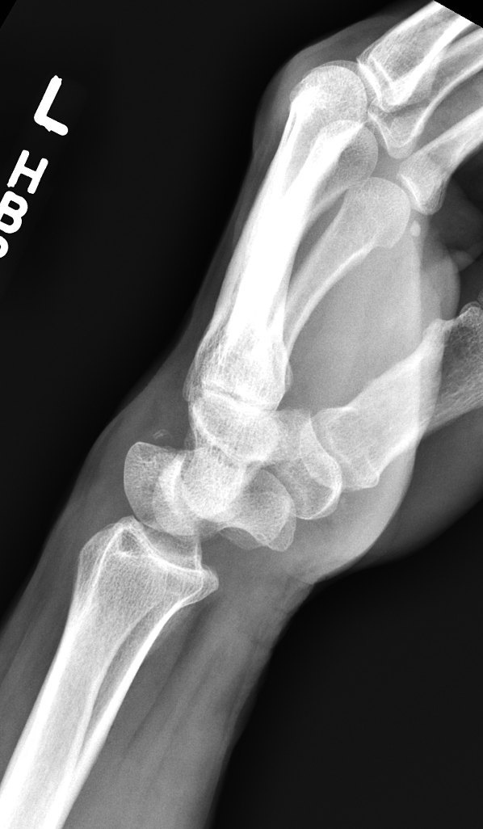
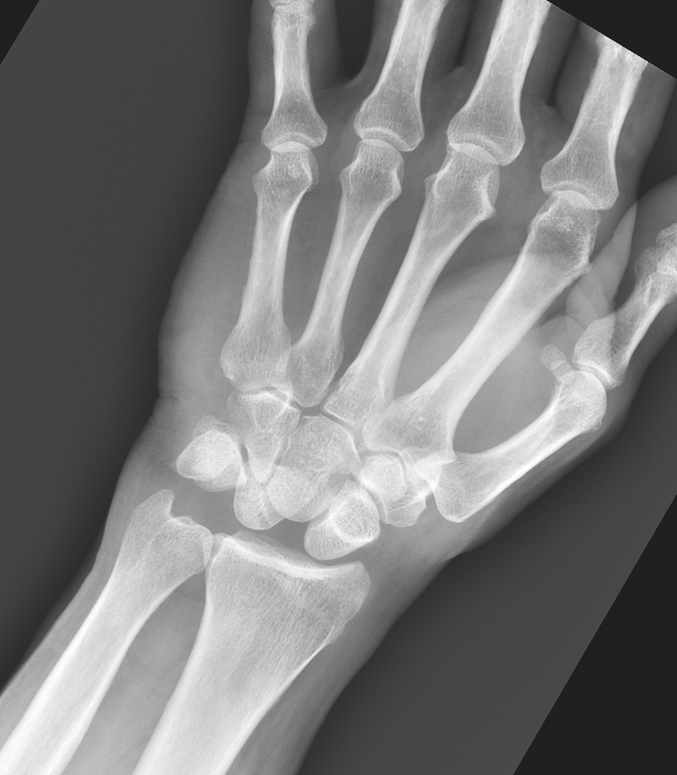

Slide 3
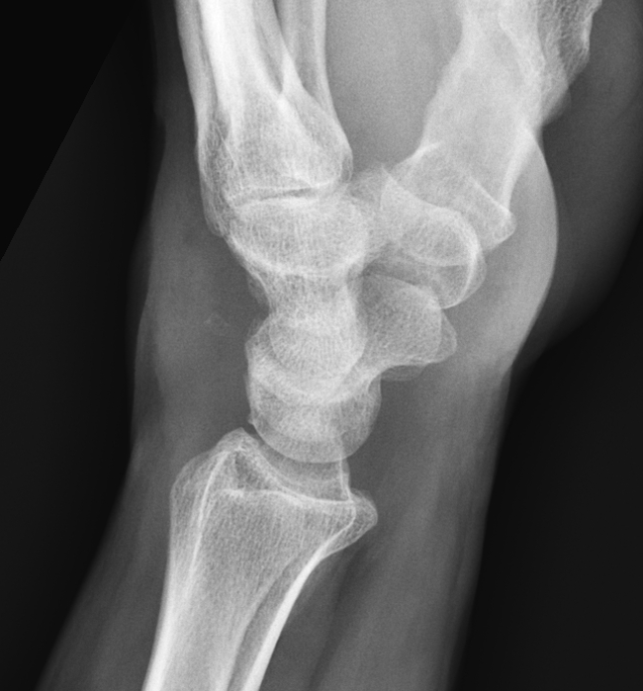
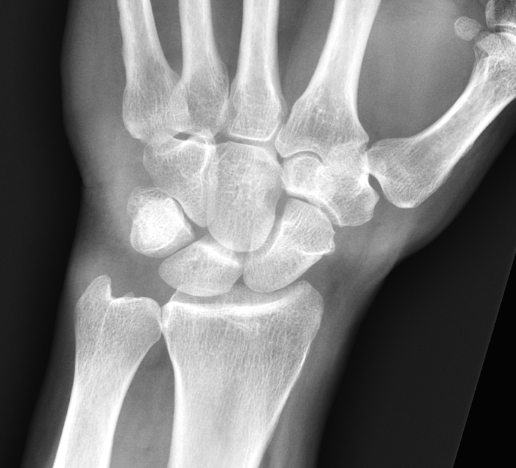
After closed reduction in ER

Slide 4
Dorsal dislocation of lunate scant reports in the literature

