Slide 1
OCAD CASE
Female, 33 years old,
increasing volume of the lower limbs since teenage
no history of significative trauma;
no previous history of diseases;
Carlos Henrique Alencar, MD
Cláudio Régis Silveira, MD
São Carlos Hospital, Fortaleza, CE, Brazil

Slide 2
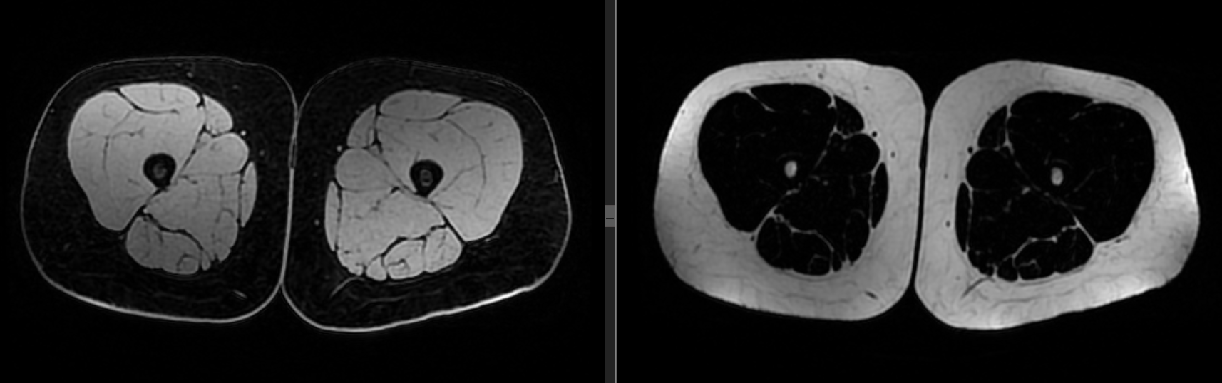
Thigh - Dixon 1.5 T

Slide 3
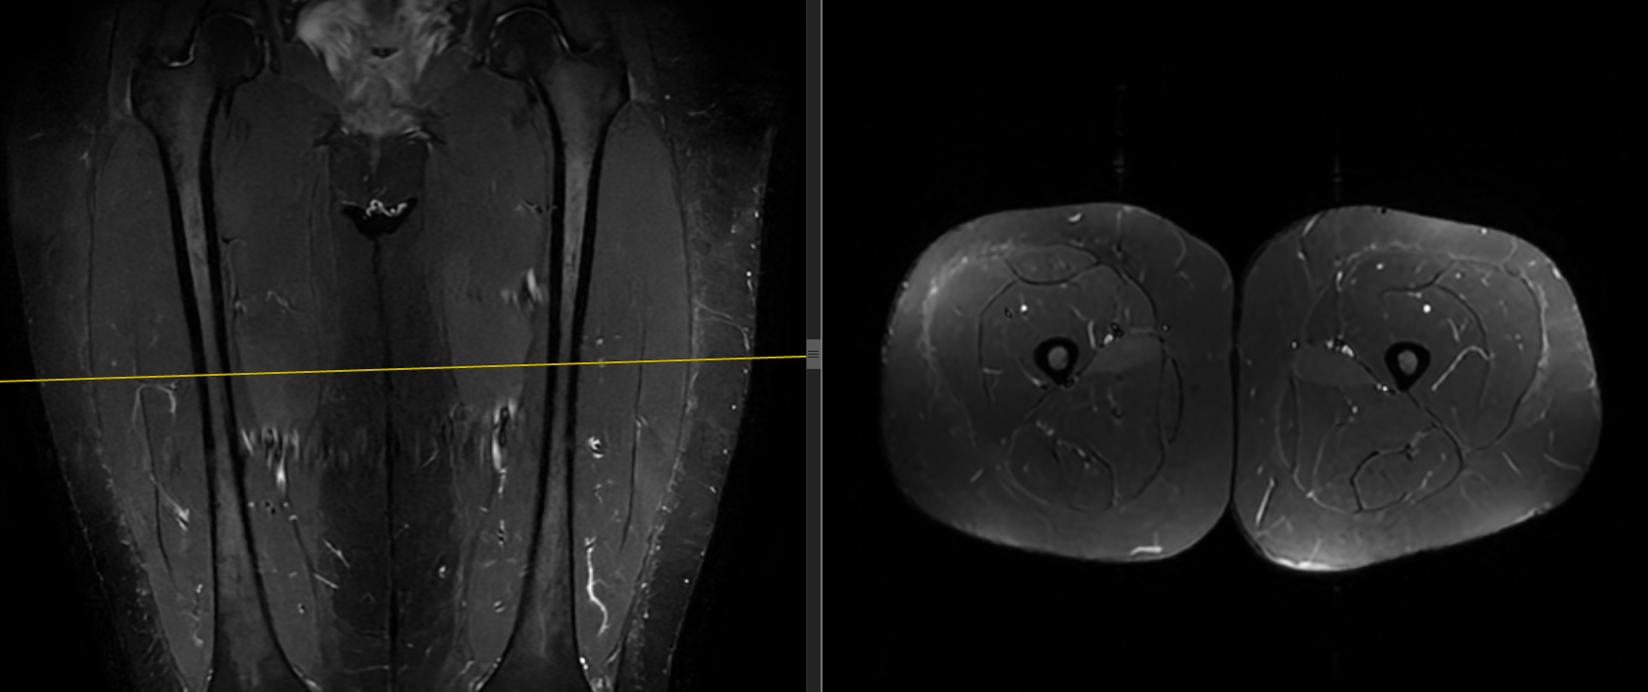

Slide 4
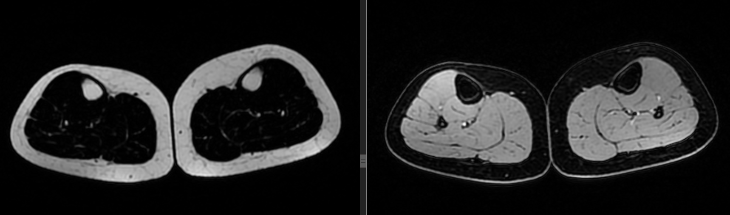
Leg - Dixon 1.5 T

Slide 5
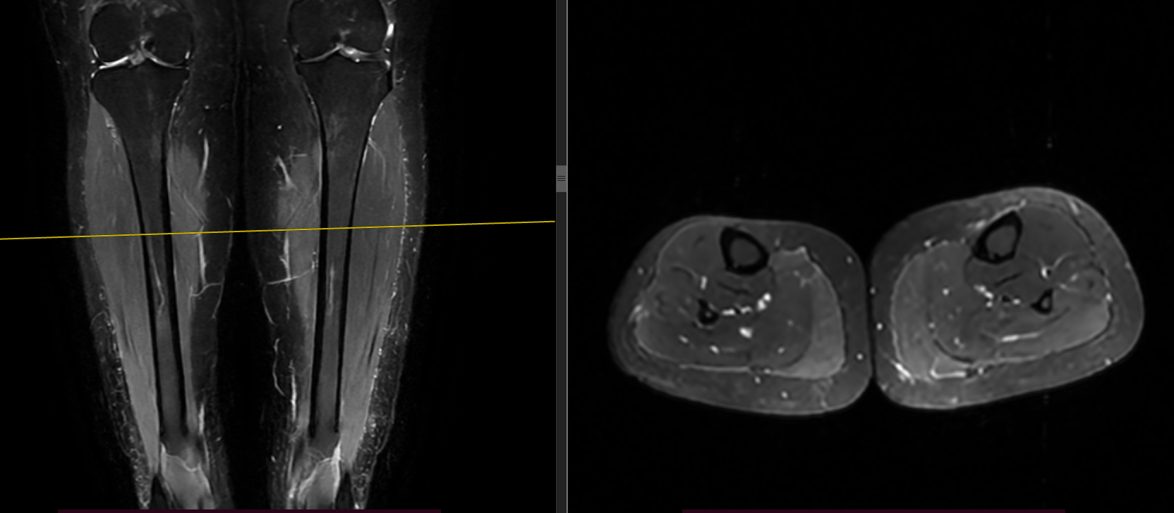

Slide 6
Normal lower limb lymphoscintigraphy...
The clinical colleague who is following the case suggested a diagnosis of lipedema.
What tools to calculate the fat/water ratio do you use?
In addition to skin and fat thickness criteria, as well as edema and fat pad reticulation, what other criteria do you use?
We don't have a defined protocol for noninvasive MR lymphangiography... Which ones do you use?
Thanks in advance! Best to all!

