Slide 1
Slips of LM

Slide 2
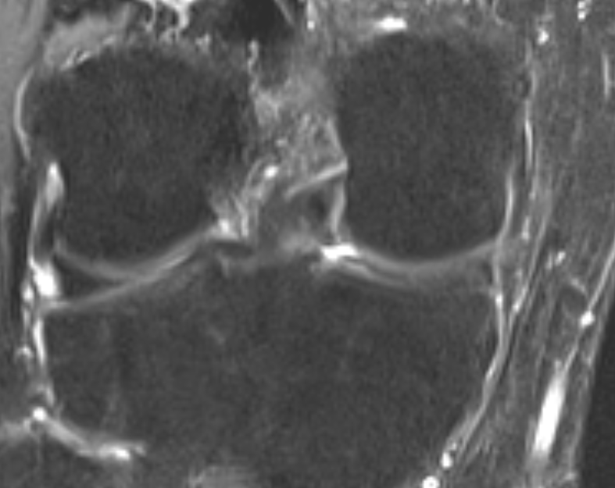
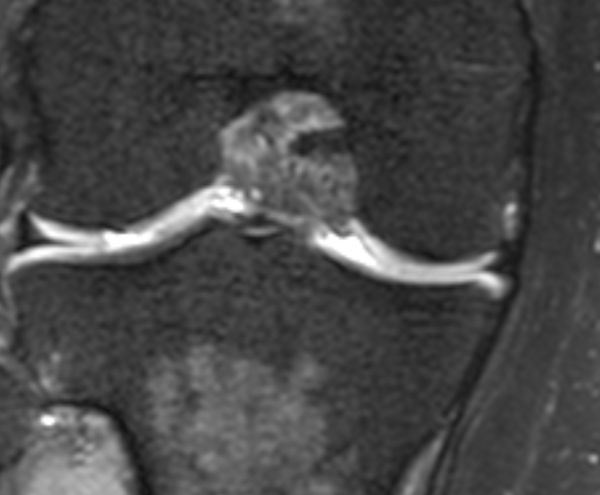
Normal- notice normal lat and med slips- small and large arrows

Slide 3
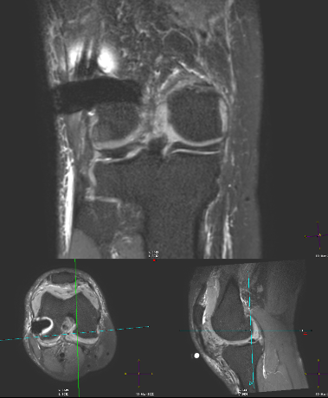
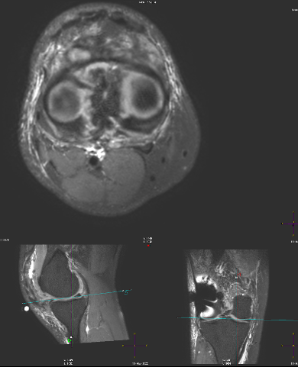
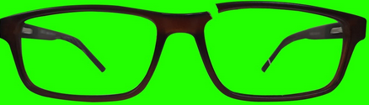
Case 1- 3D recons- Meniscus- Broken Goggle Sign- both medial and lat slips gone!
https://www.youtube.com/watch?v=MIE0vUohUEs

Slide 4
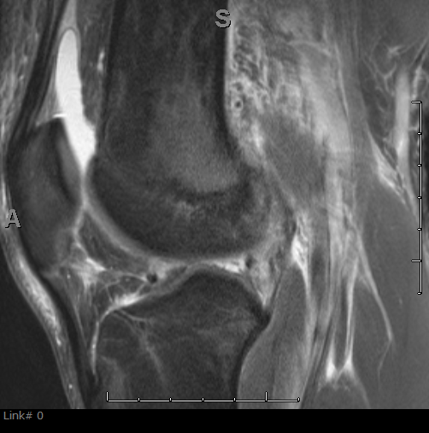
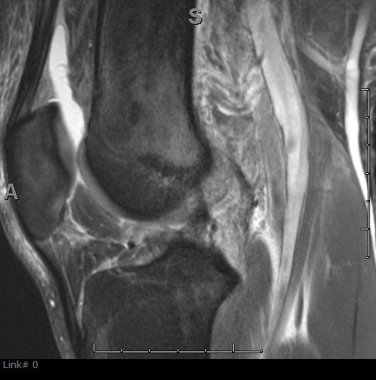
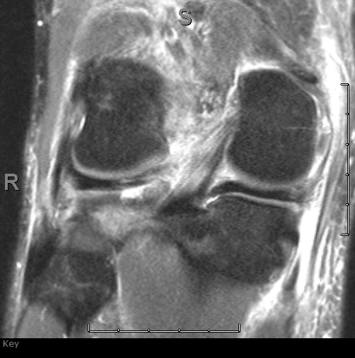
Case 2- Difficult on 2D- notice synovitis under LM

Slide 5
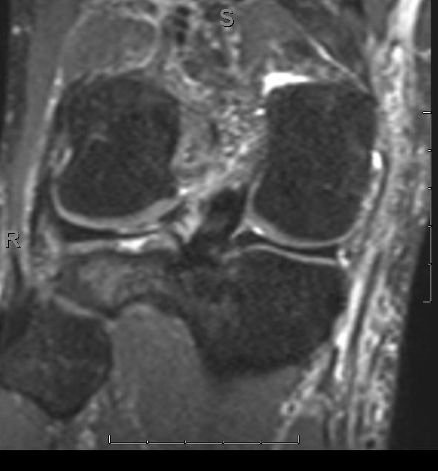
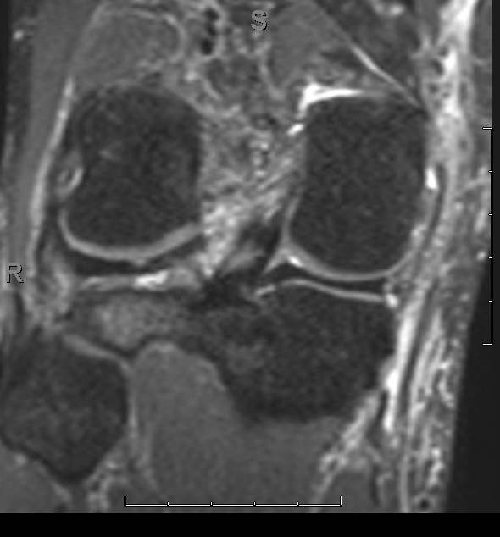
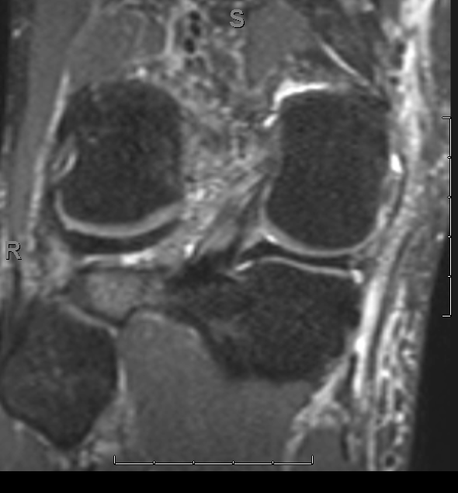
3D- lat slip gone- see synovitis (grey) vs meniscus (dark)

Slide 6
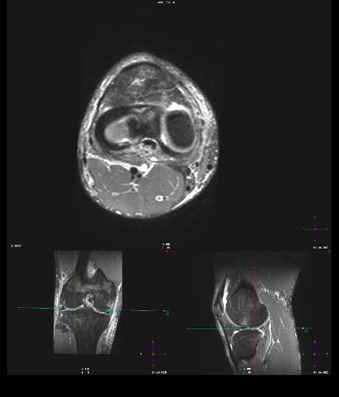
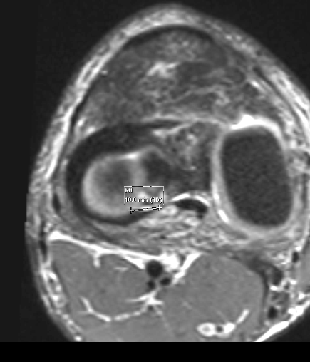
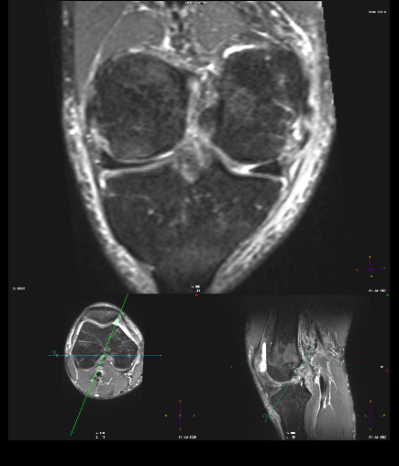

Slide 7
ISACOS and Laprade
Tear: complete lateral slip; zone one, two, three,
Radial location: Posterior horn and lateral slip root involvement
Not central to popliteus hiatus.
Pattern is radial
Meniscal tissue is nondegenerative.
Tear length: 10 mm.
Laprade: Type IV

Slide 8
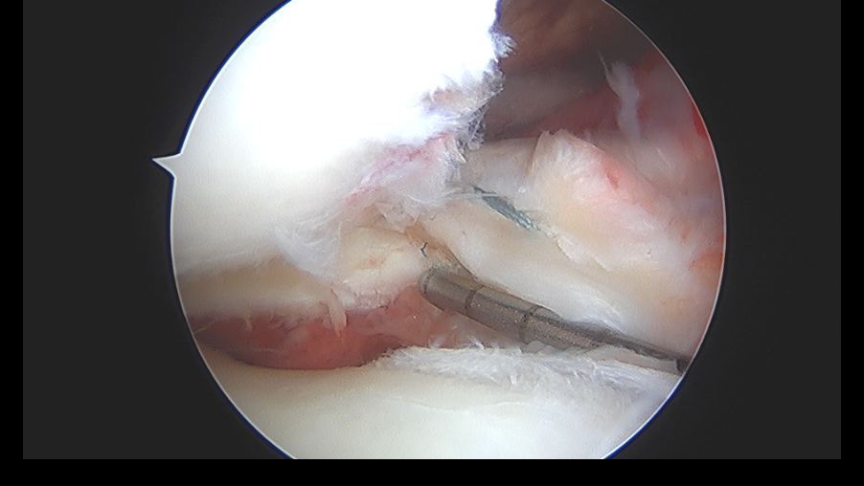
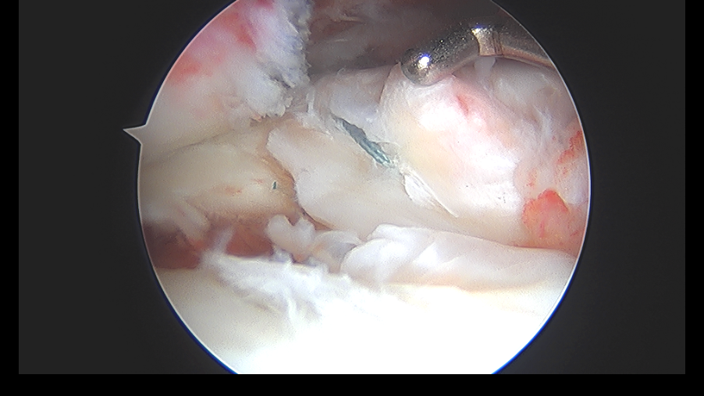
Arthroscopy- LM confirmed- undersurface- Laprade IV, 9mm, lateral slip

