Slide 1
34Y, Female, Presented with pain in left hip for nearly 2 years.
Osteochondral defect in acetabular roof with surrounding marrow oedema which enhances with Gadolinium.
A small hypointensity area on all pulse sequences postero-superior to former - ? Displaced dense bone fragment
Is this enhancement is too much for a OD ?
Can this “dense bone fragment originate from same lesion ?
Value your expert opinion.

Slide 2
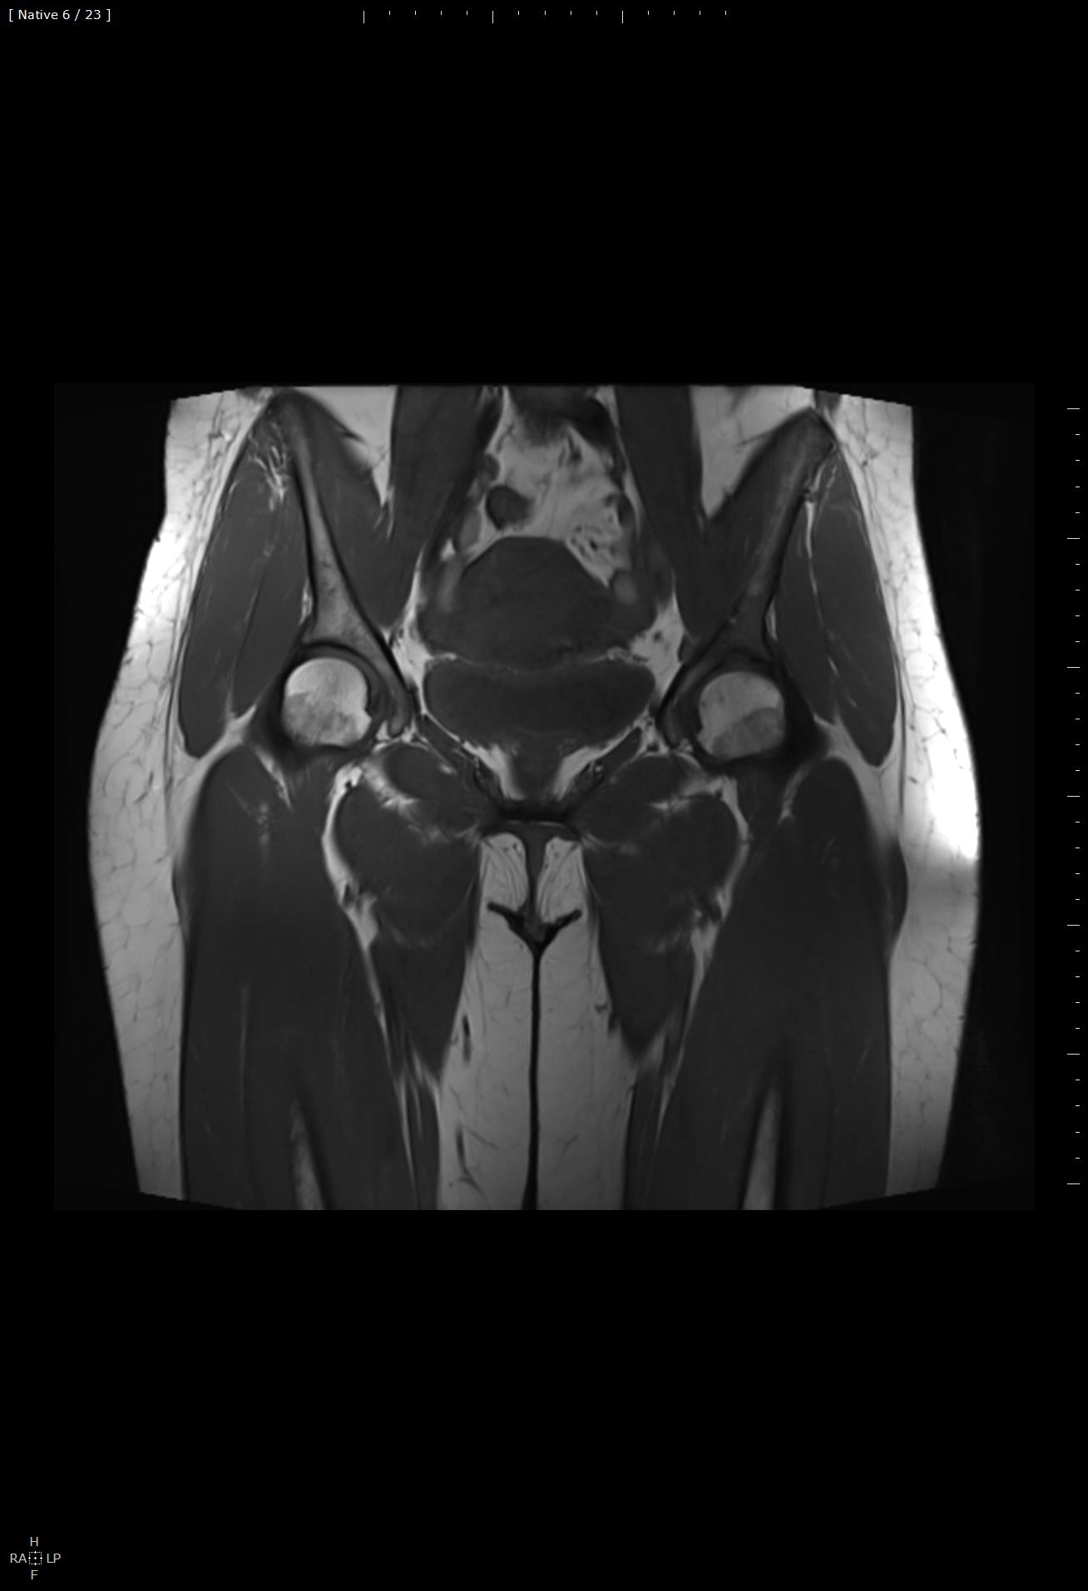
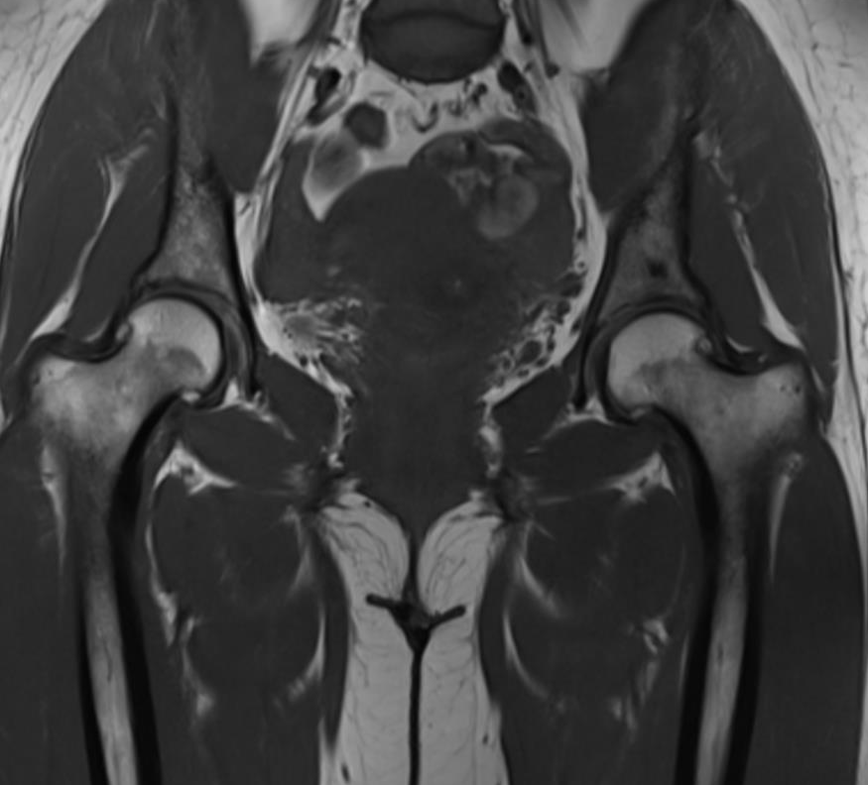
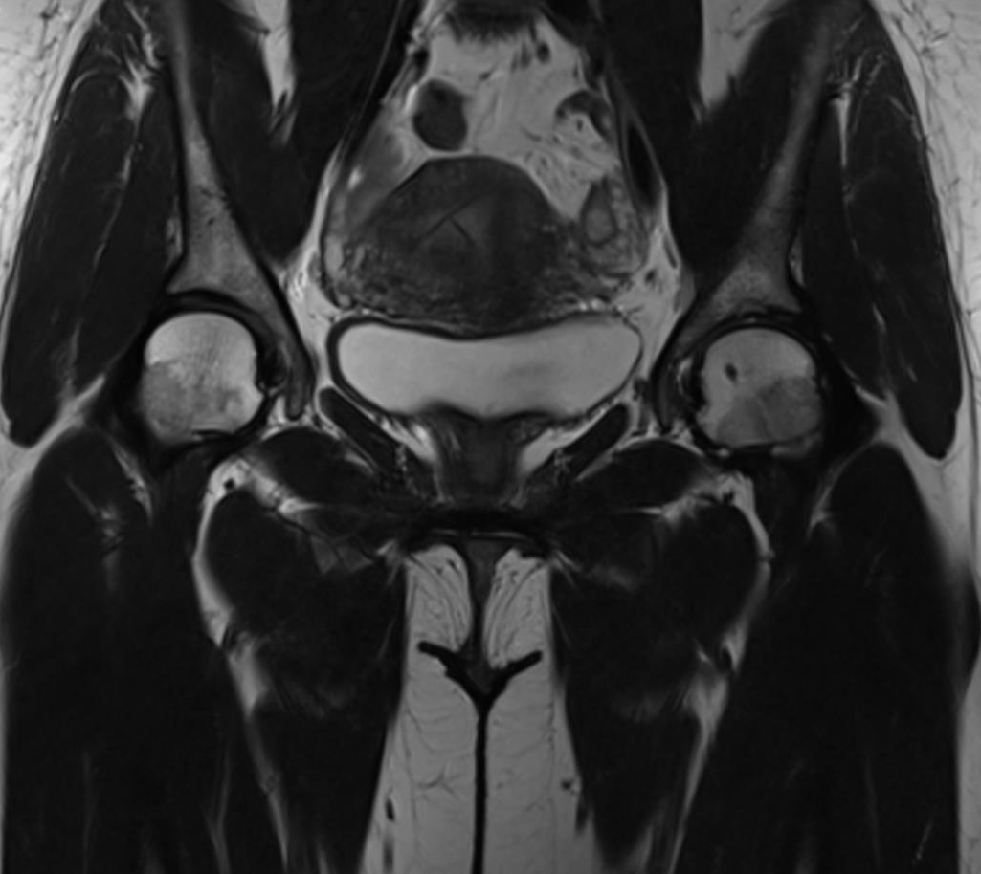
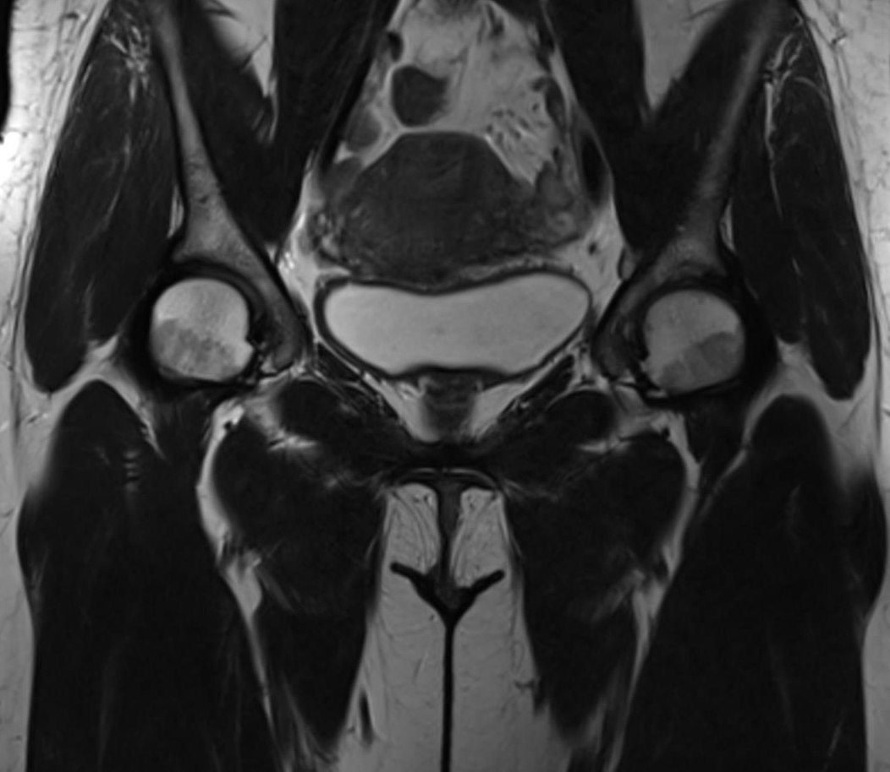
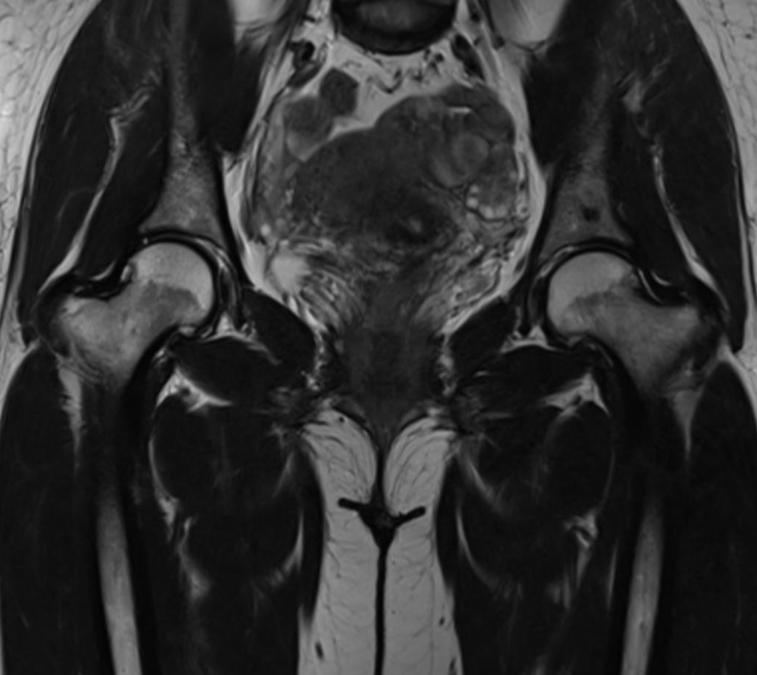
T1 W
T2 W

Slide 3
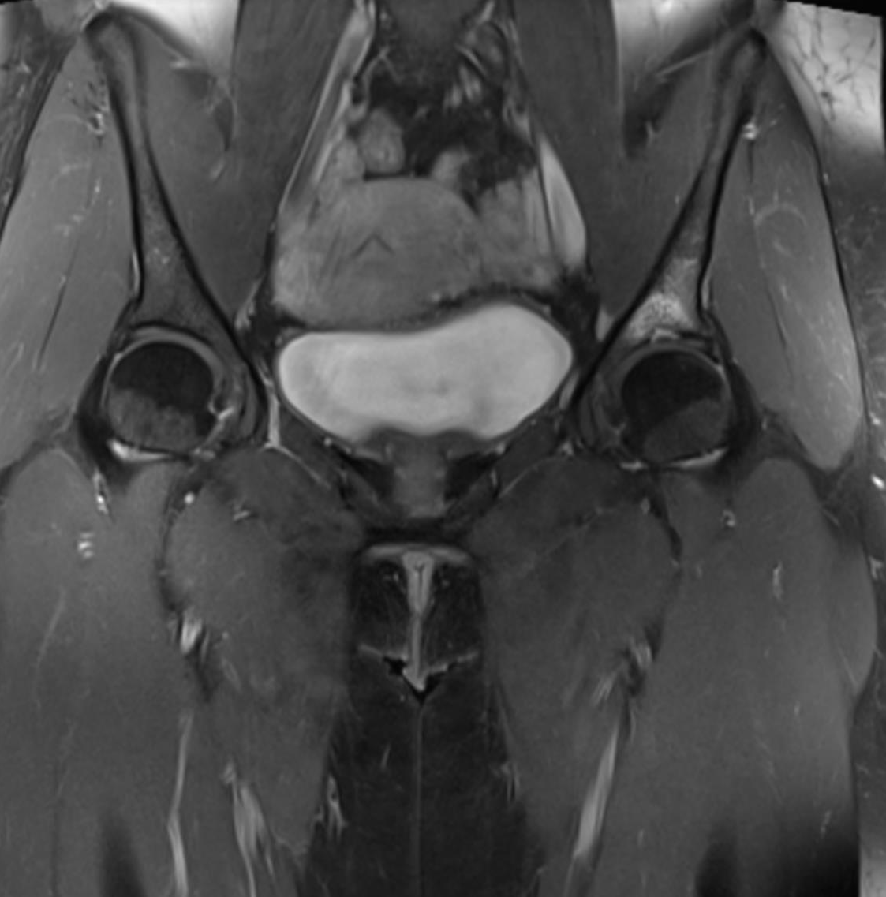
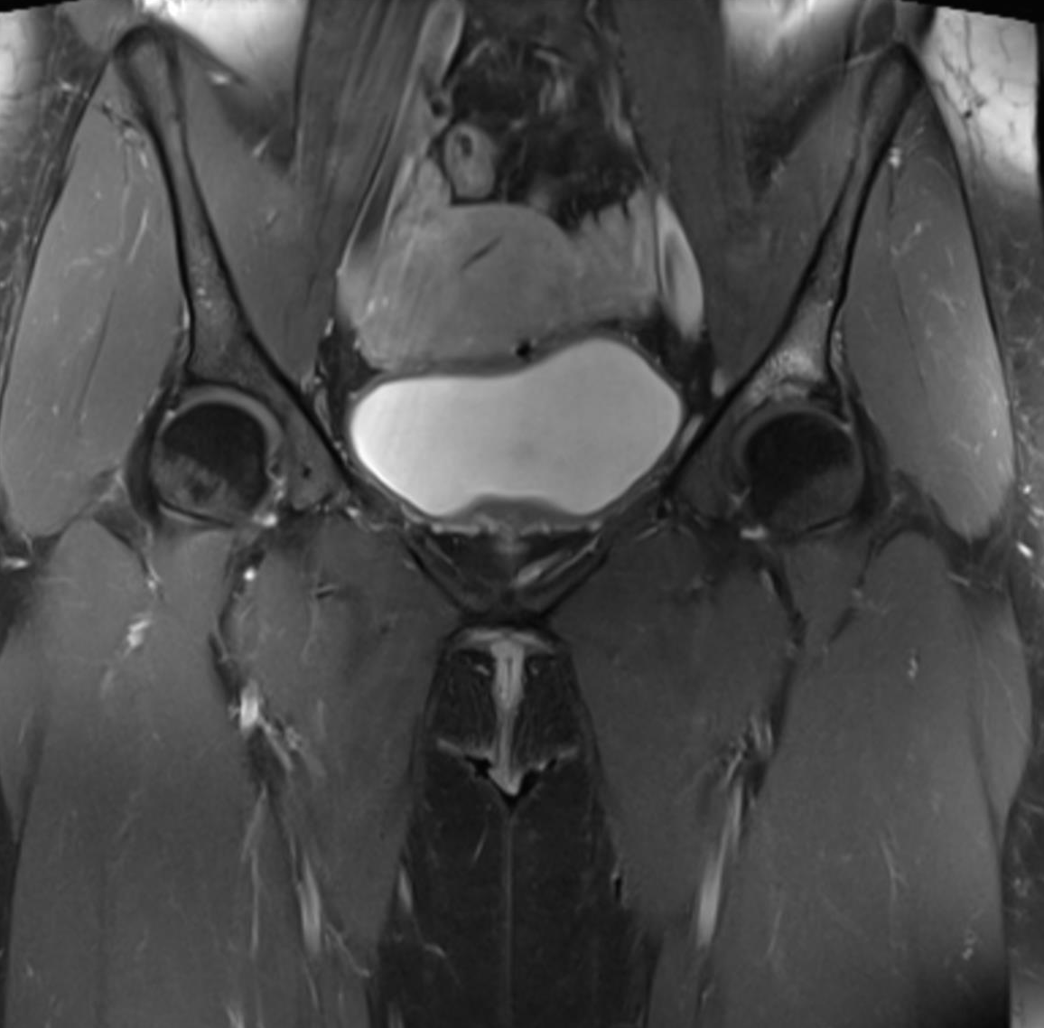
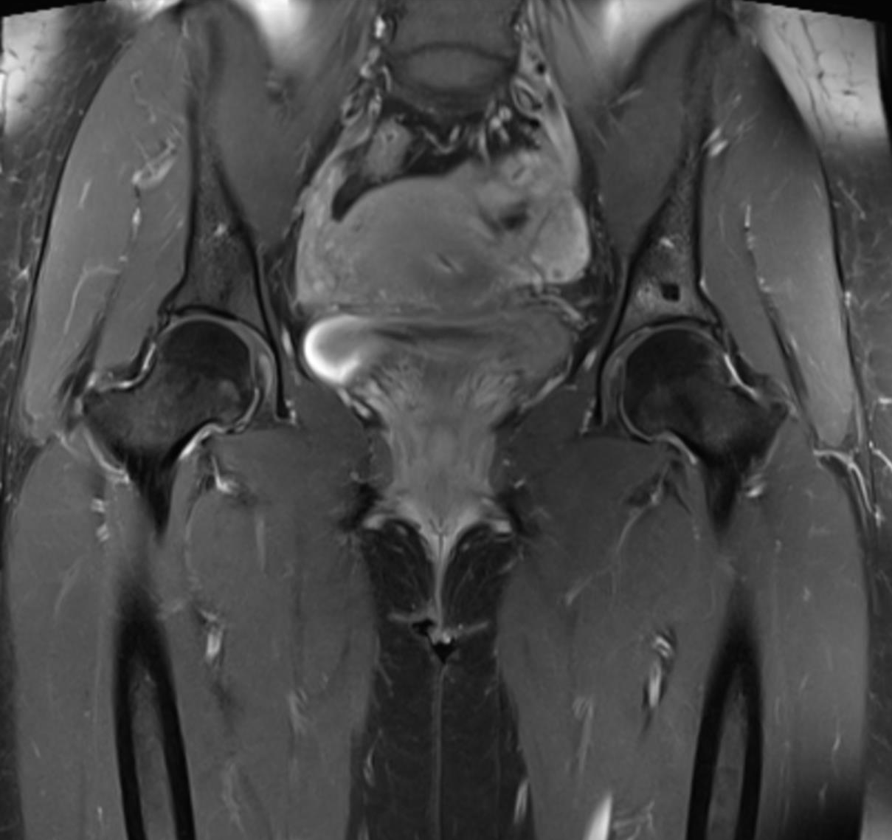
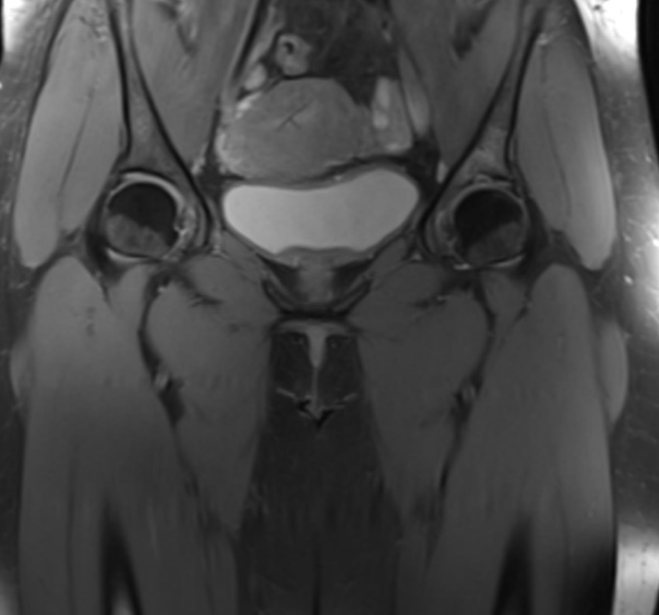
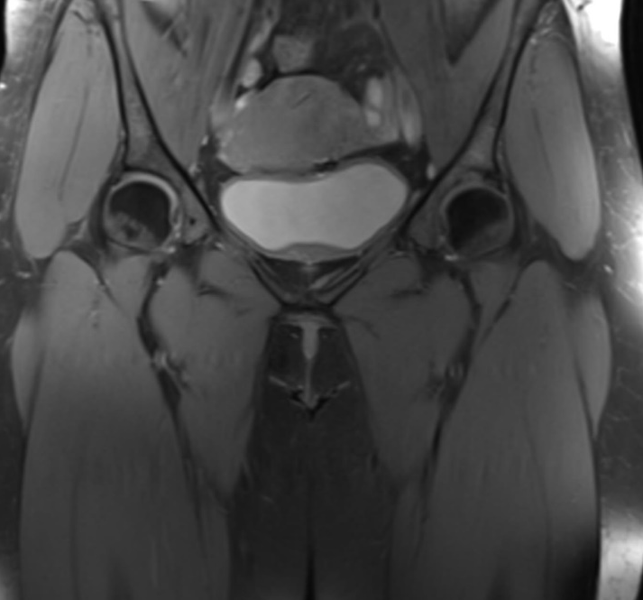
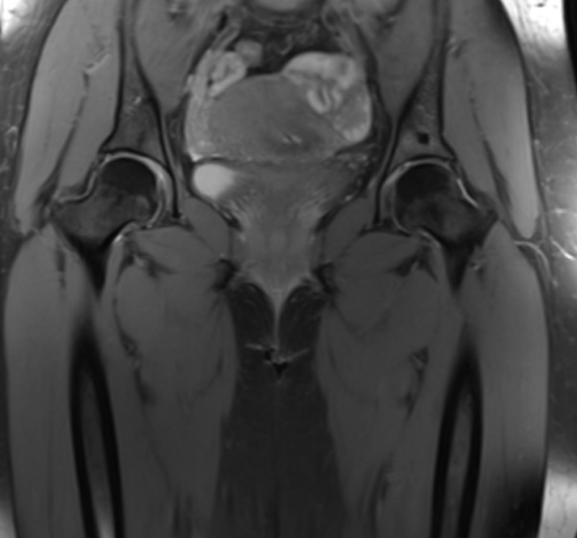
T1 W FS GE
PD W FS

