Slide 1
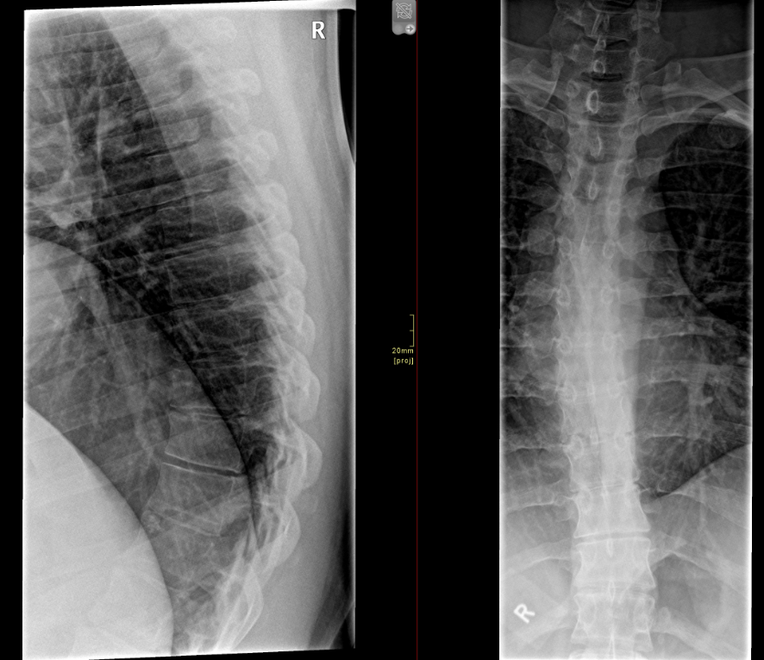
Case 1
25M
Presented with a fall
CT thoracic spine performed for isolated mid thoracic pain

Slide 2
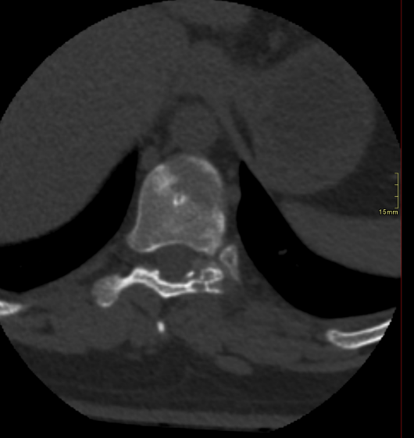
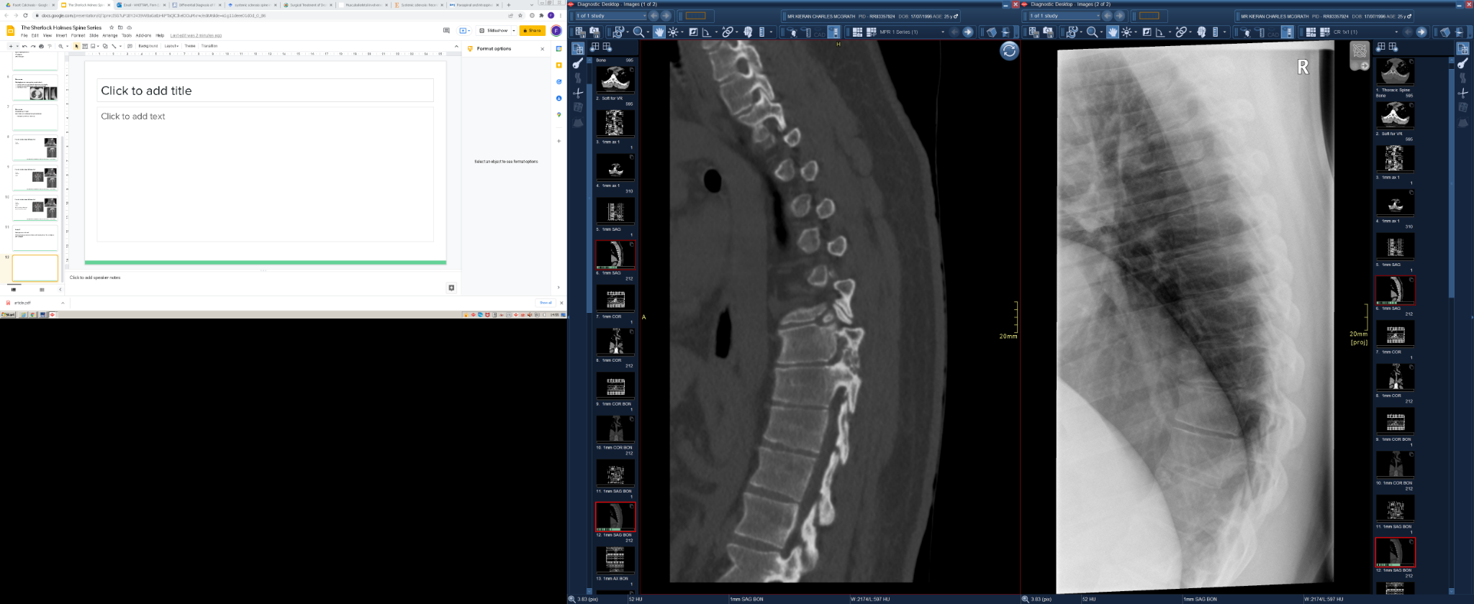
NO acute bony injury; odd looking facet joint
MRI Recommended and performed

Slide 3
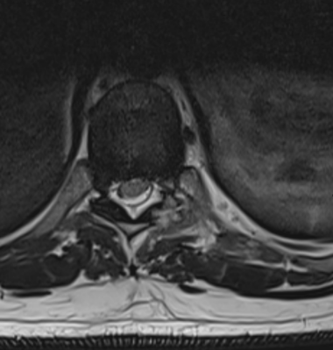
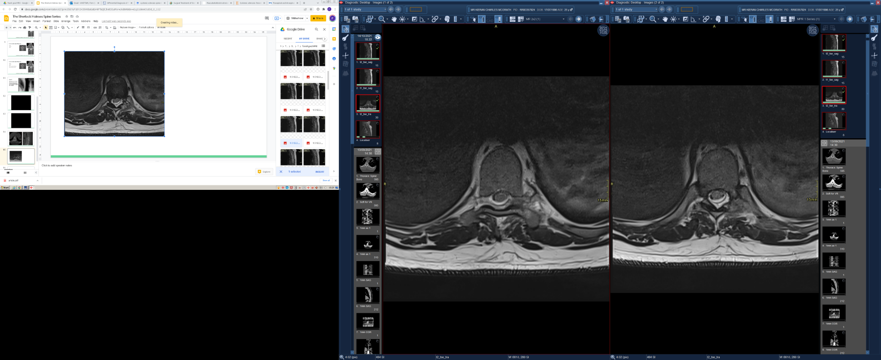

Slide 4
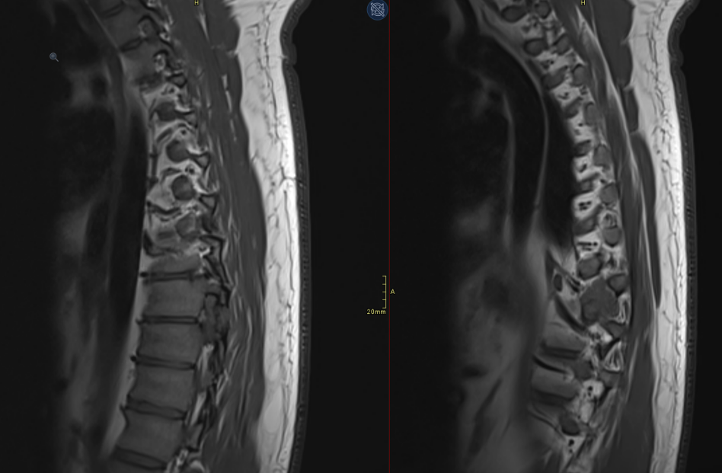

Slide 5
Recommendations
Raised diagnosis of Gout
Suggested testing serum urate

Slide 6
Further clinical information
Markedly raised serum urate; High BMI 41 (146kg)
No other arthropathic clinical symptoms
2 prior presentations with flank pain, no other characteristic joint involvement
US abdomen/urinary tract performed ?renal colic NAD

