Slide 2
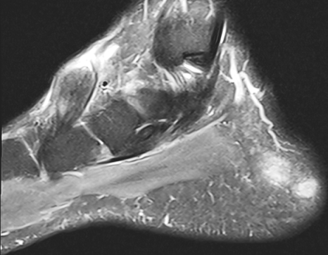
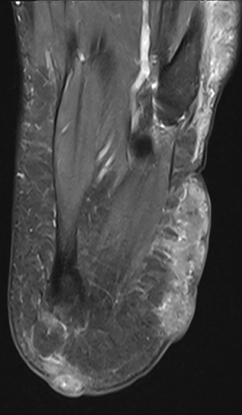
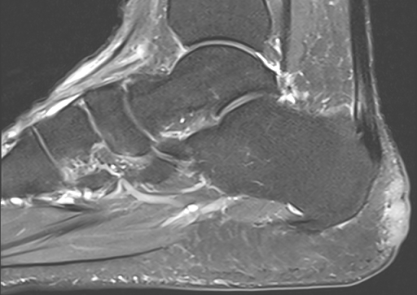
Jan 22 PDFS

Slide 3
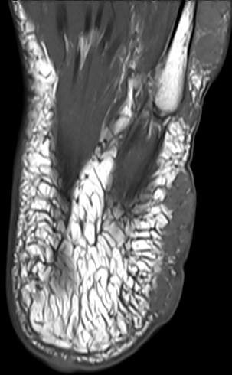
Jan 22
T1

Slide 4
Aug 22 T1

Slide 5
Aug 22 PDFS

