Slide 1
Five year old boy with isolated left lower limb fatty proliferation, without skeletal hypertrophy, neurofibromas or vascular anomalies

Slide 2
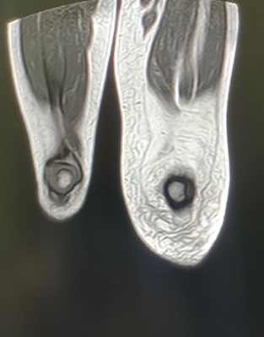
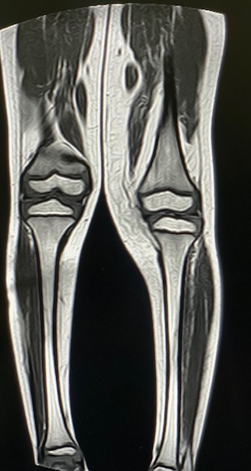
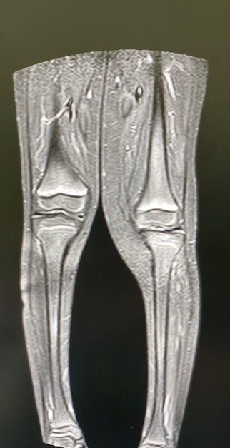

Slide 3
