Slide 1
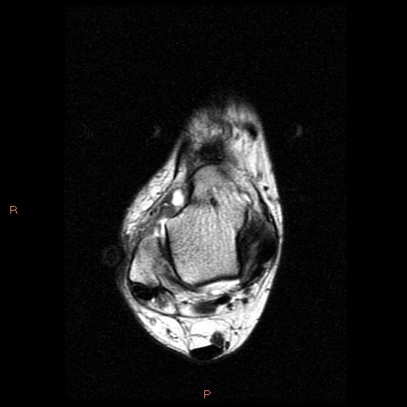
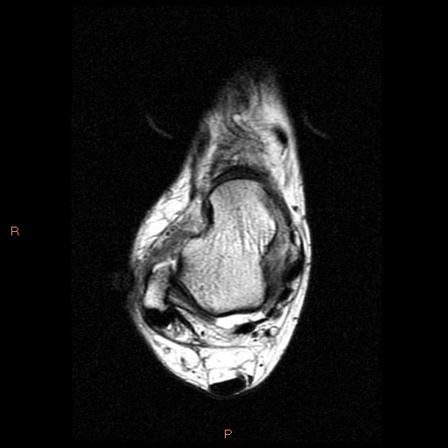
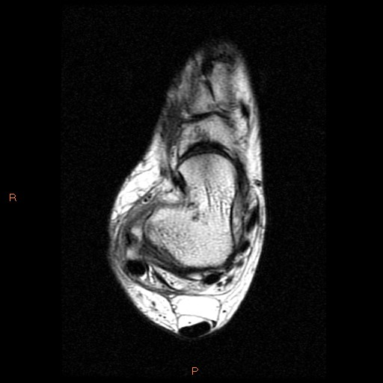
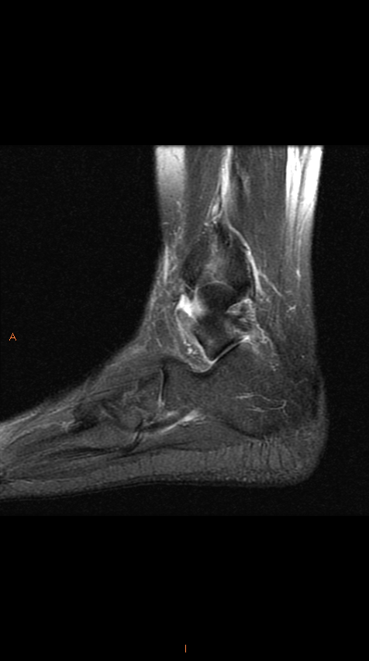
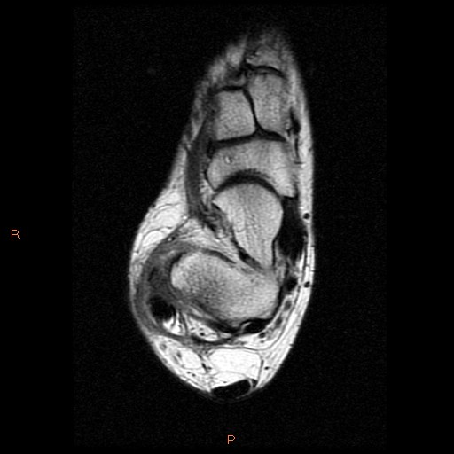
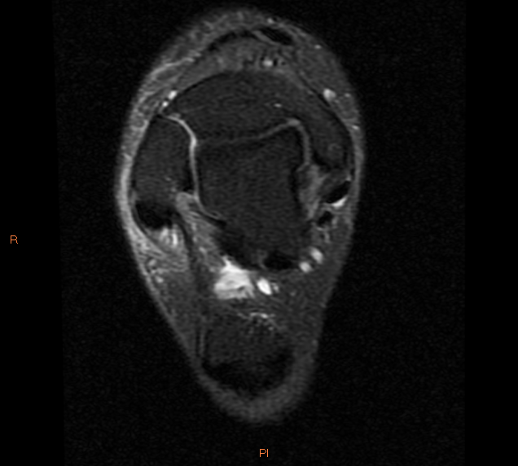
MAIN STEM
TALAR LAMINA
PERONEOCALCANEAL LAMINA
MAIMAIN STEM
TALAR LAMINA
MAIN STEM
PERONEOCALCANEAL LAMINA
PERONEOCALCANEAL LAMINA
TALAR LAMINA

