Slide 1
58F incidental finding

Slide 2
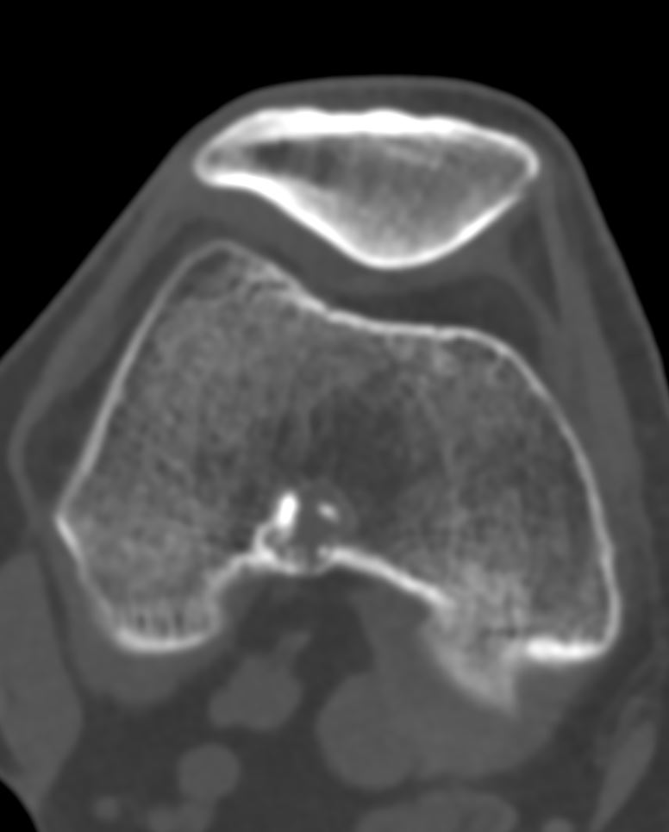
02/2022

Slide 3
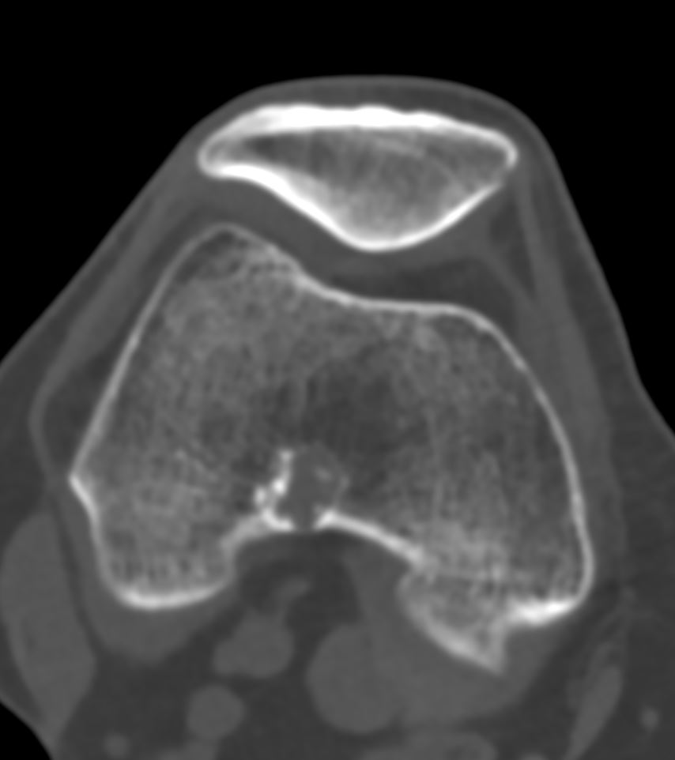
02/2022

Slide 4
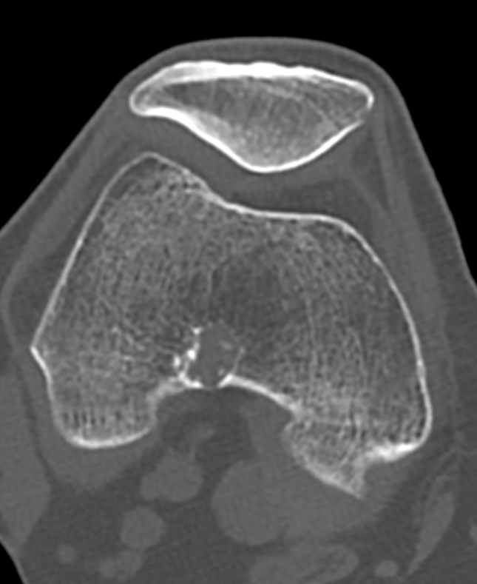
02/2022

Slide 5
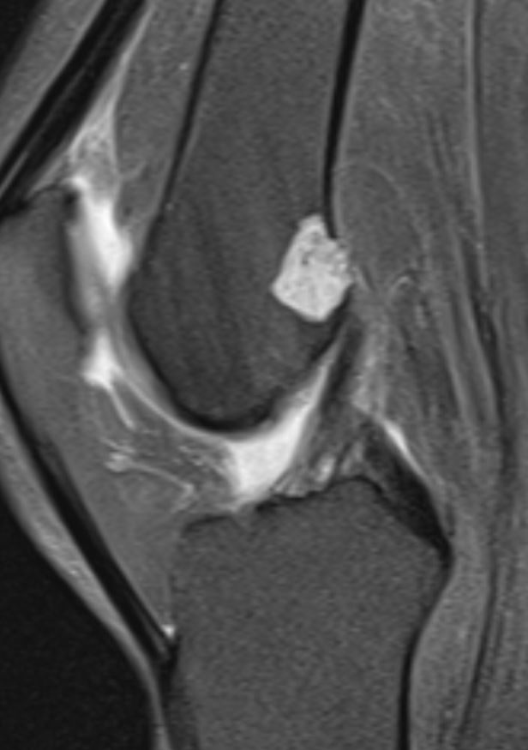
02/2022

Slide 6
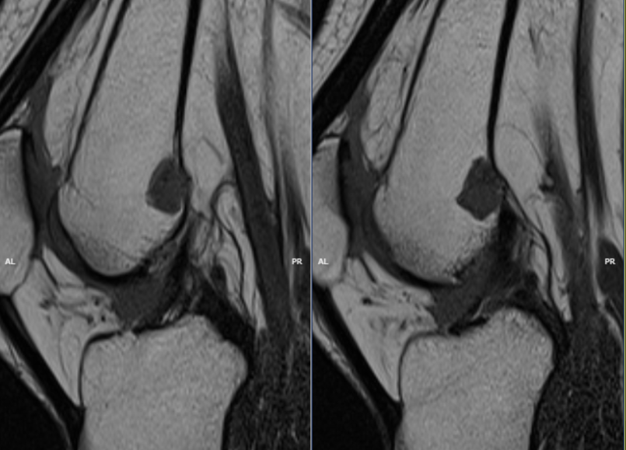
02/2022

Slide 7
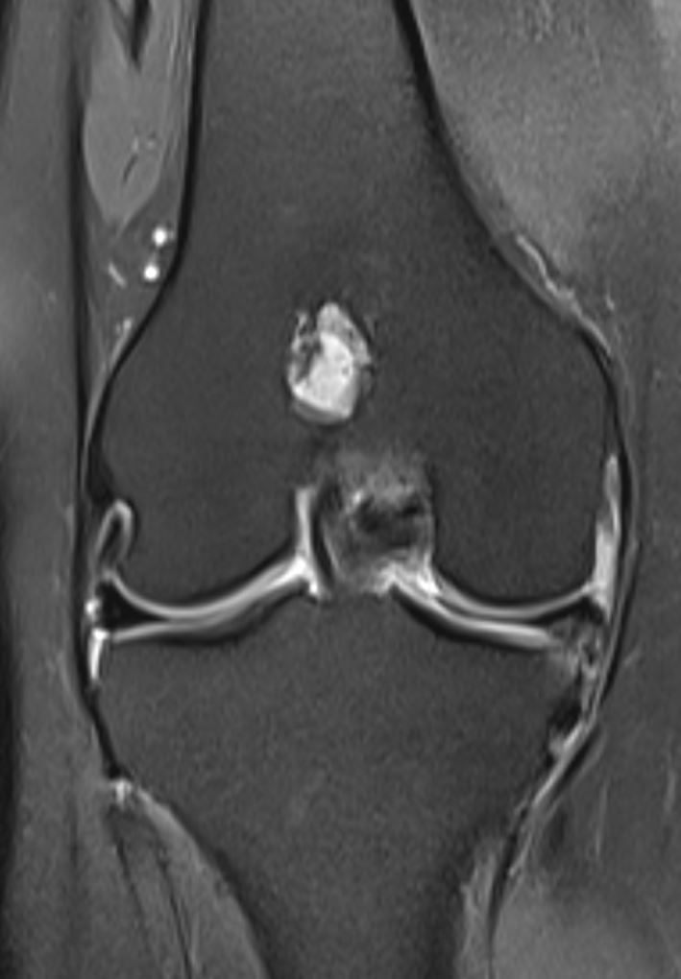
02/2022

Slide 8
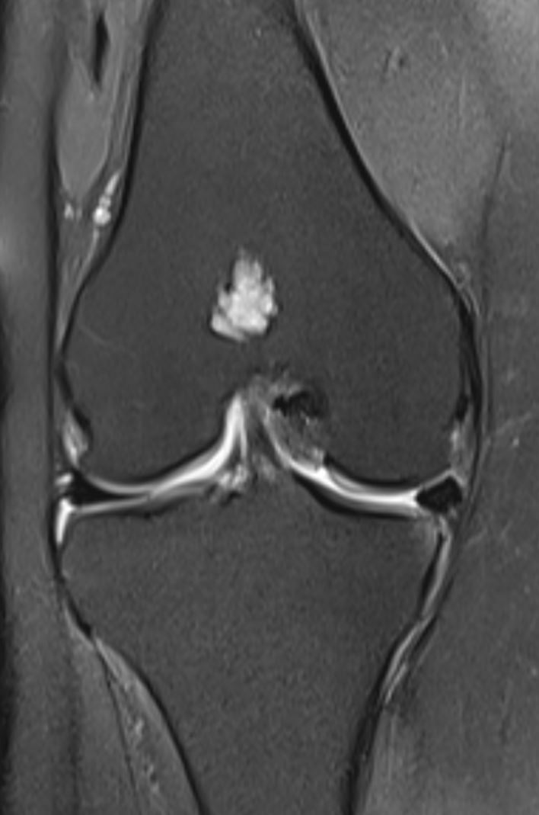
02/2022

Slide 9
DX: Enchondroma
mild cortical osteolysis

