Slide 1
58F incidental finding

Slide 2
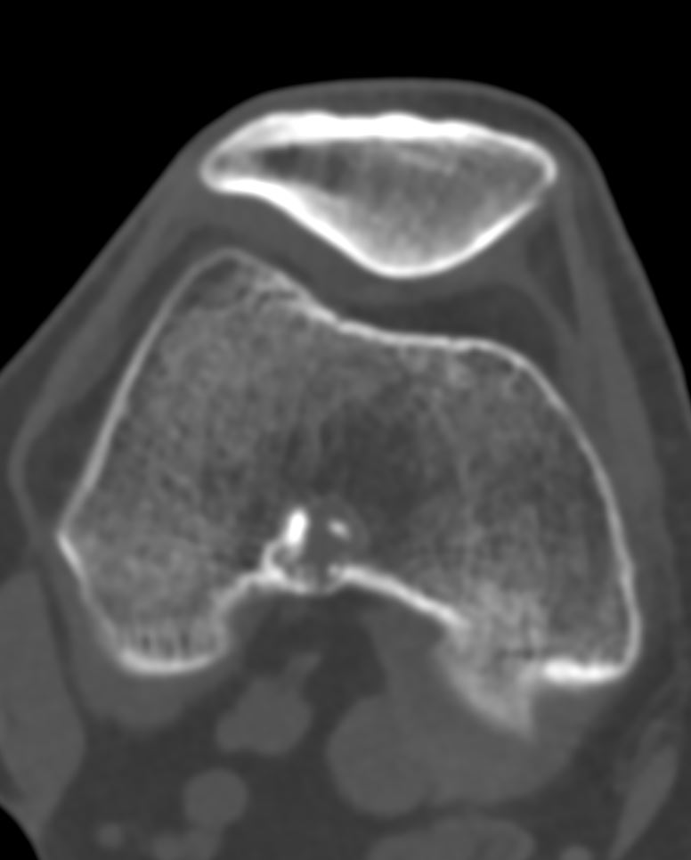
02/2022

Slide 3
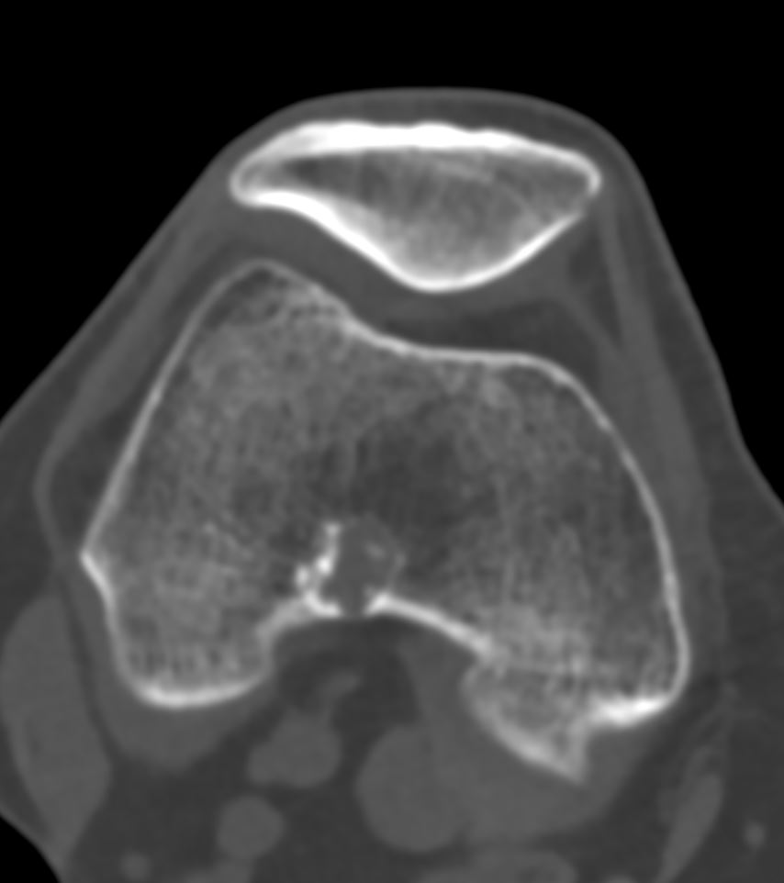
02/2022

Slide 4
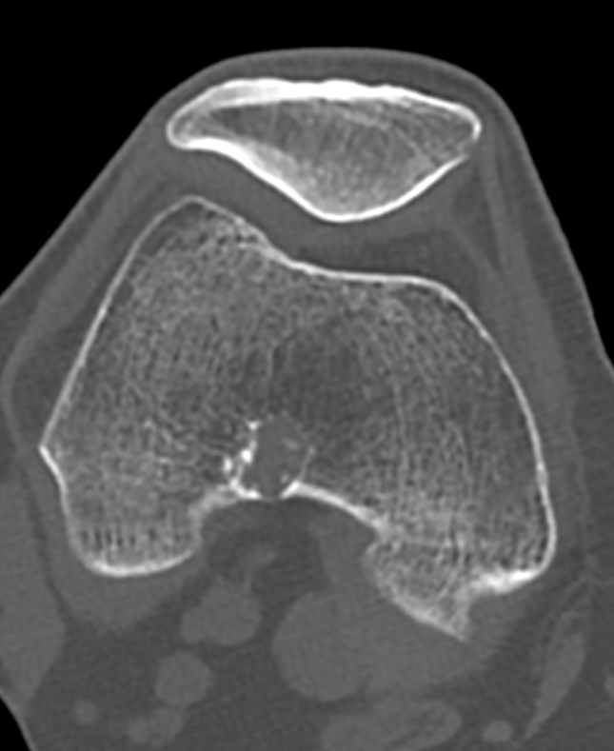
02/2022

Slide 5
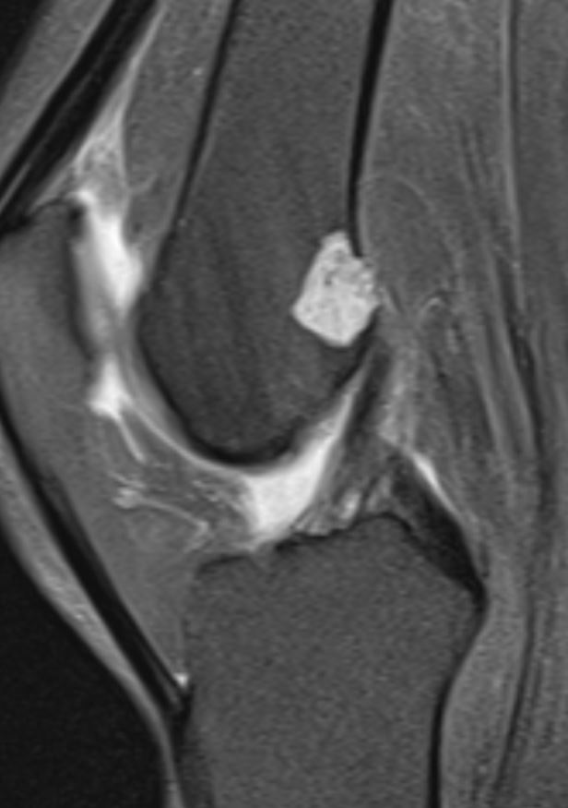
02/2022

Slide 6
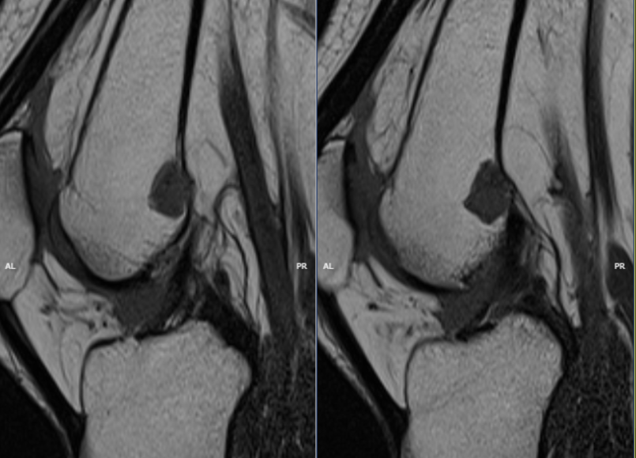
02/2022

Slide 7
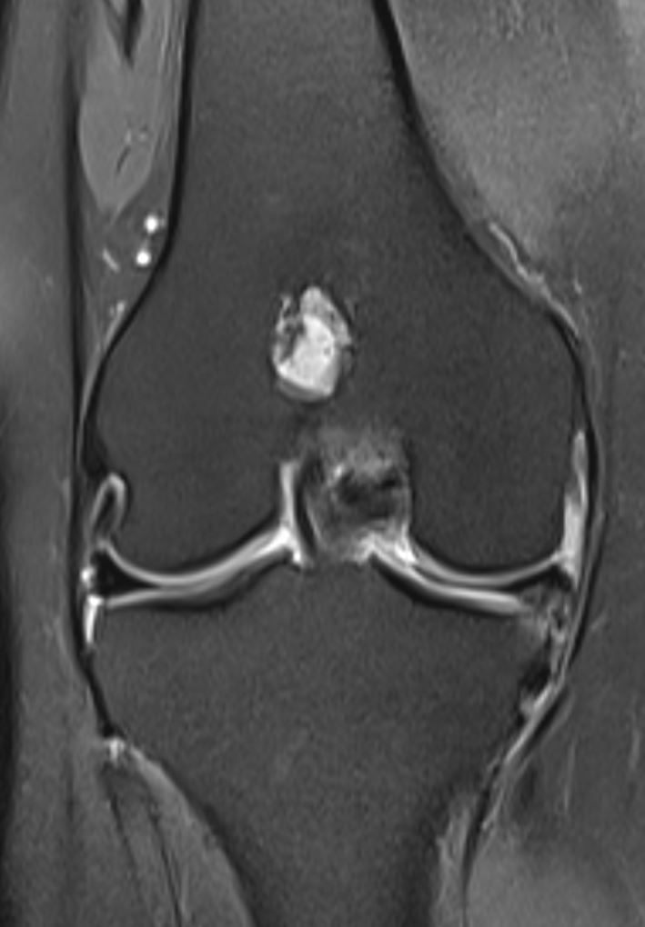
02/2022

Slide 8
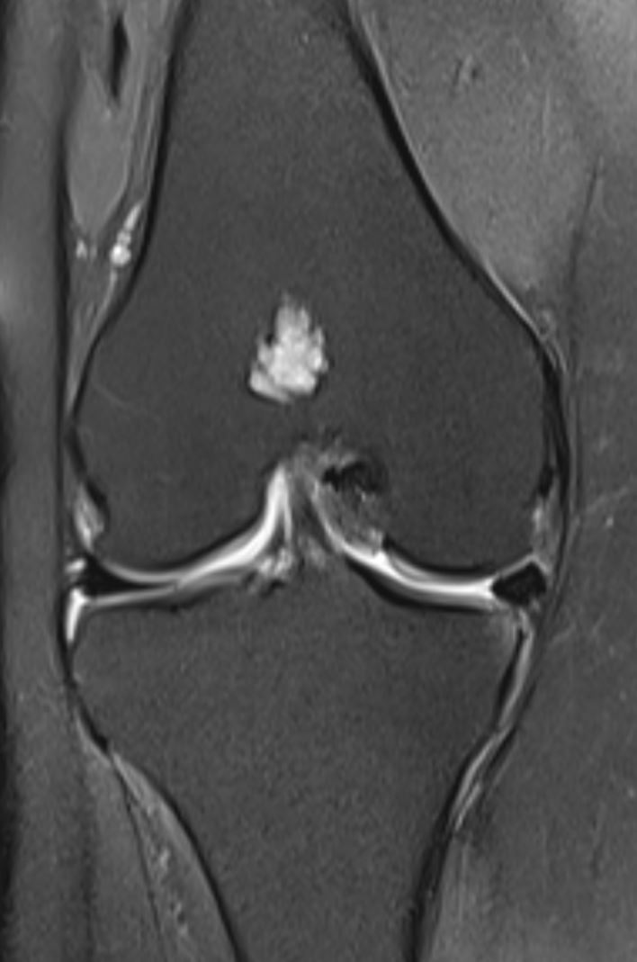
02/2022

Slide 9
DX: Enchondroma
mild cortical osteolysis

Slide 10
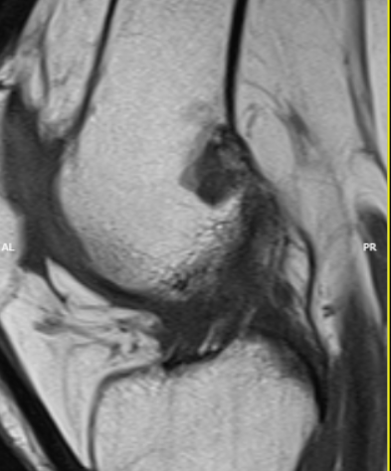
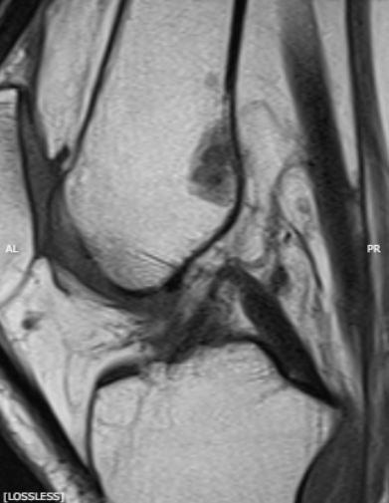
07/2022

Slide 11
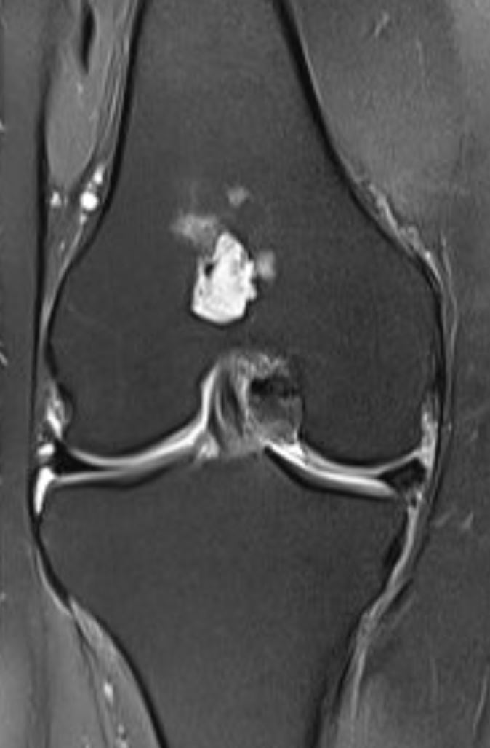
07/2022

Slide 12
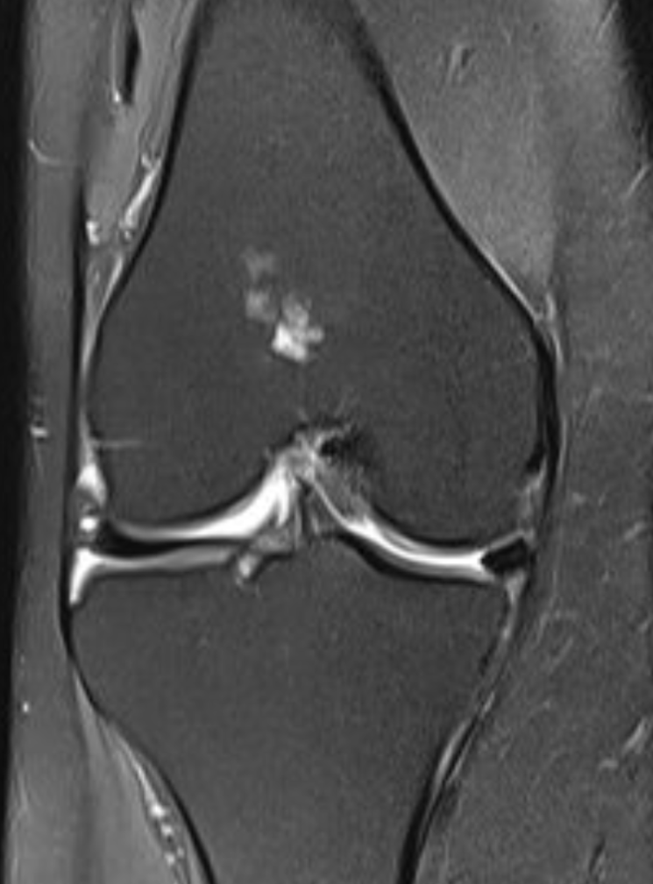
07/2022
07/2022

Slide 13
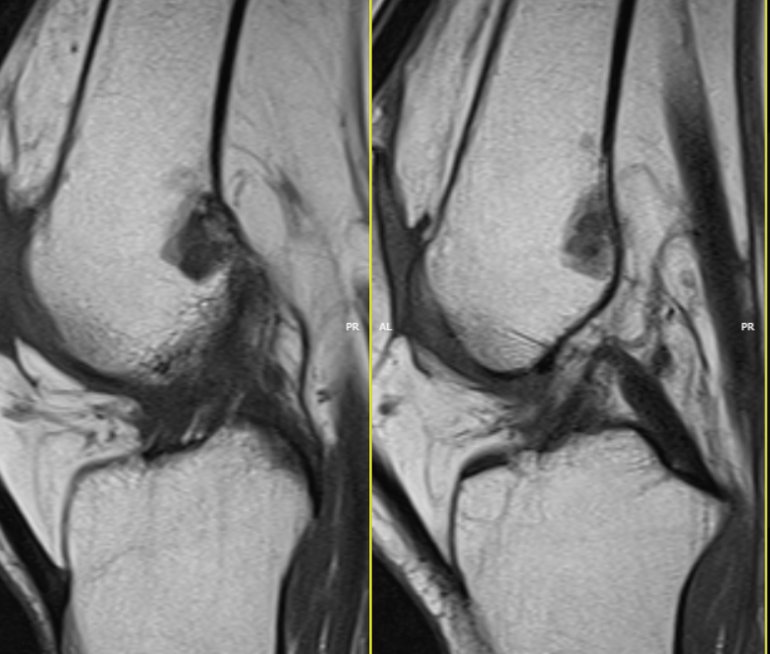
07/2022

Slide 14
02/2022
07/2022

Slide 15
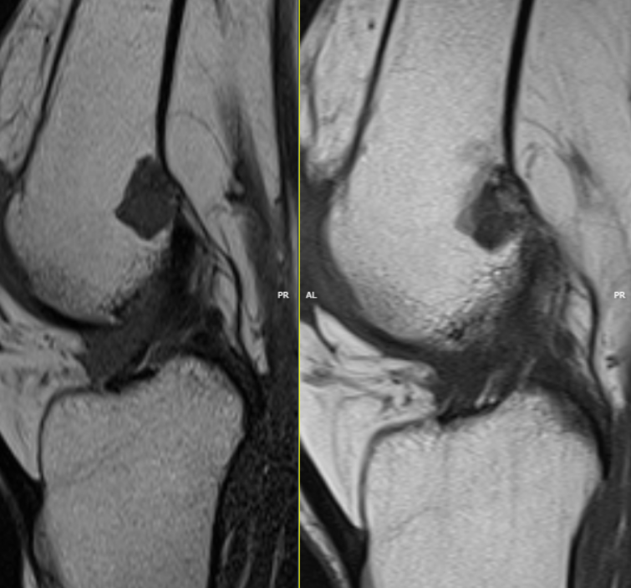
02/2022
07/2022

Slide 16
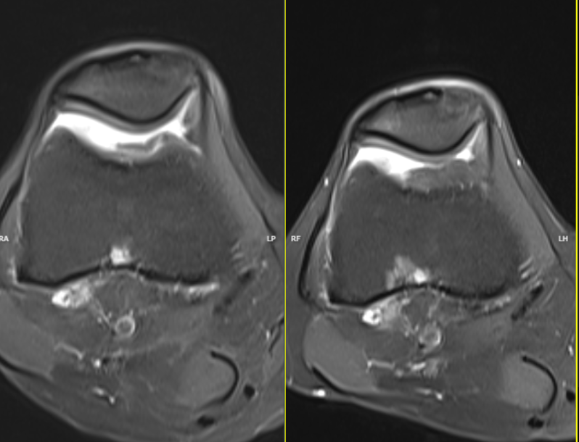
02/2022
07/2022

Slide 17
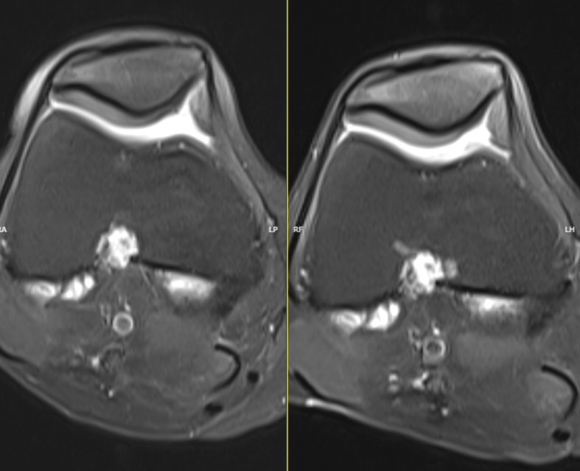
02/2022
07/2022

Slide 18
Dx: chondrosarcoma (Low-grade?)

