Slide 1
44 yo F
Palpable wrist mass, pain

Slide 2
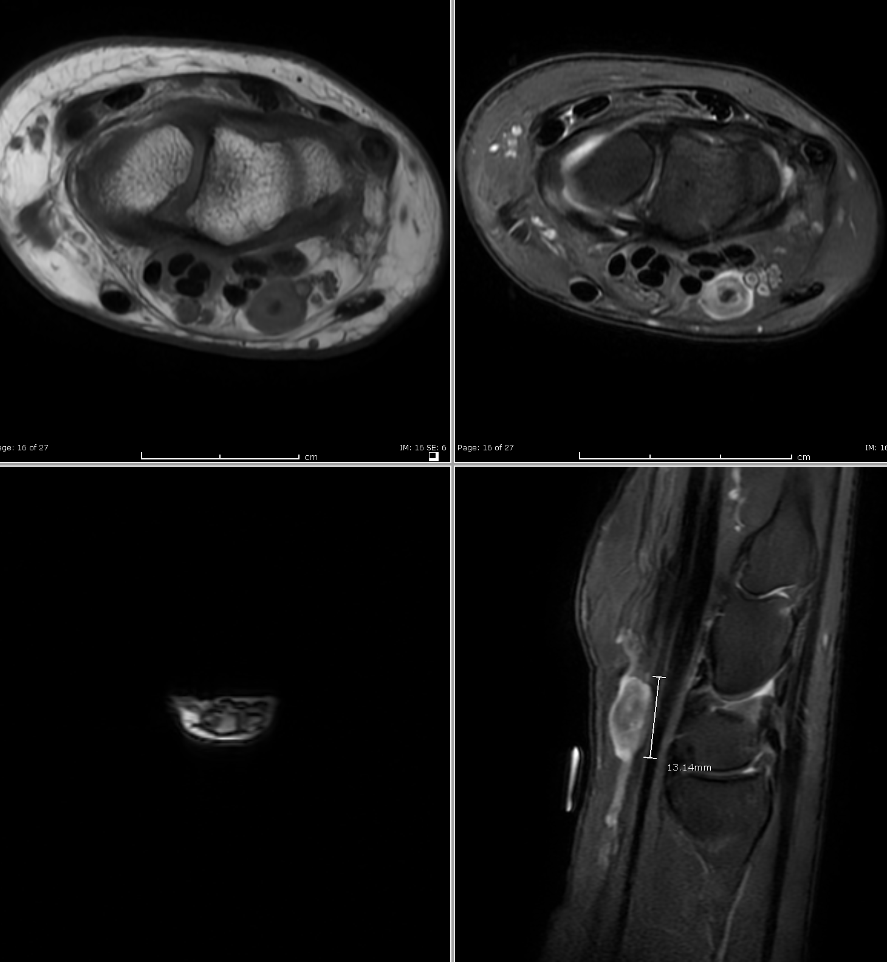
Initial xrays negative
T1, T2 FS and T2 FS images
Oval mass, ulnar volar wrist at neurovascular bundle
Appears to have vessel entering and exiting
I favored a vascular lesion/partially thrombosed venous lesion, and recommended US

Slide 3
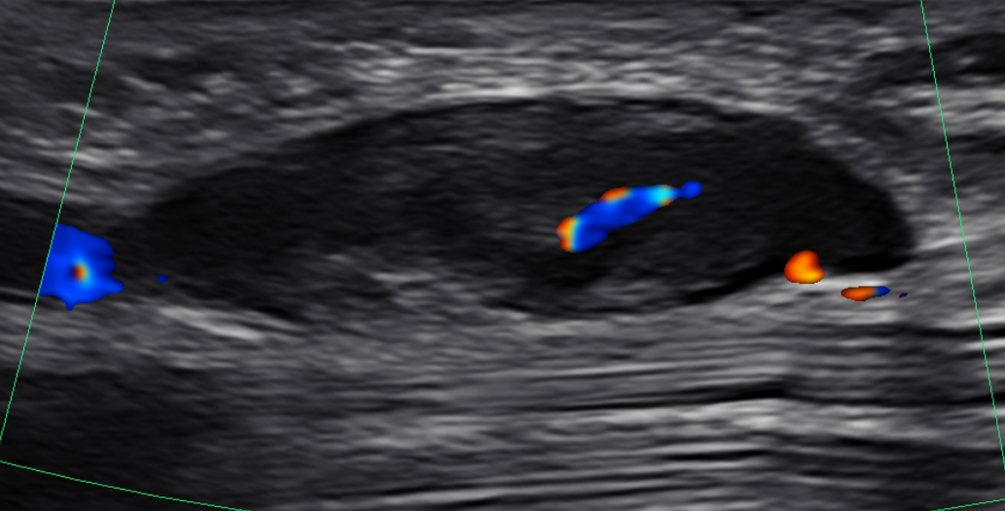

Slide 4
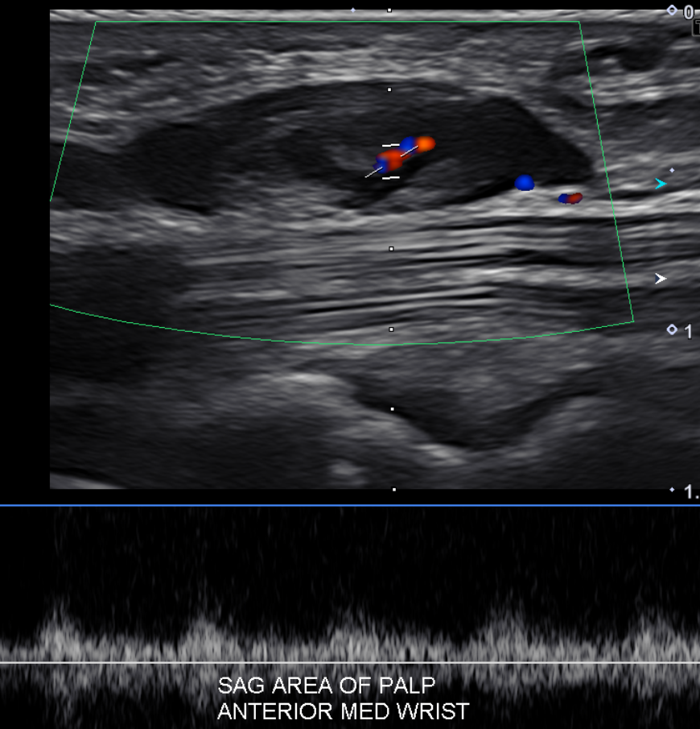

Slide 5
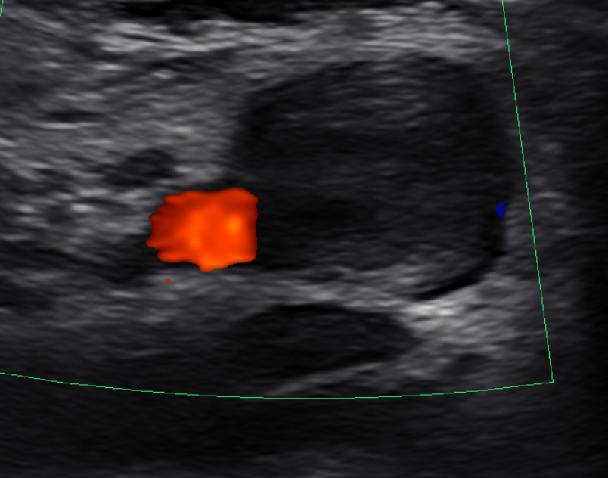
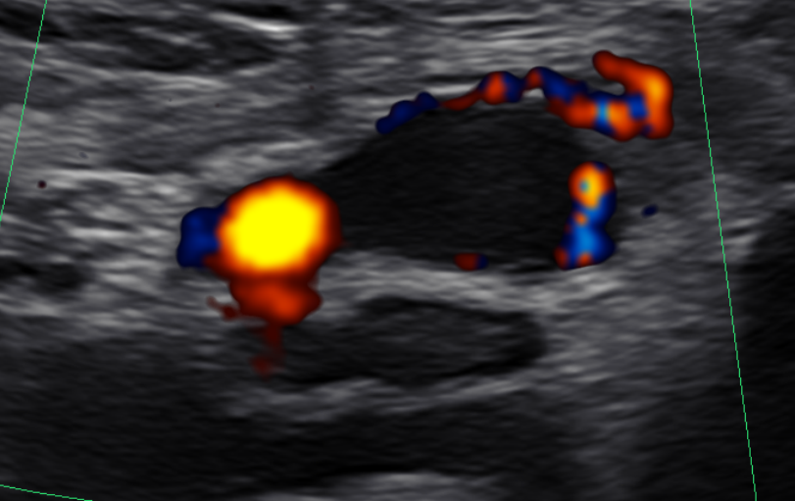
US was read by a different radiologist, who favored “partially thrombosed pseudoaneurysm. Otherwise a lymph node or soft tissue lesion can have a similar appearance.” And he recommended CTA for further evaluation, if warranted.

Slide 6
Thank you!
Any other Ddx to consider or recommendation to give?
Peripheral nerve sheath tumor crossed my mind but I left it out of my report, since the lesion is clearly separate from the ulnar nerve and looks continuous with a blood vessel. But would you have included it in the ddx?
Sarcoma is always in my mind with a soft tissue mass; but again, on MRI I really thought this looked like a vascular lesion, so I didn’t raise the possibility.
Would anyone have recommend biopsy? (I did not)

