Slide 1
Young man with witnessed left lingual nerve injury during ranula removal- s/p coaptation- current status/ neuroma

Slide 2
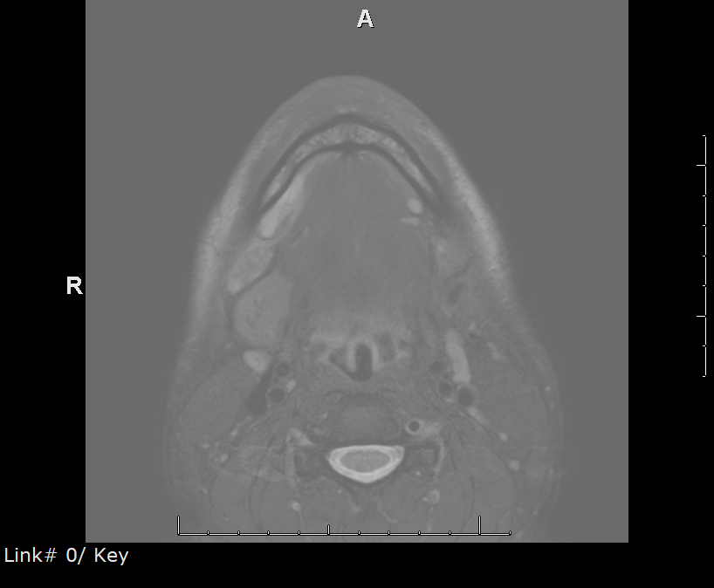
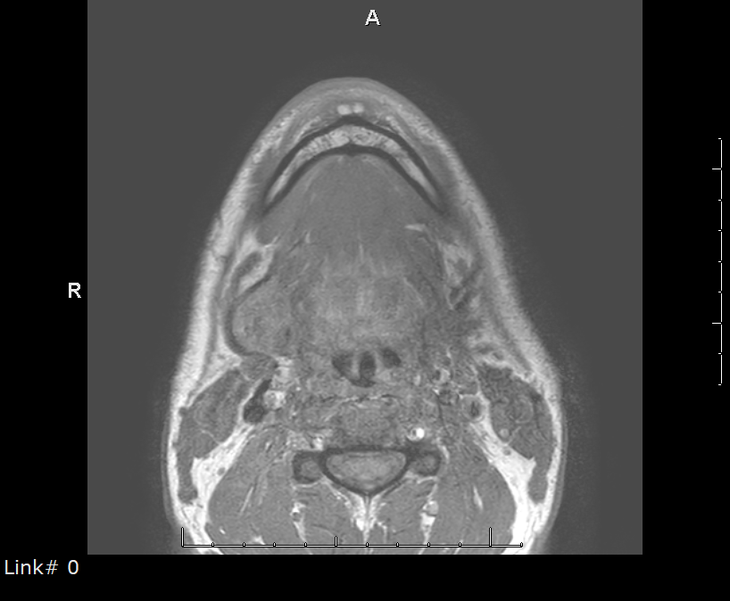
Right ranula

Slide 3
Left plunging one removed with SM gland

Slide 4
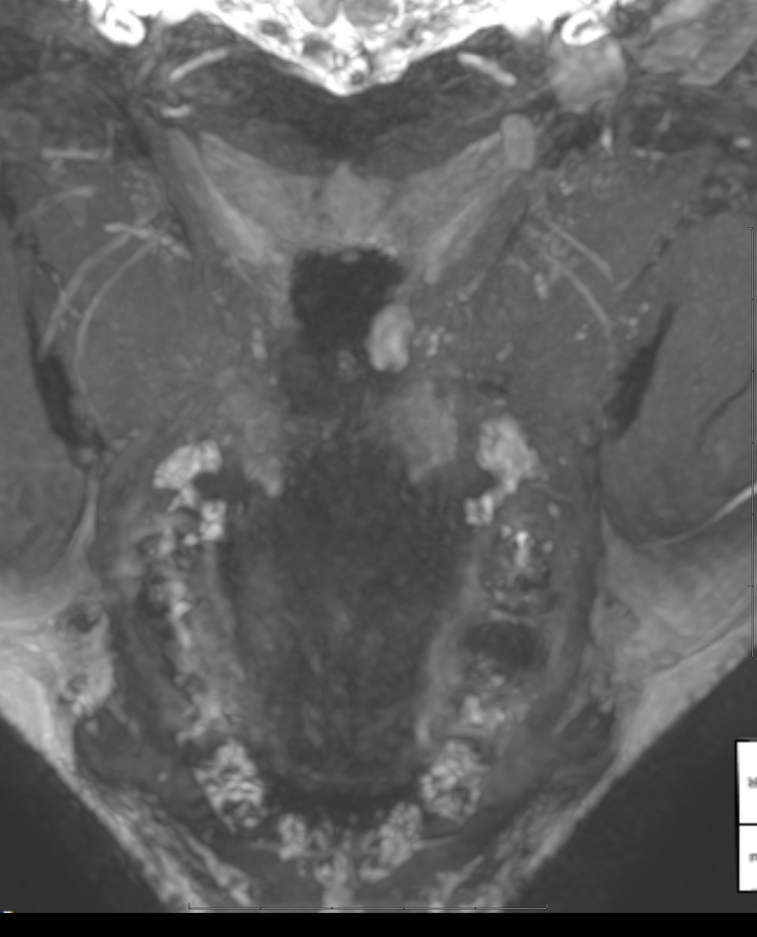
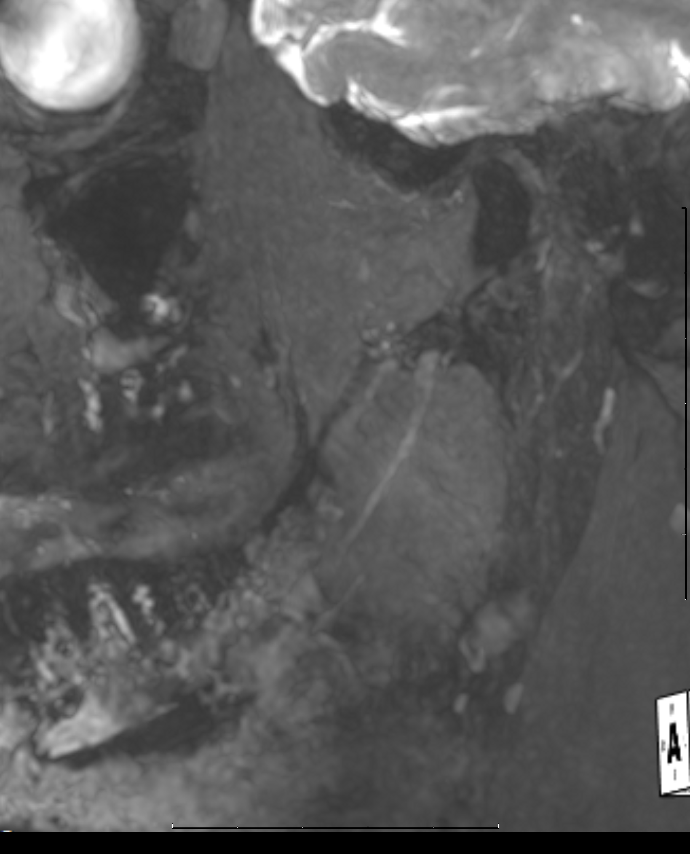

Slide 5
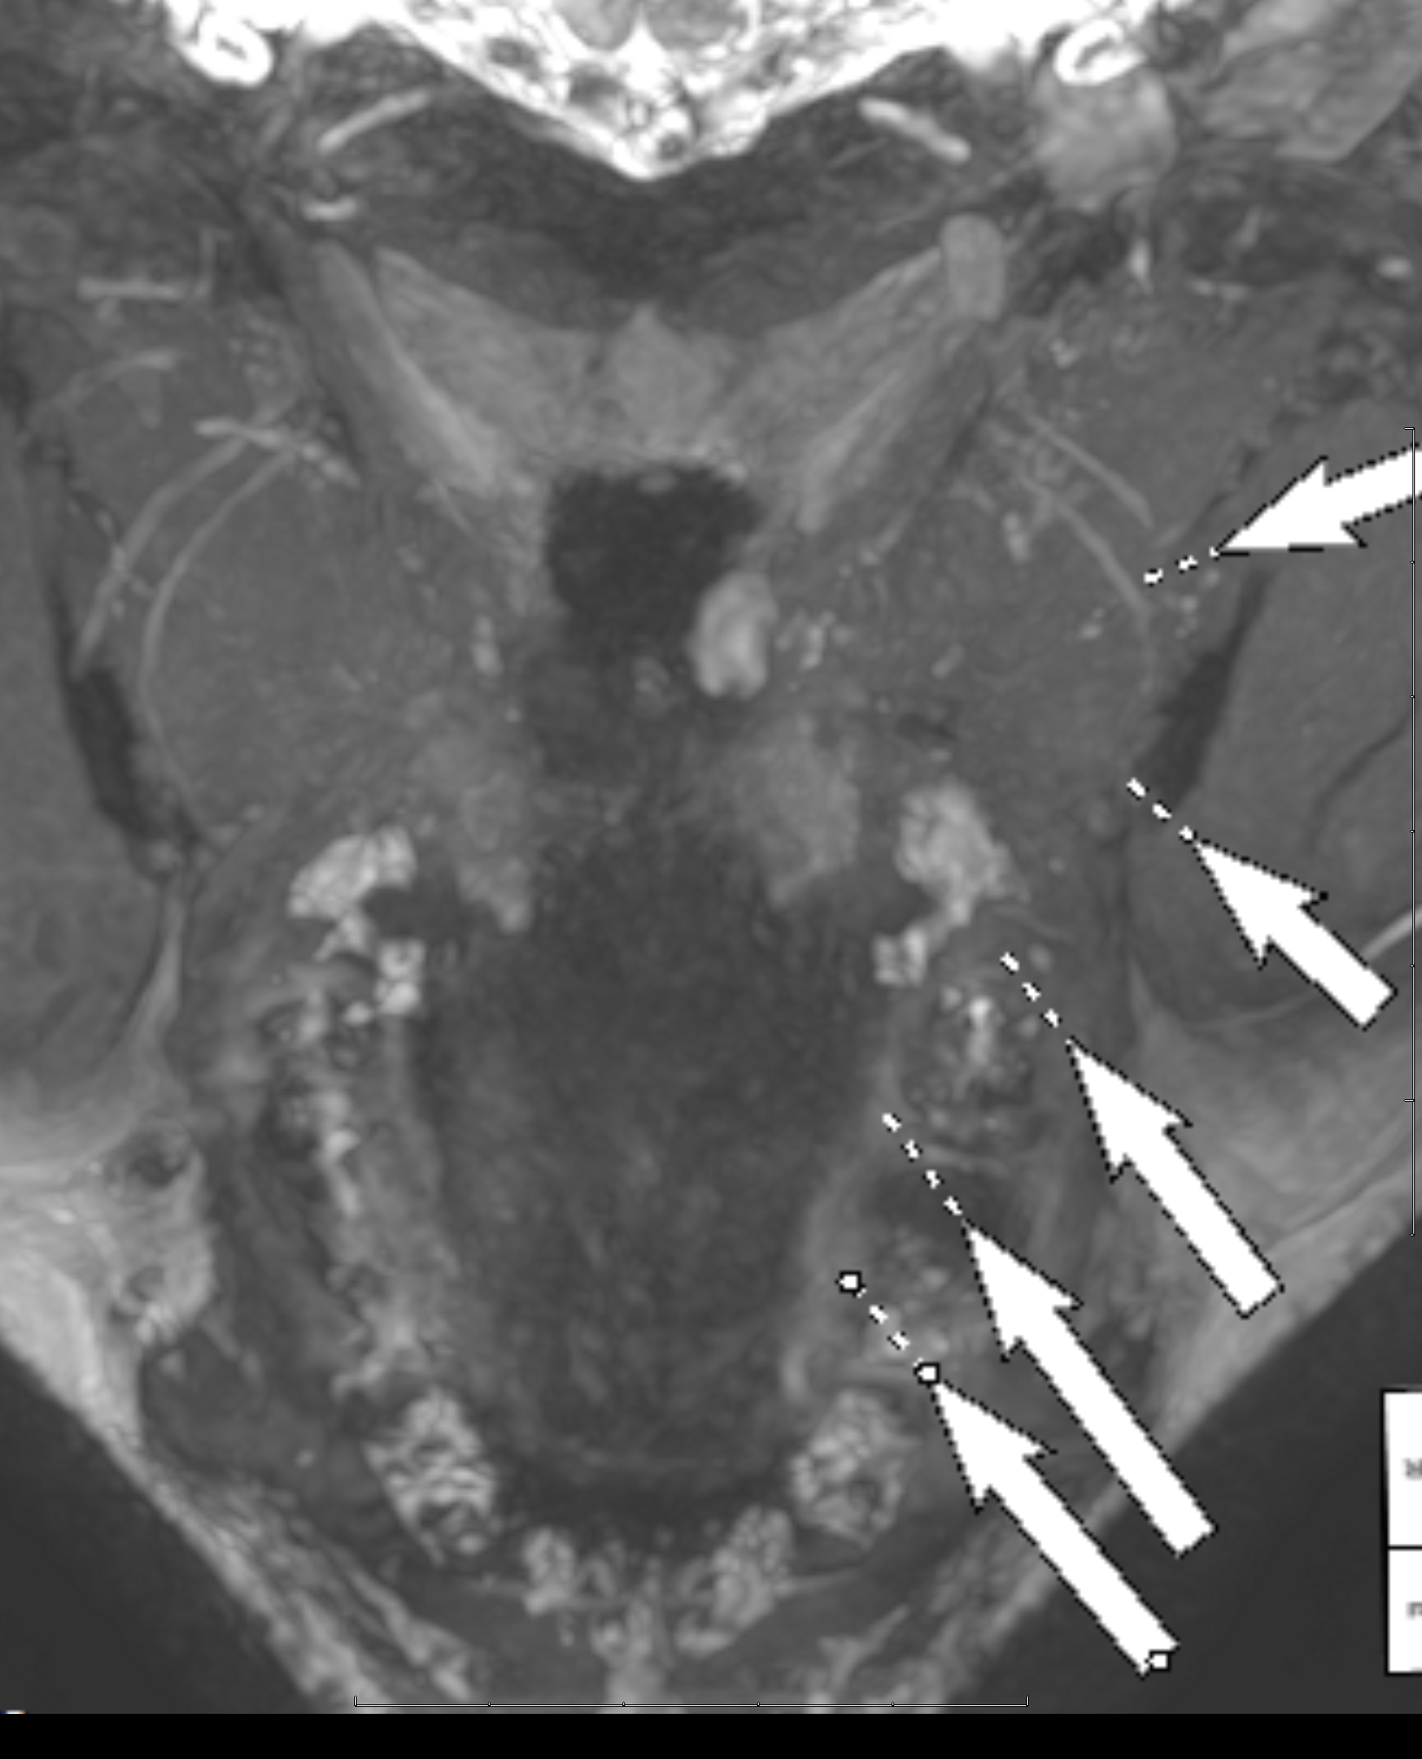
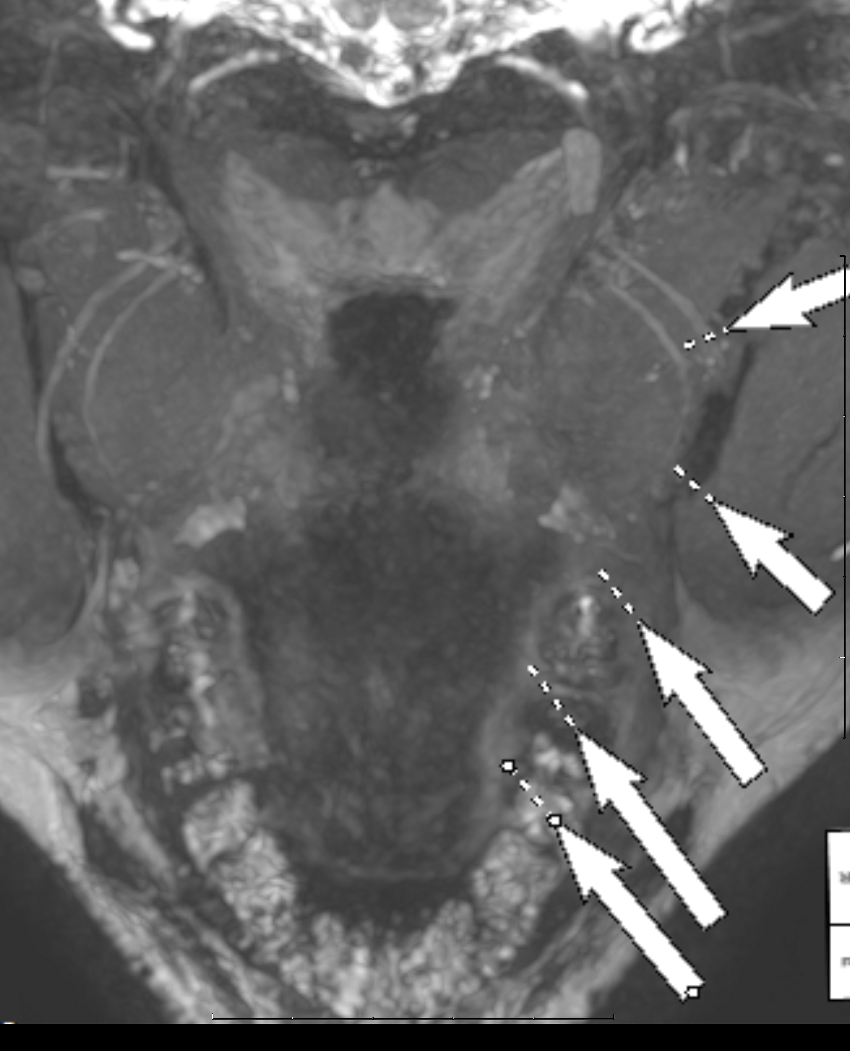

Slide 6
Clinically slowly recovering
MRN- no neuroma- nerve is in continuity
NS-RADS: Nerve: PI2 - Postintervention/surgical cases, possible persistent neuropathy, Muscle: U - Unremarkable

