Slide 1
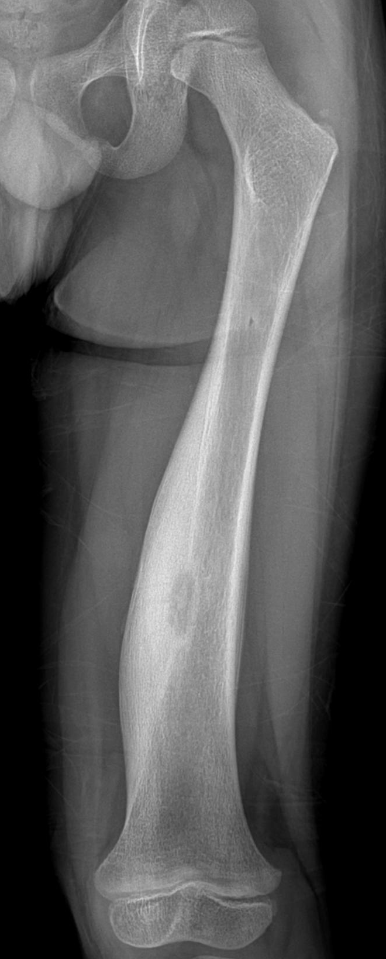
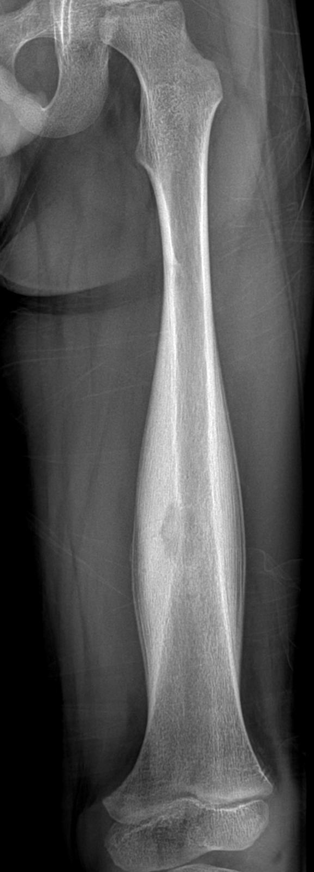
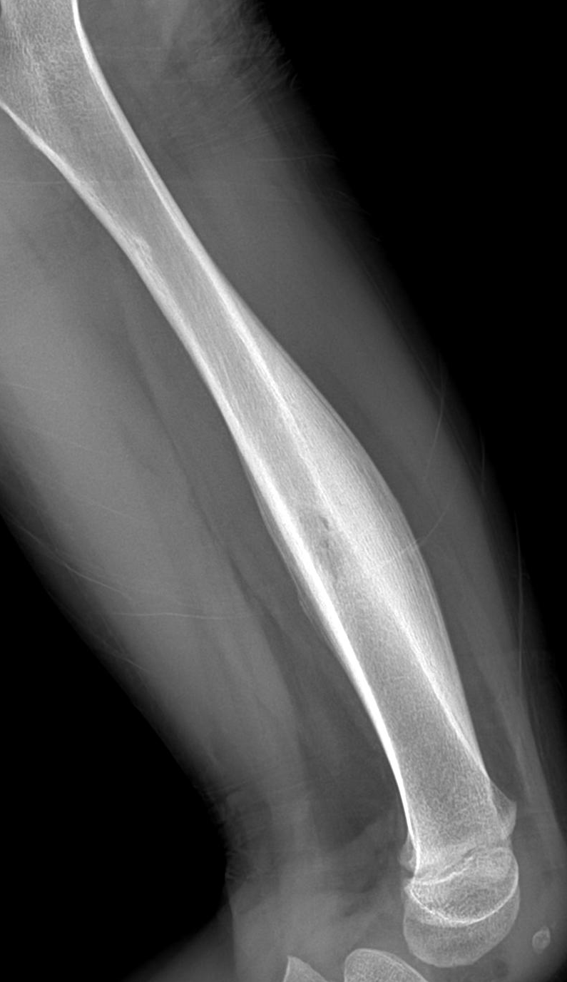
4/M
C.C.; left thigh pain for I month
night pain
Courtesy of InSook Lee
lis@pusan.ac.kr

Slide 2
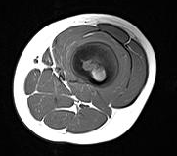
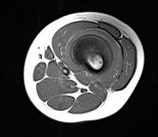
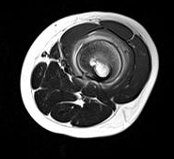
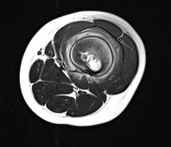
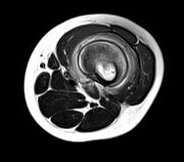
T1WI
T2WI

Slide 3
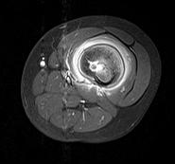
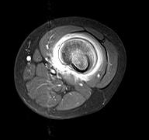
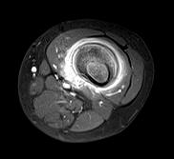
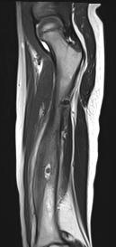
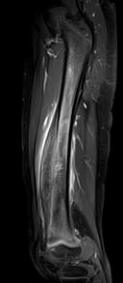
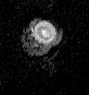

FS ENH
T2WI
FS ENH
ADC

Slide 4
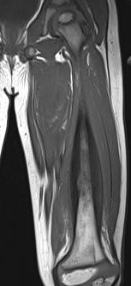
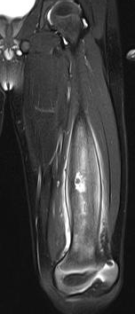
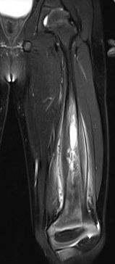
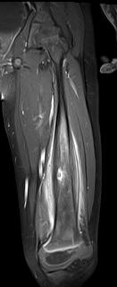
T1WI
FS T2WI
FS ENH

Slide 5
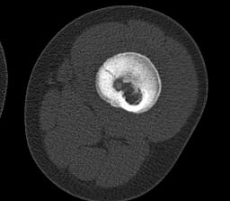
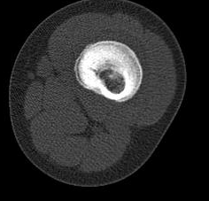

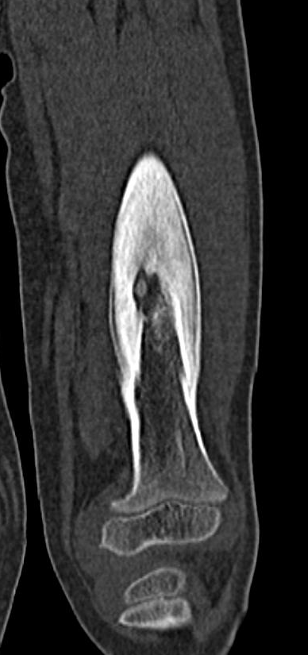
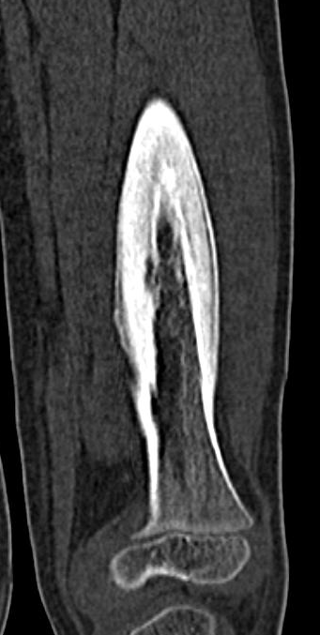

Slide 6
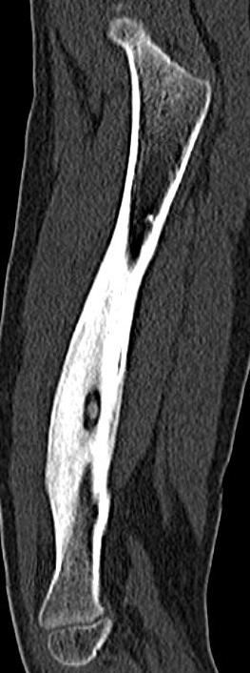
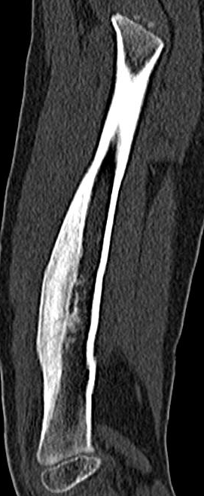

Slide 7
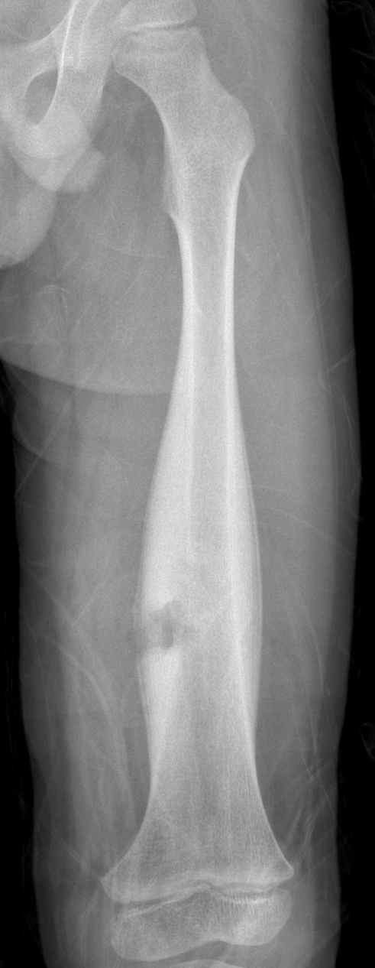
Excisional biopsy
- calcified bony fragment
and fibrous tissue (periosteum)
- necrotic bone (cortical & intramedullary)

Slide 8
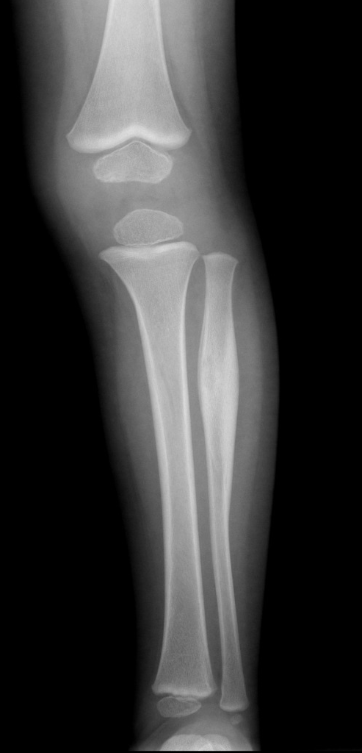
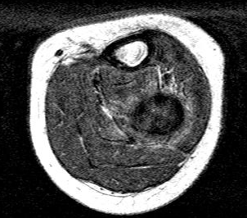
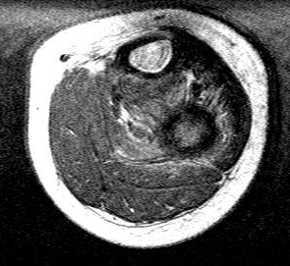
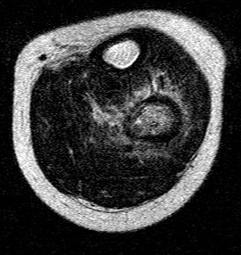
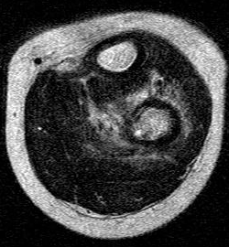
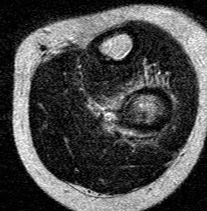
Companion case- osteoid osteoma
T1WI
T2WI
1 year/ male

Slide 9
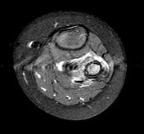
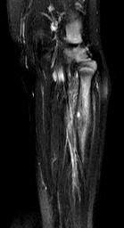
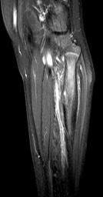
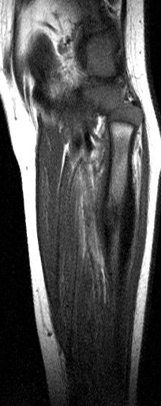
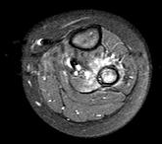
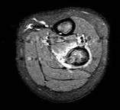
FS COR T2
FS SAG ENH
1 year/ male
SAG T1WI
FS AXI ENH

Slide 10
Osteoid osteoma
Benign bone forming tumors
Children, particularly adolescents (10-35 yrs)
M;F = 2-4:1
Night pain, relieved by salicylate analgesia
Long tubular bones (proximal femur, mid tibial diaphysis)
Usually cortical lesions >> medullary, subperiosteal, intracapsular
Characteristic lucent nidus < 2cm / surrounding solid periosteal reaction (sclerosis) /c cortical thickening
Nidus; occasionally a central sclerotic dot
CT- excellent modality
MRI- non-specific, sometimes misinterpreted as aggressive pathology

Slide 11
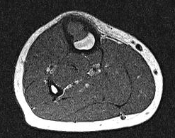
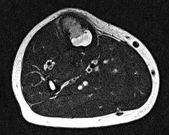
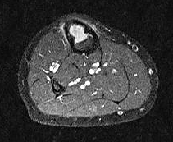
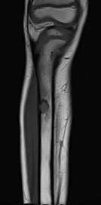
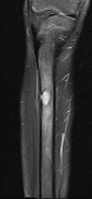
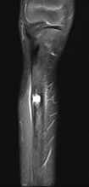
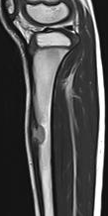
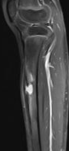
Right tibial bony mass for a year
T1WI
T2WI
FS ENH
Courtesy of InSook Lee
lis@pusan.ac.kr
T1WI
FS T2WI
FS ENH
T2WI
FS ENH

Slide 12
Radiologic DDx.
1. osteofibrous dyaplsia
2. chronic OM
3. Adamantinoma, less likely
Curettage & biopsy
- osteofibrous dysplasia

Slide 13
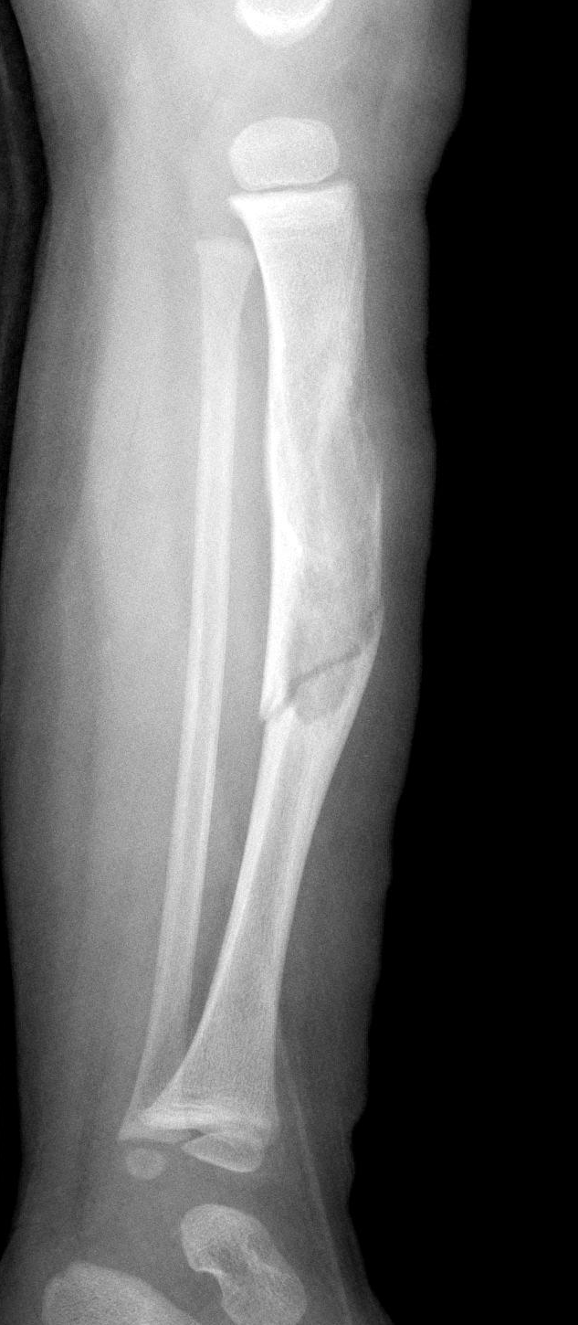
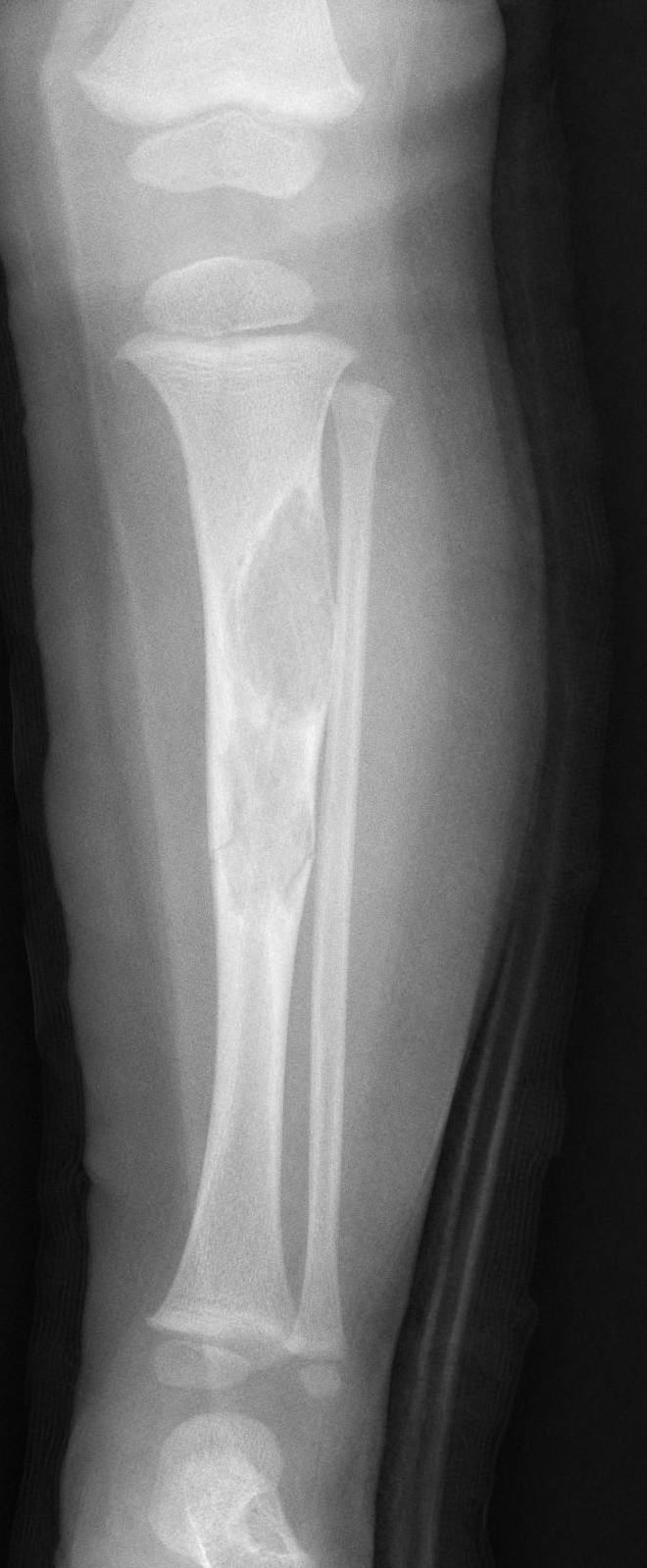
Companion case- osteofibrous dysplasia

Slide 14
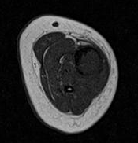
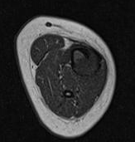
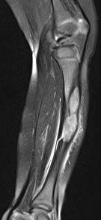







T1WI
FS COR T2WI
T1WI
FS COR ENH
T2WI

Slide 15
Osteofibrous dysplasia
Benign fibro-osseous cortical lesion (non-neoplastic condition)
Tibia & fibula
Mid-diaphysis
Some consider it synonymous with ossifying fibroma
Pain, swelling, pathologic fracture
Younger age >> adamantinoma (older age group)
Smaller >> adamantinoma
Tx.; surgery is reserved. Usually stabilize or spontaneously regress.
Local recurrence after surgery /c some aggressive recurrence, possibley due to components of adamantinoma or possible transformation to adamantinoma

Slide 16
Osteofibrous dysplasia
Plain radiograph
- mid-diaphysis, esp. anteriorly
- cortical /c medullary encroachment
- lobular-to-bubbly in appearance
- lucent or ground-glass
- well-defined sclerotic margins
- pseudotrabeculations & anterior bowing
- no periosteal reaction

Slide 17
Intracortical mass in tibia
Pubmed search
1. lipoma
2. Ewing-like adamantinoma
3. chondromyxoid fibroma
4. osteosarcoma
5. chondroma masking as an osteoid osteoma
6. adamantinoma
7. epidermal cyst
8. osteofibrous dysplasia
9. hemangioma
10. ossifying fibroma

