Slide 1
Morphea

Slide 2
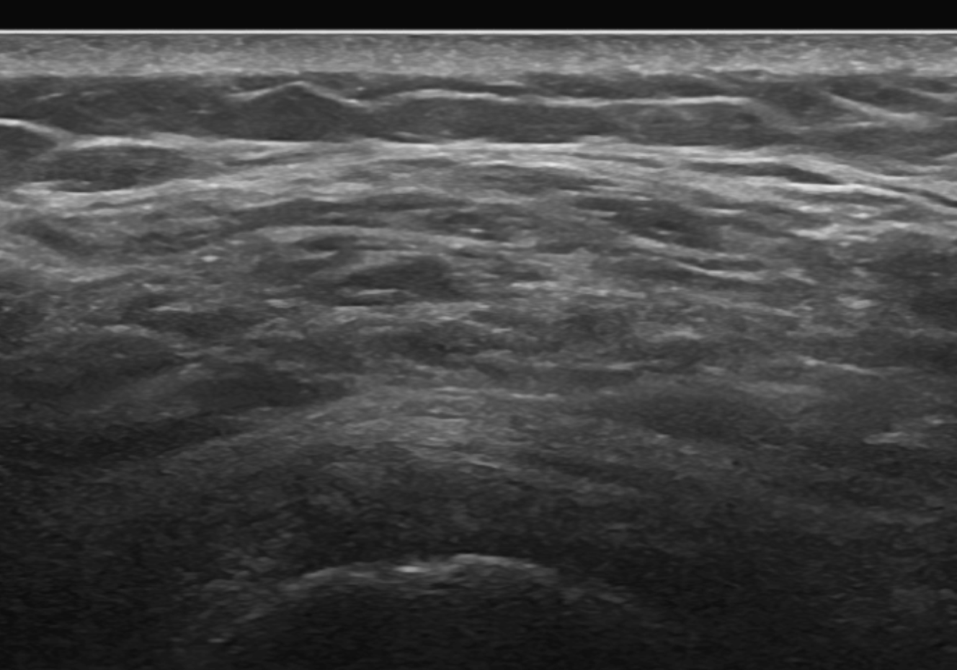
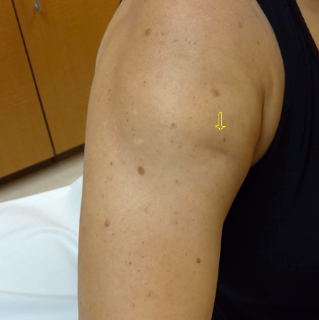
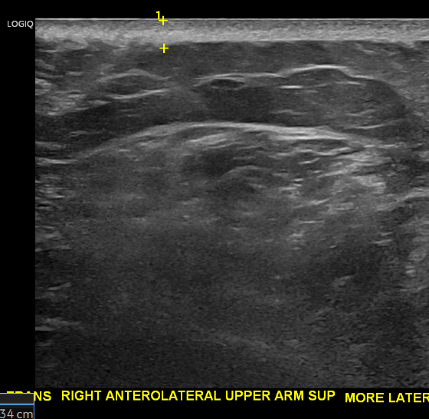
Skin thickening- 0.34mm on US and subQ heterogeneity

Slide 3
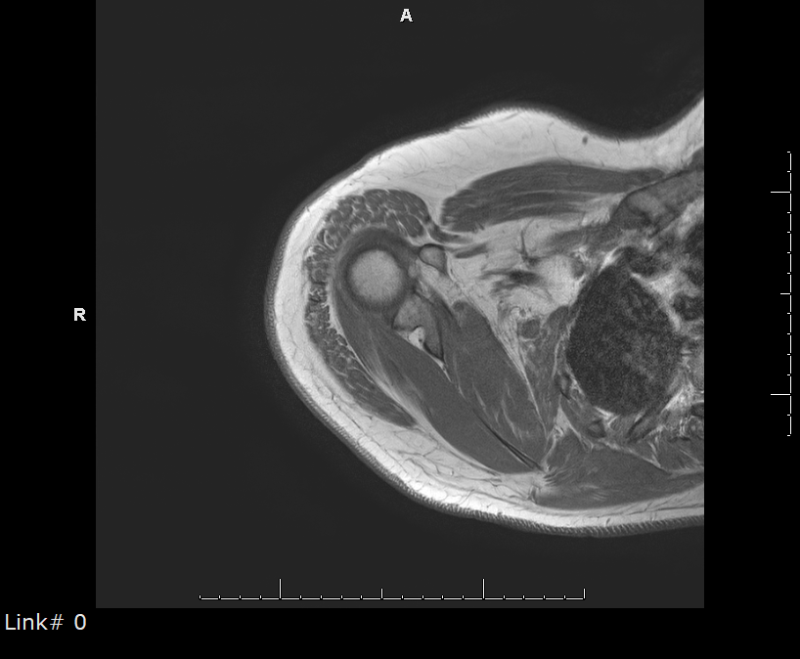
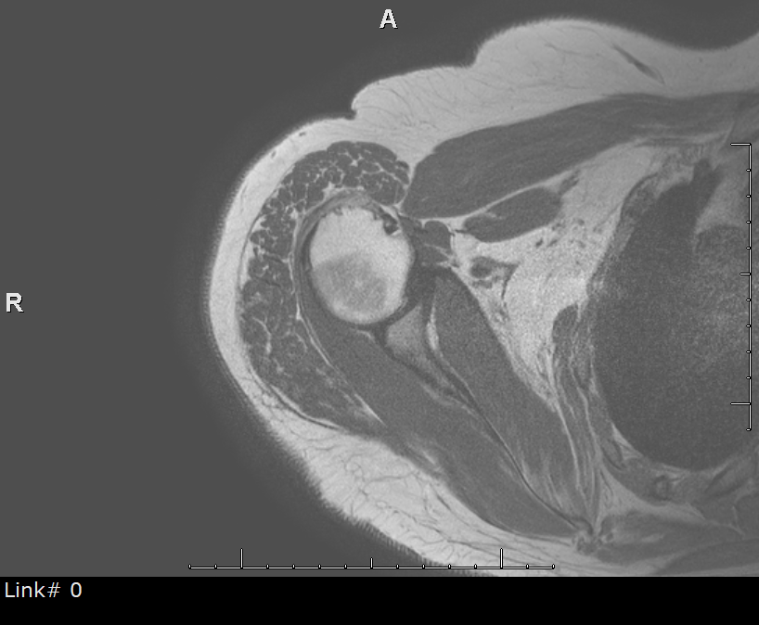
IP- skin thickening

Slide 4
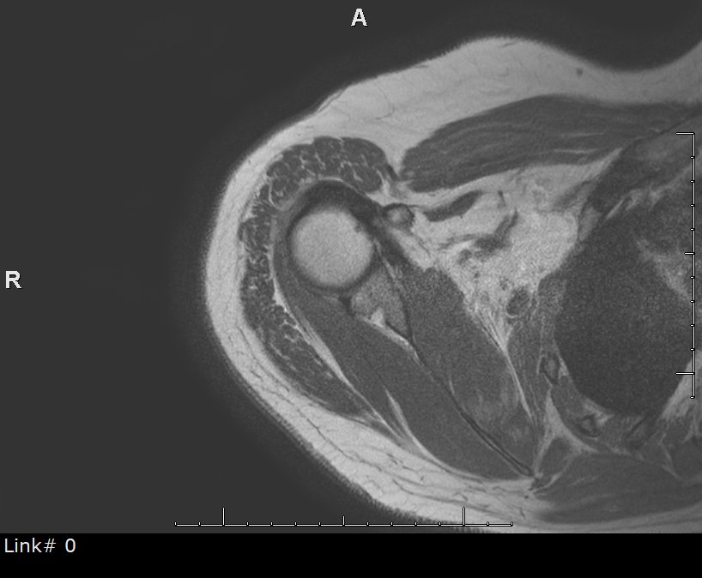
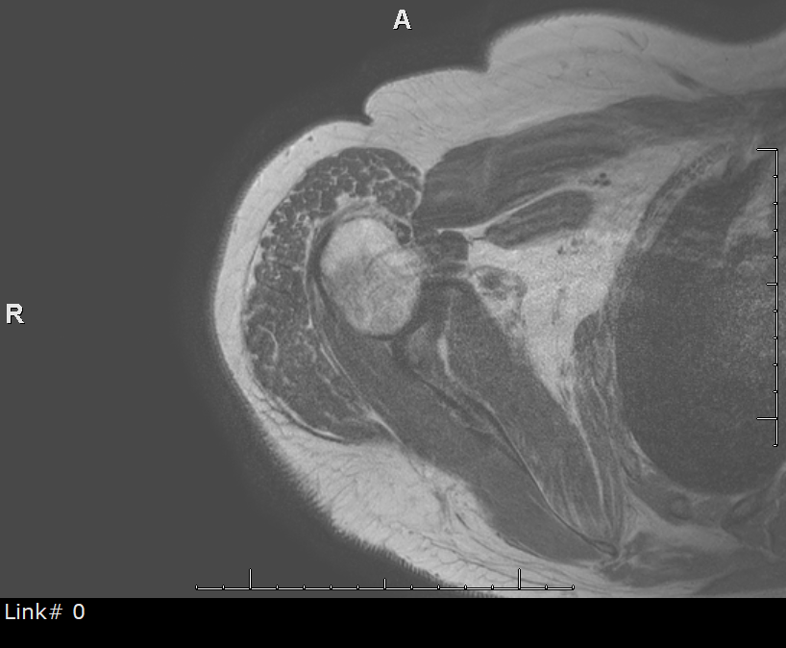
Op- superficial fascial thickening and scarring- fat atrophy laterally

Slide 5
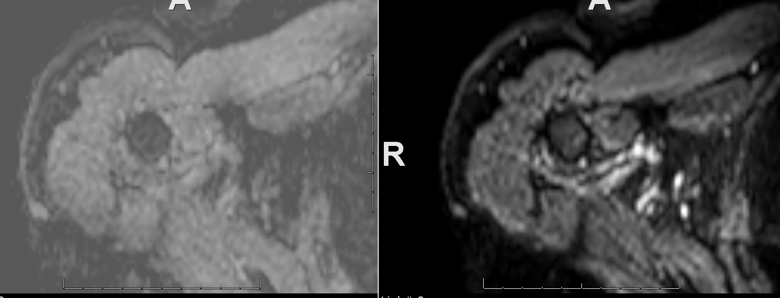
Increased adc

Slide 6
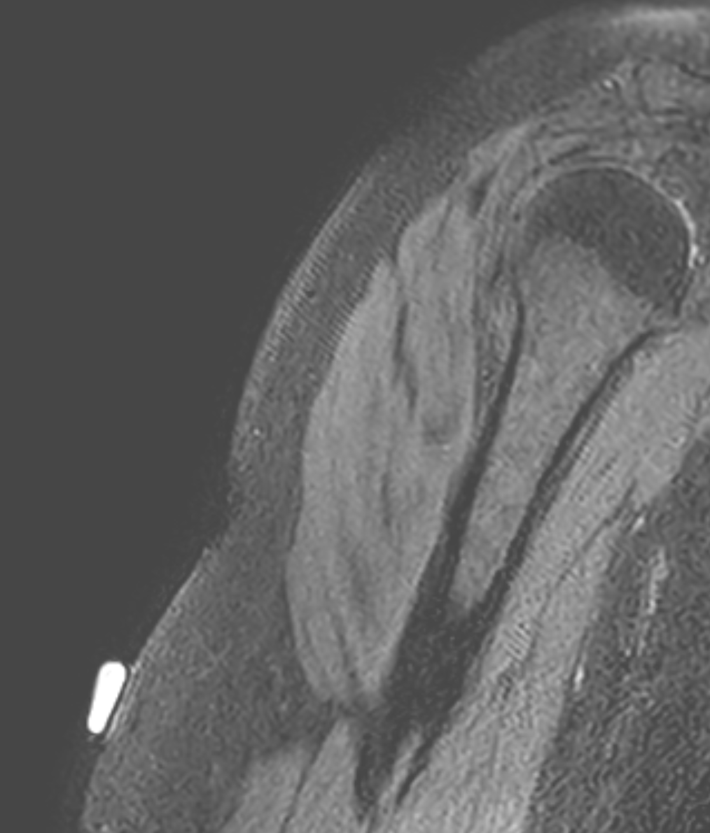
3D- look at sclerosis- strandy transverse lines across skin

Slide 7
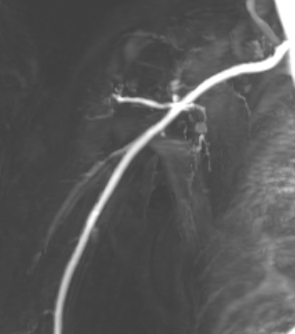
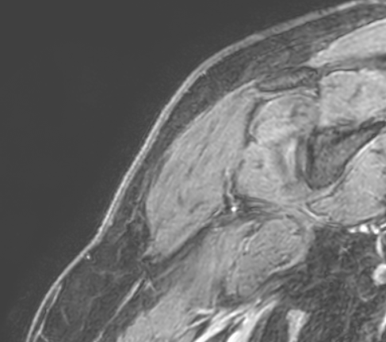
Increased vascularity and post-contrast

Slide 8
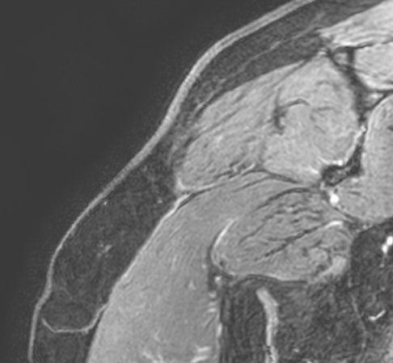
Treated with Mycophenolic acid (Myfortic)
Other options offered to patient due to incomplete response- tofacitinib and abatacept

Slide 9
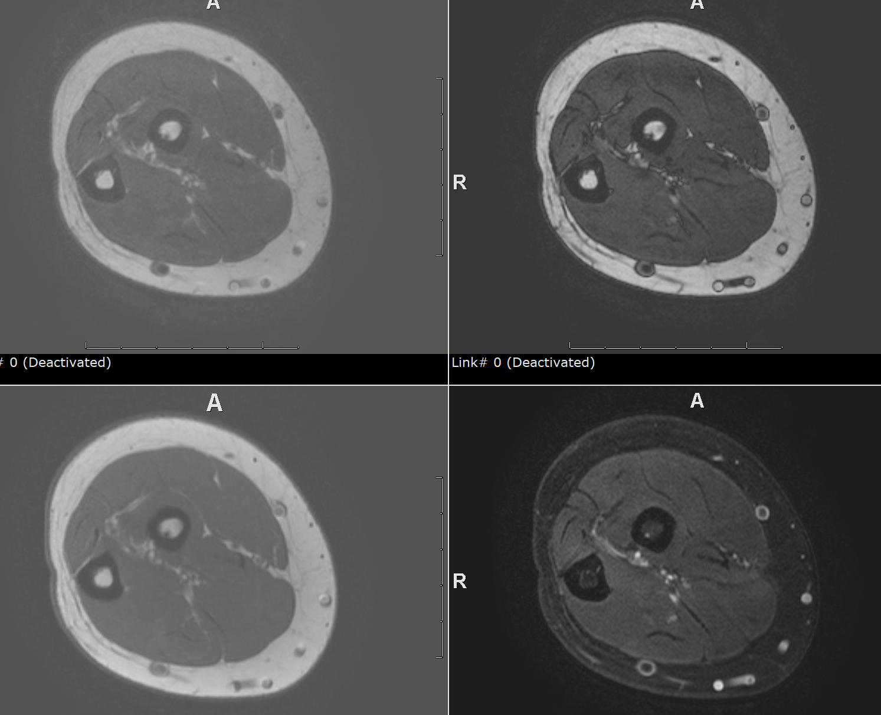
Case 2- posterior upper forearm- chronic morphea with atrophy- t2 Dixon- this one on cellcept

Slide 10
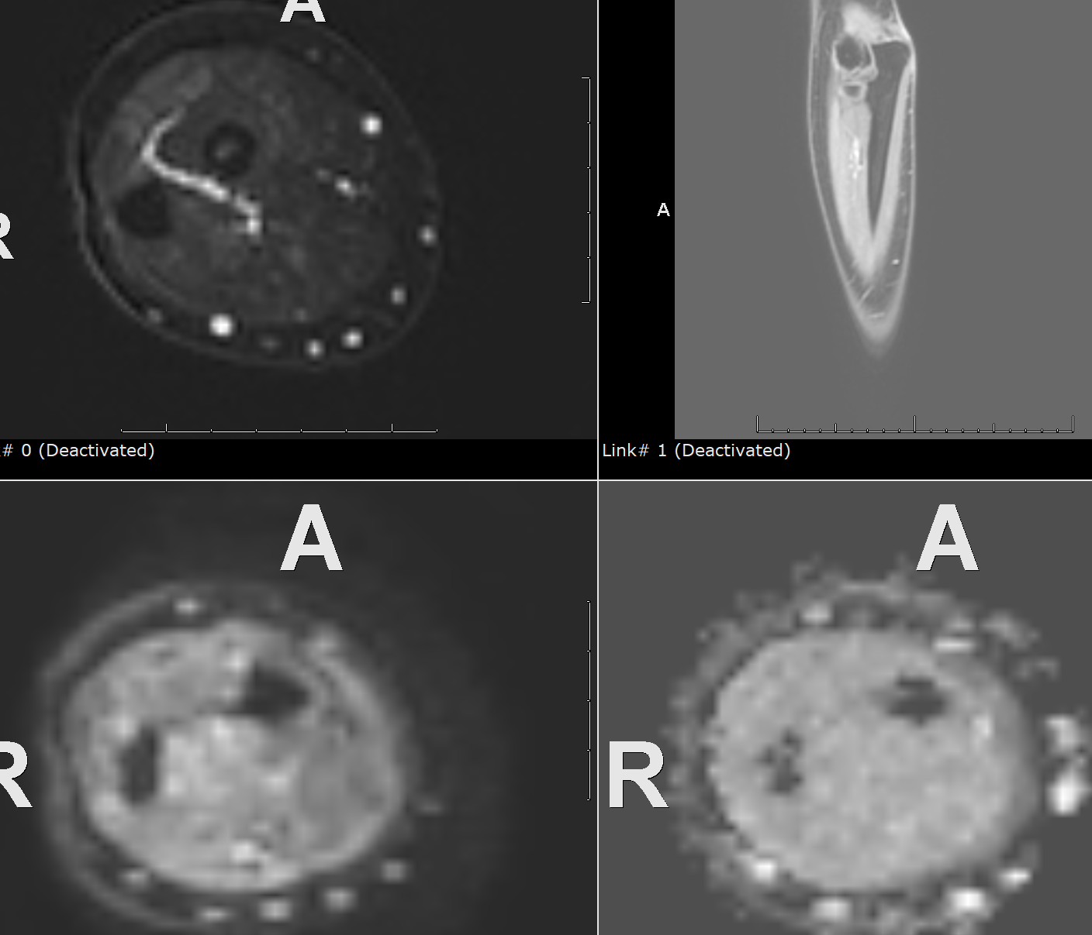
Negative on contrast and diffusion

Slide 11
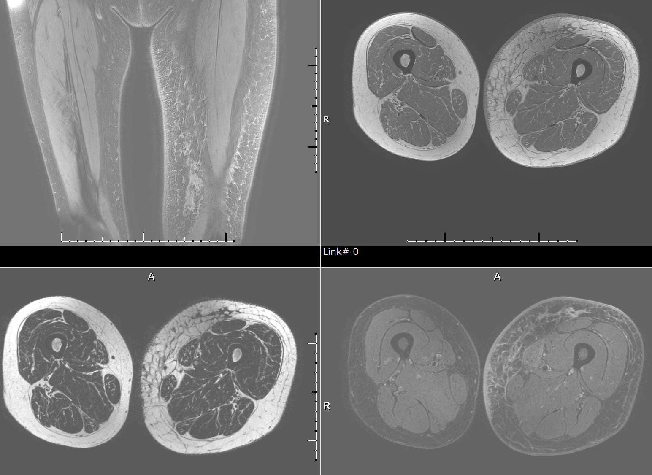
This one is active flagrant case

Slide 12
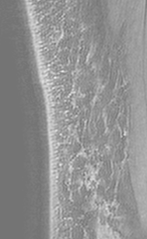
3D

Slide 13
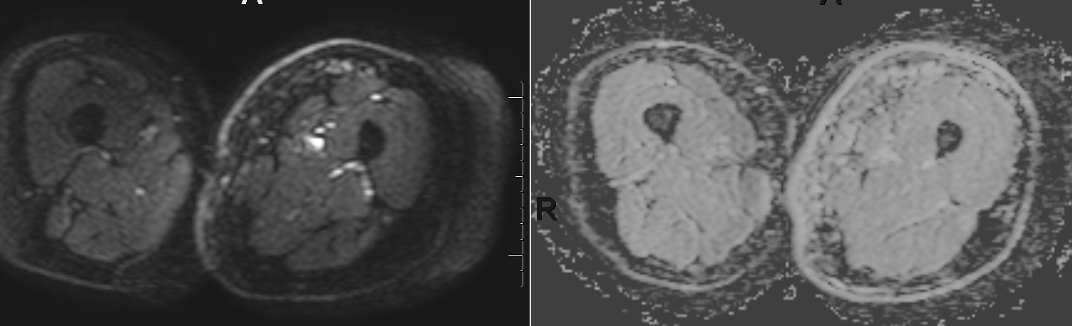
V high adc in left thigh

Slide 14
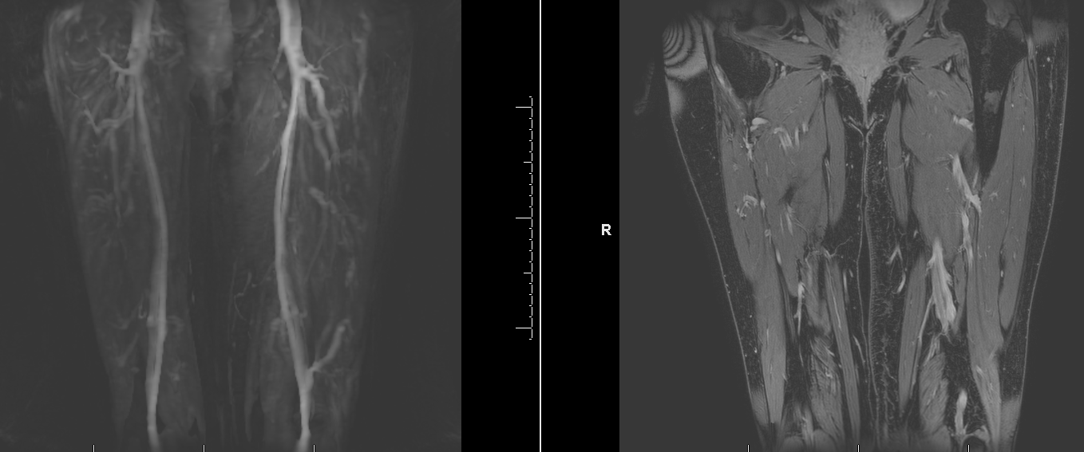
Perfusion and contrast

Slide 15
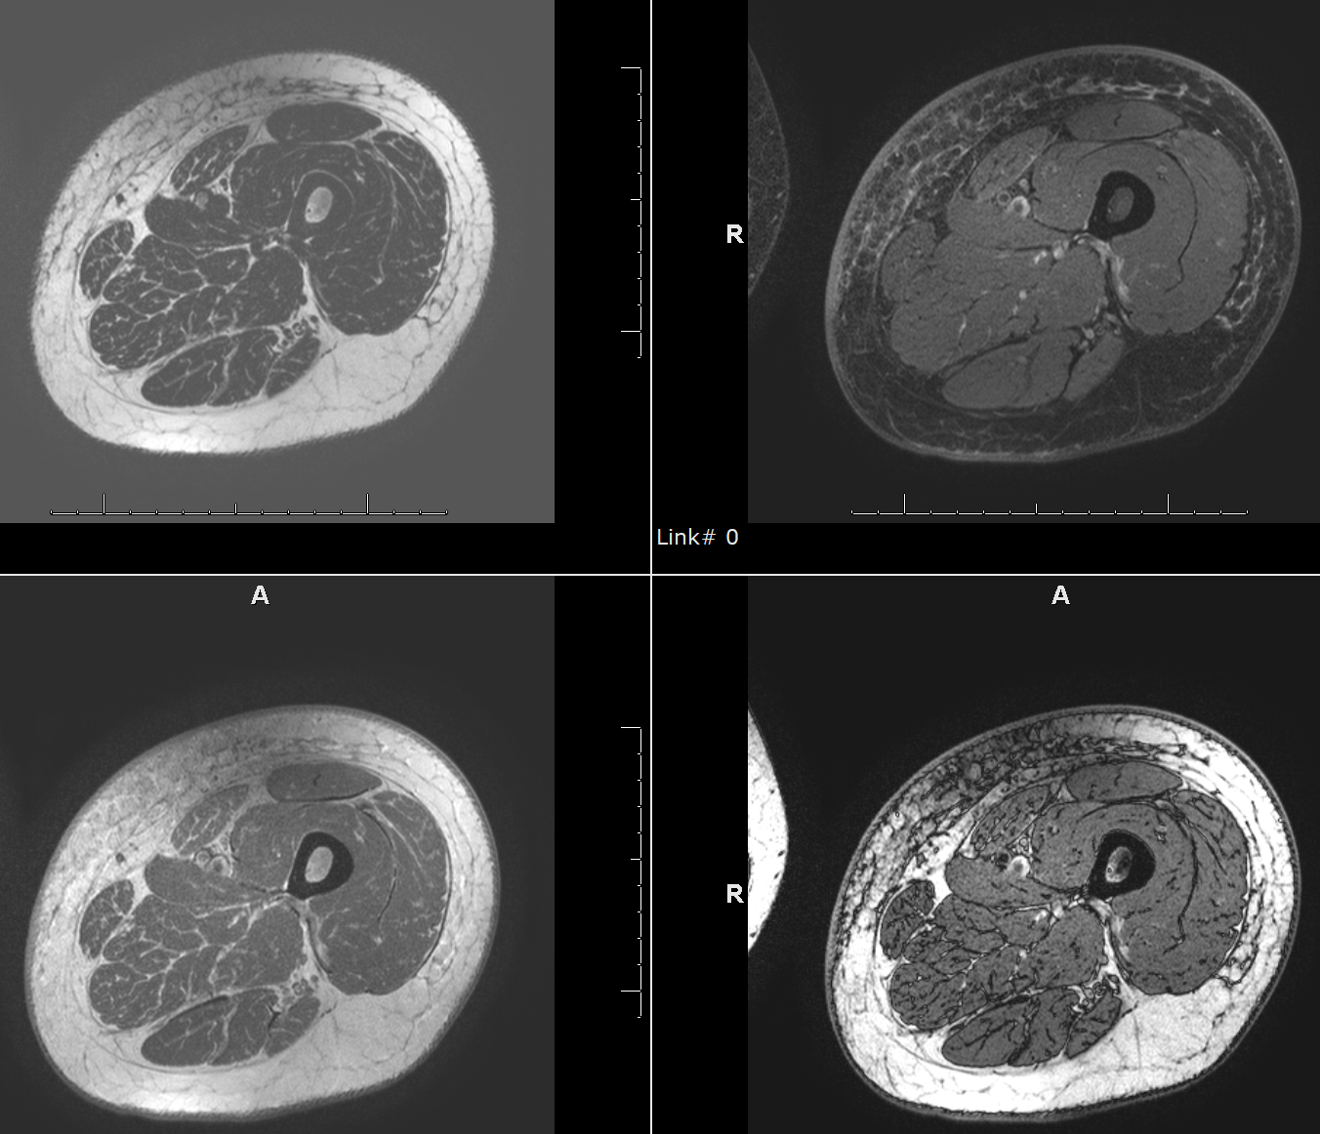
On UVA1 phototherapy and methotrexate

