Slide 1
Medial meniscus intact or normal- ACL is torn and infarcts in bone

Slide 2
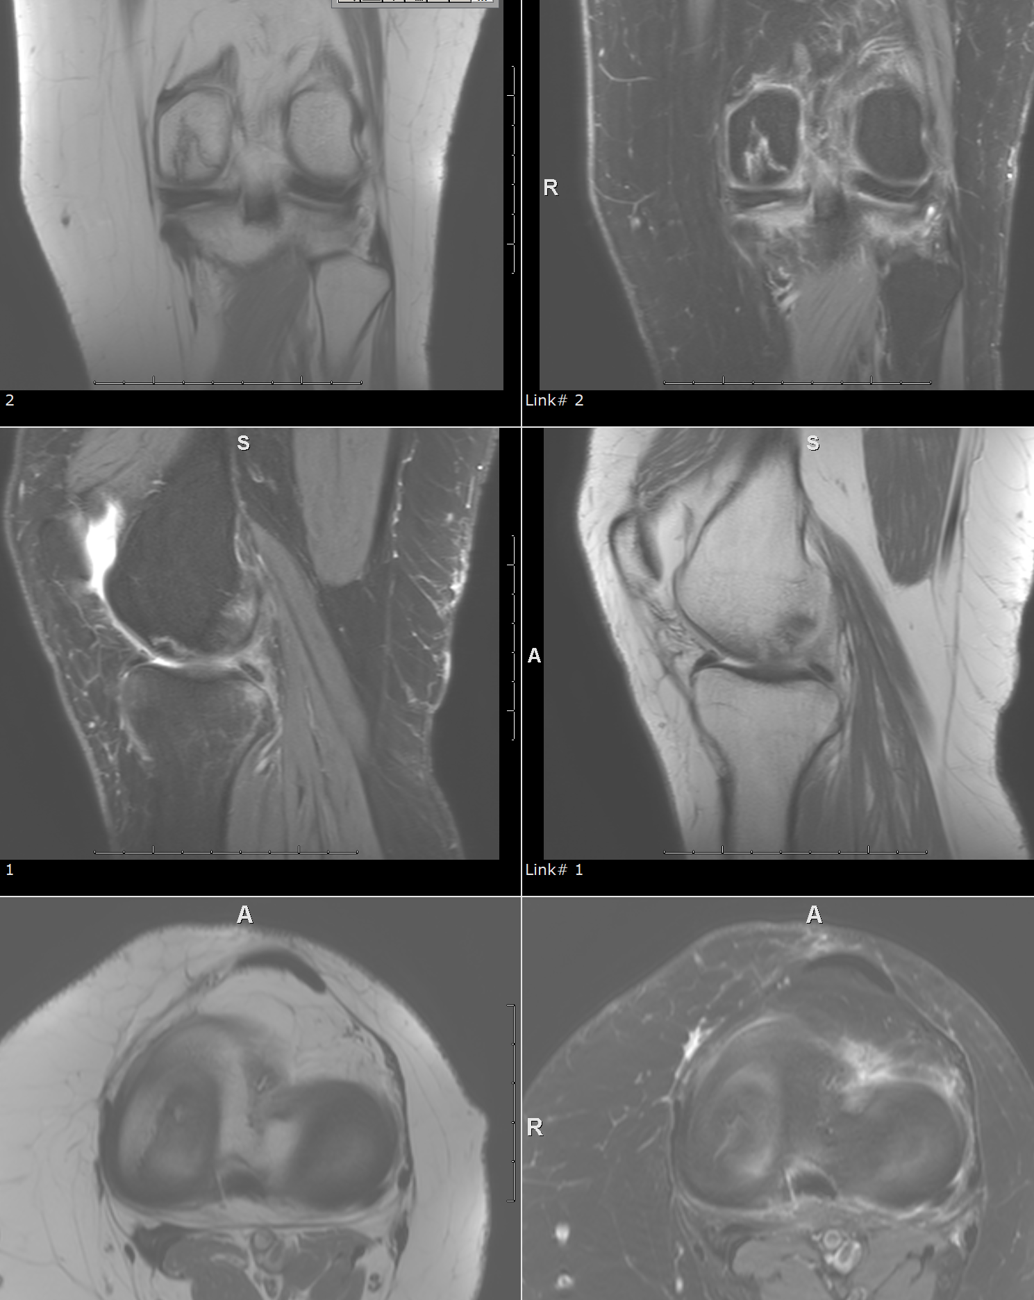

Slide 3
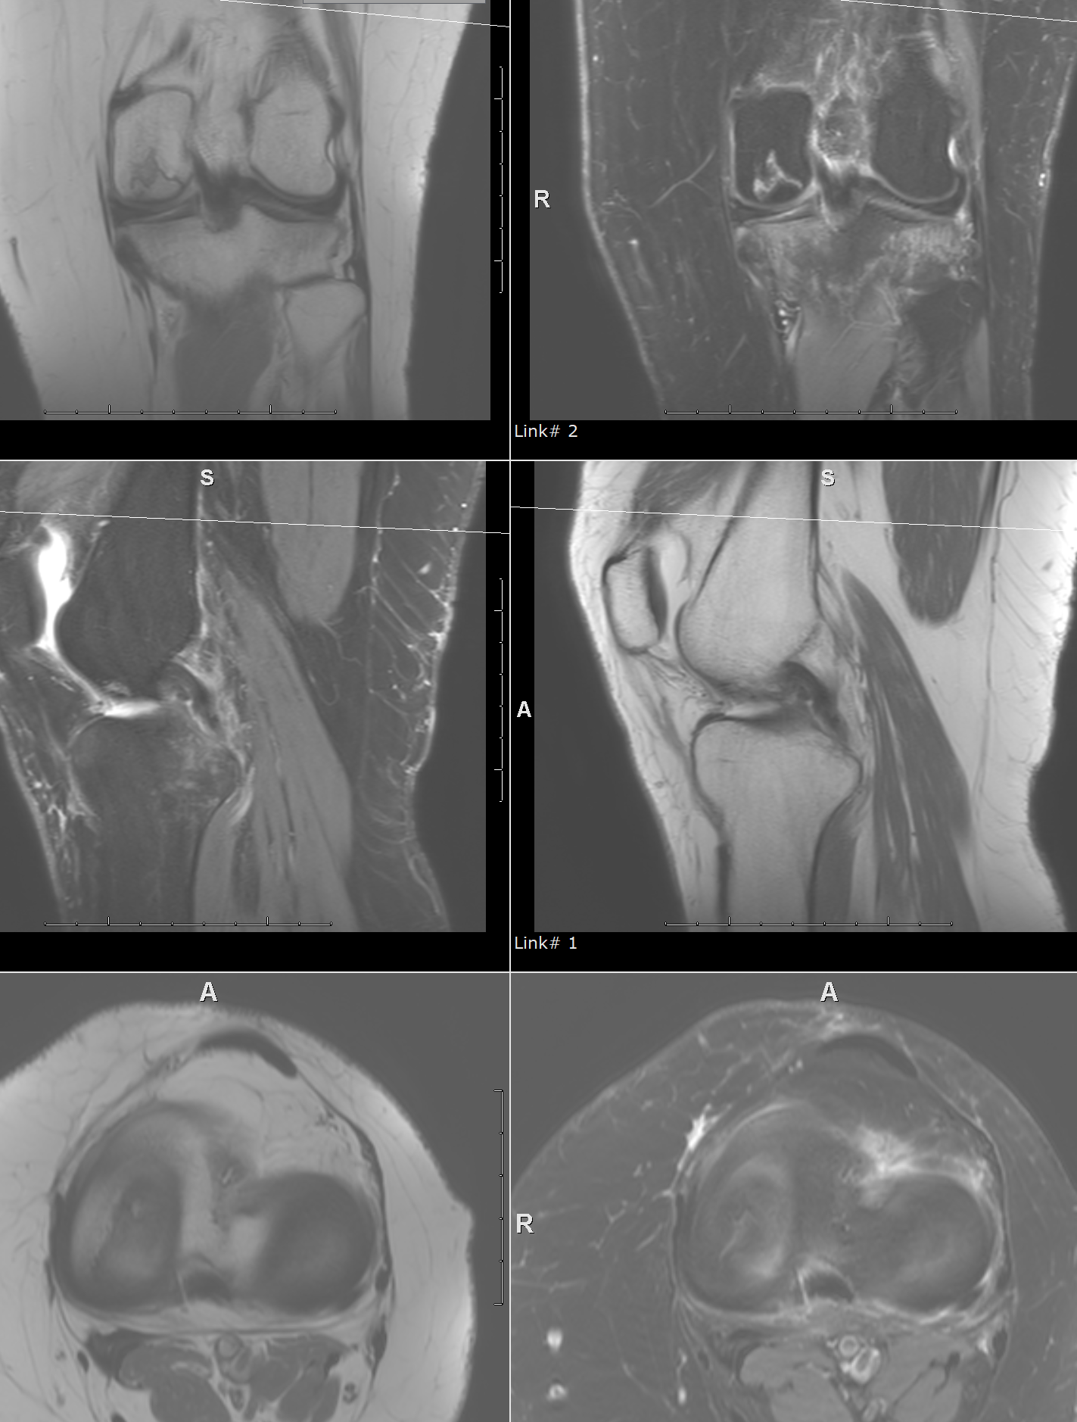

Slide 4
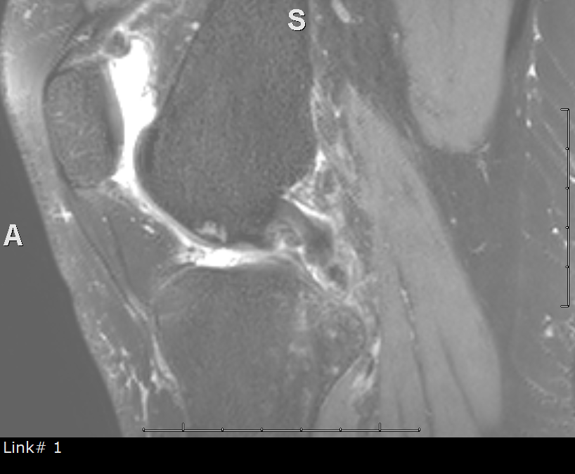
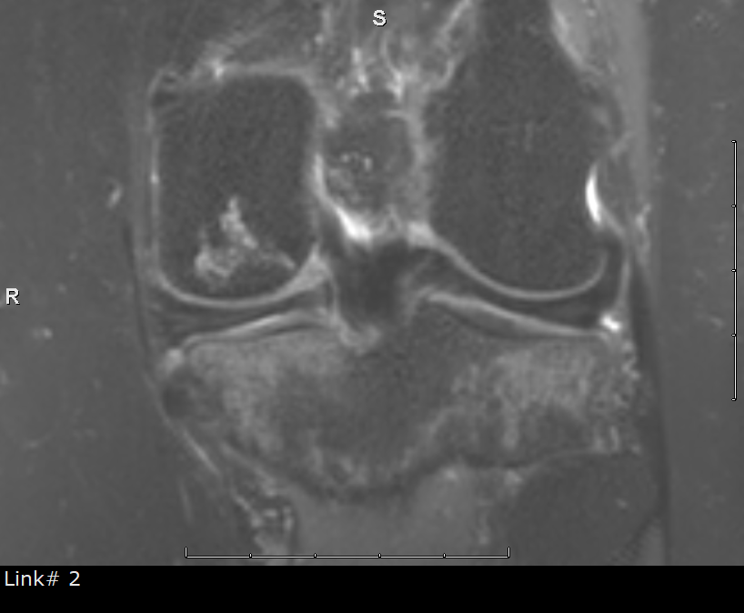
Now see 3D

Slide 5
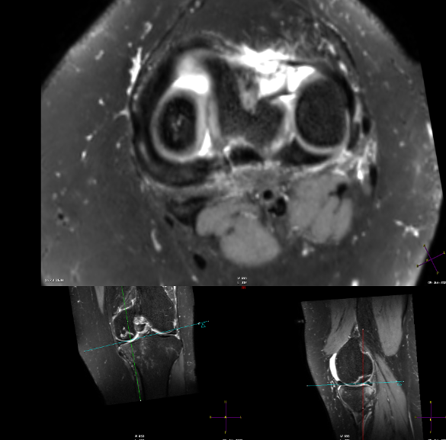
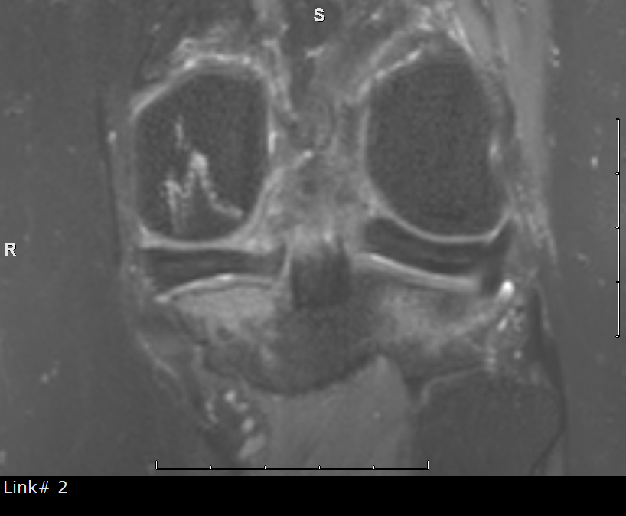

Slide 6
Which Laprade type is it?

Slide 7
Laprade IIb

