Slide 1
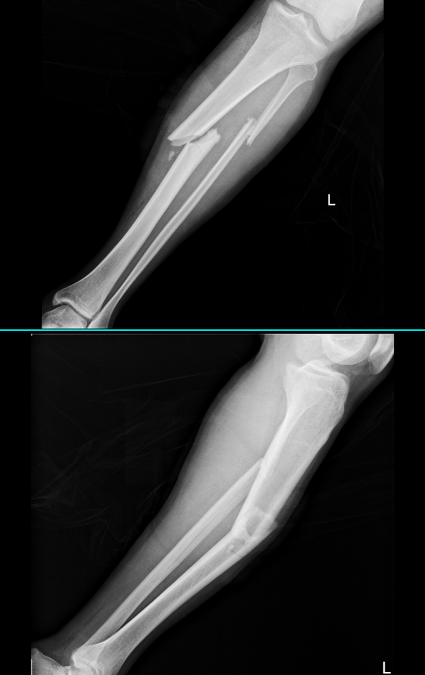
36/M
Left knee pain
s/p IM nail insertion for communited fracture in mid diaphysis of left tibia, 6 month ago
6 months ago
Courtesy of LeeSook Lee
jsyi2010@gmail.com

Slide 2
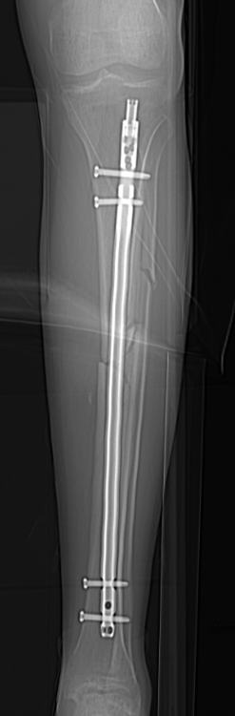
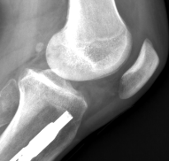
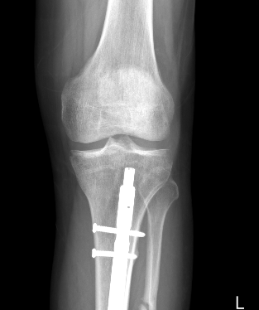

Slide 3
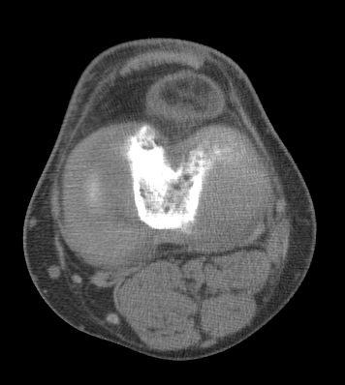
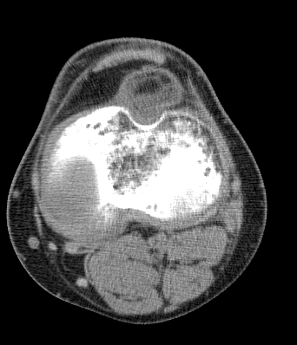
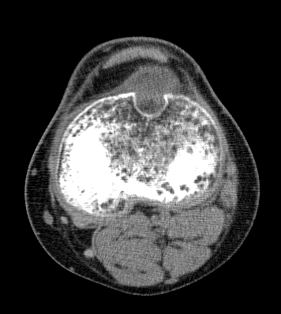

Slide 4
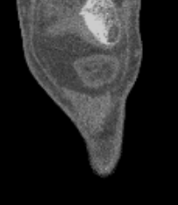
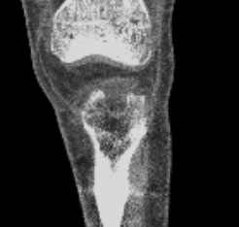
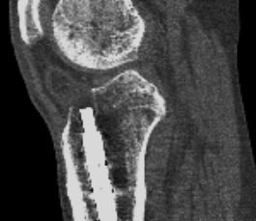
Approximately 3.0 x 2.0 x 2.2cm sized well demarcated lesion at infrapatellar fat pad, near tibial nail insertion site.
- This lesion shows thick wall and inner fat density (mean -22 HU).
- Recommendation: MRI correlation.
Callus formation and still noted fracture gap at mid diaphysis of left tibia.
- without evidence of loosening or fracture of devices inserted in left tibia.
Fracture at proximal diaphysis of left fibula.
- callus formation and still noted fracture gap.

Slide 5
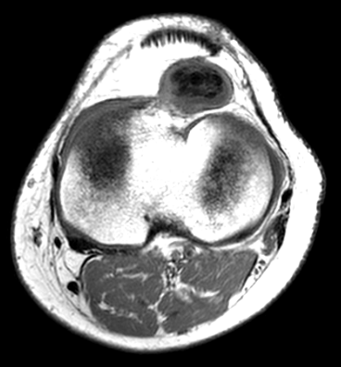
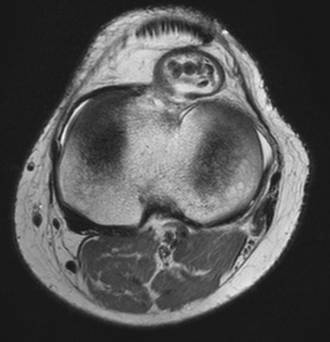
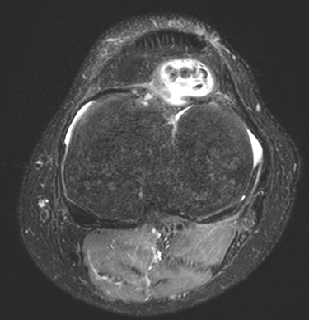
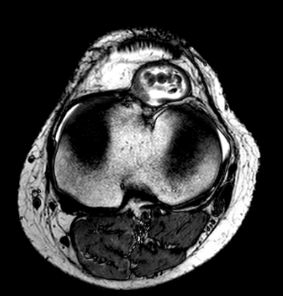
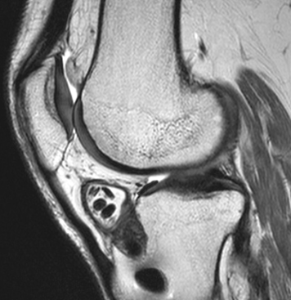
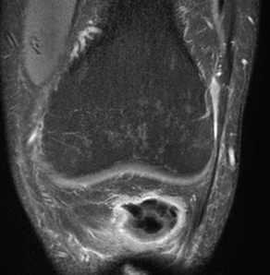

Slide 6
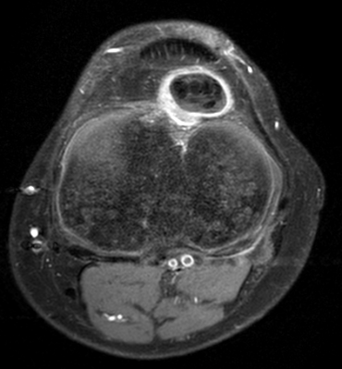
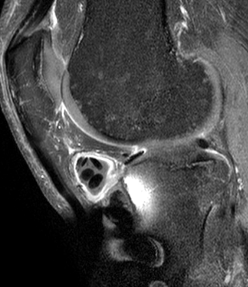
Approximately 3.0 x 2.0 x 2.2cm sized well demarcated lesion at infrapatellar fat pad, near tibial nail insertion site.
- This lesion shows inner T1 and T2 dark signal intensity round to oval lesions (less than 1cm sized) and margial enhancement.
- This lesion shows fat density lesion on CT taken on 2017-11-21.
Differential diagnosis: foreign body reaction (including paraffinoma)/ localized TSGCT.
Path: Paraffinoma

Slide 7
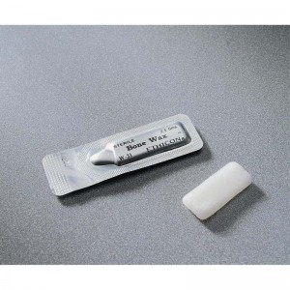
For the removing of the IM nail without difficulties,
the bone waxing applied.
A waxy substance
Help mechanically control bleeding from bone surfaces during surgical procedures
Made of beeswax with a softening agent such as paraffin or petroleum jelly
Smeared across the bleeding edge of the bone, blocking the holes and causing immediate bone hemostasis through a tamponade effect

Slide 8
Paraffinoma
Paraffin oil injection has been used to augment body contours (breast, penis, and face…)
Foreign body granulomata that form in response to the presence of paraffin oil in soft tissue
Radiographic examination of the knee showed soft tissue swelling and many dense, rounded and streaky calcifications
Within the tissues paraffin converts into a semisolid state, and causes steatonecrosis, foreign body granulomata and a strong fibrous reaction
The granulomatous tissue may undergo suppuration and fistula formation, giving rise to serous and sero-purulent drainage
Skeletal Radiol (2003) 32:485–488
AJR 1999:173:929-322

Slide 9
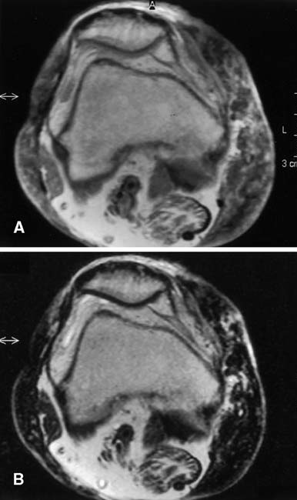
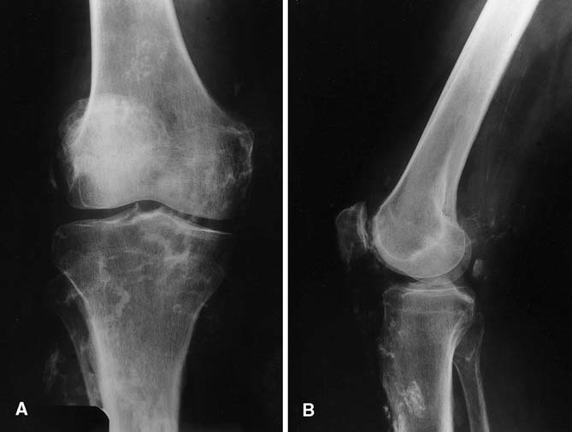
90/M, complaints of knee pain
Skeletal Radiol (2003) 32:485–488
Notes:
that at
the beginning of the Second World War the patient had injected
his own knee with paraffin in an attempt to avoid military service.

Slide 10
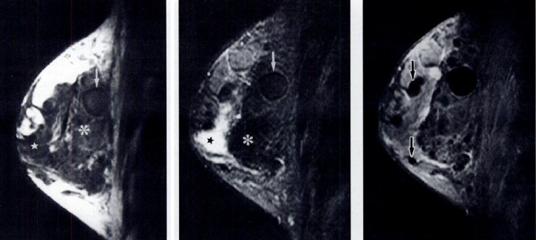
50/F, history of paraffin oil breast augmentation more then 20 years previously
AJR 1999:173:929-322

Slide 11
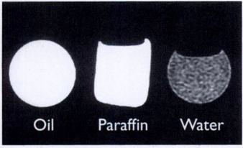
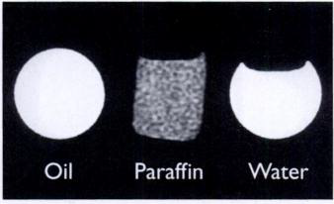
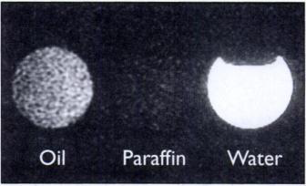
Qualitative in vitro comparison of liquid paraffin phantom with lipid and water phantoms
T1w
T2w
T2FS
AJR 1999:173:929-322

Slide 12
Qualitative in vitro comparison of liquid paraffin phantom with lipid and water phantoms
T1w
T2w
T2FS
The SI of main component, low to intermediate on both T1w and T2w images
Fibrous tissue
The SI of the paraffin-containing round component is characteristic
Low SI on both T1w and T2 images and markedly suppressed on fat-supression sequences
In vitro and in vivo signal intensity of liquid paraffinoma on T1 weighted image is different
→ Probable due to convert into semisolid state
AJR 1999:173:929-322

