Slide 1
13 year old soccer player
Fracture vrs cleft?

Slide 2
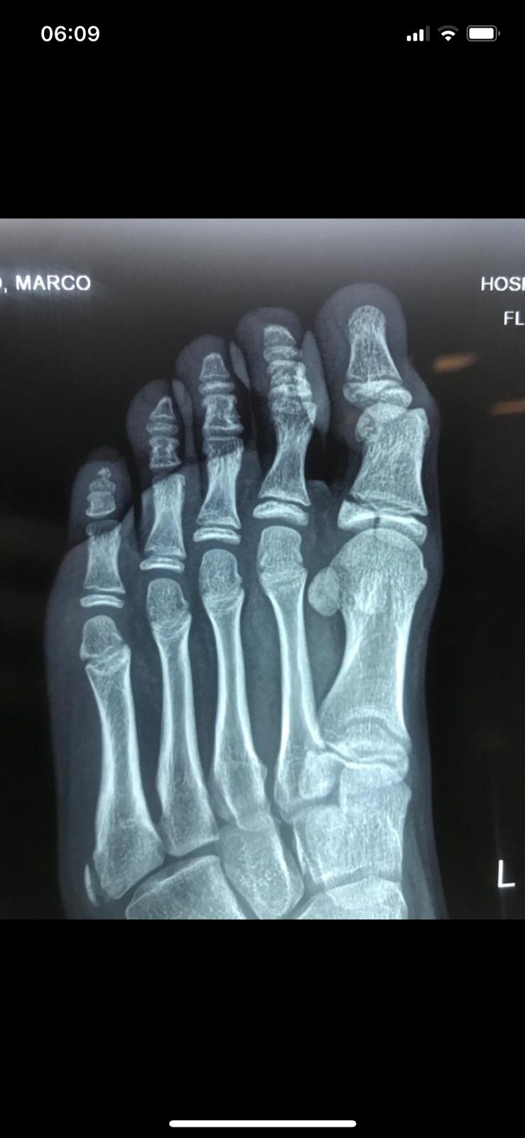
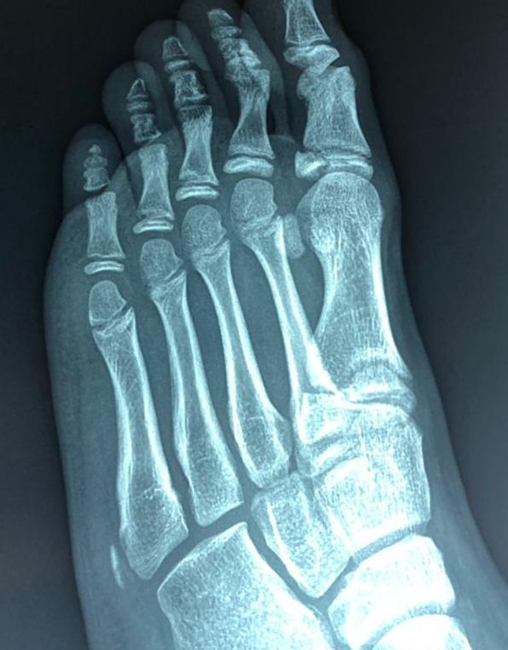
2019
History of trauma on the first left toe
Dx: Fracture Salter Harris III
Treatment: 3 months conservative treatment

Slide 3
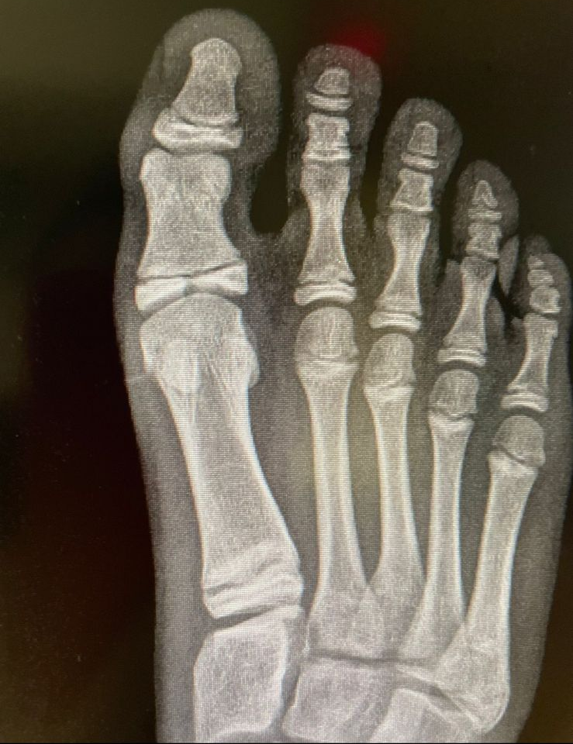
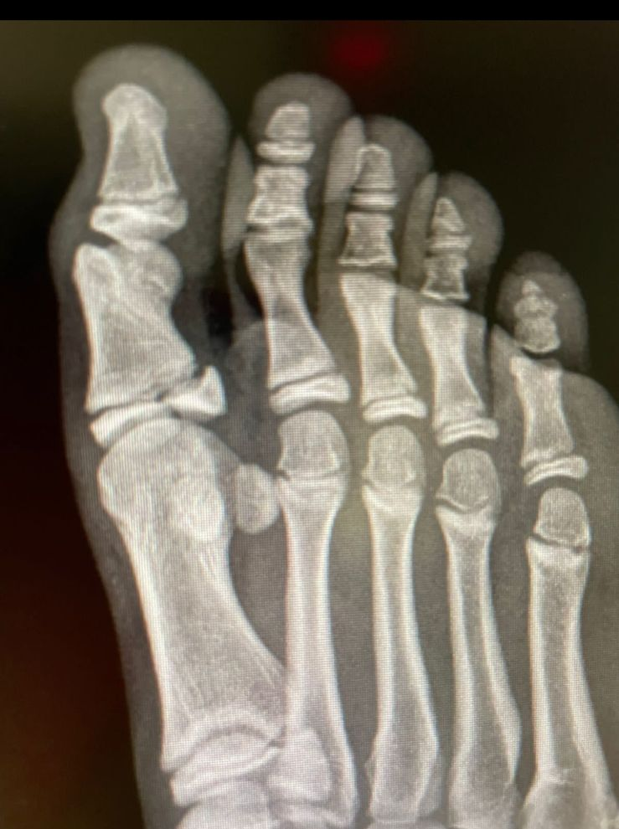
2022
No history of trauma, pain on the first right toe

Slide 4
2019 left toe
2022 right toe

Slide 5
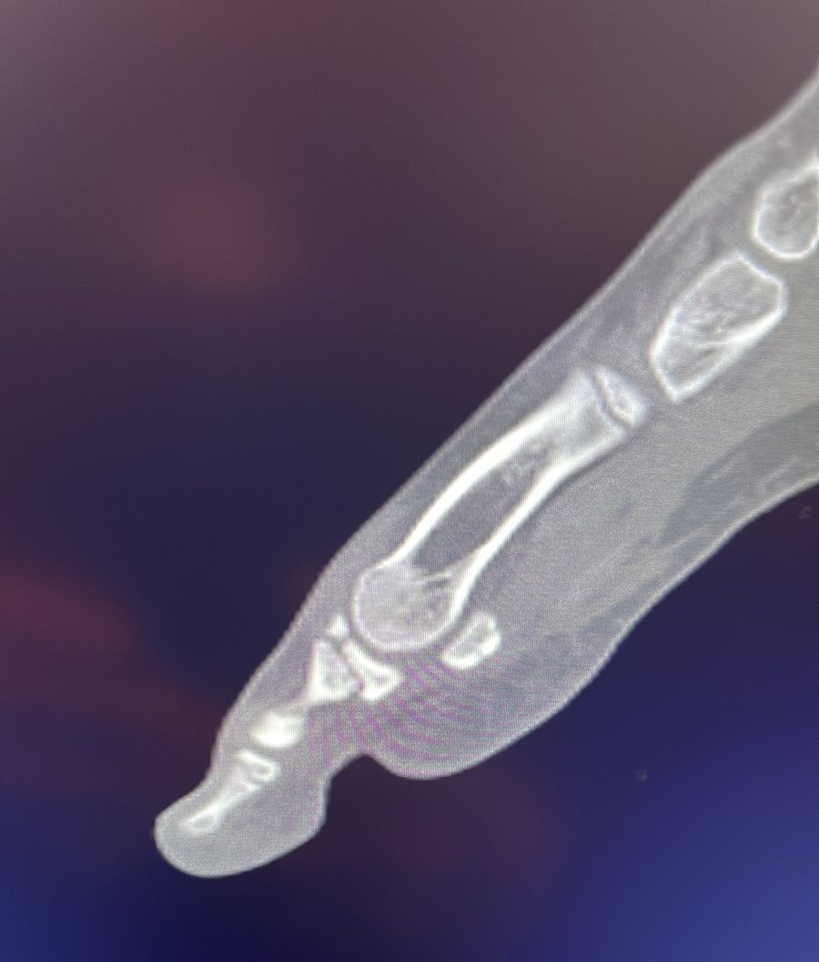
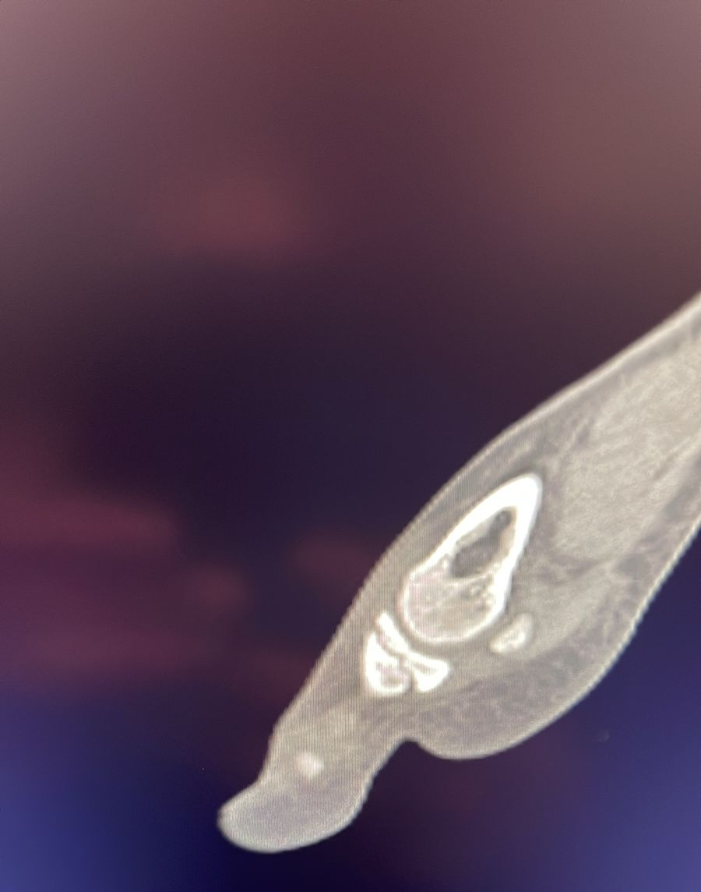
CT 2022
Right side
Left side

Slide 6
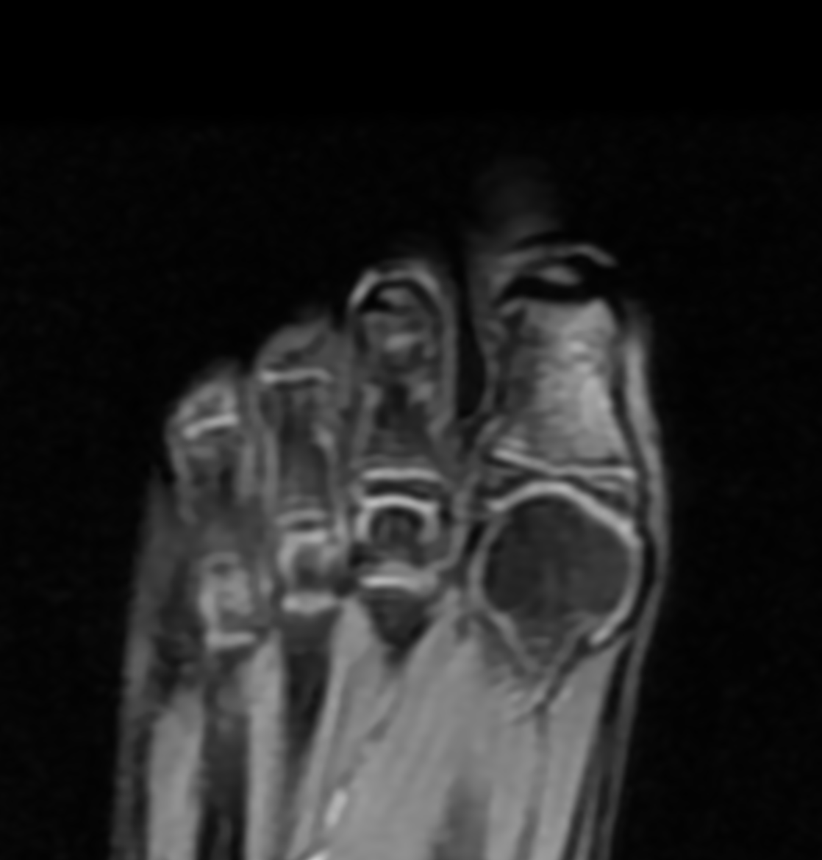
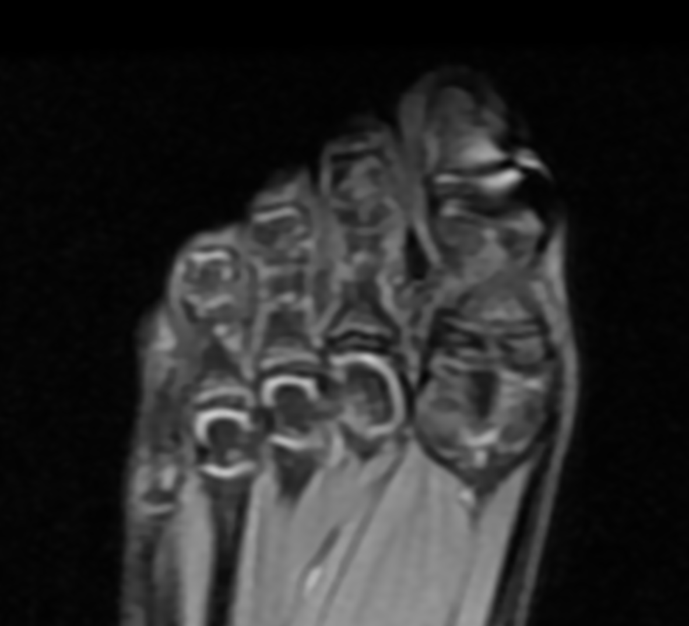
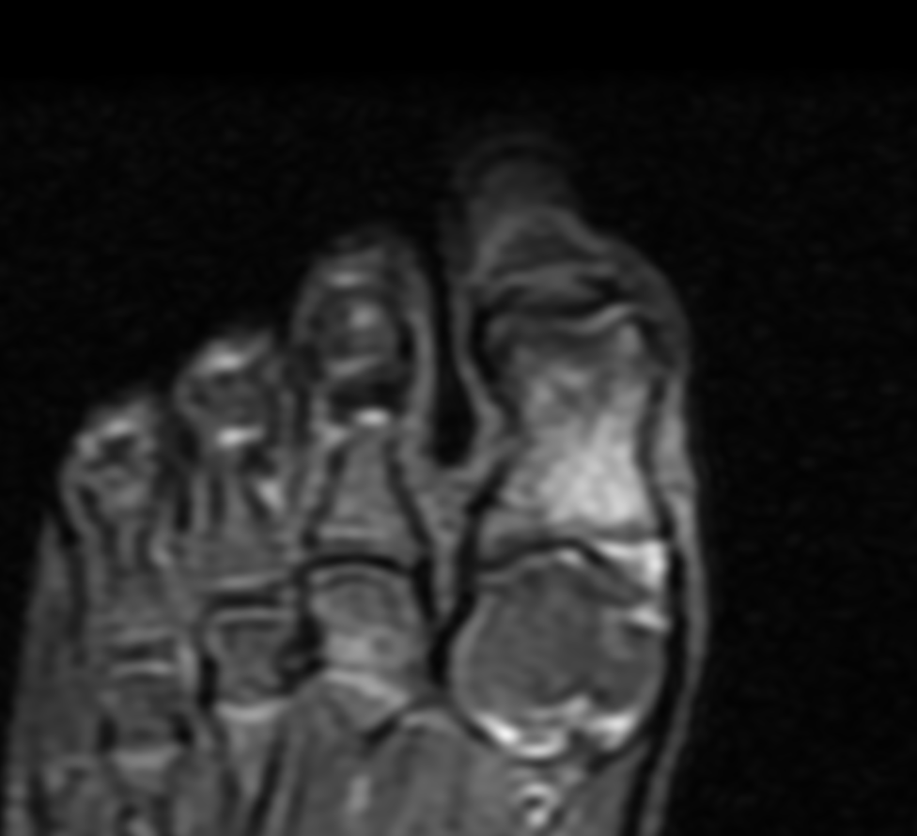
MRI Right Toe from Today
FSPD
STIR
FSPD

Slide 7
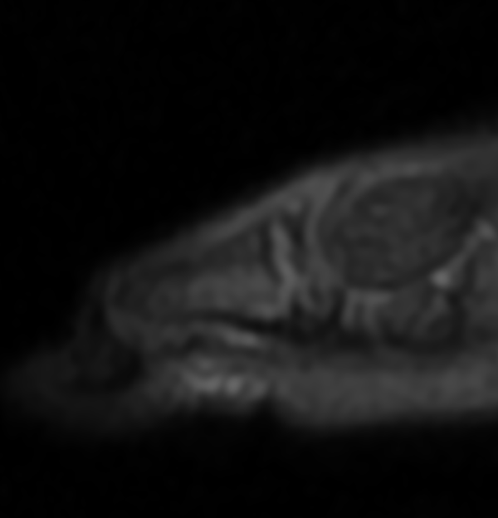
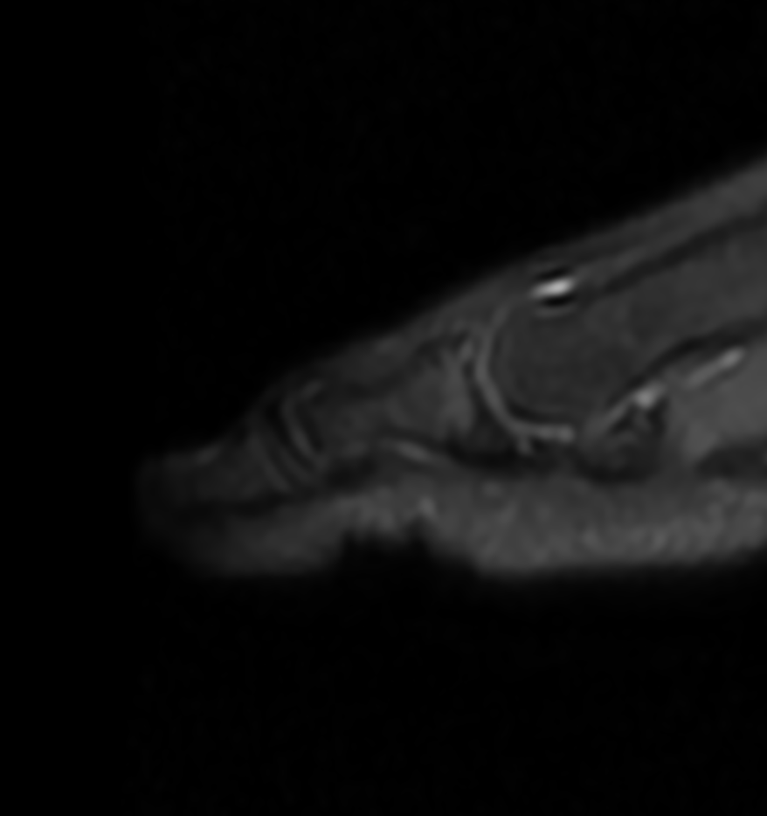
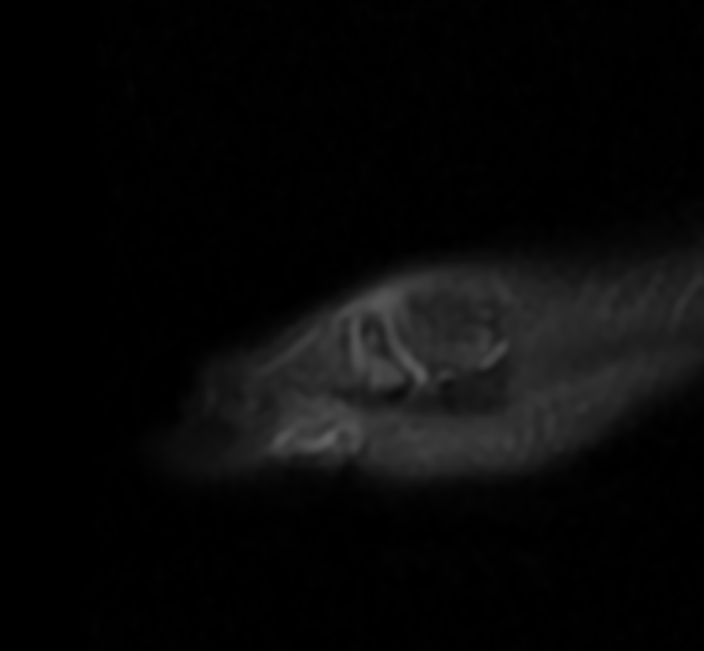

Slide 8
Question?
Do you think these is a cleft epiphysis or a fracture?

