Slide 1
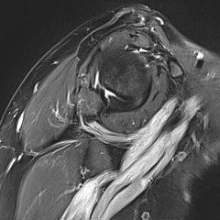
36F
CC: Right shoulder pain for 1.5 years
PH: Trauma (+)
PE: Td on LD(+) deltoid posterior part
Imp. Bony Bankart’s lesion, LD strain
MRI: Neurolymphomatosis / CIDP
Courtesy of Taeyong Moon
tymn@pusan.ac.kr

Slide 2
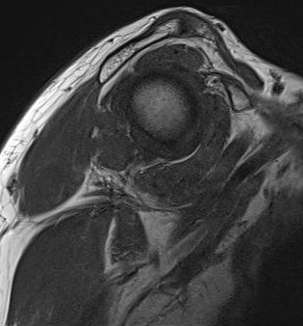
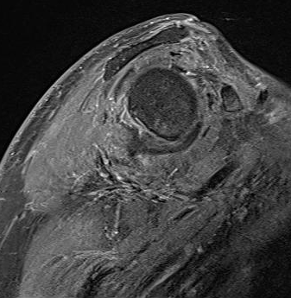
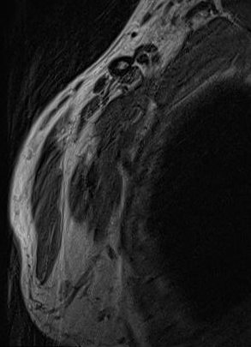
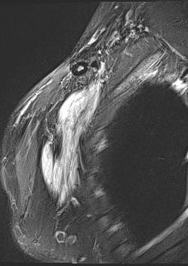
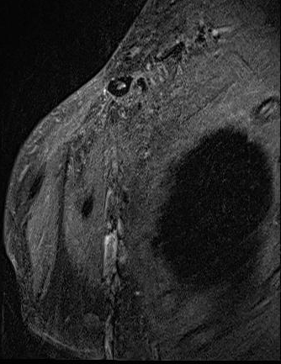
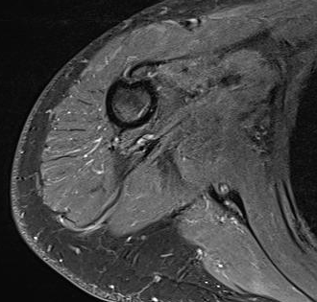

Slide 3
Neurolymphomatosis

