Slide 1
57/M
LBP, Right leg pain for 1 week
Courtesy of Hee Suk Jung
mediknight@hanmail.net

Slide 2
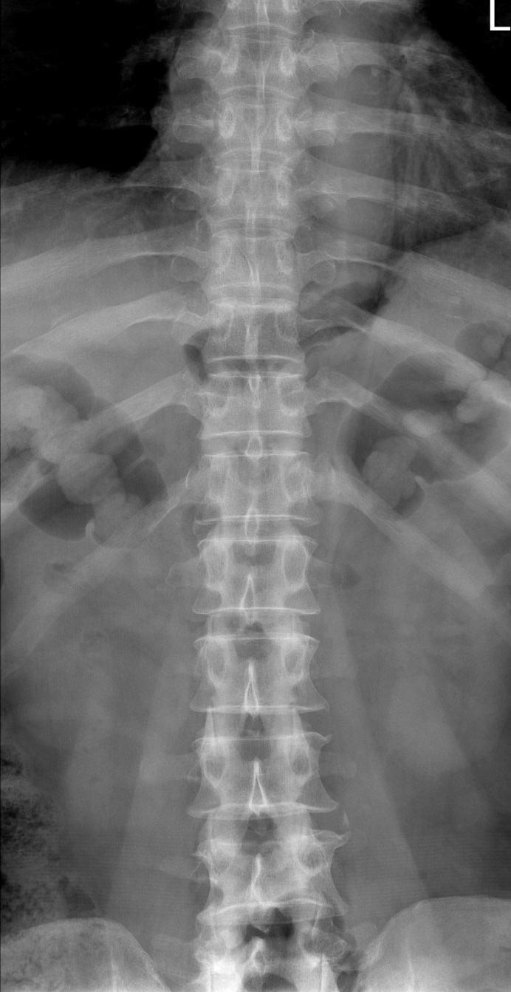
2016-05-23

Slide 3
2016-05-23 MRI
T2WI
T1WI
T1WI C+

Slide 4
2016-05-23 MRI
T2WI
T1WI
T1WI C+

Slide 5
Pathologic report
GROSS: Received is a product of tumor removal, measuring 0.2g in weight and 1.4 x 0.8 x 0.3 cm in dimensions. Sections are submitted in toto in one cassette. DIAGNOSIS: Spine, "IDEM tumor", removal Hemangioma # Immunohistochemistry CD31, CD34

Slide 6
Intradural extramedullary capillary hemangioma (AJNR Am J Neuroradiol 25:1294–1296, AJNR Am J Neuroradiol 22:799–802, ONCOLOGY LETTERS 11: 2896-2898)
6‑7% of all spinal intradural tumors ( including capillary hemangioma,
cavernous angiomas, and arteriovenous and venous malformations )
extremely rare ( >20 cases )
capillary networks surrounded by collagenous stroma without
hemosiderin deposition
arise from the blood vessels of the nerve roots in the cauda
equina, the inner surface of the dura, or the pial surface of
the spinal cord
When the tumor is small → no clear clinical symptoms
gradual growth of the tumor → pain, numbness of limb, lower limbs
hypesthesia and other neurological symptoms
(according to the tumor size and location)

Slide 7
Intradural extramedullary capillary hemangioma (AJNR Am J Neuroradiol 25:1294–1296, AJNR Am J Neuroradiol 22:799–802, ONCOLOGY LETTERS 11: 2896-2898)
MRI
- isointensity with the spinal cord on T1WI
- hyperintensity with the spinal cord on T2WI
Differential diagnosis
- meningioma, schwannoma, hemangiopericytomas, angiolipoma,
lymphomas, sarcoidosis, hemangioendotheliomas, paraganglioma,
metastasis
☞ schwannoma : hypointense, less frequently isointense, on T1WI,
necrosis or cystic changes are frequently observed
☞ meningioma : isointensity or slight hypointensity on T1WI and
isointensity or slight hyperintensity on T2WI
◈ dural tail sign
→ not useful for the differentiation between hemangioma arises
from the inner surface of the dura matter
♠ enlarged draining veins → other vascular lesions such as
hemangioblastoma or paraganglioma

Slide 8
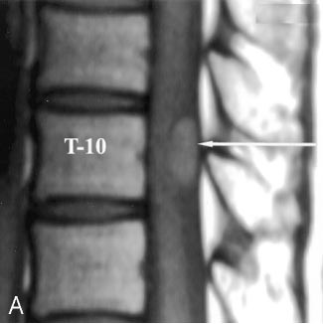
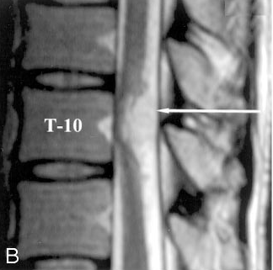
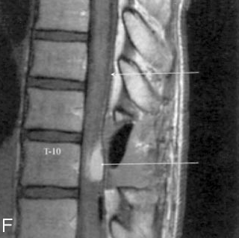
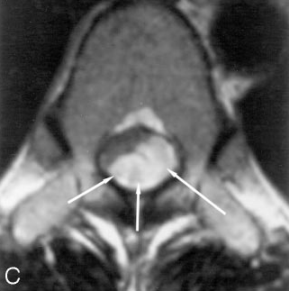
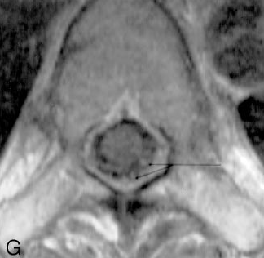
Intradural extramedullary capillary hemangioma (AJNR Am J Neuroradiol 25:1294–1296, AJNR Am J Neuroradiol 22:799–802, ONCOLOGY LETTERS 11: 2896-2898)
Notes:
perimedullary vein

