Slide 1

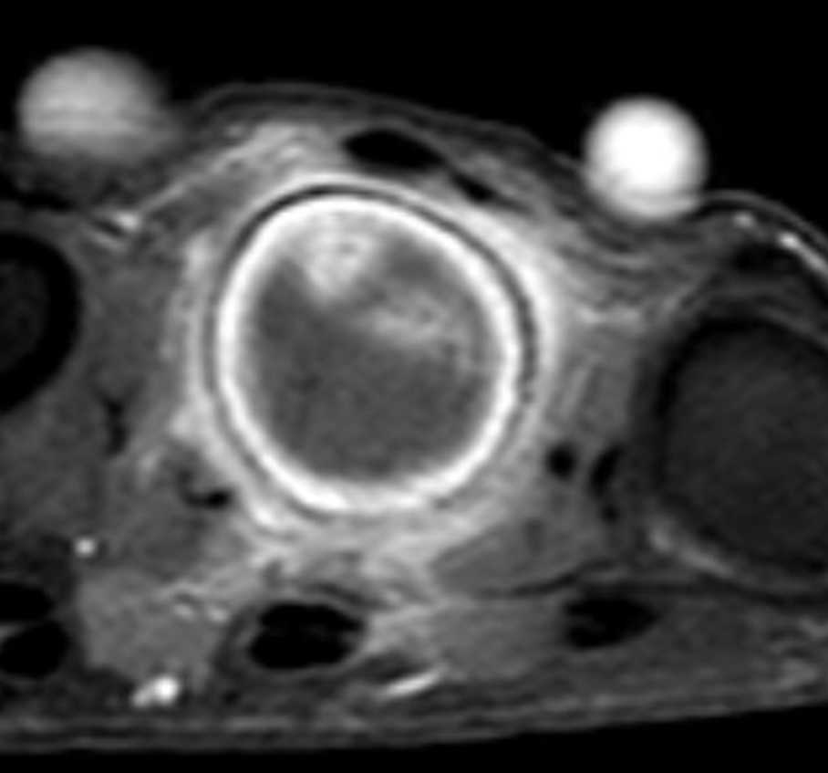
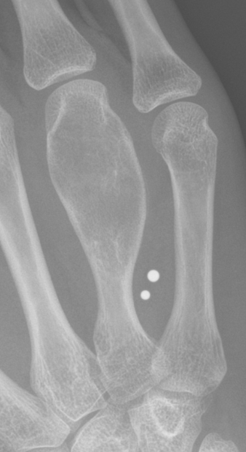
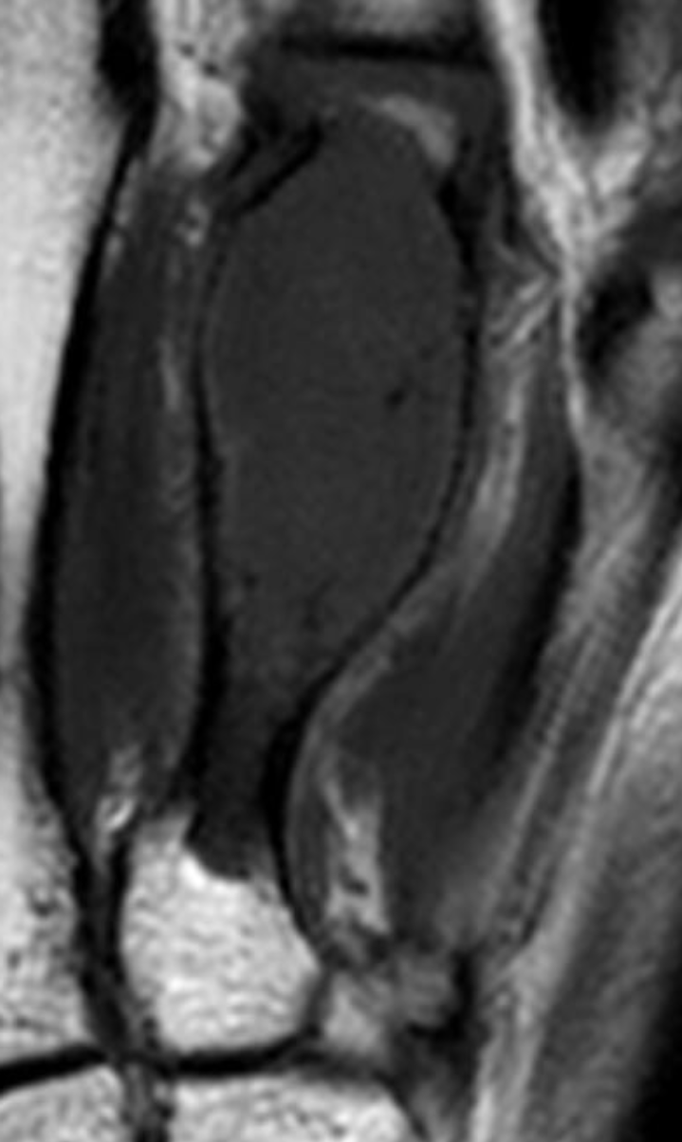
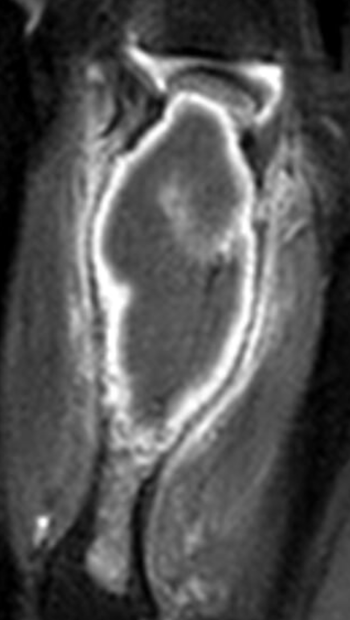
Case: 19 year old female: 1 radiologist diagnosed ACT, 3 CS-2. Histopathology: CS-2
T1 Gd fat sat
T1 Gd fat sat
X-ray shows osteolytic lesion with expansion of the medullary canal and >2/3 endosteal scalloping (arrow)
MRI coronal T1 weighted image with endosteal scallpong and thin cortex (arrow)
MRI coronal and axial T1 weighted image post contrast with septal-nodular enhancement and periosteal reaction and soft tissue oedema (arrows)

Slide 2
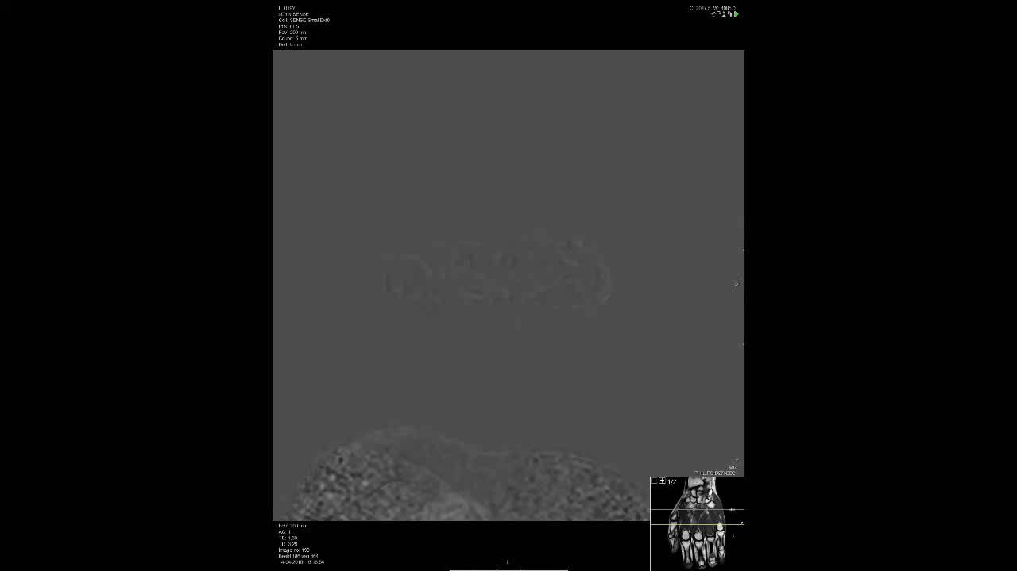
Dynamic contrast enhancement (DCE) shows rapid enhancement in the same patient
DCE-MRI
DCE-MRI video shows immediate enhancement <3sec of arterial enhancement

Slide 3
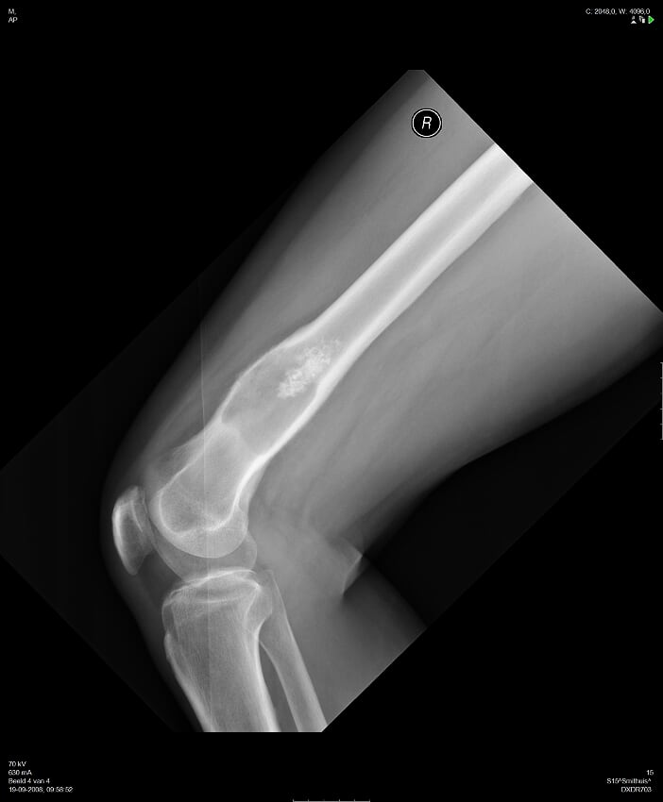
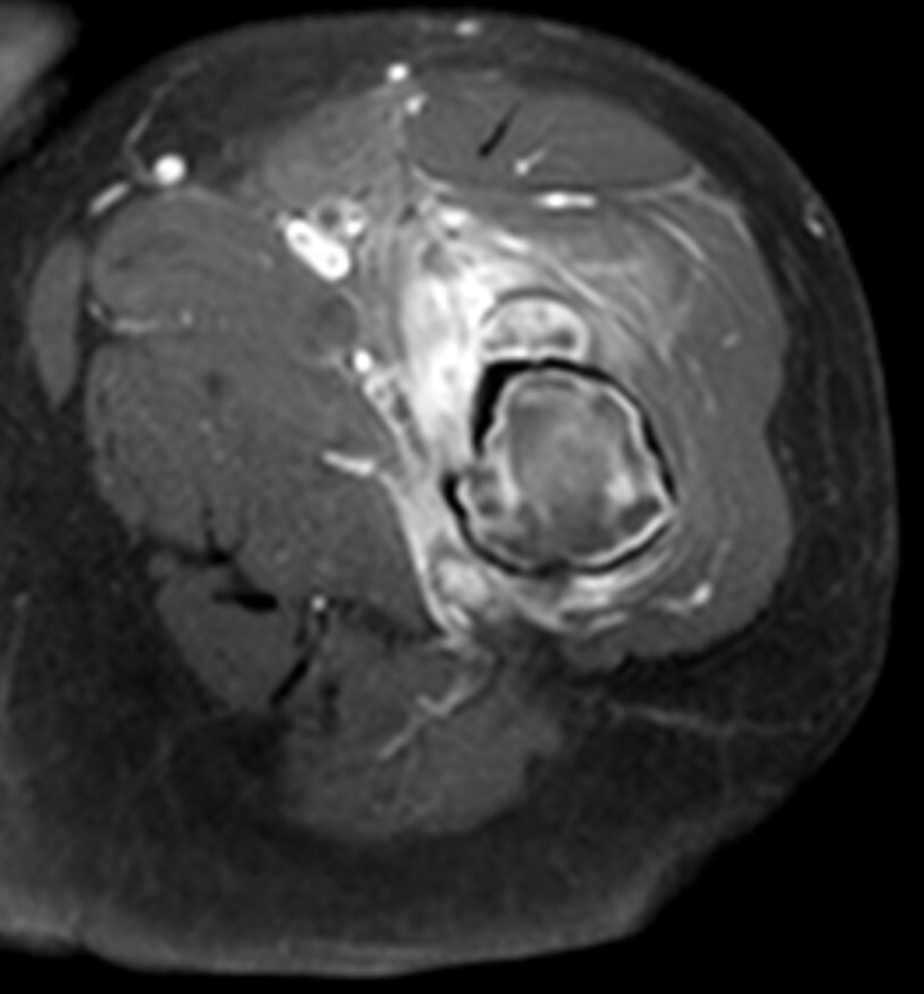
Take home messages
Several x-ray and multiple MRI features help differentiate between a CS2 and ACT/CS1 and allow for improved customized treatment.
  X-ray features in favor of CS-2: Periosteal reaction, expansion of the medullary canal, cortical breakthrough and large osteolytic component (>50%).
  MRI features in favor of CS-2: Soft tissue mass, periosteal reaction, reactive soft tissue edema, peri-tumoral intraosseous edema, expansion of the medullary canal with thinner cortex, rapid enhancement and cortical breakthrough.

